Slide 1

EDEXCEL GCSE MATHS · FOUNDATION & HIGHER
More linear graphs
Graphs
Lesson 2 of 8
openrevise.com

Slide 2

EDEXCEL GCSE MATHS · FOUNDATION & HIGHER
Warm-up
Answer each one, then check.
1
What is the gradient of y = 5x − 2?
2
Work out (9 − 3)/(4 − 1).
3
Solve 7 = 2 × 3 + c.
4
What is the equation of the y-axis?
5
Work out −1 ÷ 2.
Graphs
openrevise.com
Lesson 2 of 8

Slide 3
EDEXCEL GCSE MATHS · FOUNDATION & HIGHER
Warm-up - Answers
What is the gradient of y = 5x − 2?
5
1
Work out (9 − 3)/(4 − 1).
2
2
Solve 7 = 2 × 3 + c.
c = 1
3
What is the equation of the y-axis?
x = 0
4
Work out −1 ÷ 2.
−½
5
Graphs
openrevise.com
Lesson 2 of 8

Slide 4

EDEXCEL GCSE MATHS · FOUNDATION & HIGHER
Learning Objectives
Find the equation of a line through two points.
1
Find the equation of a line parallel to a given line.
2
Find the equation of a perpendicular line (Higher).
3
Find where two lines meet.
4
Graphs
openrevise.com
Lesson 2 of 8

Slide 5

EDEXCEL GCSE MATHS · FOUNDATION & HIGHER
Line Through Two Points
Gradient first, then the y-intercept.
1
2
3
4
Find the gradient
m = (y₂ − y₁)/(x₂ − x₁).
Write y = mx + c
Put in the value of m.
Substitute one point
Solve for c.
Write the equation
And check with the other point.
Graphs
openrevise.com
Lesson 2 of 8

Slide 6

EDEXCEL GCSE MATHS · FOUNDATION & HIGHER
Through Two Points
Find the equation of the line through (1, 3) and (4, 12).
Gradient
(12 − 3)/(4 − 1) = 9/3 = 3
1
Substitute (1, 3) into y = 3x + c
3 = 3 + c
2
Solve for c
c = 0
3
Write the equation
y = 3x
4
ANSWER
y = 3x
Graphs
openrevise.com
Lesson 2 of 8

Slide 7
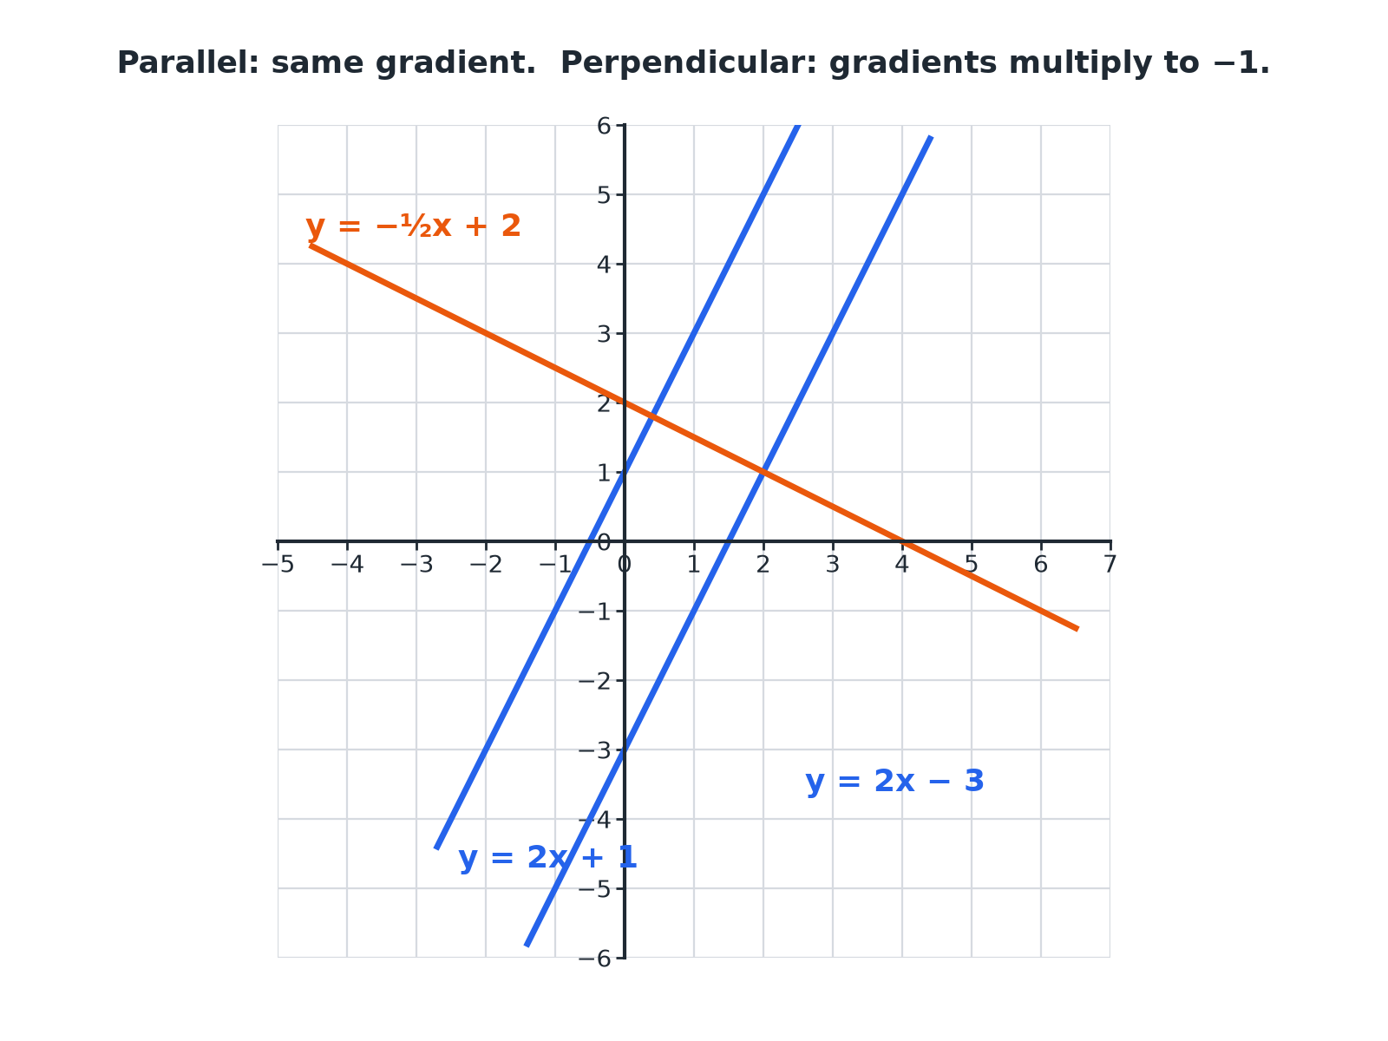

EDEXCEL GCSE MATHS · FOUNDATION & HIGHER
Parallel and Perpendicular Lines
Parallel lines have equal gradients.
Graphs
openrevise.com
Lesson 2 of 8

Slide 8

EDEXCEL GCSE MATHS · FOUNDATION & HIGHER
Parallel and Perpendicular
PARALLEL LINES
PERPENDICULAR LINES (HIGHER)
• They never meet.
• They have the same gradient.
• y = 2x + 1 and y = 2x − 3 are parallel.
• They meet at a right angle.
• The gradients multiply to give −1: m₁ × m₂ = −1.
• y = 2x + 1 and y = −½x + 4 are perpendicular.
Graphs
openrevise.com
Lesson 2 of 8

Slide 9
EDEXCEL GCSE MATHS · FOUNDATION & HIGHER
A Parallel Line
Find the equation of the line parallel to y = 2x + 3 that passes through (1, 7).
Parallel lines have the same gradient
m = 2
1
Substitute (1, 7) into y = 2x + c
7 = 2 + c
2
Solve
c = 5
3
ANSWER
y = 2x + 5
Graphs
openrevise.com
Lesson 2 of 8

Slide 10
EDEXCEL GCSE MATHS · FOUNDATION & HIGHER
A Perpendicular Line
Higher
Find the equation of the line perpendicular to y = 2x + 1 that passes through (4, 3).
The gradient of the original is 2, so the perpendicular gradient is
−½
1
Substitute (4, 3) into y = −½x + c
3 = −2 + c
2
Solve
c = 5
3
ANSWER
y = −½x + 5
Graphs
openrevise.com
Lesson 2 of 8

Slide 11
EDEXCEL GCSE MATHS · FOUNDATION & HIGHER
Where Two Lines Meet
Find the coordinates of the point where y = x + 1 and y = −x + 5 cross.
At the crossing point, the y-values are equal
x + 1 = −x + 5
1
Solve
2x = 4, so x = 2
2
Substitute to find y
y = 2 + 1 = 3
3
ANSWER
(2, 3)
Graphs
openrevise.com
Lesson 2 of 8

Slide 12

EDEXCEL GCSE MATHS · FOUNDATION & HIGHER
Finding the Perpendicular Gradient
Higher
Flip the fraction and change the sign.
Gradient
Perpendicular gradient
2
−½
¾
−4/3
−5
⅕
−2/7
7/2
Graphs
openrevise.com
Lesson 2 of 8

Slide 13

EDEXCEL GCSE MATHS · FOUNDATION & HIGHER
Key Terms
Parallel
Lines that never meet, with equal gradients.
Perpendicular
Lines that meet at a right angle.
Intersection
The point where two lines cross.
Reciprocal
A number turned upside down: the reciprocal of 2 is ½.
Simultaneous
Happening together; the intersection satisfies both equations.
Coordinates
A pair (x, y) giving a position.
Graphs
openrevise.com
Lesson 2 of 8

Slide 14

EDEXCEL GCSE MATHS · FOUNDATION & HIGHER
YOUR TASK
10 minutes
Which Lines Are Parallel?
Sort these lines into parallel pairs and find one line perpendicular to y = 2x: y = 3x + 1, y = 3x − 4, 2y = x + 6, y = ½x − 1, y = −½x + 3.
Rearrange each equation.
1
Compare gradients.
2
WHAT A GOOD ANSWER SHOWS
y = 3x + 1 and y = 3x − 4 are parallel. 2y = x + 6 is y = ½x + 3, which is parallel to y = ½x − 1. y = −½x + 3 is perpendicular to y = 2x.
Graphs
openrevise.com
Lesson 2 of 8

Slide 15

EDEXCEL GCSE MATHS · FOUNDATION & HIGHER
Can I...?
Find the gradient from two points.
Find the perpendicular gradient (Higher).
Find the equation through two points.
Find a perpendicular line through a point (Higher).
Write a line parallel to another.
Find where two lines cross.
Recognise parallel lines from their equations.
Check my equation with the other point.
Graphs
openrevise.com
Lesson 2 of 8

Slide 16
EDEXCEL GCSE MATHS · FOUNDATION & HIGHER
Summary & Exam Focus
Two points: find the gradient, then substitute one point to find c.
Parallel lines have equal gradients.
Perpendicular gradients multiply to −1 (Higher).
Where lines cross: set the y-expressions equal.
EXAM FOCUS
Find the equation of the line that is parallel to y = 3x − 2 and passes through the point (2, 9). (3 marks)
Parallel means the same gradient, so write y = 3x + c and substitute the point to find c.
openrevise.com

