Slide 1

EDEXCEL GCSE MATHS · FOUNDATION & HIGHER
Sectors of circles
Area and volume
Lesson 5 of 7
openrevise.com

Slide 2

EDEXCEL GCSE MATHS · FOUNDATION & HIGHER
Warm-up
Answer each one, then check.
1
What is the circumference of a circle with radius 5 cm, in terms of π?
2
What is the area of a circle with radius 6 cm, in terms of π?
3
Simplify 90/360.
4
How many degrees in a full turn?
5
What is the area of a triangle with base 8 and height 8?
Area and volume
openrevise.com
Lesson 5 of 7

Slide 3
EDEXCEL GCSE MATHS · FOUNDATION & HIGHER
Warm-up - Answers
What is the circumference of a circle with radius 5 cm, in terms of π?
10π
1
What is the area of a circle with radius 6 cm, in terms of π?
36π
2
Simplify 90/360.
¼
3
How many degrees in a full turn?
360
4
What is the area of a triangle with base 8 and height 8?
32
5
Area and volume
openrevise.com
Lesson 5 of 7

Slide 4

EDEXCEL GCSE MATHS · FOUNDATION & HIGHER
Learning Objectives
Identify the arc and sector of a circle.
1
Find arc length and sector area as a fraction of the whole circle.
2
Find the perimeter of a sector.
3
Find the area of a segment (Higher).
4
Area and volume
openrevise.com
Lesson 5 of 7

Slide 5
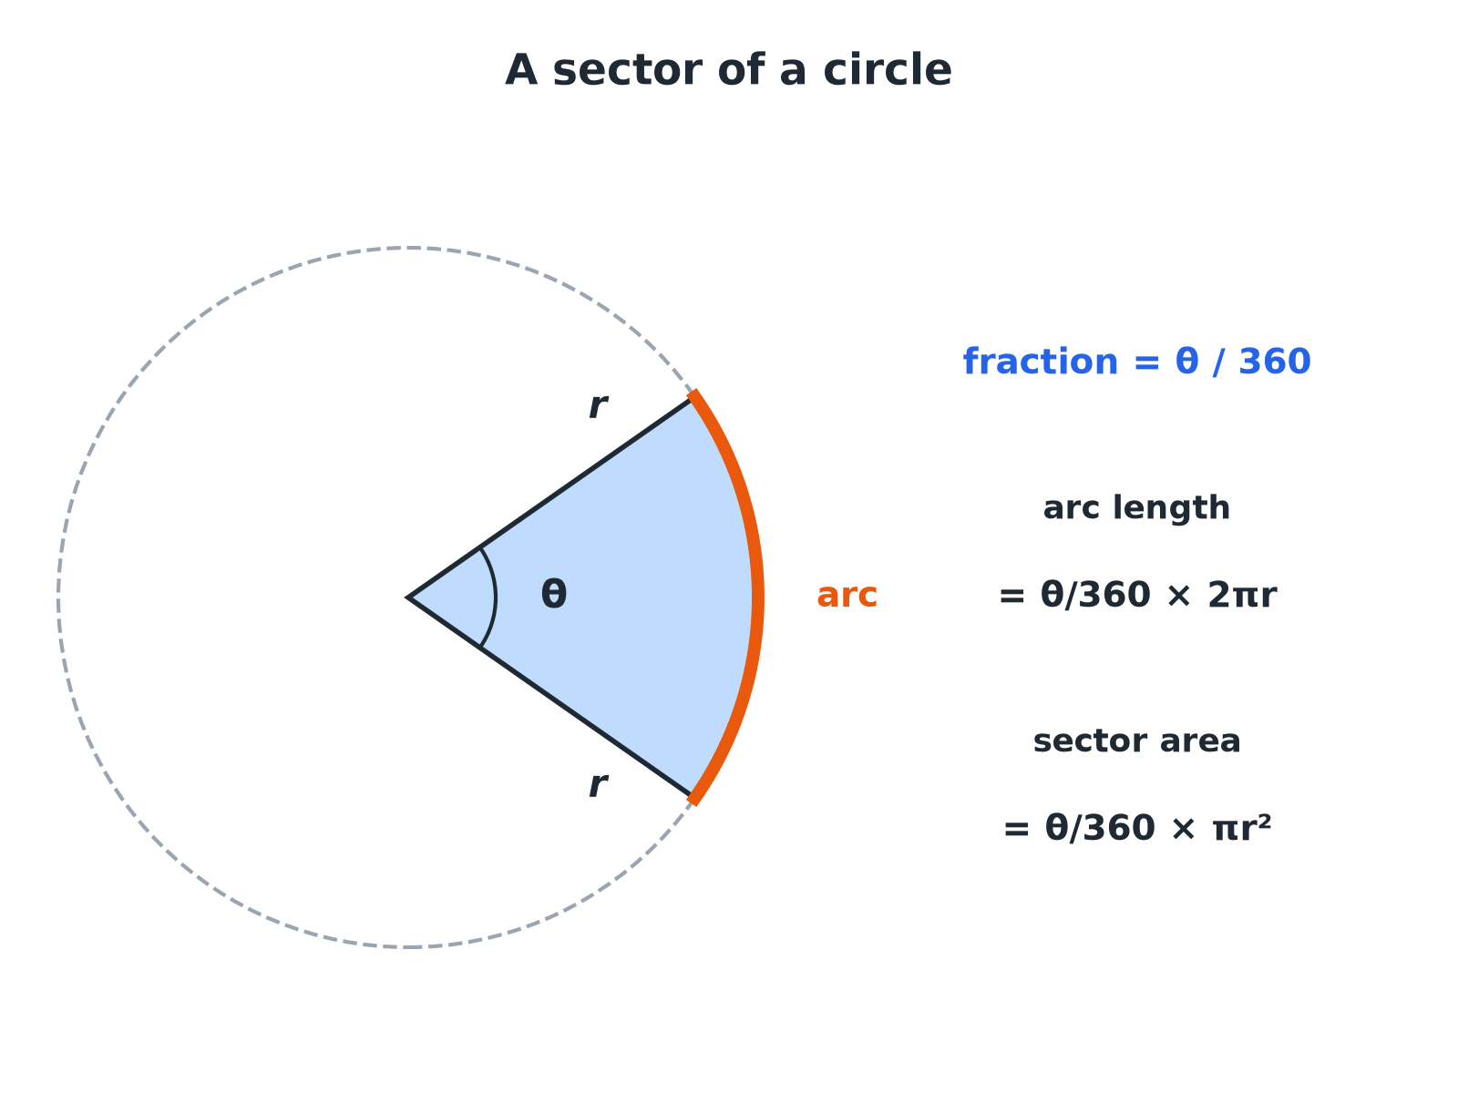

EDEXCEL GCSE MATHS · FOUNDATION & HIGHER
A Sector and Its Arc
A sector is a fraction θ/360 of the whole circle.
Area and volume
openrevise.com
Lesson 5 of 7

Slide 6

EDEXCEL GCSE MATHS · FOUNDATION & HIGHER
Sector Formulae
Fraction of the circle
θ/360, where θ is the angle at the centre in degrees.
Arc length
θ/360 × 2πr: a fraction of the circumference.
Sector area
θ/360 × πr²: a fraction of the circle's area.
Sector perimeter
Arc length + 2r (the two straight radii).
Area and volume
openrevise.com
Lesson 5 of 7

Slide 7

EDEXCEL GCSE MATHS · FOUNDATION & HIGHER
Arc Length and Sector Area
A sector has radius 6 cm and angle 60°. Find the arc length and the area, in terms of π.
Fraction of the circle
60/360 = 1/6
1
Arc length
1/6 × 2π × 6 = 2π
2
Area
1/6 × π × 6² = 6π
3
ANSWER
Arc length 2π cm (6.28 cm) and area 6π cm² (18.85 cm²).
Area and volume
openrevise.com
Lesson 5 of 7

Slide 8
EDEXCEL GCSE MATHS · FOUNDATION & HIGHER
Perimeter of a Sector
A sector has radius 5 cm and angle 90°. Find its perimeter to 1 decimal place.
Arc length
90/360 × 2π × 5 = 2.5π= 7.854...
1
Add the two radii
2 × 5 = 10
2
Total
7.854 + 10
3
ANSWER
17.9 cm
Area and volume
openrevise.com
Lesson 5 of 7

Slide 9
EDEXCEL GCSE MATHS · FOUNDATION & HIGHER
Finding the Angle
A sector has radius 12 cm and an arc length of 8π cm. Find the angle at the centre.
Arc length formula
θ/360 × 2π × 12 = 8π
1
Simplify
θ/360 × 24π= 8π
2
Divide both sides by 24π
θ/360 = ⅓
3
Solve
θ= 120
4
ANSWER
120°
Area and volume
openrevise.com
Lesson 5 of 7

Slide 10

EDEXCEL GCSE MATHS · FOUNDATION & HIGHER
HIGHER TIER
The Area of a Segment
Sector minus triangle.
openrevise.com

Slide 11
EDEXCEL GCSE MATHS · FOUNDATION & HIGHER
Segment Area
Higher
A sector has radius 8 cm and angle 90°. Find the area of the segment cut off by the chord, to 1 decimal place.
Sector area
90/360 × π × 8² = 16π= 50.27
1
Triangle area ½r² sin θ
½ × 8 × 8 × sin 90°= 32
2
Subtract
50.27 − 32
3
ANSWER
18.3 cm²
Area and volume
openrevise.com
Lesson 5 of 7

Slide 12

EDEXCEL GCSE MATHS · FOUNDATION & HIGHER
Sector or Segment?
The words are easy to mix up.
Sector
The "pizza slice" between two radii and an arc.
Segment
The region between a chord and an arc. It is a sector with a triangle cut off.
Segment area
Sector area − triangle area, where the triangle has area ½r²sin θ.
Area and volume
openrevise.com
Lesson 5 of 7

Slide 13

EDEXCEL GCSE MATHS · FOUNDATION & HIGHER
Key Terms
Sector
A region of a circle between two radii and the arc joining their ends.
Arc
Part of the circumference of a circle.
Segment
The part of a circle cut off by a chord.
Chord
A straight line joining two points on a circle.
Angle at the centre
The angle between the two radii of a sector.
Fraction of a circle
θ/360.
Area and volume
openrevise.com
Lesson 5 of 7

Slide 14

EDEXCEL GCSE MATHS · FOUNDATION & HIGHER
YOUR TASK
10 minutes
Slice the Clock
The minute hand of a clock is 15 cm long. Find the distance its tip travels in 20 minutes, and the area swept out by the hand in 20 minutes. Give both answers in terms of π.
Find the fraction of a full turn.
1
Apply it to circumference and area.
2
WHAT A GOOD ANSWER SHOWS
In 20 minutes the hand turns through 120°, which is ⅓ of a circle. Distance = ⅓ × 30π= 10π cm. Area = ⅓ × 225π= 75π cm².
Area and volume
openrevise.com
Lesson 5 of 7
Notes:
Link the angle to the fraction of an hour.

Slide 15

EDEXCEL GCSE MATHS · FOUNDATION & HIGHER
Can I...?
Write the fraction θ/360.
Find the angle from an arc length.
Find an arc length.
Give answers in terms of π.
Find a sector area.
Find a segment area (Higher).
Find the perimeter of a sector.
Tell a sector from a segment.
Area and volume
openrevise.com
Lesson 5 of 7

Slide 16
EDEXCEL GCSE MATHS · FOUNDATION & HIGHER
Summary & Exam Focus
Arc length = θ/360 × 2πr.
Sector area = θ/360 × πr².
Sector perimeter = arc + 2r.
Segment area = sector − triangle (Higher).
EXAM FOCUS
A sector of a circle has radius 9 cm and angle 40°. Work out the length of the arc of the sector. Give your answer correct to 3 significant figures. (3 marks)
Write the fraction θ/360 first. Then multiply it by the circumference (arc) or the area (sector).
openrevise.com

Slide 17
EDEXCEL GCSE MATHS · FOUNDATION & HIGHER
Exam Practice: Sectors of Circles
Answer all questions. Show your working. · 30 minutes
Question 1 · 3 marks · Calculator
The diagram shows a sector of a circle of radius 9 cm. The angle at the centre is 40°. Work out the length of the arc. Give your answer…
Question 2 · 3 marks · Calculator
A sector of a circle has radius 10 cm and angle 72°. Work out the area of the sector. Give your answer correct to 3 significant figures.
Question 3 · 4 marks · Calculator
A sector of a circle has radius 5 cm and angle 90°. Work out the perimeter of the sector. Give your answer correct to 3 significant figures.
Area and volume
openrevise.com
Lesson 5 of 7

Slide 18
EDEXCEL GCSE MATHS · FOUNDATION & HIGHER
Exam Practice: Sectors of Circles (cont.)
Question 4 · 3 marks · Non-calculator
A sector of a circle has radius 12 cm and angle 150°. Work out the length of the arc. Give your answer in terms of π.
Question 5 · 3 marks · Non-calculator
A sector of a circle has radius 12 cm. The arc length of the sector is 8π cm. Work out the angle at the centre of the sector.
Question 6 · 4 marks · Calculator
A sector of a circle has radius 8 cm and angle 90°. Work out the area of the segment formed by the chord joining the ends of the two radii…
Area and volume
openrevise.com
Lesson 5 of 7

Slide 19
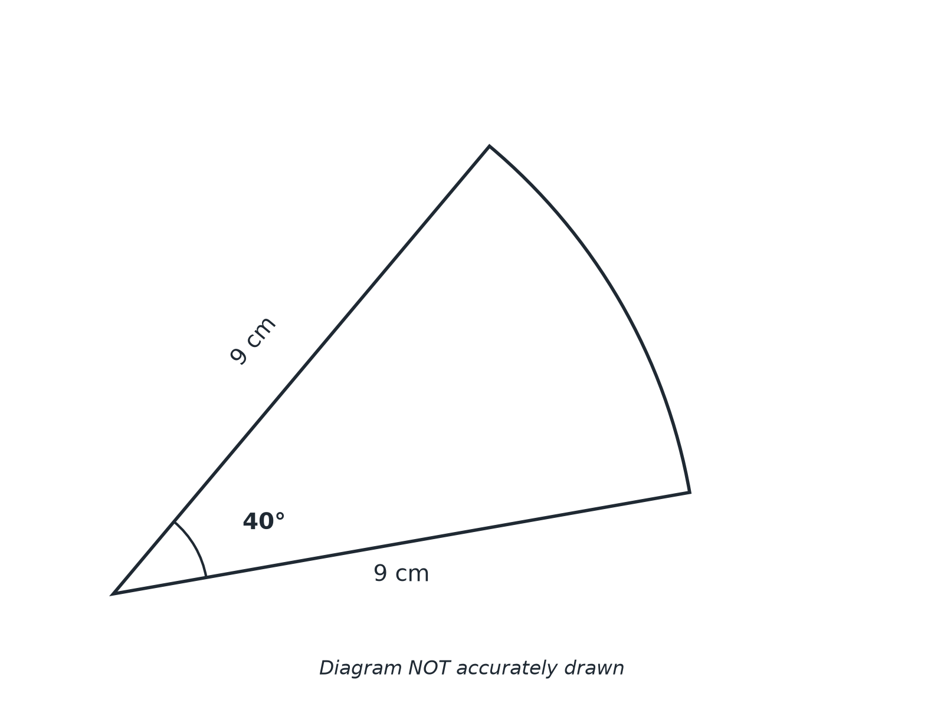
EDEXCEL GCSE MATHS · FOUNDATION & HIGHER
Question 1 · 3 marks · Calculator
The diagram shows a sector of a circle of radius 9 cm. The angle at the centre is 40°. Work out the length of the arc. Give your answer correct to 3 significant figures. (3 marks)
Area and volume
openrevise.com
Lesson 5 of 7

Slide 20
EDEXCEL GCSE MATHS · FOUNDATION & HIGHER
Question 1 · mark scheme
3 marks available. Award a mark for each point made.
40/360
M1
40/360 × 2 × π × 9
M1
6.28
A1
Area and volume
openrevise.com
Lesson 5 of 7

Slide 21
EDEXCEL GCSE MATHS · FOUNDATION & HIGHER
Question 2 · 3 marks · Calculator
“
A sector of a circle has radius 10 cm and angle 72°. Work out the area of the sector. Give your answer correct to 3 significant figures.
HOW TO ANSWER IT
Command word: Calculator. Worth 3 marks, so plan before writing.
Area and volume
openrevise.com
Lesson 5 of 7

Slide 22
EDEXCEL GCSE MATHS · FOUNDATION & HIGHER
Question 2 · mark scheme
3 marks available. Award a mark for each point made.
72/360
M1
72/360 × π × 10²
M1
62.8
A1
Area and volume
openrevise.com
Lesson 5 of 7

Slide 23
EDEXCEL GCSE MATHS · FOUNDATION & HIGHER
Question 3 · 4 marks · Calculator
“
A sector of a circle has radius 5 cm and angle 90°. Work out the perimeter of the sector. Give your answer correct to 3 significant figures.
HOW TO ANSWER IT
Command word: Calculator. Worth 4 marks, so plan before writing.
Area and volume
openrevise.com
Lesson 5 of 7

Slide 24
EDEXCEL GCSE MATHS · FOUNDATION & HIGHER
Question 3 · mark scheme
4 marks available. Award a mark for each point made.
Arc length method
M1
7.854
A1
Adding two radii
M1
17.9
A1
Area and volume
openrevise.com
Lesson 5 of 7

Slide 25
EDEXCEL GCSE MATHS · FOUNDATION & HIGHER
Question 4 · 3 marks · Non-calculator
“
A sector of a circle has radius 12 cm and angle 150°. Work out the length of the arc. Give your answer in terms of π.
HOW TO ANSWER IT
Command word: Non-calculator. Worth 3 marks, so plan before writing.
Area and volume
openrevise.com
Lesson 5 of 7

Slide 26
EDEXCEL GCSE MATHS · FOUNDATION & HIGHER
Question 4 · mark scheme
3 marks available. Award a mark for each point made.
150/360 or 5/12
M1
5/12 × 24π
M1
10π
A1
Area and volume
openrevise.com
Lesson 5 of 7

Slide 27
EDEXCEL GCSE MATHS · FOUNDATION & HIGHER
Question 5 · 3 marks · Non-calculator
“
A sector of a circle has radius 12 cm. The arc length of the sector is 8π cm. Work out the angle at the centre of the sector.
HOW TO ANSWER IT
Command word: Non-calculator. Worth 3 marks, so plan before writing.
Area and volume
openrevise.com
Lesson 5 of 7

Slide 28
EDEXCEL GCSE MATHS · FOUNDATION & HIGHER
Question 5 · mark scheme
3 marks available. Award a mark for each point made.
θ/360 × 2π × 12 = 8π
M1
θ/360 = ⅓
M1
120
A1
Area and volume
openrevise.com
Lesson 5 of 7

Slide 29
EDEXCEL GCSE MATHS · FOUNDATION & HIGHER
Question 6 · 4 marks · Calculator
“
A sector of a circle has radius 8 cm and angle 90°. Work out the area of the segment formed by the chord joining the ends of the two radii. Give your answer correct to 3 significant figures.
HOW TO ANSWER IT
Command word: Calculator. Worth 4 marks, so plan before writing.
Area and volume
openrevise.com
Lesson 5 of 7

Slide 30
EDEXCEL GCSE MATHS · FOUNDATION & HIGHER
Question 6 · mark scheme
4 marks available. Award a mark for each point made.
Sector area 50.27
M1
Triangle area 32
M1
50.27 − 32
M1
18.3
A1
Area and volume
openrevise.com
Lesson 5 of 7

