Slide 1

EDEXCEL GCSE MATHS · FOUNDATION & HIGHER
Pyramids and cones
Area and volume
Lesson 7 of 7
openrevise.com

Slide 2

EDEXCEL GCSE MATHS · FOUNDATION & HIGHER
Warm-up
Answer each one, then check.
1
What is the area of a square with side 6?
2
State Pythagoras' theorem.
3
What is ⅓ of 36 multiplied by 9?
4
What is the area of a circle with radius 4, in terms of π?
5
What is the volume of a prism?
Area and volume
openrevise.com
Lesson 7 of 7

Slide 3
EDEXCEL GCSE MATHS · FOUNDATION & HIGHER
Warm-up - Answers
What is the area of a square with side 6?
36
1
State Pythagoras' theorem.
a² + b² = c²
2
What is ⅓ of 36 multiplied by 9?
108
3
What is the area of a circle with radius 4, in terms of π?
16π
4
What is the volume of a prism?
Cross-sectional area times length
5
Area and volume
openrevise.com
Lesson 7 of 7

Slide 4

EDEXCEL GCSE MATHS · FOUNDATION & HIGHER
Learning Objectives
Find the volume of a pyramid using ⅓ × base area × h.
1
Find the volume and curved surface area of a cone.
2
Use Pythagoras to find a slant height.
3
Find the volume of a frustum (Higher).
4
Area and volume
openrevise.com
Lesson 7 of 7

Slide 5
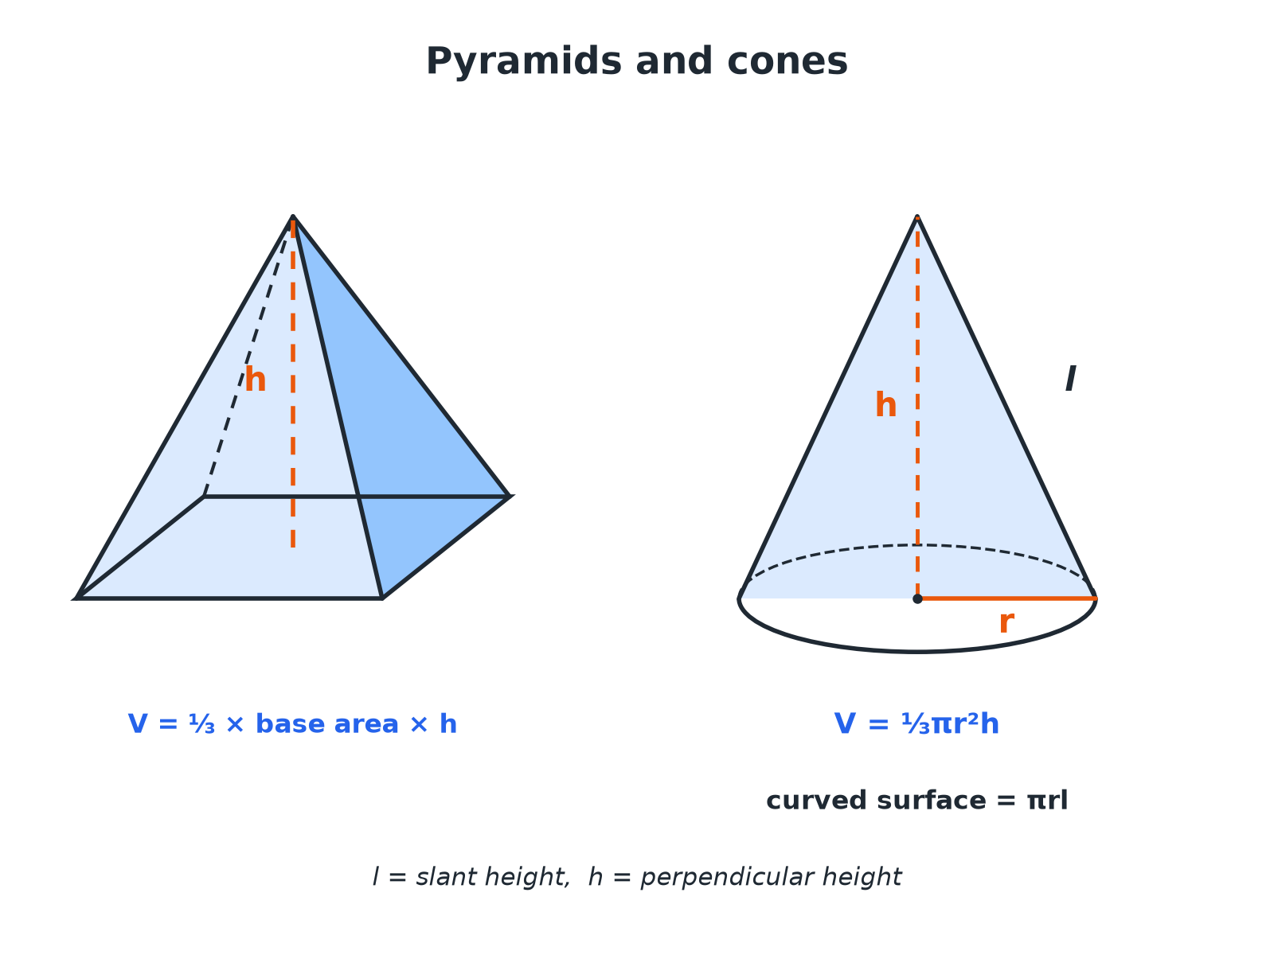

EDEXCEL GCSE MATHS · FOUNDATION & HIGHER
Pyramids and Cones
The perpendicular height is not the slant height.
Area and volume
openrevise.com
Lesson 7 of 7

Slide 6

EDEXCEL GCSE MATHS · FOUNDATION & HIGHER
THE KEY FACT
A pyramid or cone has one third of the volume of the prism or cylinder with the same base and height.
V = ⅓ × base area × perpendicular height
Area and volume
openrevise.com
Lesson 7 of 7

Slide 7

EDEXCEL GCSE MATHS · FOUNDATION & HIGHER
A Pyramid
A square-based pyramid has base side 6 cm and perpendicular height 9 cm. Find its volume.
Area of the base
6 × 6 = 36
1
Volume = ⅓ × base area × h
⅓ × 36 × 9
2
Work out
108
3
ANSWER
108 cm³
Area and volume
openrevise.com
Lesson 7 of 7

Slide 8
EDEXCEL GCSE MATHS · FOUNDATION & HIGHER
A Cone
A cone has base radius 4 cm and perpendicular height 9 cm. Find its volume in terms of π and to 1 decimal place.
Volume = ⅓πr² h
⅓ × π × 16 × 9
1
Simplify
48π
2
As a decimal
150.8
3
ANSWER
48π= 150.8 cm³
Area and volume
openrevise.com
Lesson 7 of 7

Slide 9
EDEXCEL GCSE MATHS · FOUNDATION & HIGHER
Slant Height and Curved Surface
A cone has base radius 5 cm and perpendicular height 12 cm. Find (a) the slant height, and (b) the curved surface area in terms of π.
(a) The radius, height and slant height form a right-angled triangle
l² = 5² + 12² = 169
1
Slant height
l = 13
2
(b) Curved surface area = πr l
π × 5 × 13 = 65π
3
ANSWER
(a) 13 cm (b) 65π cm² (204.2 cm²)
Area and volume
openrevise.com
Lesson 7 of 7

Slide 10

EDEXCEL GCSE MATHS · FOUNDATION & HIGHER
Formulae for Pyramids and Cones
The volume formula for a cone is on the formulae sheet; the curved surface area of a cone is too.
Solid
Volume
Surface
Pyramid
⅓ × base area × h
Add the areas of all the faces
Cone
⅓πr² h
Curved surface πr l; base πr²
Slant height
l = √(r² + h²)
Pythagoras in the cone
Area and volume
openrevise.com
Lesson 7 of 7

Slide 11

EDEXCEL GCSE MATHS · FOUNDATION & HIGHER
HIGHER TIER
Frustums
A cone with its top cut off.
openrevise.com

Slide 12
EDEXCEL GCSE MATHS · FOUNDATION & HIGHER
Volume of a Frustum
Higher
A cone of radius 6 cm and height 12 cm has a small cone of radius 3 cm and height 6 cm cut off the top. Find the volume of the frustum that is left, in terms of π.
Volume of the whole cone
⅓ × π × 6² × 12 = 144π
1
Volume of the small cone
⅓ × π × 3² × 6 = 18π
2
Subtract
144π− 18π
3
ANSWER
126π cm³ (395.8 cm³)
Area and volume
openrevise.com
Lesson 7 of 7

Slide 13

EDEXCEL GCSE MATHS · FOUNDATION & HIGHER
Key Terms
Pyramid
A solid with a polygon base and triangular faces meeting at a point.
Apex
The point at the top of a pyramid or cone.
Cone
A solid with a circular base and a curved surface up to an apex.
Perpendicular height
The height measured at right angles to the base.
Slant height
The distance from the apex down the side of a cone to the base edge.
Frustum
What is left when the top of a cone or pyramid is cut off parallel to the base.
Area and volume
openrevise.com
Lesson 7 of 7

Slide 14

EDEXCEL GCSE MATHS · FOUNDATION & HIGHER
YOUR TASK
12 minutes
Ice Cream Cone
A cone has radius 3 cm and slant height 10 cm. Work out the perpendicular height, the volume of the cone, and the volume of a hemisphere of ice cream of radius 3 cm on top. Will the ice cream fit inside the cone if it melts?
1
Use Pythagoras for the height.
2
Use each volume formula.
3
Compare.
WHAT A GOOD ANSWER SHOWS
Height = √(100 − 9) = 9.54 cm. Cone volume = ⅓π × 9 × 9.54 = 89.9 cm³. Hemisphere = ⅔π × 27 = 56.5 cm³. The ice cream volume is less than the cone volume, so it would fit.
Area and volume
openrevise.com
Lesson 7 of 7
Notes:
Encourage students to give exact and decimal answers.

Slide 15

EDEXCEL GCSE MATHS · FOUNDATION & HIGHER
Can I...?
Find the volume of a pyramid.
Find the total surface area of a cone.
Find the volume of a cone.
Work backwards to find a height.
Use Pythagoras to find a slant height.
Find the volume of a frustum (Higher).
Find the curved surface area of a cone.
Give answers in terms of π.
Area and volume
openrevise.com
Lesson 7 of 7

Slide 16
EDEXCEL GCSE MATHS · FOUNDATION & HIGHER
Summary & Exam Focus
Pyramid and cone volume: one third of base area times perpendicular height.
Cone curved surface πr l, with l = √(r² + h²).
Do not confuse perpendicular height with slant height.
Frustum: whole cone minus small cone (Higher).
EXAM FOCUS
A cone has radius 5 cm and vertical height 12 cm. Work out the curved surface area of the cone. Give your answer in terms of π. (3 marks)
Find the slant height with Pythagoras before you use πr l. The vertical height goes in the volume formula; the slant height goes in the surface area formula.
openrevise.com

Slide 17
EDEXCEL GCSE MATHS · FOUNDATION & HIGHER
Exam Practice: Pyramids and Cones
Answer all questions. Show your working. · 30 minutes
Question 1 · 2 marks · Non-calculator
A square-based pyramid has a base of side 6 cm and a perpendicular height of 9 cm. Work out the volume of the pyramid.
Question 2 · 2 marks · Calculator
A cone has a base radius of 4 cm and a perpendicular height of 9 cm. Work out the volume of the cone. Give your answer correct to 3…
Question 3 · 3 marks · Non-calculator
The diagram shows a cone with base radius 5 cm and vertical height 12 cm. Work out the curved surface area of the cone. Give your answer in…
Area and volume
openrevise.com
Lesson 7 of 7

Slide 18
EDEXCEL GCSE MATHS · FOUNDATION & HIGHER
Exam Practice: Pyramids and Cones (cont.)
Question 4 · 2 marks · Calculator
Work out the volume of the cone in the last question. Give your answer correct to 3 significant figures.
Question 5 · 4 marks · Calculator
A cone has base radius 6 cm and height 12 cm. A smaller cone of base radius 3 cm and height 6 cm is cut off the top, leaving a frustum…
Question 6 · 2 marks · Non-calculator
A pyramid has a rectangular base measuring 8 cm by 6 cm and a perpendicular height of 5 cm. Work out the volume of the pyramid.
Area and volume
openrevise.com
Lesson 7 of 7

Slide 19
EDEXCEL GCSE MATHS · FOUNDATION & HIGHER
Question 1 · 2 marks · Non-calculator
“
A square-based pyramid has a base of side 6 cm and a perpendicular height of 9 cm. Work out the volume of the pyramid.
HOW TO ANSWER IT
Command word: Non-calculator. Worth 2 marks, so plan before writing.
Area and volume
openrevise.com
Lesson 7 of 7

Slide 20
EDEXCEL GCSE MATHS · FOUNDATION & HIGHER
Question 1 · mark scheme
2 marks available. Award a mark for each point made.
⅓ × 6 × 6 × 9
M1
108
A1
Area and volume
openrevise.com
Lesson 7 of 7

Slide 21
EDEXCEL GCSE MATHS · FOUNDATION & HIGHER
Question 2 · 2 marks · Calculator
“
A cone has a base radius of 4 cm and a perpendicular height of 9 cm. Work out the volume of the cone. Give your answer correct to 3 significant figures.
HOW TO ANSWER IT
Command word: Calculator. Worth 2 marks, so plan before writing.
Area and volume
openrevise.com
Lesson 7 of 7

Slide 22
EDEXCEL GCSE MATHS · FOUNDATION & HIGHER
Question 2 · mark scheme
2 marks available. Award a mark for each point made.
⅓π × 4² × 9
M1
151
A1
Area and volume
openrevise.com
Lesson 7 of 7

Slide 23
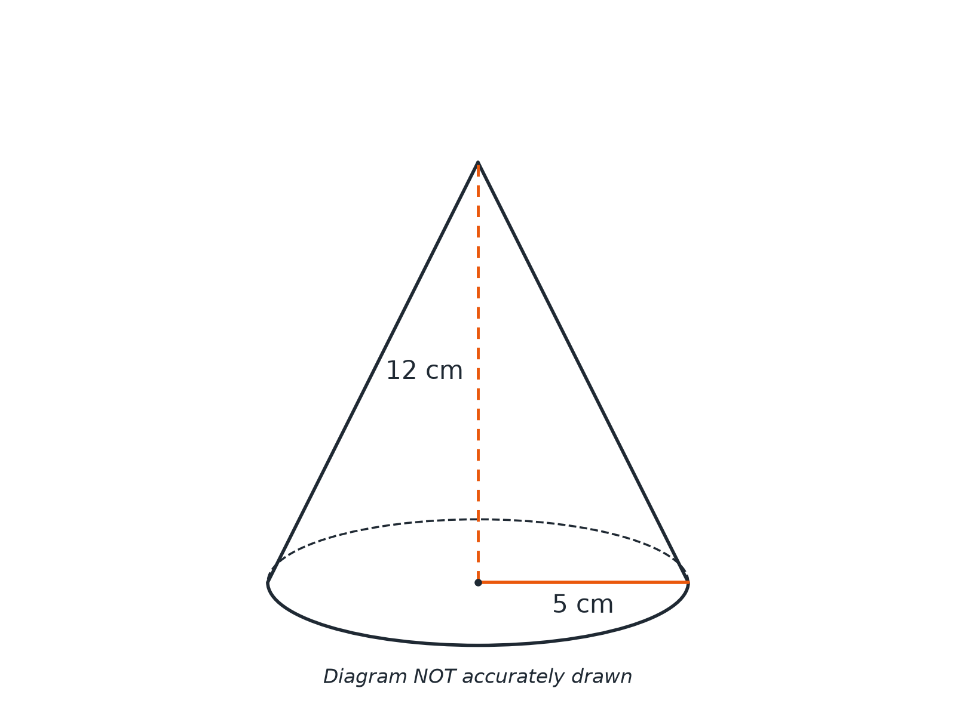
EDEXCEL GCSE MATHS · FOUNDATION & HIGHER
Question 3 · 3 marks · Non-calculator
The diagram shows a cone with base radius 5 cm and vertical height 12 cm. Work out the curved surface area of the cone. Give your answer in terms of π. (3 marks)
Area and volume
openrevise.com
Lesson 7 of 7

Slide 24
EDEXCEL GCSE MATHS · FOUNDATION & HIGHER
Question 3 · mark scheme
3 marks available. Award a mark for each point made.
5² + 12²
M1
Slant height 13
A1
65π
A1
Area and volume
openrevise.com
Lesson 7 of 7

Slide 25
EDEXCEL GCSE MATHS · FOUNDATION & HIGHER
Question 4 · 2 marks · Calculator
“
Work out the volume of the cone in the last question. Give your answer correct to 3 significant figures.
HOW TO ANSWER IT
Command word: Calculator. Worth 2 marks, so plan before writing.
Area and volume
openrevise.com
Lesson 7 of 7

Slide 26
EDEXCEL GCSE MATHS · FOUNDATION & HIGHER
Question 4 · mark scheme
2 marks available. Award a mark for each point made.
⅓π × 5² × 12
M1
314
A1
Area and volume
openrevise.com
Lesson 7 of 7

Slide 27
EDEXCEL GCSE MATHS · FOUNDATION & HIGHER
Question 5 · 4 marks · Calculator
“
A cone has base radius 6 cm and height 12 cm. A smaller cone of base radius 3 cm and height 6 cm is cut off the top, leaving a frustum. Work out the volume of the frustum. Give your answer correct to 3 significant figures.
HOW TO ANSWER IT
Command word: Calculator. Worth 4 marks, so plan before writing.
Area and volume
openrevise.com
Lesson 7 of 7

Slide 28
EDEXCEL GCSE MATHS · FOUNDATION & HIGHER
Question 5 · mark scheme
4 marks available. Award a mark for each point made.
Volume of the large cone
M1
Volume of the small cone
M1
Subtracting
M1
396
A1
Area and volume
openrevise.com
Lesson 7 of 7

Slide 29
EDEXCEL GCSE MATHS · FOUNDATION & HIGHER
Question 6 · 2 marks · Non-calculator
“
A pyramid has a rectangular base measuring 8 cm by 6 cm and a perpendicular height of 5 cm. Work out the volume of the pyramid.
HOW TO ANSWER IT
Command word: Non-calculator. Worth 2 marks, so plan before writing.
Area and volume
openrevise.com
Lesson 7 of 7

Slide 30
EDEXCEL GCSE MATHS · FOUNDATION & HIGHER
Question 6 · mark scheme
2 marks available. Award a mark for each point made.
⅓ × 8 × 6 × 5
M1
80
A1
Area and volume
openrevise.com
Lesson 7 of 7

