Slide 1
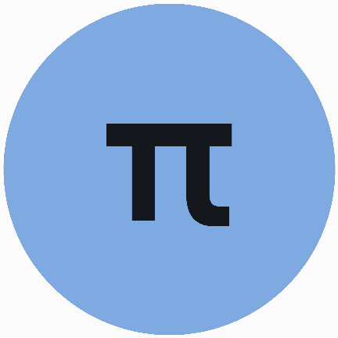
EDEXCEL GCSE MATHS · FOUNDATION & HIGHER
Cylinders and spheres
Area and volume
Lesson 6 of 7
openrevise.com

Slide 2

EDEXCEL GCSE MATHS · FOUNDATION & HIGHER
Warm-up
Answer each one, then check.
1
What is the area of a circle with radius 4, in terms of π?
2
What is the circumference of a circle with diameter 10, in terms of π?
3
Work out 5³.
4
What is the volume of a prism?
5
Round 3.979 to 2 decimal places.
Area and volume
openrevise.com
Lesson 6 of 7

Slide 3
EDEXCEL GCSE MATHS · FOUNDATION & HIGHER
Warm-up - Answers
What is the area of a circle with radius 4, in terms of π?
16π
1
What is the circumference of a circle with diameter 10, in terms of π?
10π
2
Work out 5³.
125
3
What is the volume of a prism?
Cross-sectional area times length
4
Round 3.979 to 2 decimal places.
3.98
5
Area and volume
openrevise.com
Lesson 6 of 7

Slide 4

EDEXCEL GCSE MATHS · FOUNDATION & HIGHER
Learning Objectives
Find the volume and surface area of a cylinder.
1
Find the volume and surface area of a sphere.
2
Find the volume and surface area of a hemisphere.
3
Solve problems that combine cylinders and hemispheres.
4
Area and volume
openrevise.com
Lesson 6 of 7

Slide 5
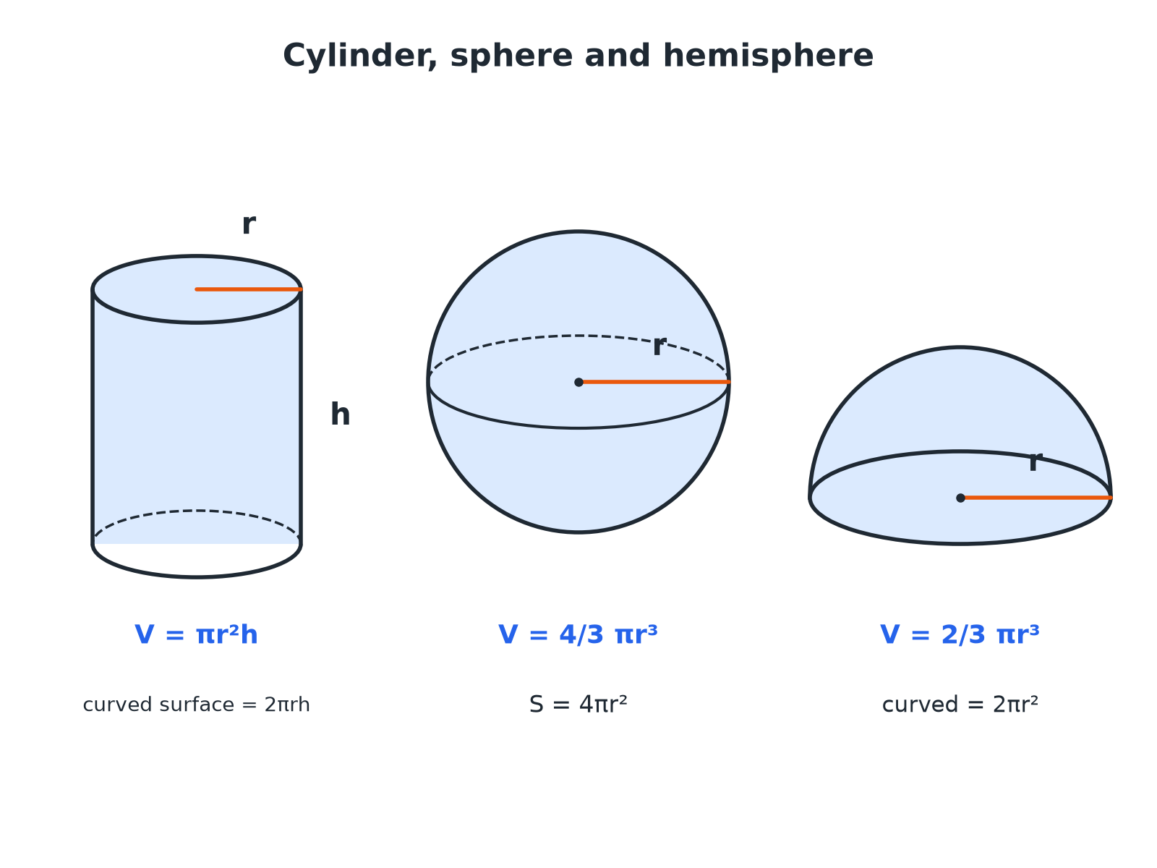

EDEXCEL GCSE MATHS · FOUNDATION & HIGHER
Cylinder, Sphere and Hemisphere
A cylinder is a prism with a circular cross-section.
Area and volume
openrevise.com
Lesson 6 of 7

Slide 6

EDEXCEL GCSE MATHS · FOUNDATION & HIGHER
Formulae
The sphere formulae are given on the Edexcel formulae sheet, but you must know the cylinder ones.
Solid
Volume
Surface area
Cylinder
πr² h
2πr² + 2πr h
Sphere
4/3πr³
4πr²
Hemisphere
⅔πr³
3πr²
Area and volume
openrevise.com
Lesson 6 of 7

Slide 7

EDEXCEL GCSE MATHS · FOUNDATION & HIGHER
A Cylinder
A cylinder has radius 5 cm and height 12 cm. Find its volume and total surface area, in terms of π and to 1 decimal place.
1
Volume = πr² h
π × 25 × 12 = 300π
2
As a decimal
942.5 cm³
3
Curved surface = 2πr h
2π × 5 × 12 = 120π
4
Two circular ends = 2πr²
2π × 25 = 50π
5
Total surface area
170π= 534.1 cm²
ANSWER
Volume 300π cm³ (942.5) and surface area 170π cm² (534.1).
Area and volume
openrevise.com
Lesson 6 of 7

Slide 8
EDEXCEL GCSE MATHS · FOUNDATION & HIGHER
A Sphere
A sphere has radius 6 cm. Find its volume and surface area, in terms of π.
Volume = 4/3πr³
4/3 × π × 216 = 288π
1
Surface area = 4πr²
4 × π × 36 = 144π
2
ANSWER
Volume 288π cm³ and surface area 144π cm².
Area and volume
openrevise.com
Lesson 6 of 7

Slide 9
EDEXCEL GCSE MATHS · FOUNDATION & HIGHER
A Hemisphere
A solid hemisphere has radius 3 cm. Find its volume in terms of π.
A hemisphere is half a sphere
½ × 4/3πr³ = ⅔πr³
1
Substitute r = 3
⅔ × π × 27
2
Work out
18π
3
ANSWER
18π cm³
Area and volume
openrevise.com
Lesson 6 of 7

Slide 10
EDEXCEL GCSE MATHS · FOUNDATION & HIGHER
Finding the Height
A cylinder has volume 200 cm³ and radius 4 cm. Find its height to 2 decimal places.
πr² h = 200
π × 16 × h = 200
1
Divide by 16π
h = 200/16π
2
Calculate
3.979...
3
ANSWER
3.98 cm
Area and volume
openrevise.com
Lesson 6 of 7

Slide 11

EDEXCEL GCSE MATHS · FOUNDATION & HIGHER
Combined Solids
Add the volumes; for surface area, do not count the joined faces.
A capsule
A cylinder with a hemisphere at each end: total volume = πr² h + 4/3πr³.
A hemisphere on top
Surface area is the cylinder's curved surface and one end, plus the hemisphere's curved surface 2πr².
Watch the radius
The radius of the hemisphere is the radius of the cylinder.
Area and volume
openrevise.com
Lesson 6 of 7

Slide 12

EDEXCEL GCSE MATHS · FOUNDATION & HIGHER
Key Terms
Cylinder
A prism with a circle as its cross-section.
Sphere
A perfectly round 3D shape, like a ball.
Hemisphere
Half a sphere.
Curved surface area
The area of the curved part only, not the flat ends.
Volume
The amount of space inside a solid.
In terms of π
Leaving π in the answer.
Area and volume
openrevise.com
Lesson 6 of 7

Slide 13

EDEXCEL GCSE MATHS · FOUNDATION & HIGHER
YOUR TASK
12 minutes
Tennis Ball Tube
Three tennis balls of radius 3.3 cm fit exactly in a cylindrical tube. Find the volume of the tube, the volume of the three balls, and the percentage of the tube filled with balls.
1
Find the height of the tube.
2
Work out both volumes.
3
Divide and convert to a percentage.
WHAT A GOOD ANSWER SHOWS
The tube has radius 3.3 and height 19.8: π × 3.3² × 19.8 = 677.4 cm³. The balls: 3 × 4/3π × 3.3³ = 4π × 35.937 = 451.6 cm³. Percentage = 451.6 ÷ 677.4 = 66.7%, exactly two thirds.
Area and volume
openrevise.com
Lesson 6 of 7
Notes:
A famous result: the sphere is exactly two thirds of the enclosing cylinder.

Slide 14

EDEXCEL GCSE MATHS · FOUNDATION & HIGHER
Can I...?
Find the volume of a cylinder.
Find the volume of a hemisphere.
Find the surface area of a cylinder.
Work backwards to find a radius or height.
Find the volume of a sphere.
Solve problems with combined solids.
Find the surface area of a sphere.
Give answers in terms of π.
Area and volume
openrevise.com
Lesson 6 of 7

Slide 15
EDEXCEL GCSE MATHS · FOUNDATION & HIGHER
Summary & Exam Focus
Cylinder volume πr² h; curved surface 2πr h.
Sphere volume 4/3πr³; surface 4πr².
Hemisphere volume ⅔πr³.
For combined solids, add volumes and take care with joined faces.
EXAM FOCUS
A cylinder has radius 5 cm and height 12 cm. Work out the volume of the cylinder. Give your answer correct to 3 significant figures. (2 marks)
Cylinder volume is the area of the circle times the height: πr² h. Check that you have the radius, not the diameter.
openrevise.com

Slide 16
EDEXCEL GCSE MATHS · FOUNDATION & HIGHER
Exam Practice: Cylinders and Spheres
Answer all questions. Show your working. · 30 minutes
Question 1 · 2 marks · Calculator
The diagram shows a cylinder with radius 5 cm and height 12 cm. Work out the volume of the cylinder. Give your answer correct to 3…
Question 2 · 3 marks · Calculator
Work out the total surface area of the cylinder in the last question. Give your answer correct to 3 significant figures.
Question 3 · 2 marks · Calculator
A sphere has a radius of 6 cm. Work out the volume of the sphere. Give your answer correct to 3 significant figures.
Area and volume
openrevise.com
Lesson 6 of 7

Slide 17
EDEXCEL GCSE MATHS · FOUNDATION & HIGHER
Exam Practice: Cylinders and Spheres (cont.)
Question 4 · 2 marks · Calculator
Work out the surface area of the sphere in the last question. Give your answer correct to 3 significant figures.
Question 5 · 3 marks · Calculator
A cylinder has a volume of 200 cm³ and a radius of 4 cm. Work out the height of the cylinder. Give your answer correct to 2 decimal places.
Question 6 · 2 marks · Non-calculator
A solid hemisphere has a radius of 3 cm. Work out the volume of the hemisphere. Give your answer in terms of π.
Area and volume
openrevise.com
Lesson 6 of 7

Slide 18
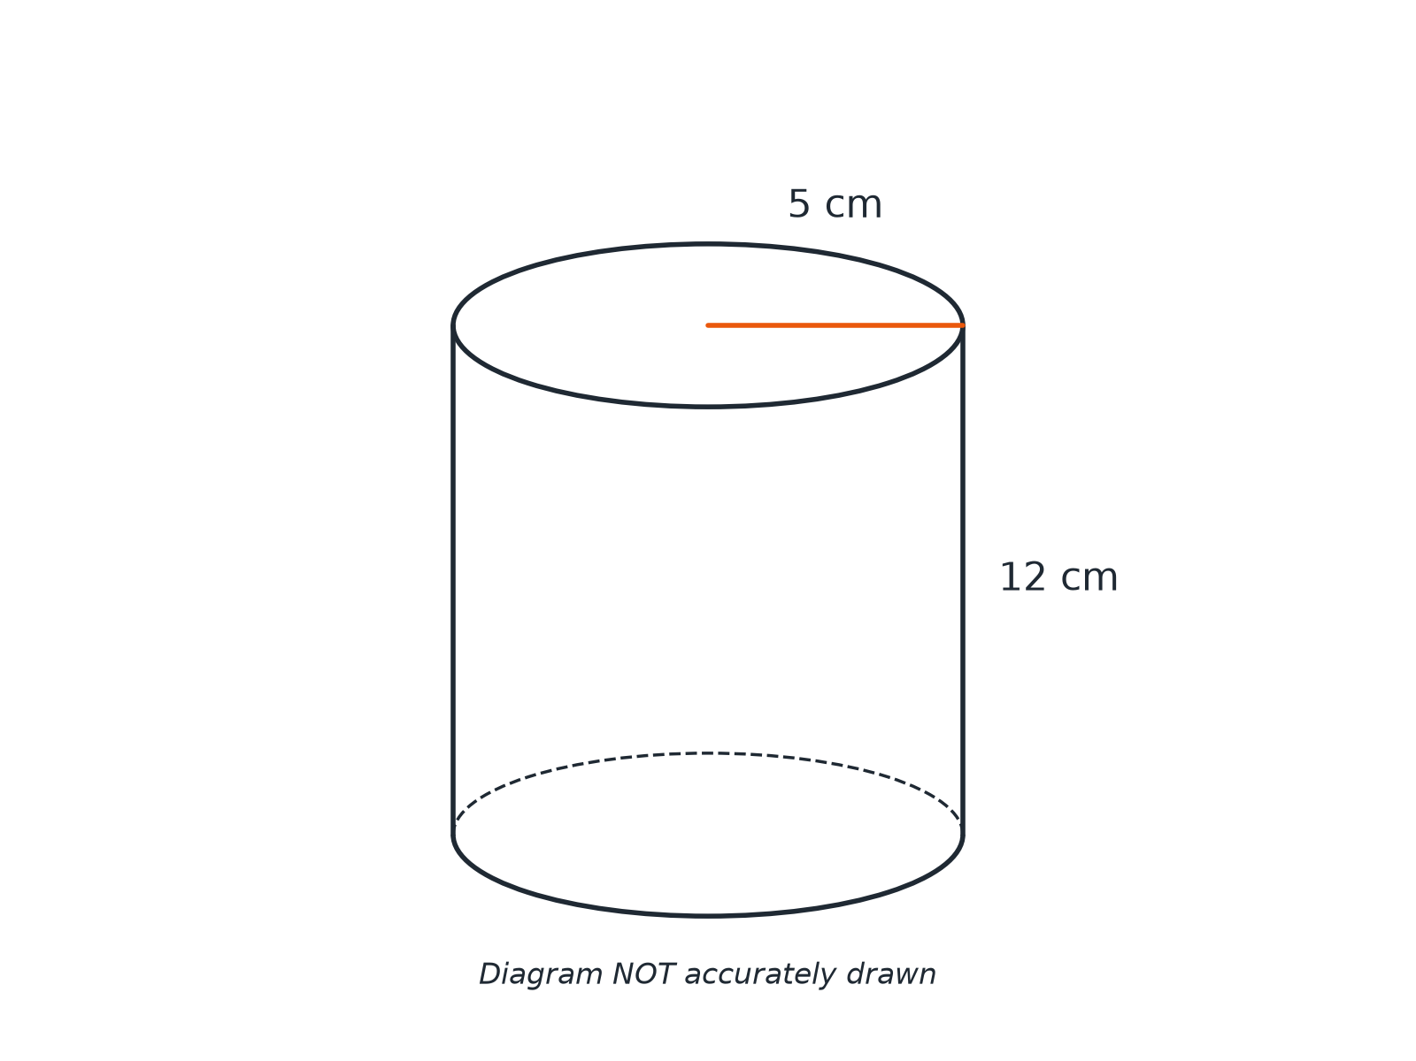
EDEXCEL GCSE MATHS · FOUNDATION & HIGHER
Question 1 · 2 marks · Calculator
The diagram shows a cylinder with radius 5 cm and height 12 cm. Work out the volume of the cylinder. Give your answer correct to 3 significant figures. (2 marks)
Area and volume
openrevise.com
Lesson 6 of 7

Slide 19
EDEXCEL GCSE MATHS · FOUNDATION & HIGHER
Question 1 · mark scheme
2 marks available. Award a mark for each point made.
π × 5² × 12
M1
942
A1
Area and volume
openrevise.com
Lesson 6 of 7

Slide 20
EDEXCEL GCSE MATHS · FOUNDATION & HIGHER
Question 2 · 3 marks · Calculator
“
Work out the total surface area of the cylinder in the last question. Give your answer correct to 3 significant figures.
HOW TO ANSWER IT
Command word: Calculator. Worth 3 marks, so plan before writing.
Area and volume
openrevise.com
Lesson 6 of 7

Slide 21
EDEXCEL GCSE MATHS · FOUNDATION & HIGHER
Question 2 · mark scheme
3 marks available. Award a mark for each point made.
2πr²
M1
2πr h
M1
534
A1
Area and volume
openrevise.com
Lesson 6 of 7

Slide 22
EDEXCEL GCSE MATHS · FOUNDATION & HIGHER
Question 3 · 2 marks · Calculator
“
A sphere has a radius of 6 cm. Work out the volume of the sphere. Give your answer correct to 3 significant figures.
HOW TO ANSWER IT
Command word: Calculator. Worth 2 marks, so plan before writing.
Area and volume
openrevise.com
Lesson 6 of 7

Slide 23
EDEXCEL GCSE MATHS · FOUNDATION & HIGHER
Question 3 · mark scheme
2 marks available. Award a mark for each point made.
4/3π × 6³
M1
905
A1
Area and volume
openrevise.com
Lesson 6 of 7

Slide 24
EDEXCEL GCSE MATHS · FOUNDATION & HIGHER
Question 4 · 2 marks · Calculator
“
Work out the surface area of the sphere in the last question. Give your answer correct to 3 significant figures.
HOW TO ANSWER IT
Command word: Calculator. Worth 2 marks, so plan before writing.
Area and volume
openrevise.com
Lesson 6 of 7

Slide 25
EDEXCEL GCSE MATHS · FOUNDATION & HIGHER
Question 4 · mark scheme
2 marks available. Award a mark for each point made.
4π × 6²
M1
452
A1
Area and volume
openrevise.com
Lesson 6 of 7

Slide 26
EDEXCEL GCSE MATHS · FOUNDATION & HIGHER
Question 5 · 3 marks · Calculator
“
A cylinder has a volume of 200 cm³ and a radius of 4 cm. Work out the height of the cylinder. Give your answer correct to 2 decimal places.
HOW TO ANSWER IT
Command word: Calculator. Worth 3 marks, so plan before writing.
Area and volume
openrevise.com
Lesson 6 of 7

Slide 27
EDEXCEL GCSE MATHS · FOUNDATION & HIGHER
Question 5 · mark scheme
3 marks available. Award a mark for each point made.
π × 4² × h = 200
M1
200/16π
M1
3.98
A1
Area and volume
openrevise.com
Lesson 6 of 7

Slide 28
EDEXCEL GCSE MATHS · FOUNDATION & HIGHER
Question 6 · 2 marks · Non-calculator
“
A solid hemisphere has a radius of 3 cm. Work out the volume of the hemisphere. Give your answer in terms of π.
HOW TO ANSWER IT
Command word: Non-calculator. Worth 2 marks, so plan before writing.
Area and volume
openrevise.com
Lesson 6 of 7

Slide 29
EDEXCEL GCSE MATHS · FOUNDATION & HIGHER
Question 6 · mark scheme
2 marks available. Award a mark for each point made.
⅔π × 27 or half of 4/3π × 27
M1
18π
A1
Area and volume
openrevise.com
Lesson 6 of 7

