Slide 1

EDEXCEL GCSE MATHS · FOUNDATION & HIGHER
3D solids
Transformations and constructions
Lesson 1 of 8
openrevise.com

Slide 2

EDEXCEL GCSE MATHS · FOUNDATION & HIGHER
Warm-up
Answer each one, then check.
1
How many faces does a cube have?
2
What is the name of a 3D shape with a circular base and one curved surface ending at a point?
3
What is the volume of a cuboid 2 by 3 by 4?
4
What shape is the cross-section of a cylinder cut straight across?
5
What is a polygon with 6 sides called?
Transformations and constructions
openrevise.com
Lesson 1 of 8

Slide 3
EDEXCEL GCSE MATHS · FOUNDATION & HIGHER
Warm-up - Answers
How many faces does a cube have?
6
1
What is the name of a 3D shape with a circular base and one curved surface ending at a point?
A cone
2
What is the volume of a cuboid 2 by 3 by 4?
24
3
What shape is the cross-section of a cylinder cut straight across?
A circle
4
What is a polygon with 6 sides called?
A hexagon
5
Transformations and constructions
openrevise.com
Lesson 1 of 8

Slide 4

EDEXCEL GCSE MATHS · FOUNDATION & HIGHER
Learning Objectives
Name common 3D solids.
1
Count faces, edges and vertices.
2
Draw and interpret plans and elevations.
3
Use a 3D drawing to work out how many cubes make a solid.
4
Transformations and constructions
openrevise.com
Lesson 1 of 8

Slide 5

EDEXCEL GCSE MATHS · FOUNDATION & HIGHER
Faces, Edges and Vertices
A face is a flat surface, an edge is where two faces meet, and a vertex is a corner.
Solid
Faces
Edges
Vertices
Cuboid
6
12
8
Triangular prism
5
9
6
Square-based pyramid
5
8
5
Cylinder
3
2
0
Cone
2
1
1
Sphere
1
0
0
Transformations and constructions
openrevise.com
Lesson 1 of 8

Slide 6

EDEXCEL GCSE MATHS · FOUNDATION & HIGHER
Naming Solids
The name comes from the shape of the base or cross-section.
Prism
The same cross-section all the way along: a triangular prism, a hexagonal prism.
Pyramid
A polygon base with triangular faces that meet at one apex.
Cylinder, cone, sphere
Solids with curved surfaces; a sphere is a perfect ball.
Tetrahedron
A pyramid with four triangular faces.
Transformations and constructions
openrevise.com
Lesson 1 of 8

Slide 7

EDEXCEL GCSE MATHS · FOUNDATION & HIGHER
EULER'S FORMULA
For any solid with flat faces, faces plus vertices minus edges equals 2.
Cuboid: 6 + 8 − 12 = 2. Square-based pyramid: 5 + 5 − 8 = 2.
Transformations and constructions
openrevise.com
Lesson 1 of 8

Slide 8
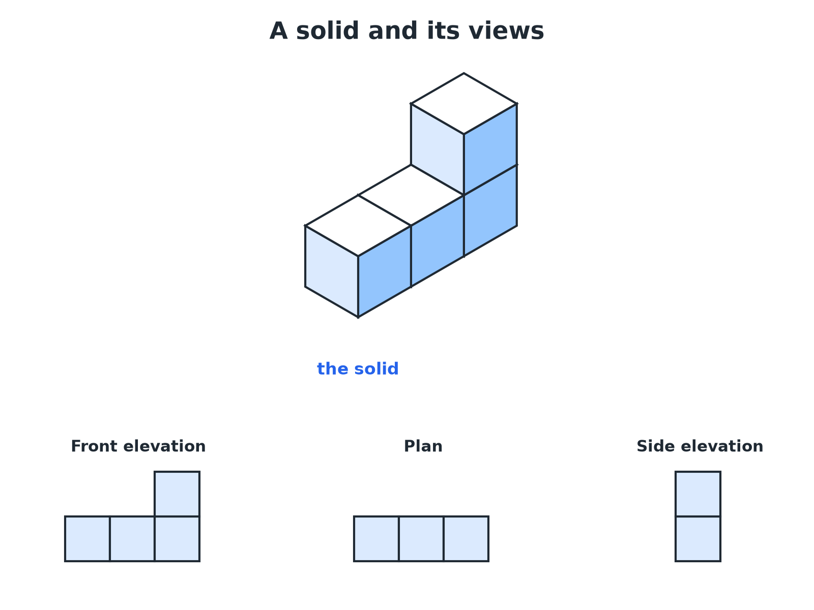

EDEXCEL GCSE MATHS · FOUNDATION & HIGHER
Plan and Elevations
The plan is the view from above; elevations are views from the front and the side.
Transformations and constructions
openrevise.com
Lesson 1 of 8

Slide 9
EDEXCEL GCSE MATHS · FOUNDATION & HIGHER
The Three Views
Plan
The view from directly above.
Front elevation
The view from the front, looking straight at the face you choose to call the front.
Side elevation
The view from one side, usually the right, looking straight at that face.
Transformations and constructions
openrevise.com
Lesson 1 of 8

Slide 10

EDEXCEL GCSE MATHS · FOUNDATION & HIGHER
Drawing the Elevations
A solid is made from four cubes: a row of three, with one more cube on top of the right-hand cube. Draw the front elevation, the plan and the side elevation viewed from the right.
Front elevation: what you see facing the row
Three squares wide; the right column is two high
1
Plan: look down from above
Three squares in a row (the top cube is hidden above the right one)
2
Side elevation from the right: you see the end
One square wide and two squares high
3
ANSWER
Front elevation: an L-shape of 4 squares. Plan: 3 squares in a row. Side elevation: 2 squares in a column.
Transformations and constructions
openrevise.com
Lesson 1 of 8

Slide 11

EDEXCEL GCSE MATHS · FOUNDATION & HIGHER
Tips for Elevations
Draw only what you can see, with straight lines.
Hidden edges
Do not draw edges you cannot see from that direction.
Use a grid
One square on the grid stands for one edge of a cube.
Check your views agree
The front elevation and plan must have the same width; the front and side must have the same height.
Transformations and constructions
openrevise.com
Lesson 1 of 8

Slide 12

EDEXCEL GCSE MATHS · FOUNDATION & HIGHER
Key Terms
Face
A flat surface of a solid.
Edge
A line where two faces meet.
Vertex
A corner where edges meet (plural: vertices).
Plan
The view of a solid from above.
Elevation
The view of a solid from the front or side.
Prism
A solid with the same cross-section all the way through.
Transformations and constructions
openrevise.com
Lesson 1 of 8

Slide 13

EDEXCEL GCSE MATHS · FOUNDATION & HIGHER
YOUR TASK
12 minutes
Build and Draw
Build a solid from 5 cubes: a row of three cubes, a fourth cube placed directly behind the middle cube of the row, and a fifth cube on top of the left-hand cube of the row. Draw its plan and its front elevation.
1
Build the solid.
2
Look from each direction.
3
Draw only what you see.
WHAT A GOOD ANSWER SHOWS
Plan: a row of three squares with a fourth square behind the middle one (a T-shape). Front elevation: three squares wide, with the left column two squares high and the other two columns one square high.
Transformations and constructions
openrevise.com
Lesson 1 of 8

Slide 14

EDEXCEL GCSE MATHS · FOUNDATION & HIGHER
Can I...?
Name the common solids.
Draw a front elevation.
Count faces, edges and vertices.
Draw a side elevation.
Check with Euler's formula.
Match views to a solid.
Say what a plan is.
Work out the volume of a cube solid from its views.
Transformations and constructions
openrevise.com
Lesson 1 of 8

Slide 15
EDEXCEL GCSE MATHS · FOUNDATION & HIGHER
Summary & Exam Focus
Faces, edges, vertices: count carefully and check with F + V − E = 2.
Plan is from above; elevations are from the sides.
Draw with straight lines on a grid.
Compare your views for consistency.
EXAM FOCUS
A solid is made of 4 cubes: a row of three cubes with one cube on top of the right-hand cube. Draw the front elevation of the solid on a square grid. (2 marks)
Look at the solid from the front only and draw what is visible: an L-shape here. Do not add depth lines.
openrevise.com

