Slide 1

EDEXCEL GCSE MATHS · FOUNDATION & HIGHER
Enlargement
Transformations and constructions
Lesson 3 of 8
openrevise.com

Slide 2

EDEXCEL GCSE MATHS · FOUNDATION & HIGHER
Warm-up
Answer each one, then check.
1
What is 3 × 4?
2
Work out ½ × 8.
3
What is the area of a rectangle 3 by 5?
4
What is the scale factor from 4 cm to 12 cm?
5
What does congruent mean?
Transformations and constructions
openrevise.com
Lesson 3 of 8

Slide 3
EDEXCEL GCSE MATHS · FOUNDATION & HIGHER
Warm-up - Answers
What is 3 × 4?
12
1
Work out ½ × 8.
4
2
What is the area of a rectangle 3 by 5?
15
3
What is the scale factor from 4 cm to 12 cm?
3
4
What does congruent mean?
The same shape and size
5
Transformations and constructions
openrevise.com
Lesson 3 of 8

Slide 4

EDEXCEL GCSE MATHS · FOUNDATION & HIGHER
Learning Objectives
Enlarge a shape by a positive scale factor from a centre.
1
Use fractional scale factors.
2
Describe an enlargement fully.
3
Use negative scale factors and similar-shape area and volume ratios (Higher).
4
Transformations and constructions
openrevise.com
Lesson 3 of 8

Slide 5

EDEXCEL GCSE MATHS · FOUNDATION & HIGHER
THE KEY IDEA
An enlargement changes the size of a shape but not its shape: every length is multiplied by the scale factor.
The centre of enlargement stays in the same place.
Transformations and constructions
openrevise.com
Lesson 3 of 8

Slide 6
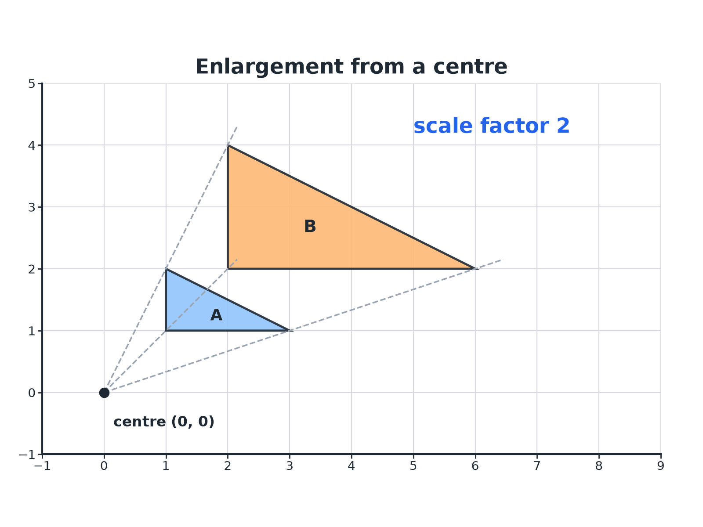

EDEXCEL GCSE MATHS · FOUNDATION & HIGHER
Enlarging from a Centre
Lines through matching points all meet at the centre of enlargement.
Transformations and constructions
openrevise.com
Lesson 3 of 8

Slide 7

EDEXCEL GCSE MATHS · FOUNDATION & HIGHER
How to Enlarge a Shape
Work from the centre to each vertex.
1
2
3
4
5
Pick the centre
It is given, or found where lines through matching points meet.
Measure to a vertex
Count squares across and up from the centre.
Multiply by the scale factor
Multiply both distances.
Plot the new vertex
Start again from the centre.
Join up
Join the new vertices to make the image.
Transformations and constructions
openrevise.com
Lesson 3 of 8

Slide 8

EDEXCEL GCSE MATHS · FOUNDATION & HIGHER
Enlarging from the Origin
Triangle A has vertices (1, 1), (3, 1) and (1, 2). Enlarge it by scale factor 2 with centre (0, 0).
Multiply each coordinate by 2
(1, 1) → (2, 2)
1
The other vertices
(3, 1) → (6, 2) and (1, 2) → (2, 4)
2
ANSWER
The image has vertices (2, 2), (6, 2) and (2, 4).
Transformations and constructions
openrevise.com
Lesson 3 of 8

Slide 9
EDEXCEL GCSE MATHS · FOUNDATION & HIGHER
Enlarging from Another Centre
A triangle has vertices (2, 2), (4, 2) and (2, 3). Enlarge it by scale factor 2 about the centre (1, 1).
Vector from the centre to the first vertex
(2, 2) − (1, 1) = (1, 1)
1
Multiply by 2
(2, 2)
2
Add back to the centre
(1 + 2, 1 + 2) = (3, 3)
3
The other vertices
(4, 2): vector (3, 1), doubled (6, 2), so (7, 3); (2, 3): vector (1, 2), doubled (2, 4), so (3, 5)
4
ANSWER
The image has vertices (3, 3), (7, 3) and (3, 5).
Transformations and constructions
openrevise.com
Lesson 3 of 8

Slide 10
EDEXCEL GCSE MATHS · FOUNDATION & HIGHER
A Fractional Scale Factor
Enlarge the triangle with vertices (2, 4), (6, 4) and (2, 8) by scale factor ½ with centre (0, 0).
Multiply each coordinate by ½
(2, 4) → (1, 2)
1
The other vertices
(6, 4) → (3, 2) and (2, 8) → (1, 4)
2
ANSWER
The image has vertices (1, 2), (3, 2) and (1, 4); it is smaller than the original.
Transformations and constructions
openrevise.com
Lesson 3 of 8

Slide 11

EDEXCEL GCSE MATHS · FOUNDATION & HIGHER
Scale Factor Sizes
SCALE FACTOR GREATER THAN 1
SCALE FACTOR BETWEEN 0 AND 1
• The image is bigger than the object.
• Lengths are multiplied by the scale factor.
• Example: scale factor 3 makes every side three times as long.
• The image is smaller than the object.
• Still called an enlargement.
• Example: scale factor ½ halves every length.
Transformations and constructions
openrevise.com
Lesson 3 of 8

Slide 12

EDEXCEL GCSE MATHS · FOUNDATION & HIGHER
HIGHER TIER
Negative Scale Factors and Similar Shapes
Enlarge through the centre, and how area and volume scale.
openrevise.com

Slide 13
EDEXCEL GCSE MATHS · FOUNDATION & HIGHER
A Negative Scale Factor
Higher
Enlarge the point (1, 2) by scale factor −2 about the origin.
Multiply the coordinates by −2
(1, 2) → (−2, −4)
1
The image is on the opposite side of the centre
And twice as far away
2
ANSWER
(−2, −4)
Transformations and constructions
openrevise.com
Lesson 3 of 8

Slide 14

EDEXCEL GCSE MATHS · FOUNDATION & HIGHER
Lengths, Areas and Volumes
Higher
For similar shapes with length scale factor k.
Measurement
Scale factor
Lengths
k
Areas
k²
Volumes
k³
Transformations and constructions
openrevise.com
Lesson 3 of 8

Slide 15
EDEXCEL GCSE MATHS · FOUNDATION & HIGHER
Area and Volume Scale Factors
Higher
Two similar bottles have heights 6 cm and 9 cm. The label of the smaller bottle has area 20 cm². Find the label area on the larger bottle. The smaller bottle holds 250 ml; find the capacity of the larger.
Length scale factor
9 ÷ 6 = 1.5
1
Area scale factor
1.5² = 2.25, so 20 × 2.25 = 45
2
Volume scale factor
1.5³ = 3.375, so 250 × 3.375 = 843.75
3
ANSWER
Label area 45 cm² and capacity 843.75 ml.
Transformations and constructions
openrevise.com
Lesson 3 of 8

Slide 16

EDEXCEL GCSE MATHS · FOUNDATION & HIGHER
Key Terms
Enlargement
A transformation that changes the size of a shape by a scale factor.
Scale factor
The number every length is multiplied by.
Centre of enlargement
The fixed point the enlargement is measured from.
Similar
The same shape but a different size.
Ray
A straight line drawn from the centre through a vertex.
Congruent
The same shape and size.
Transformations and constructions
openrevise.com
Lesson 3 of 8

Slide 17

EDEXCEL GCSE MATHS · FOUNDATION & HIGHER
YOUR TASK
12 minutes
Describe the Enlargement
Triangle P has vertices (2, 1), (4, 1) and (2, 4). Triangle Q has vertices (4, 2), (8, 2) and (4, 8). Describe fully the single transformation that maps P onto Q. Then find the ratio of their areas.
1
Compare corresponding side lengths.
2
Draw rays to find the centre.
3
Compare areas.
WHAT A GOOD ANSWER SHOWS
Enlargement, scale factor 2, centre (0, 0). The area of P is 3 and the area of Q is 12, a ratio of 1:4, which is 2².
Transformations and constructions
openrevise.com
Lesson 3 of 8
Notes:
Ask how to find the centre if it is not given (rays through matching vertices).

Slide 18

EDEXCEL GCSE MATHS · FOUNDATION & HIGHER
Can I...?
Enlarge from the origin.
Find the centre using rays.
Enlarge from another centre.
Use a negative scale factor (Higher).
Use a fractional scale factor.
Use k² for areas (Higher).
Describe an enlargement fully.
Use k³ for volumes (Higher).
Transformations and constructions
openrevise.com
Lesson 3 of 8

Slide 19
EDEXCEL GCSE MATHS · FOUNDATION & HIGHER
Summary & Exam Focus
Every length is multiplied by the scale factor.
Scale factors below 1 make the image smaller.
To describe: enlargement, scale factor, centre.
Higher: areas scale by k² and volumes by k³.
EXAM FOCUS
Describe fully the single transformation that maps triangle P onto triangle Q, where P has vertices (2, 1), (4, 1), (2, 4) and Q has vertices (4, 2), (8, 2), (4, 8). (3 marks)
For an enlargement give three things: the word enlargement, the scale factor, and the centre.
openrevise.com

Slide 20
EDEXCEL GCSE MATHS · FOUNDATION & HIGHER
Exam Practice: Enlargement
Answer all questions. Show your working. · 25 minutes
Question 1 · 2 marks · Non-calculator
Triangle A has vertices (1, 1), (3, 1) and (1, 2). It is enlarged by scale factor 2 with centre (0, 0). Write down the coordinates of the…
Question 2 · 2 marks · Non-calculator
A rectangle measures 3 cm by 5 cm. It is enlarged by scale factor 4. Write down the dimensions of the enlarged rectangle.
Question 3 · 3 marks · Non-calculator
A triangle has vertices (2, 2), (4, 2) and (2, 3). It is enlarged by scale factor 2 with centre (1, 1). Write down the coordinates of the…
Transformations and constructions
openrevise.com
Lesson 3 of 8

Slide 21
EDEXCEL GCSE MATHS · FOUNDATION & HIGHER
Exam Practice: Enlargement (cont.)
Question 4 · 3 marks · Non-calculator
Triangle Q is an enlargement of triangle P. Describe fully the single transformation that maps P onto Q.
Question 5 · 3 marks · Non-calculator
Two similar vases have heights 6 cm and 9 cm. The surface area of the smaller vase is 20 cm². Work out the surface area of the larger vase.
Question 6 · 3 marks · Calculator
A model of a ship is made to a scale of 1 : 5. The volume of the model is 250 cm³. Work out the volume of the real ship in cm³.
Transformations and constructions
openrevise.com
Lesson 3 of 8

Slide 22
EDEXCEL GCSE MATHS · FOUNDATION & HIGHER
Question 1 · 2 marks · Non-calculator
“
Triangle A has vertices (1, 1), (3, 1) and (1, 2). It is enlarged by scale factor 2 with centre (0, 0). Write down the coordinates of the vertices of the image.
HOW TO ANSWER IT
Command word: Non-calculator. Worth 2 marks, so plan before writing.
Transformations and constructions
openrevise.com
Lesson 3 of 8

Slide 23
EDEXCEL GCSE MATHS · FOUNDATION & HIGHER
Question 1 · mark scheme
2 marks available. Award a mark for each point made.
Two vertices correct
B1
All three correct
B1
Transformations and constructions
openrevise.com
Lesson 3 of 8

Slide 24
EDEXCEL GCSE MATHS · FOUNDATION & HIGHER
Question 2 · 2 marks · Non-calculator
“
A rectangle measures 3 cm by 5 cm. It is enlarged by scale factor 4. Write down the dimensions of the enlarged rectangle.
HOW TO ANSWER IT
Command word: Non-calculator. Worth 2 marks, so plan before writing.
Transformations and constructions
openrevise.com
Lesson 3 of 8

Slide 25
EDEXCEL GCSE MATHS · FOUNDATION & HIGHER
Question 2 · mark scheme
2 marks available. Award a mark for each point made.
One length correct
M1
Both correct
A1
Transformations and constructions
openrevise.com
Lesson 3 of 8

Slide 26
EDEXCEL GCSE MATHS · FOUNDATION & HIGHER
Question 3 · 3 marks · Non-calculator
“
A triangle has vertices (2, 2), (4, 2) and (2, 3). It is enlarged by scale factor 2 with centre (1, 1). Write down the coordinates of the vertices of the image.
HOW TO ANSWER IT
Command word: Non-calculator. Worth 3 marks, so plan before writing.
Transformations and constructions
openrevise.com
Lesson 3 of 8

Slide 27
EDEXCEL GCSE MATHS · FOUNDATION & HIGHER
Question 3 · mark scheme
3 marks available. Award a mark for each point made.
A correct method: vector from the centre doubled
M1
Two vertices correct
A1
All three correct
A1
Transformations and constructions
openrevise.com
Lesson 3 of 8

Slide 28
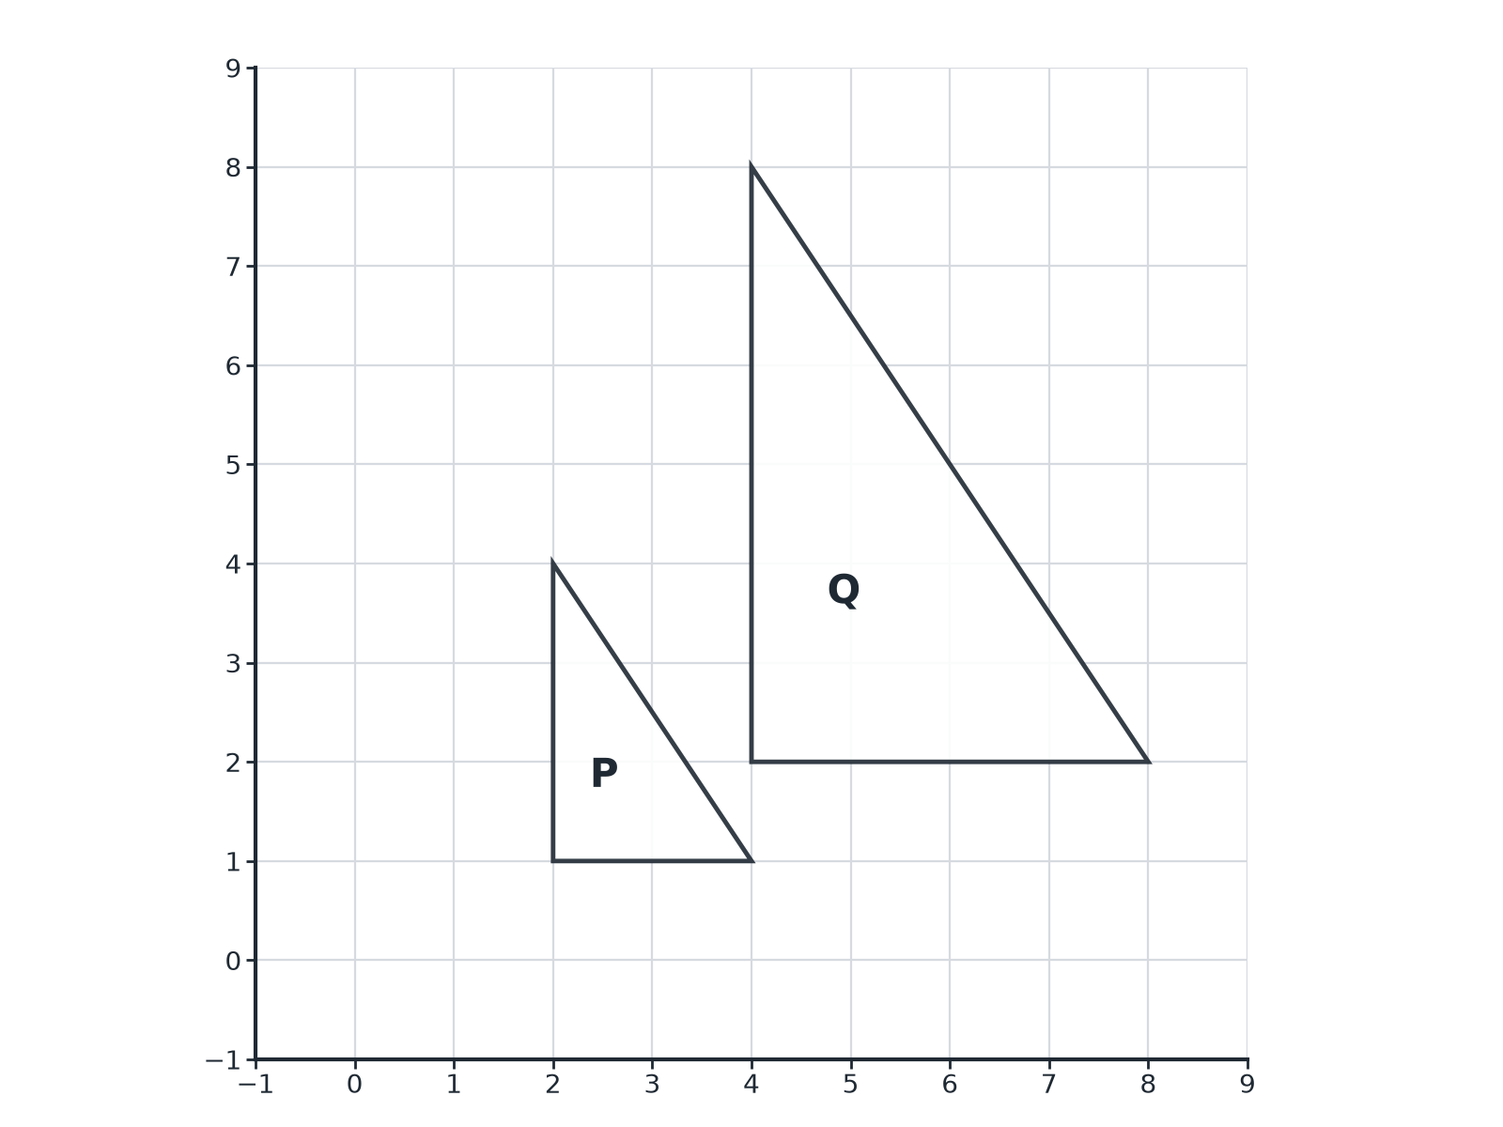
EDEXCEL GCSE MATHS · FOUNDATION & HIGHER
Question 4 · 3 marks · Non-calculator
Triangle Q is an enlargement of triangle P. Describe fully the single transformation that maps P onto Q. (3 marks)
Transformations and constructions
openrevise.com
Lesson 3 of 8

Slide 29
EDEXCEL GCSE MATHS · FOUNDATION & HIGHER
Question 4 · mark scheme
3 marks available. Award a mark for each point made.
Enlargement
B1
Scale factor 2
B1
Centre (0, 0)
B1
Transformations and constructions
openrevise.com
Lesson 3 of 8

Slide 30
EDEXCEL GCSE MATHS · FOUNDATION & HIGHER
Question 5 · 3 marks · Non-calculator
“
Two similar vases have heights 6 cm and 9 cm. The surface area of the smaller vase is 20 cm². Work out the surface area of the larger vase.
HOW TO ANSWER IT
Command word: Non-calculator. Worth 3 marks, so plan before writing.
Transformations and constructions
openrevise.com
Lesson 3 of 8

Slide 31
EDEXCEL GCSE MATHS · FOUNDATION & HIGHER
Question 5 · mark scheme
3 marks available. Award a mark for each point made.
Length scale factor 1.5
M1
1.5²
M1
45
A1
Transformations and constructions
openrevise.com
Lesson 3 of 8

Slide 32
EDEXCEL GCSE MATHS · FOUNDATION & HIGHER
Question 6 · 3 marks · Calculator
“
A model of a ship is made to a scale of 1 : 5. The volume of the model is 250 cm³. Work out the volume of the real ship in cm³.
HOW TO ANSWER IT
Command word: Calculator. Worth 3 marks, so plan before writing.
Transformations and constructions
openrevise.com
Lesson 3 of 8

Slide 33
EDEXCEL GCSE MATHS · FOUNDATION & HIGHER
Question 6 · mark scheme
3 marks available. Award a mark for each point made.
Length scale factor 5
M1
5³ = 125
M1
31 250
A1
Transformations and constructions
openrevise.com
Lesson 3 of 8

