Slide 1

EDEXCEL GCSE MATHS · FOUNDATION & HIGHER
Constructions 1
Transformations and constructions
Lesson 6 of 8
openrevise.com

Slide 2

EDEXCEL GCSE MATHS · FOUNDATION & HIGHER
Warm-up
Answer each one, then check.
1
What do the angles in a triangle add up to?
2
What is a perpendicular line?
3
What does bisect mean?
4
What is the longest side of a right-angled triangle called?
5
What is the midpoint of a line 8 cm long?
Transformations and constructions
openrevise.com
Lesson 6 of 8

Slide 3
EDEXCEL GCSE MATHS · FOUNDATION & HIGHER
Warm-up - Answers
What do the angles in a triangle add up to?
180°
1
What is a perpendicular line?
One that meets another at 90°
2
What does bisect mean?
Cut exactly in half
3
What is the longest side of a right-angled triangle called?
The hypotenuse
4
What is the midpoint of a line 8 cm long?
The point 4 cm from each end
5
Transformations and constructions
openrevise.com
Lesson 6 of 8

Slide 4

EDEXCEL GCSE MATHS · FOUNDATION & HIGHER
Learning Objectives
Construct a triangle given three sides (SSS).
1
Construct a triangle given two sides and the angle between them (SAS).
2
Construct the perpendicular bisector of a line segment.
3
Explain why a triangle can or cannot be constructed.
4
Transformations and constructions
openrevise.com
Lesson 6 of 8

Slide 5

EDEXCEL GCSE MATHS · FOUNDATION & HIGHER
The Rules of Construction
Use only a pencil, a ruler for straight lines, and compasses.
Keep the construction arcs
Do not rub them out: they show your method and earn marks.
Sharp pencil
Thin lines make the intersections easy to see.
Keep the compasses fixed
Do not change the radius between two arcs that must be equal.
Label the lengths
Write the length beside each side, and mark any angles.
Transformations and constructions
openrevise.com
Lesson 6 of 8

Slide 6
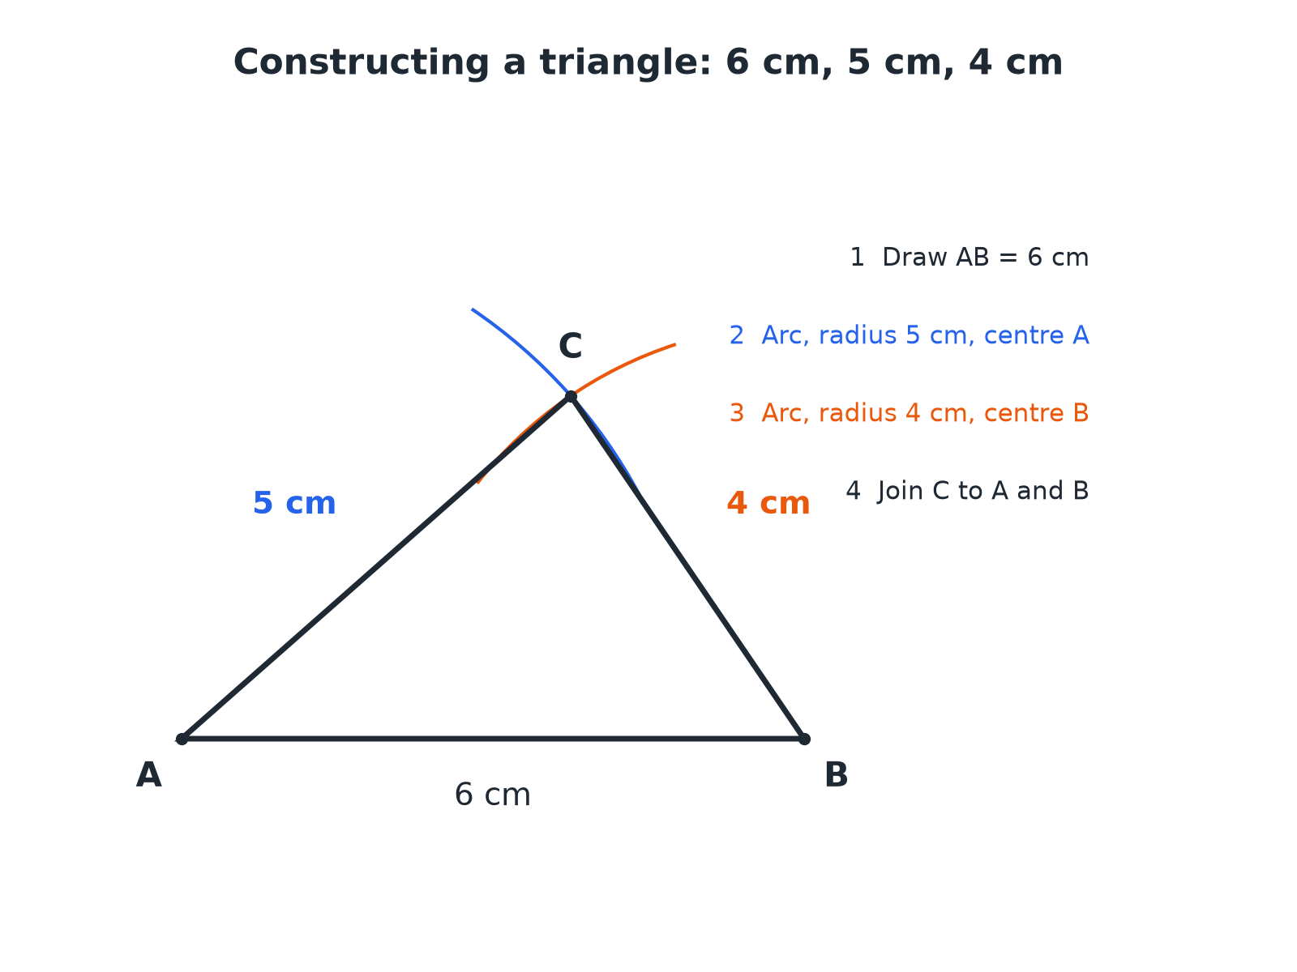

EDEXCEL GCSE MATHS · FOUNDATION & HIGHER
Constructing a Triangle from Three Sides
The point where the two arcs cross is the third vertex.
Transformations and constructions
openrevise.com
Lesson 6 of 8

Slide 7

EDEXCEL GCSE MATHS · FOUNDATION & HIGHER
Constructing an SSS Triangle
For a triangle with sides 6 cm, 5 cm and 4 cm.
1
2
3
4
5
Draw the longest side
Measure 6 cm with a ruler and label the ends A and B.
Set the compasses to 5 cm
Put the point at A and draw an arc above the line.
Set the compasses to 4 cm
Put the point at B and draw a second arc crossing the first.
Mark C where the arcs cross
Join C to A and C to B with a ruler.
Label and check
Measure to check each side and keep the arcs.
Transformations and constructions
openrevise.com
Lesson 6 of 8

Slide 8

EDEXCEL GCSE MATHS · FOUNDATION & HIGHER
Can the Triangle Be Made?
Can a triangle be constructed with sides 3 cm, 4 cm and 8 cm?
The two shorter sides must add up to more than the longest
3 + 4 = 7
1
Compare with the longest side
7 < 8
2
The arcs would not meet
The two short sides cannot reach each other
3
ANSWER
No: 3 + 4 < 8, so the arcs do not cross and no triangle exists.
Transformations and constructions
openrevise.com
Lesson 6 of 8

Slide 9
EDEXCEL GCSE MATHS · FOUNDATION & HIGHER
An SAS Triangle
Construct a triangle with sides of 5 cm and 7 cm and an angle of 40° between them.
Draw the 7 cm side
Label the ends A and B
1
Measure 40° at A
Use a protractor and mark the angle
2
Draw a line from A through the mark
Measure 5 cm along it and label C
3
Join B to C
The triangle ABC is complete
4
ANSWER
Triangle ABC with AB = 7 cm, AC = 5 cm and angle A = 40°.
Transformations and constructions
openrevise.com
Lesson 6 of 8

Slide 10
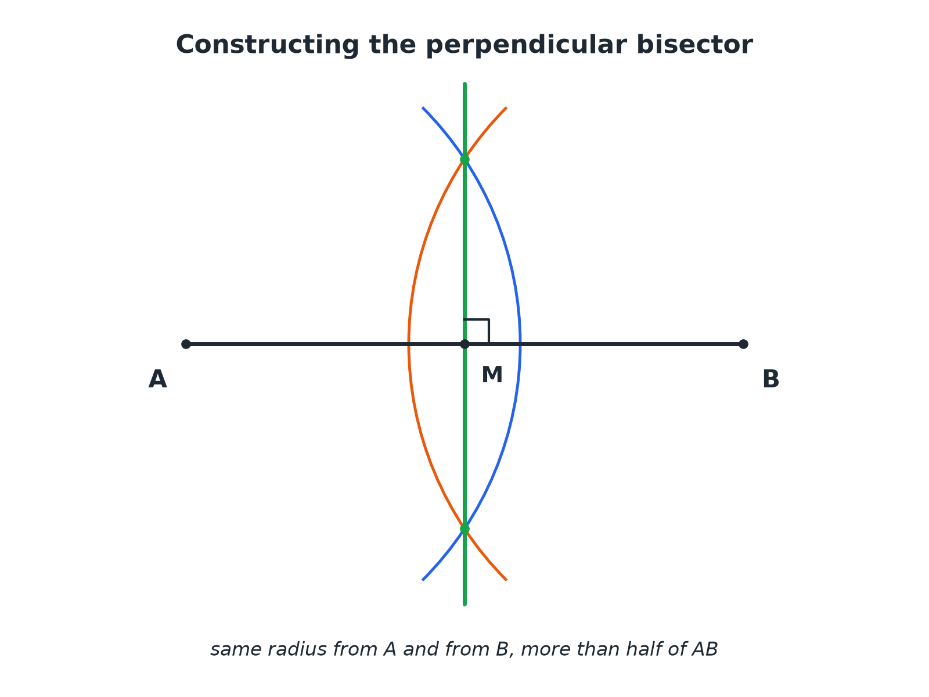
EDEXCEL GCSE MATHS · FOUNDATION & HIGHER
The Perpendicular Bisector
Every point on the perpendicular bisector is the same distance from A and B.
Transformations and constructions
openrevise.com
Lesson 6 of 8

Slide 11
EDEXCEL GCSE MATHS · FOUNDATION & HIGHER
Constructing the Perpendicular Bisector
The same radius from both ends.
1
2
3
4
5
Open the compasses more than half of AB
Any radius bigger than half will do
Draw arcs from A above and below the line
Keep the same radius
Draw arcs from B, crossing the first arcs
Do not change the radius
Mark the two crossing points
One above and one below AB
Join the crossing points with a ruler
This line bisects AB at 90°
Transformations and constructions
openrevise.com
Lesson 6 of 8

Slide 12

EDEXCEL GCSE MATHS · FOUNDATION & HIGHER
Which Construction?
SSS TRIANGLE
SAS TRIANGLE
• You know all three sides.
• Use two arcs to find the third vertex.
• Always check the two shorter sides add to more than the longest.
• You know two sides and the angle between them.
• Use a protractor for the angle.
• The third side is found by joining the ends.
Transformations and constructions
openrevise.com
Lesson 6 of 8

Slide 13

EDEXCEL GCSE MATHS · FOUNDATION & HIGHER
Key Terms
Construct
Draw accurately using only a ruler and compasses (a protractor when an angle is given).
Compasses
An instrument for drawing arcs and circles.
Arc
Part of the circumference of a circle.
Bisect
To cut exactly in half.
Perpendicular bisector
A line at 90° through the midpoint of a segment.
Vertex
A corner of a shape.
Transformations and constructions
openrevise.com
Lesson 6 of 8

Slide 14

EDEXCEL GCSE MATHS · FOUNDATION & HIGHER
YOUR TASK
15 minutes
Construct and Measure
Construct a triangle with sides 7 cm, 6 cm and 5 cm. Measure the three angles with a protractor and add them up. Then construct the perpendicular bisector of the 7 cm side and check it passes through the opposite vertex or not.
1
Construct with compasses.
2
Measure the angles.
3
Check the sum.
WHAT A GOOD ANSWER SHOWS
The angles are about 78°, 57° and 44° (sum 180°). The perpendicular bisector of the 7 cm side does not pass through the opposite vertex because the triangle is scalene; it would only do that for an isosceles triangle with equal sides on either side.
Transformations and constructions
openrevise.com
Lesson 6 of 8
Notes:
Ask what would be special if the bisector did pass through the vertex.

Slide 15

EDEXCEL GCSE MATHS · FOUNDATION & HIGHER
Can I...?
Draw a line of exact length.
Construct a perpendicular bisector.
Construct an SSS triangle.
Keep construction arcs.
Construct an SAS triangle.
Test whether three lengths make a triangle.
Use a protractor accurately.
Explain each step of a construction.
Transformations and constructions
openrevise.com
Lesson 6 of 8

Slide 16
EDEXCEL GCSE MATHS · FOUNDATION & HIGHER
Summary & Exam Focus
SSS: draw the longest side, then two arcs.
SAS: draw one side, measure the angle, then measure the second side.
The perpendicular bisector cuts a segment in half at 90°.
Always leave your construction lines.
EXAM FOCUS
Using ruler and compasses only, construct the perpendicular bisector of the line AB. You must show all your construction lines. (2 marks)
Use the same compass setting from both ends, more than half of AB. Do not rub out the arcs.
openrevise.com

Slide 17
EDEXCEL GCSE MATHS · FOUNDATION & HIGHER
Exam Practice: Constructions 1
Answer all questions. Use a sharp pencil, a ruler, compasses and a protractor. Show all construction lines. · 30 minutes
Question 1 · 3 marks · Construct
Using ruler and compasses only, construct a triangle with sides of length 6 cm, 5 cm and 4 cm. Show all your construction lines.
Question 2 · 2 marks · Construct
The line AB is 6 cm long. Using ruler and compasses only, construct the perpendicular bisector of the line AB. Show all your construction…
Question 3 · 2 marks · Explain
Explain why it is not possible to construct a triangle with sides of length 3 cm, 4 cm and 8 cm.
Transformations and constructions
openrevise.com
Lesson 6 of 8

Slide 18
EDEXCEL GCSE MATHS · FOUNDATION & HIGHER
Exam Practice: Constructions 1 (cont.)
Question 4 · 3 marks · Construct
Construct a triangle ABC with AB = 7 cm, AC = 5 cm and angle BAC = 40°.
Question 5 · 2 marks · Measure
In the triangle with sides 6 cm, 5 cm and 4 cm, measure the size of the largest angle.
Question 6 · 2 marks · Decide
For each set of lengths, state whether a triangle can be constructed. (a) 5 cm, 6 cm, 7 cm (b) 2 cm, 3 cm, 6 cm
Transformations and constructions
openrevise.com
Lesson 6 of 8

Slide 19
EDEXCEL GCSE MATHS · FOUNDATION & HIGHER
Question 1 · 3 marks · Construct
“
Using ruler and compasses only, construct a triangle with sides of length 6 cm, 5 cm and 4 cm. Show all your construction lines.
HOW TO ANSWER IT
Command word: Construct. Worth 3 marks, so plan before writing.
Transformations and constructions
openrevise.com
Lesson 6 of 8

Slide 20
EDEXCEL GCSE MATHS · FOUNDATION & HIGHER
Question 1 · mark scheme
3 marks available. Award a mark for each point made.
A 6 cm line drawn accurately
B1
Both arcs drawn correctly
M1
Triangle completed and arcs shown
A1
Transformations and constructions
openrevise.com
Lesson 6 of 8

Slide 21
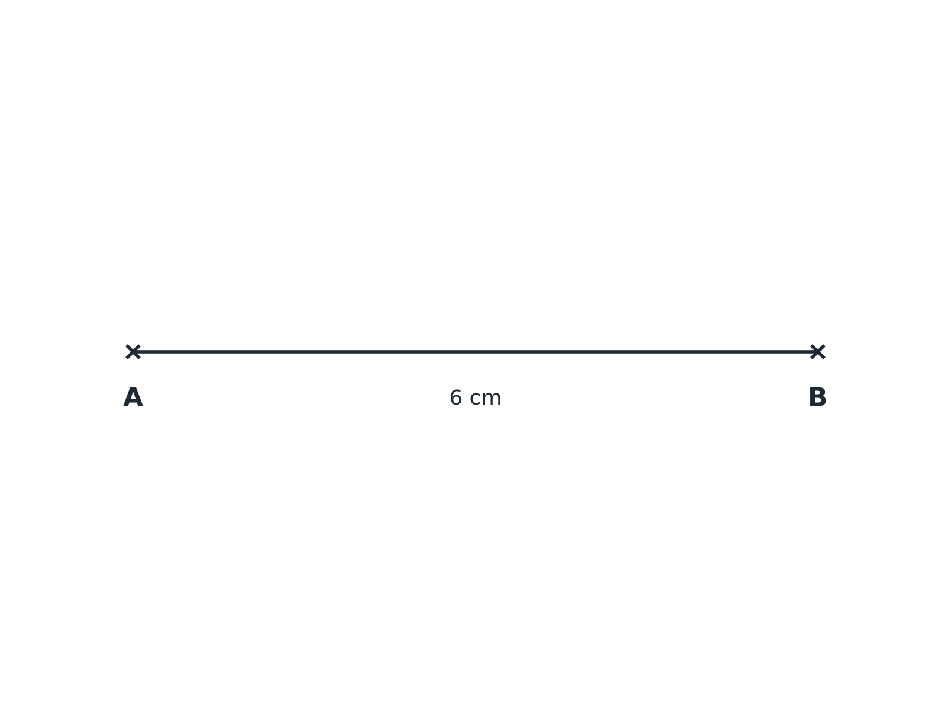
EDEXCEL GCSE MATHS · FOUNDATION & HIGHER
Question 2 · 2 marks · Construct
The line AB is 6 cm long. Using ruler and compasses only, construct the perpendicular bisector of the line AB. Show all your construction lines. (2 marks)
Transformations and constructions
openrevise.com
Lesson 6 of 8

Slide 22
EDEXCEL GCSE MATHS · FOUNDATION & HIGHER
Question 2 · mark scheme
2 marks available. Award a mark for each point made.
Arcs of equal radius from A and B
M1
Correct crossings, both sides
A1
Transformations and constructions
openrevise.com
Lesson 6 of 8

Slide 23
EDEXCEL GCSE MATHS · FOUNDATION & HIGHER
Question 3 · 2 marks · Explain
“
Explain why it is not possible to construct a triangle with sides of length 3 cm, 4 cm and 8 cm.
HOW TO ANSWER IT
Command word: Explain. Worth 2 marks, so plan before writing.
Transformations and constructions
openrevise.com
Lesson 6 of 8

Slide 24
EDEXCEL GCSE MATHS · FOUNDATION & HIGHER
Question 3 · mark scheme
2 marks available. Award a mark for each point made.
3 + 4 = 7
M1
7 < 8, so the arcs do not meet
C1
Transformations and constructions
openrevise.com
Lesson 6 of 8

Slide 25
EDEXCEL GCSE MATHS · FOUNDATION & HIGHER
Question 4 · 3 marks · Construct
“
Construct a triangle ABC with AB = 7 cm, AC = 5 cm and angle BAC = 40°.
HOW TO ANSWER IT
Command word: Construct. Worth 3 marks, so plan before writing.
Transformations and constructions
openrevise.com
Lesson 6 of 8

Slide 26
EDEXCEL GCSE MATHS · FOUNDATION & HIGHER
Question 4 · mark scheme
3 marks available. Award a mark for each point made.
AB drawn accurately
B1
Angle of 40° at A
M1
AC = 5 cm and triangle completed
A1
Transformations and constructions
openrevise.com
Lesson 6 of 8

Slide 27
EDEXCEL GCSE MATHS · FOUNDATION & HIGHER
Question 5 · 2 marks · Measure
“
In the triangle with sides 6 cm, 5 cm and 4 cm, measure the size of the largest angle.
HOW TO ANSWER IT
Command word: Measure. Worth 2 marks, so plan before writing.
Transformations and constructions
openrevise.com
Lesson 6 of 8

Slide 28
EDEXCEL GCSE MATHS · FOUNDATION & HIGHER
Question 5 · mark scheme
2 marks available. Award a mark for each point made.
Identifying the angle opposite the 6 cm side
M1
83 (within the range)
A1
Transformations and constructions
openrevise.com
Lesson 6 of 8

Slide 29
EDEXCEL GCSE MATHS · FOUNDATION & HIGHER
Question 6 · 2 marks · Decide
“
For each set of lengths, state whether a triangle can be constructed. (a) 5 cm, 6 cm, 7 cm (b) 2 cm, 3 cm, 6 cm
HOW TO ANSWER IT
Command word: Decide. Worth 2 marks, so plan before writing.
Transformations and constructions
openrevise.com
Lesson 6 of 8

Slide 30
EDEXCEL GCSE MATHS · FOUNDATION & HIGHER
Question 6 · mark scheme
2 marks available. Award a mark for each point made.
(a) Yes
B1
(b) No
B1
Transformations and constructions
openrevise.com
Lesson 6 of 8

