Slide 1

EDEXCEL GCSE MATHS · FOUNDATION & HIGHER
Constructions 2
Transformations and constructions
Lesson 7 of 8
openrevise.com

Slide 2

EDEXCEL GCSE MATHS · FOUNDATION & HIGHER
Warm-up
Answer each one, then check.
1
What does perpendicular mean?
2
What is half of 60°?
3
How many degrees in each angle of an equilateral triangle?
4
What is an angle bisector?
5
What are the tools for a construction?
Transformations and constructions
openrevise.com
Lesson 7 of 8

Slide 3
EDEXCEL GCSE MATHS · FOUNDATION & HIGHER
Warm-up - Answers
What does perpendicular mean?
At 90°
1
What is half of 60°?
30°
2
How many degrees in each angle of an equilateral triangle?
60°
3
What is an angle bisector?
A line that cuts an angle in half
4
What are the tools for a construction?
Ruler, compasses (and a sharp pencil)
5
Transformations and constructions
openrevise.com
Lesson 7 of 8

Slide 4

EDEXCEL GCSE MATHS · FOUNDATION & HIGHER
Learning Objectives
Construct the bisector of an angle.
1
Construct a perpendicular from a point to a line.
2
Construct a perpendicular at a point on a line.
3
Construct angles of 60°, 30° and 90°.
4
Transformations and constructions
openrevise.com
Lesson 7 of 8

Slide 5
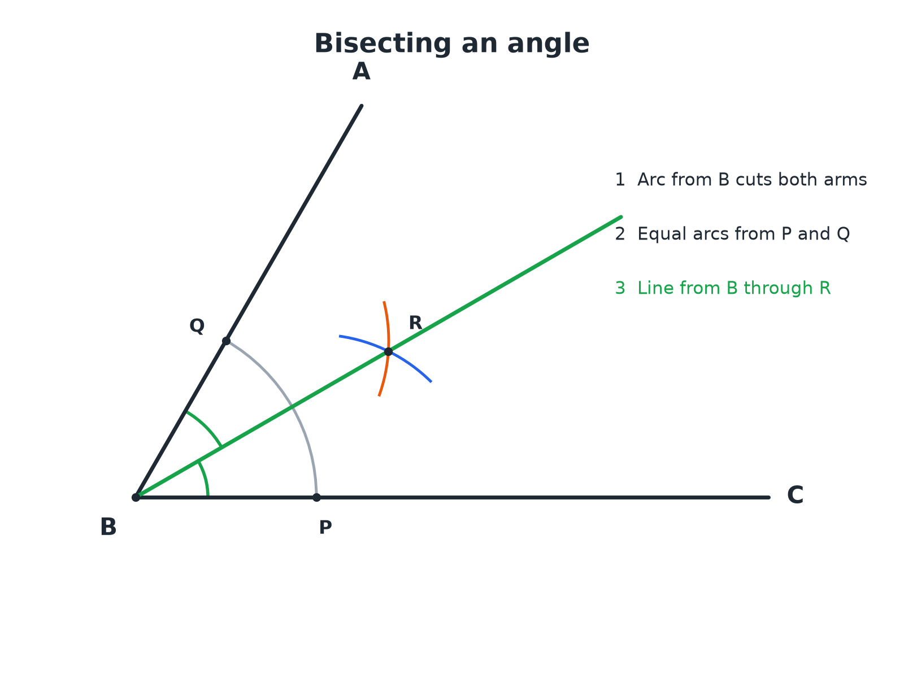

EDEXCEL GCSE MATHS · FOUNDATION & HIGHER
Bisecting an Angle
The bisector splits the angle into two equal halves.
Transformations and constructions
openrevise.com
Lesson 7 of 8

Slide 6

EDEXCEL GCSE MATHS · FOUNDATION & HIGHER
Bisecting an Angle
Three arcs and one line.
1
2
3
4
Arc from the vertex
Centre B, cutting both arms at P and Q
Arcs from P and Q
Same radius from each; they cross at R
Draw the line BR
This is the angle bisector
Check
Measure the two halves; they should be equal
Transformations and constructions
openrevise.com
Lesson 7 of 8

Slide 7

EDEXCEL GCSE MATHS · FOUNDATION & HIGHER
Angle Bisector Check
Angle ABC is 70°. After bisecting it, what is the size of each half?
The bisector cuts the angle in half
70 ÷ 2
1
Work out
35
2
ANSWER
Each half is 35°.
Transformations and constructions
openrevise.com
Lesson 7 of 8

Slide 8
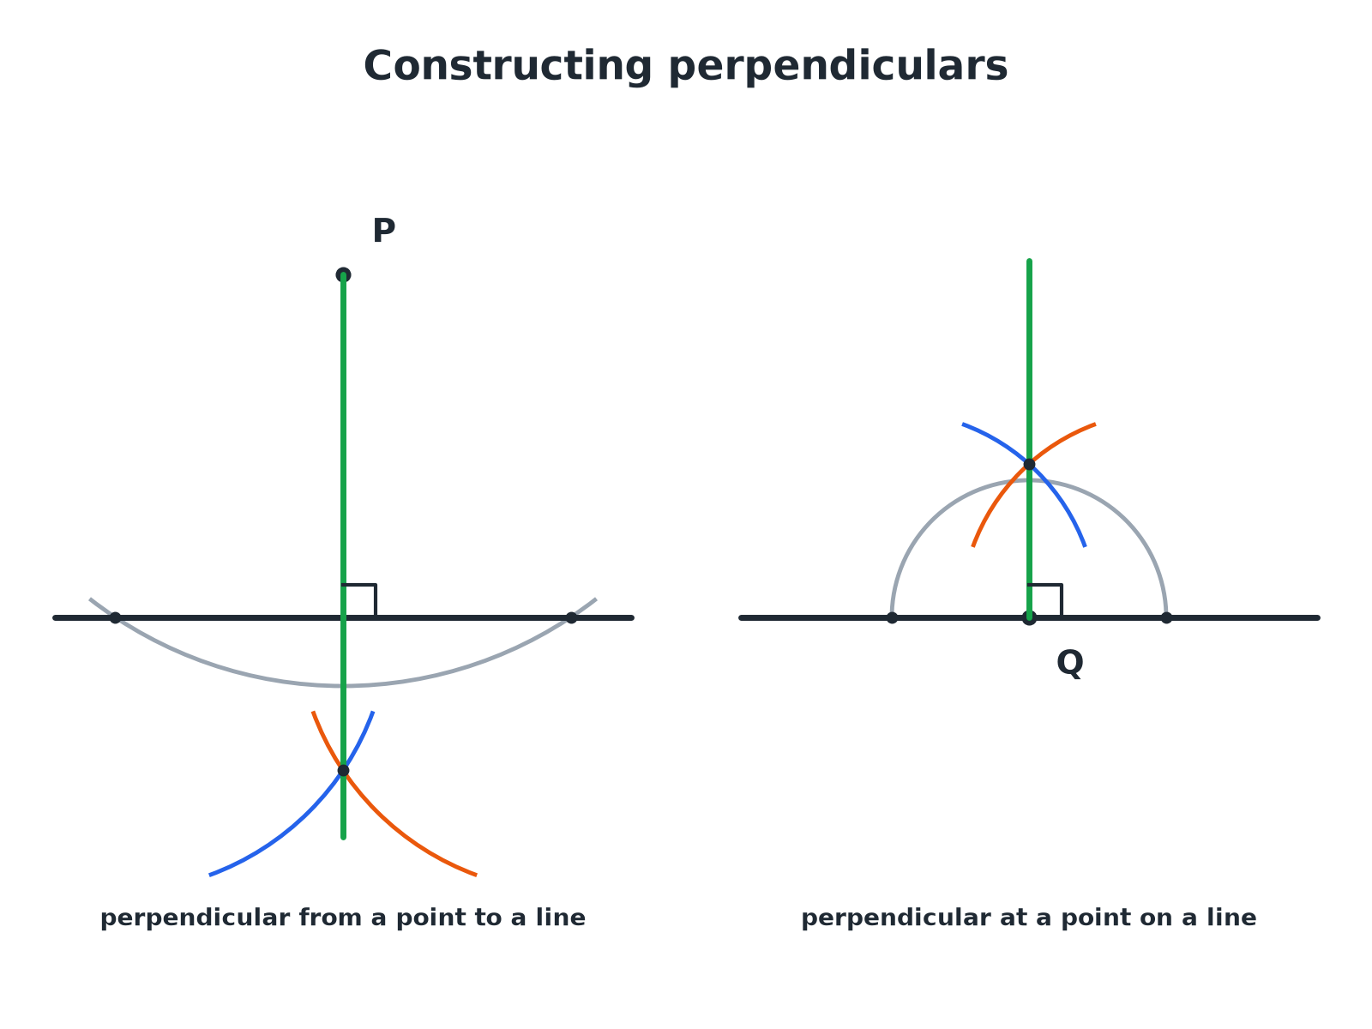
EDEXCEL GCSE MATHS · FOUNDATION & HIGHER
Perpendiculars
Both use the perpendicular bisector method on a pair of points.
Transformations and constructions
openrevise.com
Lesson 7 of 8

Slide 9
EDEXCEL GCSE MATHS · FOUNDATION & HIGHER
Perpendicular from a Point to a Line
Point P is above the line.
1
2
3
4
Arc centred on P
It crosses the line at two points, X and Y
Arcs from X and Y
Same radius, crossing on the other side of the line at Z
Join P to Z
This line is perpendicular to the line
Label the right angle
Mark it with a small square
Transformations and constructions
openrevise.com
Lesson 7 of 8

Slide 10
EDEXCEL GCSE MATHS · FOUNDATION & HIGHER
Perpendicular at a Point on a Line
Point Q is on the line.
1
2
3
4
Arc centred on Q
It crosses the line either side at U and V
Larger arcs from U and V
Same radius, crossing above the line at W
Join Q to W
This line is perpendicular to the line at Q
Check
The angle is 90°
Transformations and constructions
openrevise.com
Lesson 7 of 8

Slide 11

EDEXCEL GCSE MATHS · FOUNDATION & HIGHER
Constructing 60° and 30°
Compasses can make an equilateral triangle, which gives 60°.
60°
Draw an arc from A across the line at B, then an arc of the same radius from B; join A to where they cross.
30°
Bisect the 60° angle.
90°
Use the perpendicular construction.
45°
Bisect a 90° angle.
Transformations and constructions
openrevise.com
Lesson 7 of 8

Slide 12

EDEXCEL GCSE MATHS · FOUNDATION & HIGHER
Key Terms
Angle bisector
A line that cuts an angle exactly in half.
Perpendicular
At 90° to a line.
Arc
Part of a circle's circumference.
Equidistant
The same distance from two things.
Construction lines
The arcs and lines you leave to show your method.
Vertex
The point where the arms of an angle meet.
Transformations and constructions
openrevise.com
Lesson 7 of 8

Slide 13

EDEXCEL GCSE MATHS · FOUNDATION & HIGHER
YOUR TASK
12 minutes
Build a Kite
Construct an angle of 60° at A. Bisect it to make 30°. Then use the perpendicular construction to make a right angle at a point on one arm. Sketch a kite using your construction lines.
1
Make 60° with compasses.
2
Bisect it.
3
Add a 90° angle.
WHAT A GOOD ANSWER SHOWS
A 60° angle from an equilateral construction, 30° from the bisector, and a 90° angle by the perpendicular at a point. A kite can be made from two triangles sharing the bisector.
Transformations and constructions
openrevise.com
Lesson 7 of 8
Notes:
Discuss how the bisector gives the kite its line of symmetry.

Slide 14

EDEXCEL GCSE MATHS · FOUNDATION & HIGHER
Can I...?
Bisect an angle.
Construct 30°.
Drop a perpendicular from a point.
Construct 90°.
Draw a perpendicular at a point on a line.
Explain why the constructions work.
Construct 60°.
Show all construction lines.
Transformations and constructions
openrevise.com
Lesson 7 of 8

Slide 15
EDEXCEL GCSE MATHS · FOUNDATION & HIGHER
Summary & Exam Focus
Angle bisector: arc, two equal arcs, join to the vertex.
Perpendicular from a point: arc, two equal arcs, join.
60° from an equilateral triangle; halve it for 30°.
Keep all construction arcs.
EXAM FOCUS
Using ruler and compasses only, construct the bisector of angle ABC. You must show all your construction lines. (2 marks)
Start with an arc centred on the vertex, then use equal arcs from the two points where it crosses the arms.
openrevise.com

Slide 16
EDEXCEL GCSE MATHS · FOUNDATION & HIGHER
Exam Practice: Constructions 2
Answer all questions. Use a sharp pencil, a ruler and compasses. Show all construction lines. · 30 minutes
Question 1 · 2 marks · Construct
The diagram shows an angle ABC. Using ruler and compasses only, construct the bisector of angle ABC. Show all your construction lines.
Question 2 · 3 marks · Construct
Point P is 4 cm above a horizontal line. Using ruler and compasses only, construct the perpendicular from P to the line. Show all your…
Question 3 · 3 marks · Construct
Using ruler and compasses only, construct an angle of 60° at the end A of a line AB.
Transformations and constructions
openrevise.com
Lesson 7 of 8

Slide 17
EDEXCEL GCSE MATHS · FOUNDATION & HIGHER
Exam Practice: Constructions 2 (cont.)
Question 4 · 3 marks · Construct
Using ruler and compasses only, construct an angle of 30° at the end A of a line AB.
Question 5 · 3 marks · Construct
Q is a point on a straight line. Using ruler and compasses only, construct the perpendicular to the line at Q.
Question 6 · 2 marks · Explain
Explain why the line through the crossing arcs is the bisector of the angle in the angle bisector construction.
Transformations and constructions
openrevise.com
Lesson 7 of 8

Slide 18
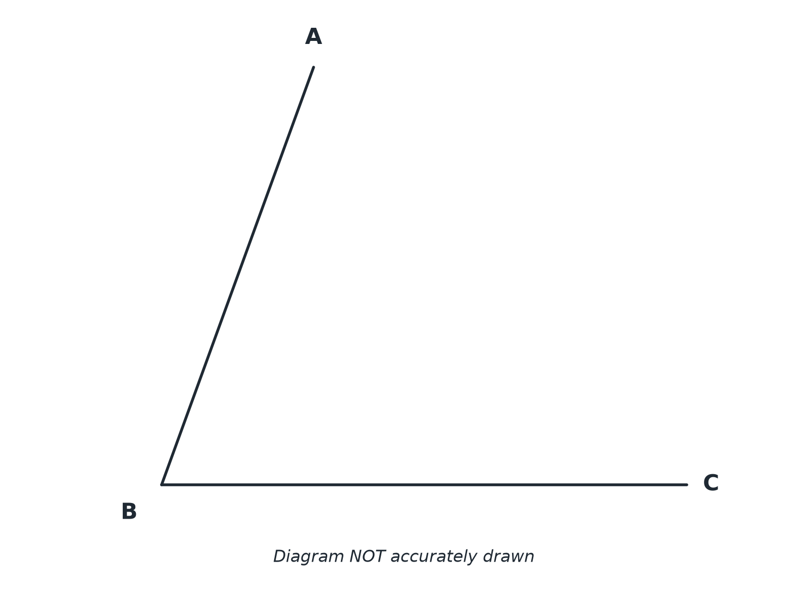
EDEXCEL GCSE MATHS · FOUNDATION & HIGHER
Question 1 · 2 marks · Construct
The diagram shows an angle ABC. Using ruler and compasses only, construct the bisector of angle ABC. Show all your construction lines. (2 marks)
Transformations and constructions
openrevise.com
Lesson 7 of 8

Slide 19
EDEXCEL GCSE MATHS · FOUNDATION & HIGHER
Question 1 · mark scheme
2 marks available. Award a mark for each point made.
Arcs from B and from the two crossing points
M1
A correct bisector with arcs shown
A1
Transformations and constructions
openrevise.com
Lesson 7 of 8

Slide 20
EDEXCEL GCSE MATHS · FOUNDATION & HIGHER
Question 2 · 3 marks · Construct
“
Point P is 4 cm above a horizontal line. Using ruler and compasses only, construct the perpendicular from P to the line. Show all your construction lines.
HOW TO ANSWER IT
Command word: Construct. Worth 3 marks, so plan before writing.
Transformations and constructions
openrevise.com
Lesson 7 of 8

Slide 21
EDEXCEL GCSE MATHS · FOUNDATION & HIGHER
Question 2 · mark scheme
3 marks available. Award a mark for each point made.
Arc from P crossing the line twice
M1
Equal arcs from the two points
M1
A correct perpendicular
A1
Transformations and constructions
openrevise.com
Lesson 7 of 8

Slide 22
EDEXCEL GCSE MATHS · FOUNDATION & HIGHER
Question 3 · 3 marks · Construct
“
Using ruler and compasses only, construct an angle of 60° at the end A of a line AB.
HOW TO ANSWER IT
Command word: Construct. Worth 3 marks, so plan before writing.
Transformations and constructions
openrevise.com
Lesson 7 of 8

Slide 23
EDEXCEL GCSE MATHS · FOUNDATION & HIGHER
Question 3 · mark scheme
3 marks available. Award a mark for each point made.
Arc centred on A
M1
Second arc with the same radius
M1
Line completed and angle correct
A1
Transformations and constructions
openrevise.com
Lesson 7 of 8

Slide 24
EDEXCEL GCSE MATHS · FOUNDATION & HIGHER
Question 4 · 3 marks · Construct
“
Using ruler and compasses only, construct an angle of 30° at the end A of a line AB.
HOW TO ANSWER IT
Command word: Construct. Worth 3 marks, so plan before writing.
Transformations and constructions
openrevise.com
Lesson 7 of 8

Slide 25
EDEXCEL GCSE MATHS · FOUNDATION & HIGHER
Question 4 · mark scheme
3 marks available. Award a mark for each point made.
60° constructed
M1
Bisector constructed
M1
Angle of 30°
A1
Transformations and constructions
openrevise.com
Lesson 7 of 8

Slide 26
EDEXCEL GCSE MATHS · FOUNDATION & HIGHER
Question 5 · 3 marks · Construct
“
Q is a point on a straight line. Using ruler and compasses only, construct the perpendicular to the line at Q.
HOW TO ANSWER IT
Command word: Construct. Worth 3 marks, so plan before writing.
Transformations and constructions
openrevise.com
Lesson 7 of 8

Slide 27
EDEXCEL GCSE MATHS · FOUNDATION & HIGHER
Question 5 · mark scheme
3 marks available. Award a mark for each point made.
Arc centred on Q
M1
Equal arcs from both points
M1
Correct perpendicular
A1
Transformations and constructions
openrevise.com
Lesson 7 of 8

Slide 28
EDEXCEL GCSE MATHS · FOUNDATION & HIGHER
Question 6 · 2 marks · Explain
“
Explain why the line through the crossing arcs is the bisector of the angle in the angle bisector construction.
HOW TO ANSWER IT
Command word: Explain. Worth 2 marks, so plan before writing.
Transformations and constructions
openrevise.com
Lesson 7 of 8

Slide 29
EDEXCEL GCSE MATHS · FOUNDATION & HIGHER
Question 6 · mark scheme
2 marks available. Award a mark for each point made.
Equal distances used
M1
Congruent triangles or kite symmetry
C1
Transformations and constructions
openrevise.com
Lesson 7 of 8

