Slide 1

EDEXCEL GCSE MATHS · FOUNDATION & HIGHER
Loci
Transformations and constructions
Lesson 8 of 8
openrevise.com

Slide 2

EDEXCEL GCSE MATHS · FOUNDATION & HIGHER
Warm-up
Answer each one, then check.
1
What is the distance round a circle called?
2
What is a perpendicular bisector?
3
What does an angle bisector do?
4
What is the radius of a circle with diameter 8 cm?
5
What does equidistant mean?
Transformations and constructions
openrevise.com
Lesson 8 of 8

Slide 3
EDEXCEL GCSE MATHS · FOUNDATION & HIGHER
Warm-up - Answers
What is the distance round a circle called?
The circumference
1
What is a perpendicular bisector?
A line at 90° through the midpoint of a segment
2
What does an angle bisector do?
Cuts an angle in half
3
What is the radius of a circle with diameter 8 cm?
4 cm
4
What does equidistant mean?
The same distance from
5
Transformations and constructions
openrevise.com
Lesson 8 of 8

Slide 4

EDEXCEL GCSE MATHS · FOUNDATION & HIGHER
Learning Objectives
Explain what a locus is.
1
Draw the four standard loci.
2
Combine loci to find a region.
3
Solve problems in context, using a scale.
4
Transformations and constructions
openrevise.com
Lesson 8 of 8

Slide 5

EDEXCEL GCSE MATHS · FOUNDATION & HIGHER
LOCUS
A locus is the set of all points that follow a rule.
The plural is loci.
Transformations and constructions
openrevise.com
Lesson 8 of 8

Slide 6
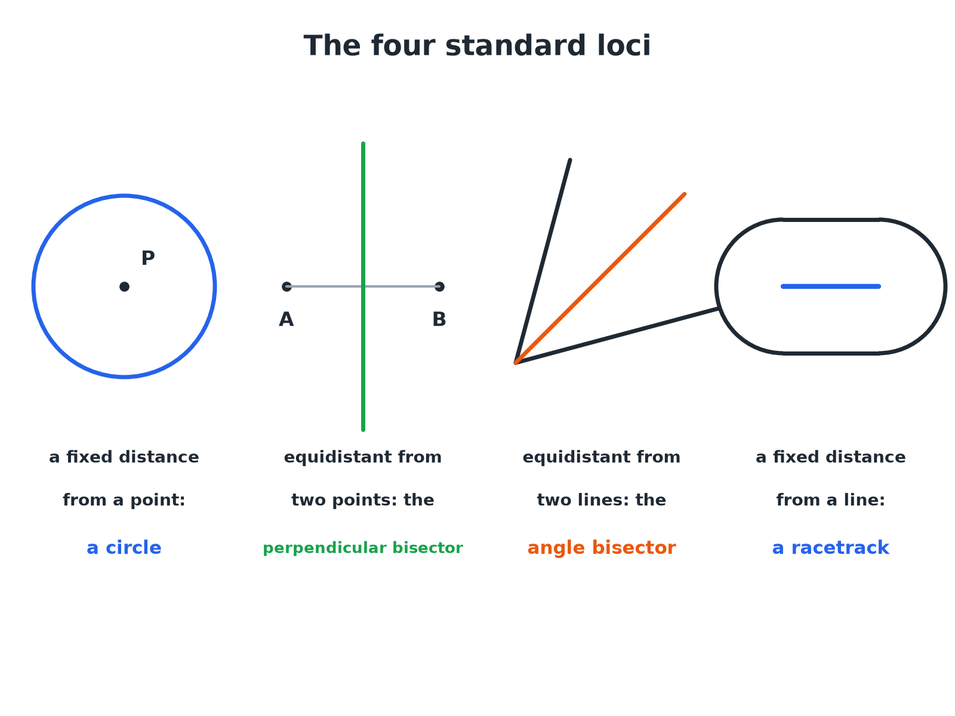

EDEXCEL GCSE MATHS · FOUNDATION & HIGHER
The Standard Loci
Learn these four and you can solve most locus questions.
Transformations and constructions
openrevise.com
Lesson 8 of 8

Slide 7

EDEXCEL GCSE MATHS · FOUNDATION & HIGHER
The Four Standard Loci
A fixed distance from a point
A circle, centred on the point.
Equidistant from two points
The perpendicular bisector of the line joining the points.
Equidistant from two lines
The angle bisector of the angle between them.
A fixed distance from a line
A racetrack: two parallel lines with semicircular ends.
Transformations and constructions
openrevise.com
Lesson 8 of 8

Slide 8

EDEXCEL GCSE MATHS · FOUNDATION & HIGHER
A Region Bounded by Two Loci
ABCD is a rectangle with A at (0, 0), B at (8, 0), C at (8, 5) and D at (0, 5), with 1 cm representing 1 m. A tree is nearer to AB than to AD and less than 4 m from C. Describe the region where the tree can be.
Equidistant from AB and AD
The bisector of angle DAB, the line from A at 45°
1
Nearer to AB than AD
The side of the bisector next to AB (below the line y = x)
2
Less than 4 m from C
Inside a circle of radius 4 cm centred on C
3
Combine
The part of the rectangle that is both below the bisector and inside the circle
4
ANSWER
The region inside the rectangle, below the bisector from A and inside the circle of radius 4 cm centred on C.
Transformations and constructions
openrevise.com
Lesson 8 of 8

Slide 9

EDEXCEL GCSE MATHS · FOUNDATION & HIGHER
Tackling a Locus Question
Split the rule into simple loci.
1
2
3
4
Read the rule
Underline each condition.
Draw the standard locus for each
Circle, bisector, perpendicular bisector, or parallel lines.
Decide which side
Use a test point.
Shade the region
Or mark the route required.
Transformations and constructions
openrevise.com
Lesson 8 of 8

Slide 10
EDEXCEL GCSE MATHS · FOUNDATION & HIGHER
Equidistant from Two Points
P and Q are 6 cm apart. Draw the locus of points equidistant from P and Q, and within 4 cm of P.
The locus of points equidistant from P and Q
The perpendicular bisector of PQ
1
Within 4 cm of P
Inside a circle of radius 4 cm centred on P
2
The part of the bisector inside the circle
A line segment where the bisector crosses the circle
3
ANSWER
The segment of the perpendicular bisector of PQ that lies inside the circle of radius 4 cm centred on P.
Transformations and constructions
openrevise.com
Lesson 8 of 8

Slide 11
EDEXCEL GCSE MATHS · FOUNDATION & HIGHER
A Fixed Distance from a Line
A path is 6 m long. A dog is allowed within 2 m of the path. Describe the boundary of the area.
The set of points 2 m from a line
Two parallel lines, 2 m either side
1
Ends of the path
Two semicircles of radius 2 m
2
Together
A racetrack shape around the path
3
ANSWER
A racetrack: two parallel lines 2 m either side of the path with a semicircle of radius 2 m at each end.
Transformations and constructions
openrevise.com
Lesson 8 of 8

Slide 12

EDEXCEL GCSE MATHS · FOUNDATION & HIGHER
Key Terms
Locus
A set of points that all obey a rule.
Loci
More than one locus.
Equidistant
The same distance from two points or lines.
Region
An area of the plane described by one or more rules.
Perpendicular bisector
The locus of points equidistant from two points.
Angle bisector
The locus of points equidistant from two lines.
Transformations and constructions
openrevise.com
Lesson 8 of 8

Slide 13

EDEXCEL GCSE MATHS · FOUNDATION & HIGHER
YOUR TASK
15 minutes
Where Should the Mast Go?
Three villages A, B and C form a triangle. A phone mast must be equidistant from A and B, and no more than 5 km from C. Draw the triangle (AB = 8 cm, AC = 6 cm, BC = 7 cm, where 1 cm = 1 km), construct the perpendicular bisector of AB, draw the circle of radius 5 cm about C, and shade the possible positions.
1
Construct the triangle.
2
Draw the two loci.
3
Identify the overlap.
WHAT A GOOD ANSWER SHOWS
The possible positions lie along the segment of the perpendicular bisector of AB that lies within the circle. Students should show construction arcs for the bisector and mark the two points where it meets the circle.
Transformations and constructions
openrevise.com
Lesson 8 of 8

Slide 14

EDEXCEL GCSE MATHS · FOUNDATION & HIGHER
Can I...?
Explain what a locus is.
Draw a racetrack locus.
Draw a circle locus.
Combine two loci.
Draw a perpendicular bisector locus.
Use a scale in a locus problem.
Draw an angle bisector locus.
Shade the correct region.
Transformations and constructions
openrevise.com
Lesson 8 of 8

Slide 15
EDEXCEL GCSE MATHS · FOUNDATION & HIGHER
Summary & Exam Focus
Circle: a fixed distance from a point.
Perpendicular bisector: equidistant from two points.
Angle bisector: equidistant from two lines.
Racetrack: a fixed distance from a line segment.
EXAM FOCUS
ABCD is a rectangle with AB = 8 cm and BC = 5 cm. A point is nearer to AB than to AD, and is less than 4 cm from C. Shade the region that contains all such points. (4 marks)
Draw each locus, then use one test point in the rectangle to decide which side of each locus to shade.
openrevise.com

