Slide 1

EDEXCEL GCSE MATHS · FOUNDATION & HIGHER
Solving quadratic equations 1
Equations and inequalities
Lesson 2 of 7
openrevise.com

Slide 2

EDEXCEL GCSE MATHS · FOUNDATION & HIGHER
Warm-up
Answer each one, then check.
1
Factorise x² + 5x + 6.
2
Factorise x² − 9.
3
Solve x − 4 = 0.
4
Expand (x + 2)(x + 3).
5
What is the product of 0 and any number?
Equations and inequalities
openrevise.com
Lesson 2 of 7

Slide 3
EDEXCEL GCSE MATHS · FOUNDATION & HIGHER
Warm-up - Answers
Factorise x² + 5x + 6.
(x + 2)(x + 3)
1
Factorise x² − 9.
(x − 3)(x + 3)
2
Solve x − 4 = 0.
x = 4
3
Expand (x + 2)(x + 3).
x² + 5x + 6
4
What is the product of 0 and any number?
0
5
Equations and inequalities
openrevise.com
Lesson 2 of 7

Slide 4

EDEXCEL GCSE MATHS · FOUNDATION & HIGHER
Learning Objectives
Solve x² + bx + c = 0 by factorising.
1
Solve equations of the form x² − a² = 0.
2
Rearrange to zero before factorising.
3
Solve problems that lead to quadratic equations.
4
Equations and inequalities
openrevise.com
Lesson 2 of 7

Slide 5

EDEXCEL GCSE MATHS · FOUNDATION & HIGHER
THE NULL FACTOR LAW
If two things multiply to give zero, at least one of them must be zero.
So (x − 2)(x − 3) = 0 means x = 2 or x = 3.
Equations and inequalities
openrevise.com
Lesson 2 of 7

Slide 6
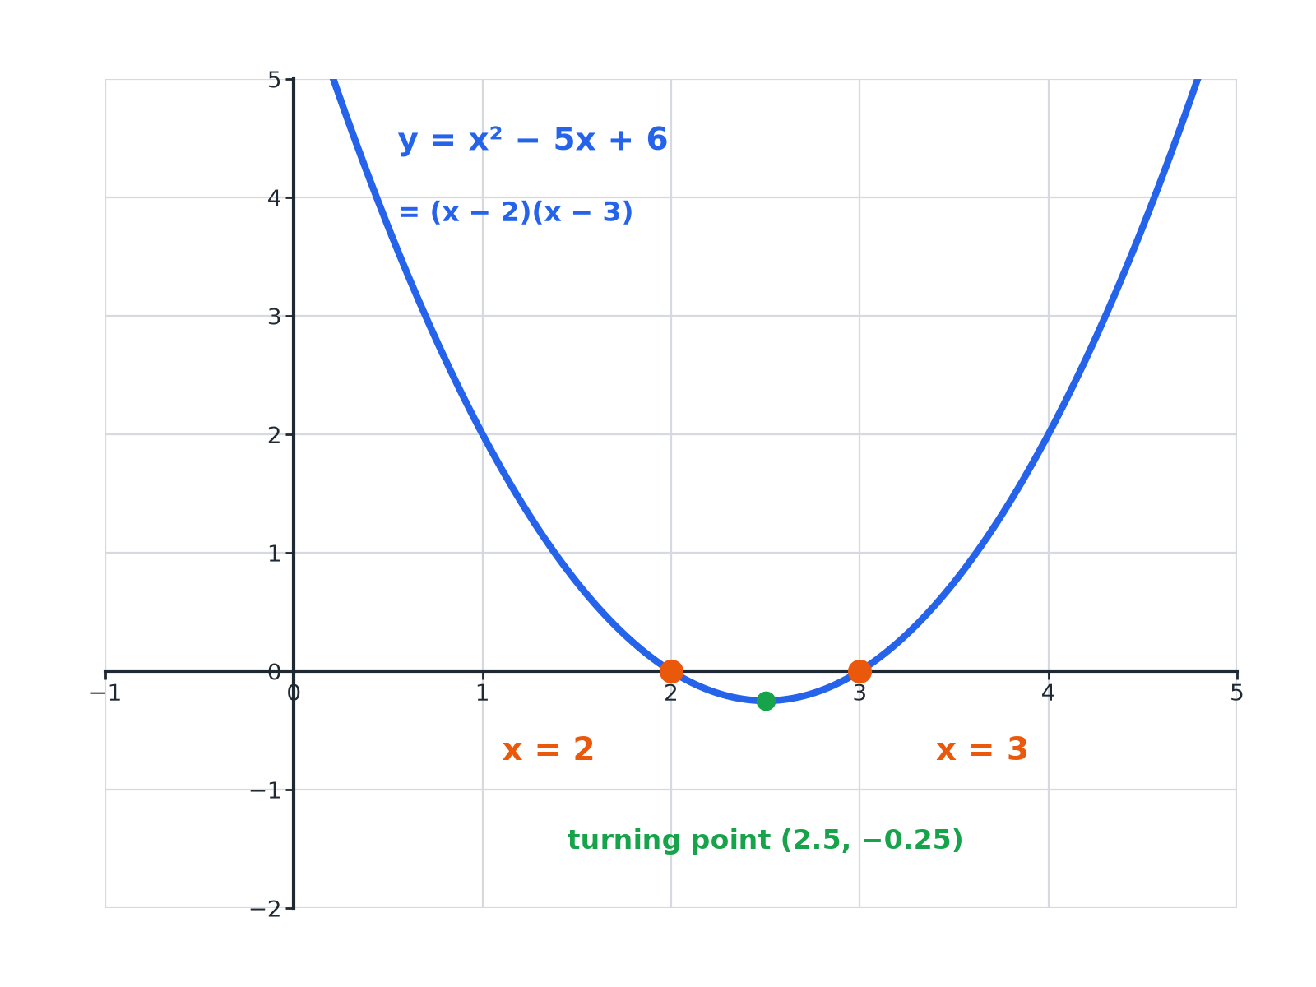

EDEXCEL GCSE MATHS · FOUNDATION & HIGHER
Roots on a Graph
The solutions of the equation are where the graph crosses the x-axis.
Equations and inequalities
openrevise.com
Lesson 2 of 7

Slide 7

EDEXCEL GCSE MATHS · FOUNDATION & HIGHER
Solving by Factorising
Always get zero on one side first.
1
2
3
4
Rearrange
Write the equation as ax² + bx + c = 0
Factorise
Find two numbers that multiply to c and add to b
Set each bracket to zero
Use the null factor law
Solve
Two solutions, or one repeated solution
Equations and inequalities
openrevise.com
Lesson 2 of 7

Slide 8

EDEXCEL GCSE MATHS · FOUNDATION & HIGHER
A Standard Quadratic
Solve x² + 5x + 6 = 0.
Two numbers with product 6 and sum 5
2 and 3
1
Factorise
(x + 2)(x + 3) = 0
2
Set each bracket to zero
x + 2 = 0 or x + 3 = 0
3
ANSWER
x = −2 or x = −3
Equations and inequalities
openrevise.com
Lesson 2 of 7

Slide 9
EDEXCEL GCSE MATHS · FOUNDATION & HIGHER
With Negative Numbers
Solve x² − 2x − 15 = 0.
Product −15, sum −2
−5 and 3
1
Factorise
(x − 5)(x + 3) = 0
2
Solve
x = 5 or x = −3
3
ANSWER
x = 5 or x = −3
Equations and inequalities
openrevise.com
Lesson 2 of 7

Slide 10

EDEXCEL GCSE MATHS · FOUNDATION & HIGHER
Special Cases
Difference of two squares
x² − 49 = 0 factorises as (x − 7)(x + 7), so x = 7 or x = −7.
No constant term
x² − 7x = 0 factorises as x(x − 7), so x = 0 or x = 7.
A perfect square
x² − 6x + 9 = 0 is (x − 3)², so there is one solution, x = 3.
Do not divide by x
Dividing x² = 7x by x loses the solution x = 0.
Equations and inequalities
openrevise.com
Lesson 2 of 7

Slide 11
EDEXCEL GCSE MATHS · FOUNDATION & HIGHER
Rearranging First
Solve x² = 3x + 10.
Move everything to one side
x² − 3x − 10 = 0
1
Factorise
(x − 5)(x + 2) = 0
2
Solve
x = 5 or x = −2
3
ANSWER
x = 5 or x = −2
Equations and inequalities
openrevise.com
Lesson 2 of 7

Slide 12
EDEXCEL GCSE MATHS · FOUNDATION & HIGHER
A Rectangle Problem
A rectangle has length (x + 3) cm and width x cm. Its area is 40 cm². Find x, and the dimensions.
Area equation
x(x + 3) = 40
1
Expand and rearrange
x² + 3x − 40 = 0
2
Factorise
(x + 8)(x − 5) = 0
3
A length cannot be negative
x = 5, and x = −8 is rejected
4
ANSWER
x = 5; the rectangle is 8 cm by 5 cm.
Equations and inequalities
openrevise.com
Lesson 2 of 7

Slide 13

EDEXCEL GCSE MATHS · FOUNDATION & HIGHER
Key Terms
Quadratic equation
An equation whose highest power is x².
Root
A solution of an equation; where a graph crosses the x-axis.
Factorise
Write as a product of brackets.
Null factor law
If ab = 0, then a = 0 or b = 0.
Difference of two squares
a² − b² = (a − b)(a + b).
Perfect square
A quadratic that is a bracket squared.
Equations and inequalities
openrevise.com
Lesson 2 of 7

Slide 14

EDEXCEL GCSE MATHS · FOUNDATION & HIGHER
YOUR TASK
12 minutes
Solve and Check
Solve each equation by factorising, then substitute your answers back to check. (a) x² − 8x + 15 = 0 (b) x² + 4x = 0 (c) x² − 25 = 0 (d) x² = 2x + 24.
1
Rearrange to zero.
2
Factorise.
3
Check by substituting.
WHAT A GOOD ANSWER SHOWS
(a) (x − 3)(x − 5) = 0: x = 3 or 5. (b) x(x + 4) = 0: x = 0 or −4. (c) (x − 5)(x + 5) = 0: x = ± 5. (d) x² − 2x − 24 = 0, (x − 6)(x + 4) = 0: x = 6 or −4.
Equations and inequalities
openrevise.com
Lesson 2 of 7
Notes:
Ask students to show the graph would cross the axis at those values.

Slide 15

EDEXCEL GCSE MATHS · FOUNDATION & HIGHER
Can I...?
Factorise x² + bx + c.
Rearrange to zero first.
Use the null factor law.
Reject impossible solutions.
Solve a difference of two squares.
Form a quadratic from a problem.
Solve an equation with no constant term.
Check by substituting.
Equations and inequalities
openrevise.com
Lesson 2 of 7

Slide 16
EDEXCEL GCSE MATHS · FOUNDATION & HIGHER
Summary & Exam Focus
Make the equation equal zero before factorising.
Set each bracket to zero.
Difference of two squares: x² − a² = (x − a)(x + a).
Check solutions make sense in context.
EXAM FOCUS
A rectangle has length (x + 3) cm and width x cm. The area of the rectangle is 40 cm². Work out the value of x. (4 marks)
Form the equation, rearrange to zero, factorise, and reject any negative length.
openrevise.com

Slide 17
EDEXCEL GCSE MATHS · FOUNDATION & HIGHER
Exam Practice: Solving Quadratic Equations 1
Answer all questions. Show your working. · 30 minutes
Question 1 · 3 marks · Non-calculator
Solve x² + 5x + 6 = 0.
Question 2 · 3 marks · Non-calculator
Solve x² − 2x − 15 = 0.
Question 3 · 2 marks · Non-calculator
Solve x² − 49 = 0.
Equations and inequalities
openrevise.com
Lesson 2 of 7

Slide 18
EDEXCEL GCSE MATHS · FOUNDATION & HIGHER
Exam Practice: Solving Quadratic Equations 1 (cont.)
Question 4 · 2 marks · Non-calculator
Solve x² − 7x = 0.
Question 5 · 3 marks · Non-calculator
Solve x² = 3x + 10.
Question 6 · 4 marks · Non-calculator
The diagram shows a rectangle. The length is (x + 3) cm and the width is x cm. The area of the rectangle is 40 cm². Work out the value of x.
Equations and inequalities
openrevise.com
Lesson 2 of 7

Slide 19
EDEXCEL GCSE MATHS · FOUNDATION & HIGHER
Question 1 · 3 marks · Non-calculator
“
Solve x² + 5x + 6 = 0.
HOW TO ANSWER IT
Command word: Non-calculator. Worth 3 marks, so plan before writing.
Equations and inequalities
openrevise.com
Lesson 2 of 7

Slide 20
EDEXCEL GCSE MATHS · FOUNDATION & HIGHER
Question 1 · mark scheme
3 marks available. Award a mark for each point made.
Correct factorisation
M1
One solution
A1
Both solutions
A1
Equations and inequalities
openrevise.com
Lesson 2 of 7

Slide 21
EDEXCEL GCSE MATHS · FOUNDATION & HIGHER
Question 2 · 3 marks · Non-calculator
“
Solve x² − 2x − 15 = 0.
HOW TO ANSWER IT
Command word: Non-calculator. Worth 3 marks, so plan before writing.
Equations and inequalities
openrevise.com
Lesson 2 of 7

Slide 22
EDEXCEL GCSE MATHS · FOUNDATION & HIGHER
Question 2 · mark scheme
3 marks available. Award a mark for each point made.
Correct factorisation
M1
One solution
A1
Both solutions
A1
Equations and inequalities
openrevise.com
Lesson 2 of 7

Slide 23
EDEXCEL GCSE MATHS · FOUNDATION & HIGHER
Question 3 · 2 marks · Non-calculator
“
Solve x² − 49 = 0.
HOW TO ANSWER IT
Command word: Non-calculator. Worth 2 marks, so plan before writing.
Equations and inequalities
openrevise.com
Lesson 2 of 7

Slide 24
EDEXCEL GCSE MATHS · FOUNDATION & HIGHER
Question 3 · mark scheme
2 marks available. Award a mark for each point made.
Factorising or x² = 49
M1
x = 7 and x = −7
A1
Equations and inequalities
openrevise.com
Lesson 2 of 7

Slide 25
EDEXCEL GCSE MATHS · FOUNDATION & HIGHER
Question 4 · 2 marks · Non-calculator
“
Solve x² − 7x = 0.
HOW TO ANSWER IT
Command word: Non-calculator. Worth 2 marks, so plan before writing.
Equations and inequalities
openrevise.com
Lesson 2 of 7

Slide 26
EDEXCEL GCSE MATHS · FOUNDATION & HIGHER
Question 4 · mark scheme
2 marks available. Award a mark for each point made.
x(x − 7)
M1
x = 0 and x = 7
A1
Equations and inequalities
openrevise.com
Lesson 2 of 7

Slide 27
EDEXCEL GCSE MATHS · FOUNDATION & HIGHER
Question 5 · 3 marks · Non-calculator
“
Solve x² = 3x + 10.
HOW TO ANSWER IT
Command word: Non-calculator. Worth 3 marks, so plan before writing.
Equations and inequalities
openrevise.com
Lesson 2 of 7

Slide 28
EDEXCEL GCSE MATHS · FOUNDATION & HIGHER
Question 5 · mark scheme
3 marks available. Award a mark for each point made.
Rearranging to zero
M1
Correct factorisation
M1
x = 5 and x = −2
A1
Equations and inequalities
openrevise.com
Lesson 2 of 7

Slide 29
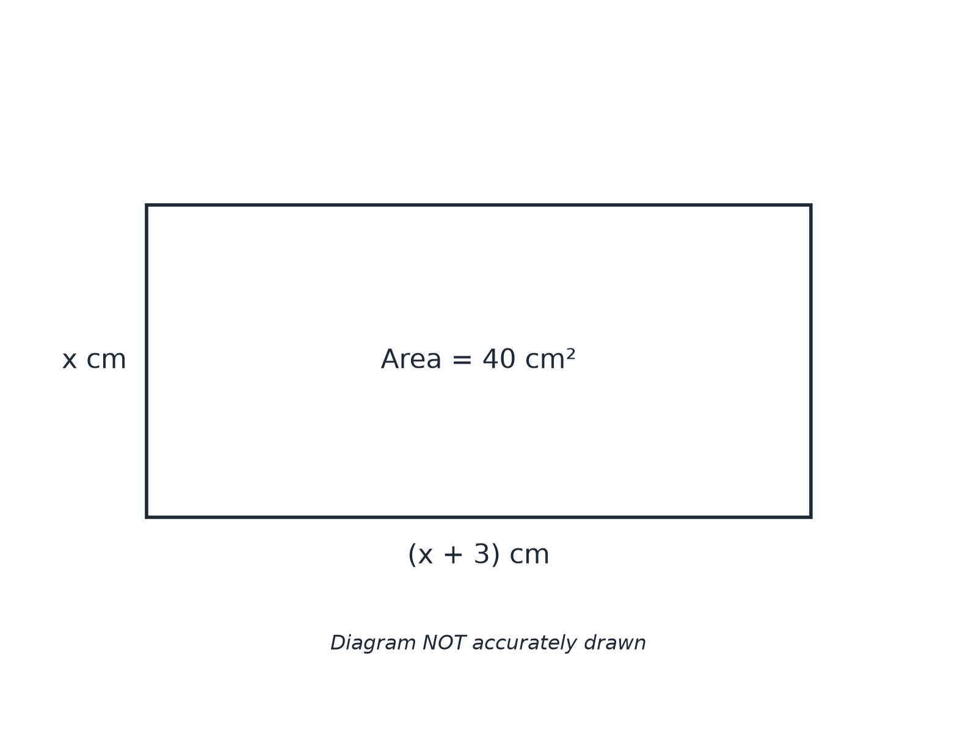
EDEXCEL GCSE MATHS · FOUNDATION & HIGHER
Question 6 · 4 marks · Non-calculator
The diagram shows a rectangle. The length is (x + 3) cm and the width is x cm. The area of the rectangle is 40 cm². Work out the value of x. (4 marks)
Equations and inequalities
openrevise.com
Lesson 2 of 7

Slide 30
EDEXCEL GCSE MATHS · FOUNDATION & HIGHER
Question 6 · mark scheme
4 marks available. Award a mark for each point made.
Forming the equation
M1
Rearranging to zero
M1
Factorising
M1
x = 5
A1
Equations and inequalities
openrevise.com
Lesson 2 of 7

