Slide 1

EDEXCEL GCSE MATHS · HIGHER
Solving quadratic equations 2
Equations and inequalities
Lesson 3 of 7
openrevise.com

Slide 2

EDEXCEL GCSE MATHS · HIGHER
Warm-up
Answer each one, then check.
1
Solve x² − 5x + 6 = 0.
2
Expand (2x + 1)(x + 3).
3
Work out √81.
4
Work out 5² − 4 × 1 × 6.
5
Round 5.385 to 2 decimal places.
Equations and inequalities
openrevise.com
Lesson 3 of 7

Slide 3
EDEXCEL GCSE MATHS · HIGHER
Warm-up - Answers
Solve x² − 5x + 6 = 0.
x = 2 or x = 3
1
Expand (2x + 1)(x + 3).
2x² + 7x + 3
2
Work out √81.
9
3
Work out 5² − 4 × 1 × 6.
1
4
Round 5.385 to 2 decimal places.
5.39
5
Equations and inequalities
openrevise.com
Lesson 3 of 7

Slide 4

EDEXCEL GCSE MATHS · HIGHER
Learning Objectives
Factorise and solve ax² + bx + c = 0.
1
Use the quadratic formula.
2
Give answers to a given accuracy or as surds.
3
Decide which method to use.
4
Equations and inequalities
openrevise.com
Lesson 3 of 7

Slide 5

EDEXCEL GCSE MATHS · HIGHER
Factorising ax² + bx + c
Use the product ac and the sum b.
1
2
3
4
5
Multiply a by c
For 2x² + 7x + 3: 2 × 3 = 6
Find two numbers with that product and sum b
1 and 6 (they add to 7)
Split the middle term
2x² + x + 6x + 3
Factorise in pairs
x(2x + 1) + 3(2x + 1)
Write as two brackets
(2x + 1)(x + 3)
Equations and inequalities
openrevise.com
Lesson 3 of 7

Slide 6

EDEXCEL GCSE MATHS · HIGHER
A Harder Factorisation
Solve 2x² + 7x + 3 = 0.
Factorise
(2x + 1)(x + 3) = 0
1
Set each bracket to zero
2x + 1 = 0 or x + 3 = 0
2
Solve
x = −½ or x = −3
3
ANSWER
x = −½ or x = −3
Equations and inequalities
openrevise.com
Lesson 3 of 7

Slide 7
EDEXCEL GCSE MATHS · HIGHER
Another Factorisation
Solve 3x² − 10x + 8 = 0.
ac = 24; two numbers with product 24 and sum −10
−4 and −6
1
Split and factorise
3x² − 4x − 6x + 8 = x(3x − 4) − 2(3x − 4)
2
Write as brackets
(3x − 4)(x − 2) = 0
3
Solve
x = 4/3 or x = 2
4
ANSWER
x = 4/3 or x = 2
Equations and inequalities
openrevise.com
Lesson 3 of 7

Slide 8

EDEXCEL GCSE MATHS · HIGHER
THE QUADRATIC FORMULA
For ax² + bx + c = 0, the solutions are x = (−b ± √(b² − 4ac))/2a.
Learn it: it is not on the formulae sheet.
Equations and inequalities
openrevise.com
Lesson 3 of 7

Slide 9
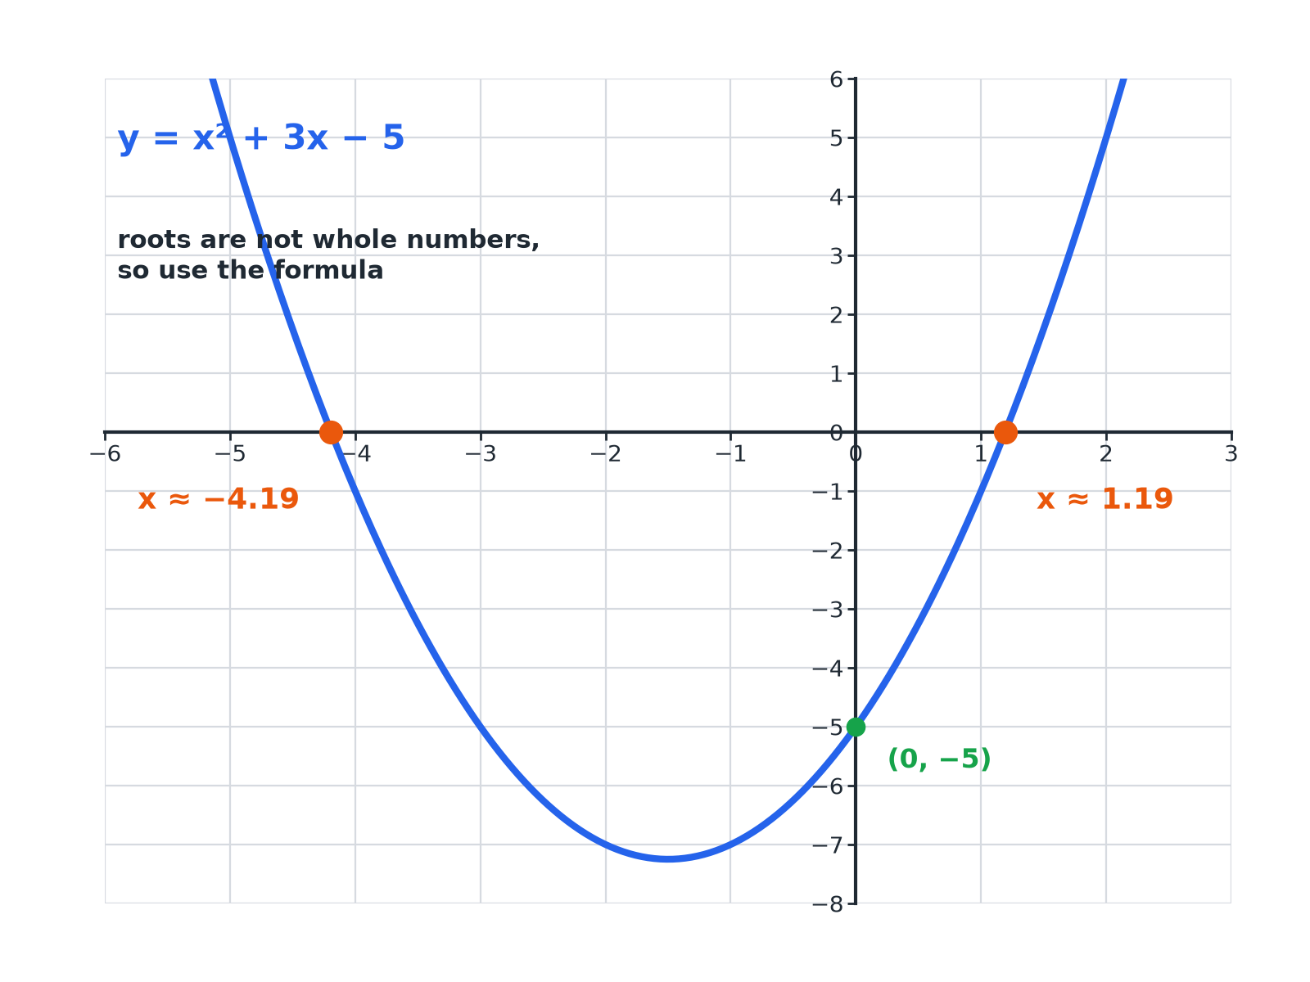

EDEXCEL GCSE MATHS · HIGHER
When It Will Not Factorise
The roots are not whole numbers, so factorising will not work.
Equations and inequalities
openrevise.com
Lesson 3 of 7

Slide 10
EDEXCEL GCSE MATHS · HIGHER
Using the Formula
Solve x² + 3x − 5 = 0, giving your answers to 2 decimal places.
1
Identify a = 1, b = 3, c = −5
Substitute into the formula
2
b² − 4ac
9 − 4(1)(−5) = 9 + 20 = 29
3
Write the formula
x = (−3 ± √29)/2
4
Calculate
√29 = 5.385...
5
The two solutions
x = 1.19 or x = −4.19
ANSWER
x = 1.19 or x = −4.19
Equations and inequalities
openrevise.com
Lesson 3 of 7

Slide 11
EDEXCEL GCSE MATHS · HIGHER
Leaving the Answer as a Surd
Solve x² − 6x + 2 = 0, giving your answers in the form p ± √q.
a = 1, b = −6, c = 2
b² − 4ac = 36 − 8 = 28
1
Formula
x = (6 ± √28)/2
2
Simplify √28 = 2√7
x = (6 ± 2√7)/2
3
Divide through by 2
x = 3 ± √7
4
ANSWER
x = 3 + √7 or x = 3 − √7
Equations and inequalities
openrevise.com
Lesson 3 of 7

Slide 12

EDEXCEL GCSE MATHS · HIGHER
Which Method?
FACTORISING
THE QUADRATIC FORMULA
• Quick when the numbers are simple.
• Works when the roots are rational.
• Gives exact answers.
• Always works.
• Needed for "give to 2 decimal places" or surds.
• Take care with the signs of b and c.
Equations and inequalities
openrevise.com
Lesson 3 of 7

Slide 13

EDEXCEL GCSE MATHS · HIGHER
Common Mistakes
The formula has plenty of places to slip.
Sign of b
The formula starts with −b; if b = −6, then −b = 6.
The bracket
b² must be squared before any minus: (−6)² = 36.
Dividing
Divide the WHOLE numerator by 2a, not just the surd.
Order of the calculation
Use brackets on the calculator for the top line.
Equations and inequalities
openrevise.com
Lesson 3 of 7

Slide 14

EDEXCEL GCSE MATHS · HIGHER
Key Terms
Coefficient
The number multiplying a variable, such as the 2 in 2x².
Quadratic formula
x = (−b ± √(b² − 4ac))/2a.
Discriminant
The expression b² − 4ac under the square root.
Surd
A root that cannot be simplified to a whole number, such as √7.
Root
A solution of an equation.
Substitute
Replace letters with numbers.
Equations and inequalities
openrevise.com
Lesson 3 of 7

Slide 15

EDEXCEL GCSE MATHS · HIGHER
YOUR TASK
12 minutes
Choose Your Method
For each equation, decide whether to factorise or use the formula, then solve it. (a) 2x² − 5x − 12 = 0 (b) x² + 4x − 3 = 0 (to 2 d.p.) (c) x² − 10x + 25 = 0.
Test for simple factors.
1
Otherwise use the formula.
2
WHAT A GOOD ANSWER SHOWS
(a) (2x + 3)(x − 4) = 0: x = −1.5 or 4. (b) Formula: (−4 ± √28)/2 = −2 ± √7: x = 0.65 or −4.65. (c) (x − 5)² = 0: x = 5 (one repeated solution).
Equations and inequalities
openrevise.com
Lesson 3 of 7

Slide 16

EDEXCEL GCSE MATHS · HIGHER
Can I...?
Factorise ax² + bx + c.
Substitute carefully with brackets.
Solve by factorising.
Give answers to 2 decimal places.
Write down the quadratic formula.
Give answers as surds.
Identify a, b and c correctly.
Choose between methods.
Equations and inequalities
openrevise.com
Lesson 3 of 7

Slide 17
EDEXCEL GCSE MATHS · HIGHER
Summary & Exam Focus
x = (−b ± √(b² − 4ac))/2a.
Factorise when the numbers are simple; otherwise use the formula.
Watch the signs and divide the whole numerator by 2a.
Check by substituting your answers into the original equation.
EXAM FOCUS
Solve x² + 3x − 5 = 0. Give your solutions correct to 2 decimal places. (3 marks)
Write a, b and c first, and put brackets round negative numbers when you substitute.
openrevise.com

