Slide 1

EDEXCEL GCSE MATHS · HIGHER
Completing the square
Equations and inequalities
Lesson 4 of 7
openrevise.com

Slide 2

EDEXCEL GCSE MATHS · HIGHER
Warm-up
Answer each one, then check.
1
Expand (x + 3)².
2
Expand (x − 4)².
3
Work out √11 to 2 decimal places.
4
Half of 6 is what?
5
What is the turning point of y = x²?
Equations and inequalities
openrevise.com
Lesson 4 of 7

Slide 3
EDEXCEL GCSE MATHS · HIGHER
Warm-up - Answers
Expand (x + 3)².
x² + 6x + 9
1
Expand (x − 4)².
x² − 8x + 16
2
Work out √11 to 2 decimal places.
3.32
3
Half of 6 is what?
3
4
What is the turning point of y = x²?
(0, 0)
5
Equations and inequalities
openrevise.com
Lesson 4 of 7

Slide 4

EDEXCEL GCSE MATHS · HIGHER
Learning Objectives
Write x² + bx + c in the form (x + p)² + q.
1
Complete the square when the coefficient of x² is not 1.
2
Solve quadratic equations by completing the square.
3
Find the turning point of a quadratic graph.
4
Equations and inequalities
openrevise.com
Lesson 4 of 7

Slide 5

EDEXCEL GCSE MATHS · HIGHER
THE METHOD
x² + bx + c = (x + b/2)² − (b/2)² + c
Halve the coefficient of x, square it, and subtract it.
Equations and inequalities
openrevise.com
Lesson 4 of 7

Slide 6

EDEXCEL GCSE MATHS · HIGHER
Completing the Square
Write x² + 6x + 5 in the form (x + p)² + q.
Halve the coefficient of x
6 ÷ 2 = 3, so (x + 3)²
1
(x + 3)² expands to
x² + 6x + 9
2
Adjust the constant: we need 5, not 9
5 − 9 = −4
3
Write the result
(x + 3)² − 4
4
ANSWER
(x + 3)² − 4
Equations and inequalities
openrevise.com
Lesson 4 of 7

Slide 7
EDEXCEL GCSE MATHS · HIGHER
A Negative Coefficient
Write x² − 8x + 3 in the form (x + p)² + q.
Halve −8
−4, so (x − 4)²
1
(x − 4)² expands to
x² − 8x + 16
2
Adjust the constant
3 − 16 = −13
3
ANSWER
(x − 4)² − 13
Equations and inequalities
openrevise.com
Lesson 4 of 7

Slide 8
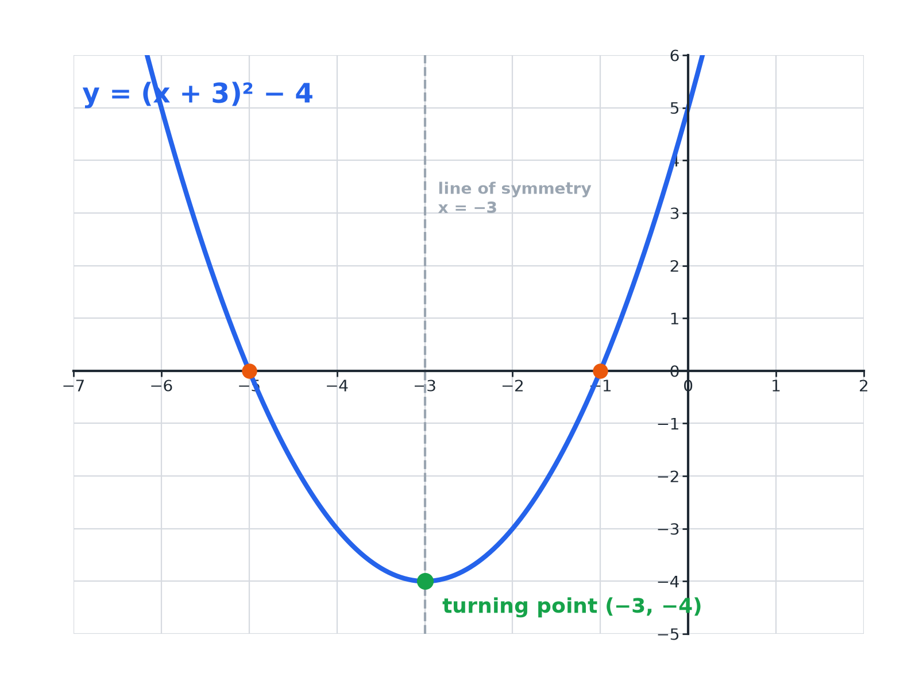

EDEXCEL GCSE MATHS · HIGHER
What the Form Tells You
In y = (x + p)² + q the turning point is (−p, q).
Equations and inequalities
openrevise.com
Lesson 4 of 7

Slide 9

EDEXCEL GCSE MATHS · HIGHER
Reading the Completed Square Form
y = (x + 3)² − 4
Turning point (−3, −4): the sign inside the bracket is reversed.
Line of symmetry
x = −3.
Minimum value
−4, when x = −3.
Never below the minimum
(x + 3)² ≥ 0, so y ≥ −4.
Equations and inequalities
openrevise.com
Lesson 4 of 7

Slide 10
EDEXCEL GCSE MATHS · HIGHER
Solving by Completing the Square
Solve x² + 6x − 2 = 0, leaving your answer in surd form.
Complete the square
(x + 3)² − 9 − 2 = 0, so (x + 3)² − 11 = 0
1
Rearrange
(x + 3)² = 11
2
Take the square root of both sides
x + 3 = ± √11
3
Solve
x = −3 ± √11
4
ANSWER
x = −3 + √11 or x = −3 − √11
Equations and inequalities
openrevise.com
Lesson 4 of 7

Slide 11
EDEXCEL GCSE MATHS · HIGHER
A Coefficient of x² Not 1
Write 2x² + 12x + 7 in the form a(x + p)² + q.
Take out the 2 from the x terms
2(x² + 6x) + 7
1
Complete the square inside
2[(x + 3)² − 9] + 7
2
Multiply out the 2
2(x + 3)² − 18 + 7
3
Simplify
2(x + 3)² − 11
4
ANSWER
2(x + 3)² − 11
Equations and inequalities
openrevise.com
Lesson 4 of 7

Slide 12
EDEXCEL GCSE MATHS · HIGHER
A Proof
Show that x² + 4x + 5 is always positive.
Complete the square
x² + 4x + 5 = (x + 2)² + 1
1
A square is never negative
(x + 2)² ≥ 0
2
Add 1
(x + 2)² + 1 ≥ 1
3
ANSWER
(x + 2)² + 1 ≥ 1 > 0, so the expression is always positive.
Equations and inequalities
openrevise.com
Lesson 4 of 7

Slide 13

EDEXCEL GCSE MATHS · HIGHER
Key Terms
Completing the square
Rewriting a quadratic as a squared bracket plus a constant.
Turning point
The lowest or highest point of a quadratic graph.
Minimum value
The smallest value a function can take.
Line of symmetry
The vertical line through the turning point.
Surd
A root left in exact form, such as √11.
Coefficient
The number multiplying a variable.
Equations and inequalities
openrevise.com
Lesson 4 of 7

Slide 14

EDEXCEL GCSE MATHS · HIGHER
YOUR TASK
12 minutes
Complete the Square Race
Write each in the form (x + p)² + q, then state the turning point of its graph. (a) x² + 4x + 1 (b) x² − 10x + 30 (c) x² + 2x − 8 (d) x² − 3x.
1
Halve the coefficient of x.
2
Subtract its square.
3
Read off the turning point.
WHAT A GOOD ANSWER SHOWS
(a) (x + 2)² − 3, turning point (−2, −3). (b) (x − 5)² + 5, turning point (5, 5). (c) (x + 1)² − 9, turning point (−1, −9). (d) (x − 3/2)² − 9/4, turning point (3/2, −9/4).
Equations and inequalities
openrevise.com
Lesson 4 of 7

Slide 15

EDEXCEL GCSE MATHS · HIGHER
Can I...?
Complete the square when a = 1.
Give answers as surds.
Complete the square when a ≠ 1.
Use the form to find the minimum value.
Find the turning point from the completed form.
Prove a quadratic is always positive.
Solve by completing the square.
Check by expanding.
Equations and inequalities
openrevise.com
Lesson 4 of 7

Slide 16
EDEXCEL GCSE MATHS · HIGHER
Summary & Exam Focus
x² + bx + c = (x + b/2)² + c − (b/2)².
Turning point of y = (x + p)² + q is (−p, q).
Solve by rearranging to (x + p)² = k.
(x + p)² ≥ 0 helps with proofs.
EXAM FOCUS
Write x² − 8x + 3 in the form (x + a)² + b. (2 marks)
Halve the coefficient of x (keeping its sign) and square it. Then adjust the constant. Always check by expanding.
openrevise.com

