Slide 1

EDEXCEL GCSE MATHS · FOUNDATION & HIGHER
More simultaneous equations
Equations and inequalities
Lesson 6 of 7
openrevise.com

Slide 2

EDEXCEL GCSE MATHS · FOUNDATION & HIGHER
Warm-up
Answer each one, then check.
1
Solve x + y = 5 and x − y = 1.
2
Multiply 2x + 3y = 5 by 3.
3
What is the lowest common multiple of 2 and 3?
4
Solve 4y = 12.
5
What is −6 + 6?
Equations and inequalities
openrevise.com
Lesson 6 of 7

Slide 3
EDEXCEL GCSE MATHS · FOUNDATION & HIGHER
Warm-up - Answers
Solve x + y = 5 and x − y = 1.
x = 3, y = 2
1
Multiply 2x + 3y = 5 by 3.
6x + 9y = 15
2
What is the lowest common multiple of 2 and 3?
6
3
Solve 4y = 12.
y = 3
4
What is −6 + 6?
0
5
Equations and inequalities
openrevise.com
Lesson 6 of 7

Slide 4

EDEXCEL GCSE MATHS · FOUNDATION & HIGHER
Learning Objectives
Multiply one equation to match coefficients.
1
Multiply both equations to match coefficients.
2
Solve worded problems using two equations.
3
Check that answers satisfy both equations.
4
Equations and inequalities
openrevise.com
Lesson 6 of 7

Slide 5
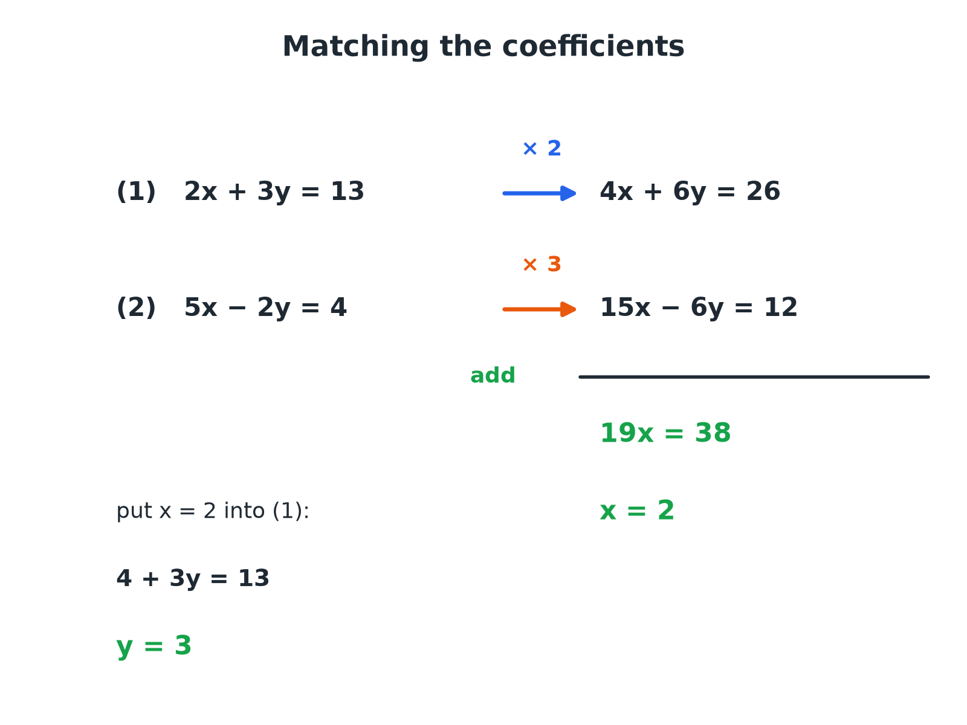

EDEXCEL GCSE MATHS · FOUNDATION & HIGHER
Matching the Coefficients
Multiply so that one pair of coefficients matches, then add or subtract.
Equations and inequalities
openrevise.com
Lesson 6 of 7

Slide 6

EDEXCEL GCSE MATHS · FOUNDATION & HIGHER
Multiplying Before Eliminating
When no pair of coefficients matches.
1
2
3
4
5
Choose the unknown to eliminate
Look for the easiest pair of coefficients
Find the lowest common multiple
For 3 and 2 it is 6
Multiply each equation
So the coefficients of that unknown match
Add or subtract
Same signs subtract, opposite signs add
Solve, substitute, check
Two values, checked in both equations
Equations and inequalities
openrevise.com
Lesson 6 of 7

Slide 7

EDEXCEL GCSE MATHS · FOUNDATION & HIGHER
Multiplying Both Equations
Solve 2x + 3y = 13 and 5x − 2y = 4.
1
Multiply (1) by 2 and (2) by 3 to match the y terms
4x + 6y = 26 and 15x − 6y = 12
2
The y terms have opposite signs, so add
19x = 38
3
Solve
x = 2
4
Substitute into (1)
4 + 3y = 13, so y = 3
5
Check in (2)
5 × 2 − 2 × 3 = 4
ANSWER
x = 2 and y = 3
Equations and inequalities
openrevise.com
Lesson 6 of 7

Slide 8
EDEXCEL GCSE MATHS · FOUNDATION & HIGHER
Another Pair
Solve 3x + 2y = 12 and 5x − 3y = 1.
Multiply (1) by 3 and (2) by 2
9x + 6y = 36 and 10x − 6y = 2
1
Add
19x = 38, so x = 2
2
Substitute into (1)
6 + 2y = 12, so y = 3
3
Check in (2)
10 − 9 = 1
4
ANSWER
x = 2 and y = 3
Equations and inequalities
openrevise.com
Lesson 6 of 7

Slide 9
EDEXCEL GCSE MATHS · FOUNDATION & HIGHER
A Number Problem
The sum of two numbers is 25. Twice the first number plus three times the second number is 62. Find the numbers.
Let the numbers be x and y
x + y = 25 and 2x + 3y = 62
1
Multiply the first by 2
2x + 2y = 50
2
Subtract from the second
y = 12
3
Find x
x = 25 − 12 = 13
4
ANSWER
The numbers are 13 and 12.
Equations and inequalities
openrevise.com
Lesson 6 of 7

Slide 10
EDEXCEL GCSE MATHS · FOUNDATION & HIGHER
A Cost Problem
3 apples and 2 bananas cost £1.80. 2 apples and 5 bananas cost £2.30. Find the cost of one apple and one banana.
Write the equations in pence
3a + 2b = 180 and 2a + 5b = 230
1
Multiply (1) by 2 and (2) by 3
6a + 4b = 360 and 6a + 15b = 690
2
Subtract
11b = 330, so b = 30
3
Find a
3a + 60 = 180, so a = 40
4
ANSWER
An apple costs 40p and a banana costs 30p.
Equations and inequalities
openrevise.com
Lesson 6 of 7

Slide 11

EDEXCEL GCSE MATHS · FOUNDATION & HIGHER
Common Slips
Check every step.
Multiply every term
Both sides and every term of the equation.
Signs when subtracting
Subtracting −6y adds 6y.
Wrong equation for substitution
Substitute into either original equation, then check in the other.
Units
In a money problem, keep everything in pence or everything in pounds.
Equations and inequalities
openrevise.com
Lesson 6 of 7

Slide 12

EDEXCEL GCSE MATHS · FOUNDATION & HIGHER
Key Terms
Simultaneous equations
Equations that must both be true for the same unknown values.
Elimination
Removing an unknown by adding or subtracting.
Lowest common multiple
The smallest number that is a multiple of two numbers.
Coefficient
The number multiplying an unknown.
Substitute
Replace an unknown by its value.
Check
Put the answers back into both equations.
Equations and inequalities
openrevise.com
Lesson 6 of 7

Slide 13

EDEXCEL GCSE MATHS · FOUNDATION & HIGHER
YOUR TASK
12 minutes
Spot the Method
For each pair, say how you would eliminate an unknown, then solve. (a) x + 2y = 8 and 3x − y = 3 (b) 3x + 4y = 25 and 5x − 2y = 7 (c) 2x + 5y = 16 and 3x − 2y = 5.
1
Choose the unknown to eliminate.
2
Multiply to match.
3
Solve and check.
WHAT A GOOD ANSWER SHOWS
(a) Multiply the second by 2: 6x − 2y = 6, add: 7x = 14, so x = 2, y = 3. (b) Multiply the second by 2: 10x − 4y = 14, add: 13x = 39, so x = 3, y = 4. (c) Multiply the first by 2 and the second by 5: 4x + 10y = 32 and 15x − 10y = 25, add: 19x = 57, so x = 3, y = 2.
Equations and inequalities
openrevise.com
Lesson 6 of 7

Slide 14

EDEXCEL GCSE MATHS · FOUNDATION & HIGHER
Can I...?
Multiply one equation to match coefficients.
Check in both equations.
Multiply both equations.
Form equations from a worded problem.
Choose add or subtract correctly.
Work in consistent units.
Find both unknowns.
Explain each step.
Equations and inequalities
openrevise.com
Lesson 6 of 7

Slide 15
EDEXCEL GCSE MATHS · FOUNDATION & HIGHER
Summary & Exam Focus
Multiply so that one pair of coefficients matches.
Same signs: subtract. Opposite signs: add.
Substitute back and check in both equations.
In problems, define the letters and write two equations.
EXAM FOCUS
Solve the simultaneous equations 2x + 3y = 13 and 5x − 2y = 4. (4 marks)
Multiply both equations so that the y-coefficients match (6 and 6), then add because the signs are opposite.
openrevise.com

