Slide 1

EDEXCEL GCSE MATHS · HIGHER
Solving linear and quadratic simultaneous equations
Equations and inequalities
Lesson 7 of 7
openrevise.com

Slide 2

EDEXCEL GCSE MATHS · HIGHER
Warm-up
Answer each one, then check.
1
Expand (x + 1)².
2
Solve x² + x − 12 = 0.
3
Solve 5x² = 20.
4
What is the equation of a circle with centre the origin and radius 5?
5
What is a tangent to a curve?
Equations and inequalities
openrevise.com
Lesson 7 of 7

Slide 3
EDEXCEL GCSE MATHS · HIGHER
Warm-up - Answers
Expand (x + 1)².
x² + 2x + 1
1
Solve x² + x − 12 = 0.
x = 3 or x = −4
2
Solve 5x² = 20.
x = ± 2
3
What is the equation of a circle with centre the origin and radius 5?
x² + y² = 25
4
What is a tangent to a curve?
A line that touches the curve at one point
5
Equations and inequalities
openrevise.com
Lesson 7 of 7

Slide 4

EDEXCEL GCSE MATHS · HIGHER
Learning Objectives
Solve a linear and a quadratic equation together by substitution.
1
Solve a line with a circle x² + y² = r².
2
Find the points where a line meets a curve.
3
Show that a line is a tangent by getting a repeated root.
4
Equations and inequalities
openrevise.com
Lesson 7 of 7

Slide 5

EDEXCEL GCSE MATHS · HIGHER
Substitution Method
Get the linear equation into y = … or x = … first.
1
2
3
4
5
Rearrange the linear equation
So one unknown is on its own
Substitute into the quadratic
You now have a quadratic in one unknown
Rearrange to zero and solve
Factorise, or use the formula
Find the other unknown
Substitute each solution into the LINEAR equation
Write pairs
Each solution is a pair of coordinates
Equations and inequalities
openrevise.com
Lesson 7 of 7

Slide 6
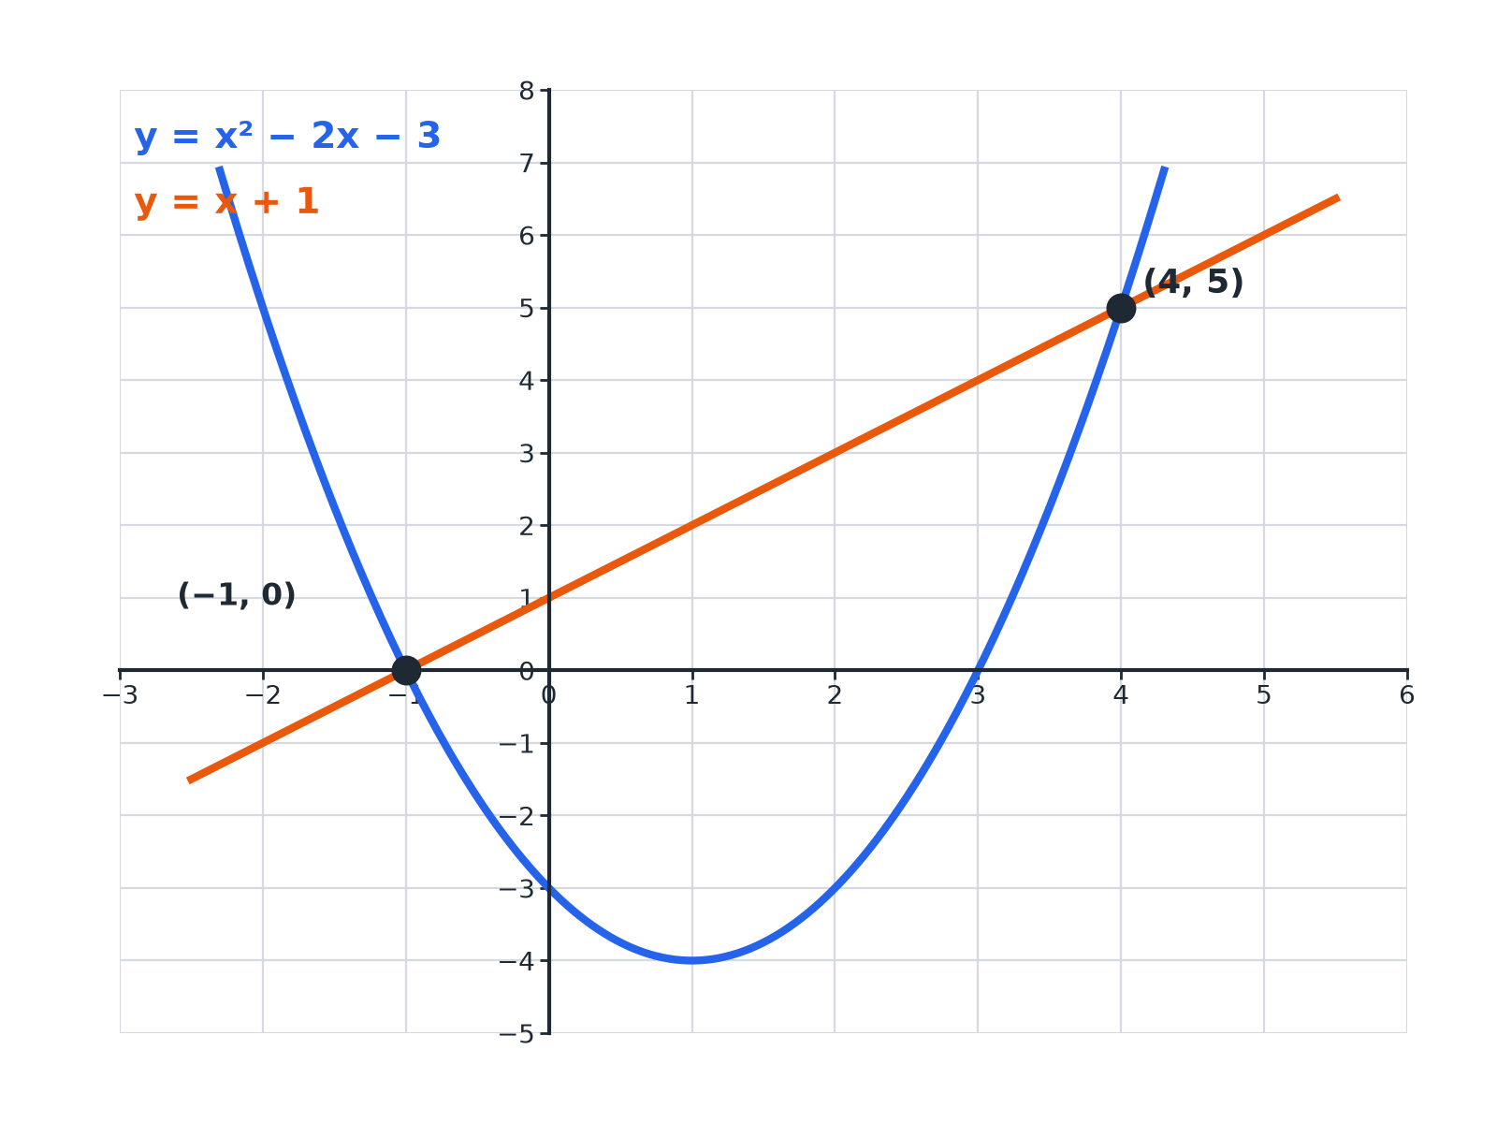

EDEXCEL GCSE MATHS · HIGHER
A Line Meeting a Curve
Two solutions mean the line crosses the curve twice.
Equations and inequalities
openrevise.com
Lesson 7 of 7

Slide 7

EDEXCEL GCSE MATHS · HIGHER
A Line and a Parabola
Solve simultaneously y = x² − 2x − 3 and y = x + 1.
Set the y-values equal
x² − 2x − 3 = x + 1
1
Rearrange to zero
x² − 3x − 4 = 0
2
Factorise
(x − 4)(x + 1) = 0, so x = 4 or x = −1
3
Find y from the line y = x + 1
x = 4: y = 5; x = −1: y = 0
4
ANSWER
(4, 5) and (−1, 0)
Equations and inequalities
openrevise.com
Lesson 7 of 7

Slide 8
EDEXCEL GCSE MATHS · HIGHER
A Line and a Circle
Solve simultaneously x² + y² = 25 and y = x + 1.
Substitute y = x + 1
x² + (x + 1)² = 25
1
Expand
2x² + 2x + 1 = 25, so 2x² + 2x − 24 = 0
2
Divide by 2 and factorise
x² + x − 12 = 0, so (x + 4)(x − 3) = 0
3
Find y
x = 3: y = 4; x = −4: y = −3
4
ANSWER
(3, 4) and (−4, −3)
Equations and inequalities
openrevise.com
Lesson 7 of 7

Slide 9
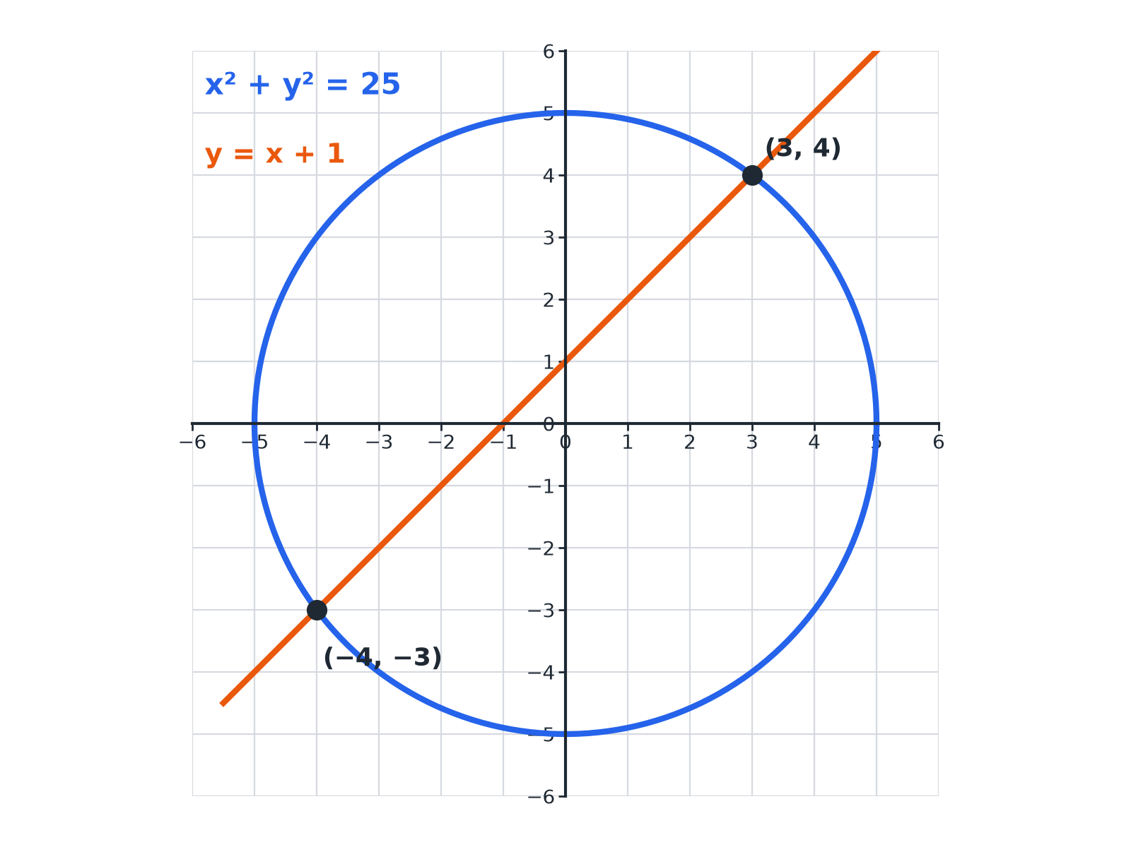
EDEXCEL GCSE MATHS · HIGHER
A Line and a Circle
Substituting gives the two intersection points.
Equations and inequalities
openrevise.com
Lesson 7 of 7

Slide 10
EDEXCEL GCSE MATHS · HIGHER
Another Circle Problem
Solve simultaneously x² + y² = 20 and y = 2x.
Substitute
x² + 4x² = 20
1
Simplify
5x² = 20, so x² = 4
2
Solve
x = 2 or x = −2
3
Find y
y = 4 or y = −4
4
ANSWER
(2, 4) and (−2, −4)
Equations and inequalities
openrevise.com
Lesson 7 of 7

Slide 11
EDEXCEL GCSE MATHS · HIGHER
Showing a Line Is a Tangent
Show that the line y = 2x − 1 is a tangent to the curve y = x².
Set equal
x² = 2x − 1
1
Rearrange
x² − 2x + 1 = 0
2
Factorise
(x − 1)² = 0
3
One repeated solution
The line touches the curve at one point only, (1, 1)
4
ANSWER
The equation has one repeated root x = 1, so the line is a tangent.
Equations and inequalities
openrevise.com
Lesson 7 of 7

Slide 12

EDEXCEL GCSE MATHS · HIGHER
How Many Solutions?
TWO SOLUTIONS
ONE OR NO SOLUTIONS
• The line crosses the curve at two points.
• The quadratic has two different roots.
• The discriminant b² − 4ac is positive.
• One repeated root: the line is a tangent.
• No real roots: the line misses the curve.
• The discriminant is zero or negative.
Equations and inequalities
openrevise.com
Lesson 7 of 7

Slide 13

EDEXCEL GCSE MATHS · HIGHER
Key Terms
Tangent
A line that touches a curve at exactly one point.
Repeated root
A solution that occurs twice, such as x = 1 in (x − 1)² = 0.
Intersection
A point where a line and a curve meet.
Substitution
Replacing a letter with an expression.
Circle equation
x² + y² = r² for a circle centred on the origin.
Discriminant
b² − 4ac; it shows the number of real roots.
Equations and inequalities
openrevise.com
Lesson 7 of 7

Slide 14

EDEXCEL GCSE MATHS · HIGHER
YOUR TASK
15 minutes
Where Do They Meet?
Find the intersection points of each pair. (a) y = x² and y = 3x − 2 (b) x + y = 7 and x² + y² = 25 (c) y = x² + 1 and y = 3x − 1.
1
Substitute.
2
Solve the quadratic.
3
Find y for each x.
WHAT A GOOD ANSWER SHOWS
(a) x² − 3x + 2 = 0: (1, 1) and (2, 4). (b) y = 7 − x: 2x² − 14x + 24 = 0, x² − 7x + 12 = 0: (3, 4) and (4, 3). (c) x² − 3x + 2 = 0: (1, 2) and (2, 5).
Equations and inequalities
openrevise.com
Lesson 7 of 7
Notes:
Ask which of these are tangents (none): the quadratics have two roots each.

Slide 15

EDEXCEL GCSE MATHS · HIGHER
Can I...?
Rearrange the linear equation.
Solve a line and a circle.
Substitute into the quadratic.
Show a line is a tangent.
Solve the resulting quadratic.
Give answers as coordinate pairs.
Find both coordinates of each point.
Check by substituting.
Equations and inequalities
openrevise.com
Lesson 7 of 7

Slide 16
EDEXCEL GCSE MATHS · HIGHER
Summary & Exam Focus
Substitute the linear equation into the quadratic or the circle.
Solve the quadratic in one unknown.
Pair up each x with its y using the linear equation.
A repeated root means the line is a tangent.
EXAM FOCUS
Solve the simultaneous equations y = x² − 2x − 3 and y = x + 1. (5 marks)
Substitute the linear equation into the quadratic. When you find each x, use the LINEAR equation to find the matching y.
openrevise.com

Slide 17
EDEXCEL GCSE MATHS · HIGHER
Exam Practice: Linear and Quadratic Simultaneous Equations
Answer all questions. Show your working. · 35 minutes
Question 1 · 5 marks · Non-calculator
Solve the simultaneous equations y = x² − 2x − 3 and y = x + 1.
Question 2 · 5 marks · Non-calculator
The circle x² + y² = 25 and the line y = x + 1 intersect at two points. Find the coordinates of the two points.
Question 3 · 4 marks · Non-calculator
Solve the simultaneous equations x² + y² = 20 and y = 2x.
Equations and inequalities
openrevise.com
Lesson 7 of 7

Slide 18
EDEXCEL GCSE MATHS · HIGHER
Exam Practice: Linear and Quadratic Simultaneous Equations (cont.)
Question 4 · 4 marks · Show that
Show that the line y = 2x − 1 is a tangent to the curve y = x².
Question 5 · 5 marks · Non-calculator
Solve the simultaneous equations x + y = 7 and x² + y² = 25.
Question 6 · 5 marks · Non-calculator
Solve the simultaneous equations y = x² + 1 and y = 3x − 1.
Equations and inequalities
openrevise.com
Lesson 7 of 7

Slide 19
EDEXCEL GCSE MATHS · HIGHER
Question 1 · 5 marks · Non-calculator
“
Solve the simultaneous equations y = x² − 2x − 3 and y = x + 1.
HOW TO ANSWER IT
Command word: Non-calculator. Worth 5 marks, so plan before writing.
Equations and inequalities
openrevise.com
Lesson 7 of 7

Slide 20
EDEXCEL GCSE MATHS · HIGHER
Question 1 · mark scheme
5 marks available. Award a mark for each point made.
Equating
M1
Rearranging to zero
M1
Factorising
M1
Equations and inequalities
openrevise.com
Lesson 7 of 7

Slide 21
EDEXCEL GCSE MATHS · HIGHER
Question 1 · mark scheme (cont.)
Both x values
A1
Both correct pairs
A1
Equations and inequalities
openrevise.com
Lesson 7 of 7

Slide 22
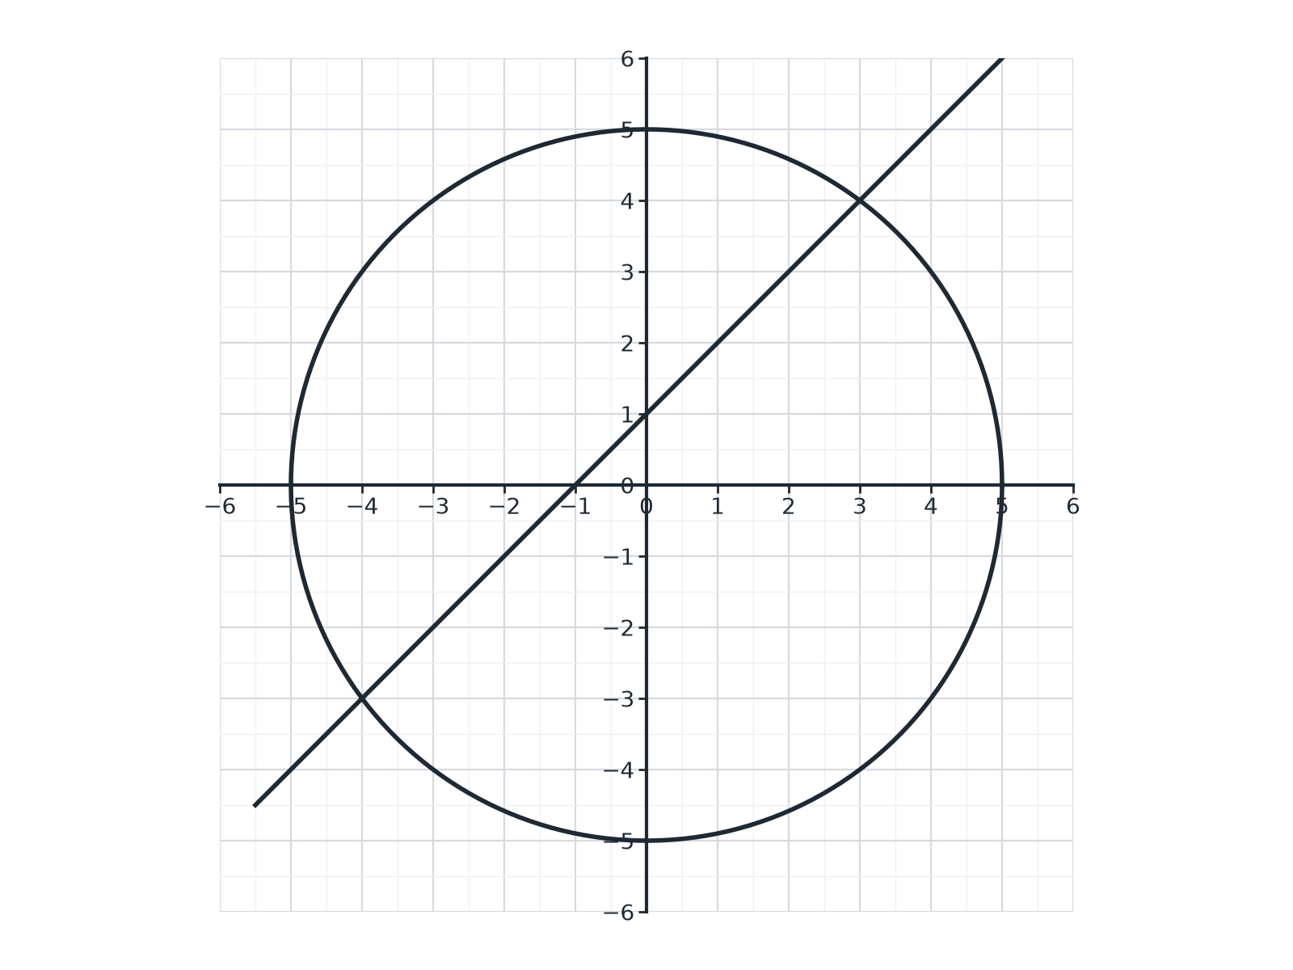
EDEXCEL GCSE MATHS · HIGHER
Question 2 · 5 marks · Non-calculator
The circle x² + y² = 25 and the line y = x + 1 intersect at two points. Find the coordinates of the two points. (5 marks)
Equations and inequalities
openrevise.com
Lesson 7 of 7

Slide 23
EDEXCEL GCSE MATHS · HIGHER
Question 2 · mark scheme
5 marks available. Award a mark for each point made.
Substituting
M1
Simplifying to a quadratic
M1
Solving
M1
Equations and inequalities
openrevise.com
Lesson 7 of 7

Slide 24
EDEXCEL GCSE MATHS · HIGHER
Question 2 · mark scheme (cont.)
Both x values
A1
Both correct pairs
A1
Equations and inequalities
openrevise.com
Lesson 7 of 7

Slide 25
EDEXCEL GCSE MATHS · HIGHER
Question 3 · 4 marks · Non-calculator
“
Solve the simultaneous equations x² + y² = 20 and y = 2x.
HOW TO ANSWER IT
Command word: Non-calculator. Worth 4 marks, so plan before writing.
Equations and inequalities
openrevise.com
Lesson 7 of 7

Slide 26
EDEXCEL GCSE MATHS · HIGHER
Question 3 · mark scheme
4 marks available. Award a mark for each point made.
Substituting
M1
5x² = 20
M1
x = 2 and x = −2
A1
Both pairs
A1
Equations and inequalities
openrevise.com
Lesson 7 of 7

Slide 27
EDEXCEL GCSE MATHS · HIGHER
Question 4 · 4 marks · Show that
“
Show that the line y = 2x − 1 is a tangent to the curve y = x².
HOW TO ANSWER IT
Command word: Show that. Worth 4 marks, so plan before writing.
Equations and inequalities
openrevise.com
Lesson 7 of 7

Slide 28
EDEXCEL GCSE MATHS · HIGHER
Question 4 · mark scheme
4 marks available. Award a mark for each point made.
Equating
M1
Rearranging to x² − 2x + 1 = 0
M1
(x − 1)² = 0
M1
Conclusion
C1
Equations and inequalities
openrevise.com
Lesson 7 of 7

Slide 29
EDEXCEL GCSE MATHS · HIGHER
Question 5 · 5 marks · Non-calculator
“
Solve the simultaneous equations x + y = 7 and x² + y² = 25.
HOW TO ANSWER IT
Command word: Non-calculator. Worth 5 marks, so plan before writing.
Equations and inequalities
openrevise.com
Lesson 7 of 7

Slide 30
EDEXCEL GCSE MATHS · HIGHER
Question 5 · mark scheme
5 marks available. Award a mark for each point made.
Rearranging and substituting
M1
Expanding (7 − x)²
M1
Solving
M1
Equations and inequalities
openrevise.com
Lesson 7 of 7

Slide 31
EDEXCEL GCSE MATHS · HIGHER
Question 5 · mark scheme (cont.)
Both x values
A1
Both correct pairs
A1
Equations and inequalities
openrevise.com
Lesson 7 of 7

Slide 32
EDEXCEL GCSE MATHS · HIGHER
Question 6 · 5 marks · Non-calculator
“
Solve the simultaneous equations y = x² + 1 and y = 3x − 1.
HOW TO ANSWER IT
Command word: Non-calculator. Worth 5 marks, so plan before writing.
Equations and inequalities
openrevise.com
Lesson 7 of 7

Slide 33
EDEXCEL GCSE MATHS · HIGHER
Question 6 · mark scheme
5 marks available. Award a mark for each point made.
Equating
M1
Rearranging to zero
M1
Factorising
M1
Equations and inequalities
openrevise.com
Lesson 7 of 7

Slide 34
EDEXCEL GCSE MATHS · HIGHER
Question 6 · mark scheme (cont.)
Both x values
A1
Both correct pairs
A1
Equations and inequalities
openrevise.com
Lesson 7 of 7

