Slide 1

EDEXCEL GCSE MATHS · FOUNDATION & HIGHER
Mutually exclusive events
Probability
Lesson 2 of 6
openrevise.com

Slide 2

EDEXCEL GCSE MATHS · FOUNDATION & HIGHER
Warm-up
Answer each one, then check.
1
What is the probability of an impossible event?
2
What is the probability of a certain event?
3
Work out 1 − 0.35.
4
Simplify 10/25.
5
Work out 3/10 + 2/10.
Probability
openrevise.com
Lesson 2 of 6

Slide 3
EDEXCEL GCSE MATHS · FOUNDATION & HIGHER
Warm-up - Answers
What is the probability of an impossible event?
0
1
What is the probability of a certain event?
1
2
Work out 1 − 0.35.
0.65
3
Simplify 10/25.
2/5
4
Work out 3/10 + 2/10.
½
5
Probability
openrevise.com
Lesson 2 of 6

Slide 4

EDEXCEL GCSE MATHS · FOUNDATION & HIGHER
Learning Objectives
Use the probability scale from 0 to 1.
1
Recognise mutually exclusive events.
2
Use P(A or B) = P(A) + P(B) for mutually exclusive events.
3
Use P(not A) = 1 − P(A) and complete probability tables.
4
Probability
openrevise.com
Lesson 2 of 6

Slide 5
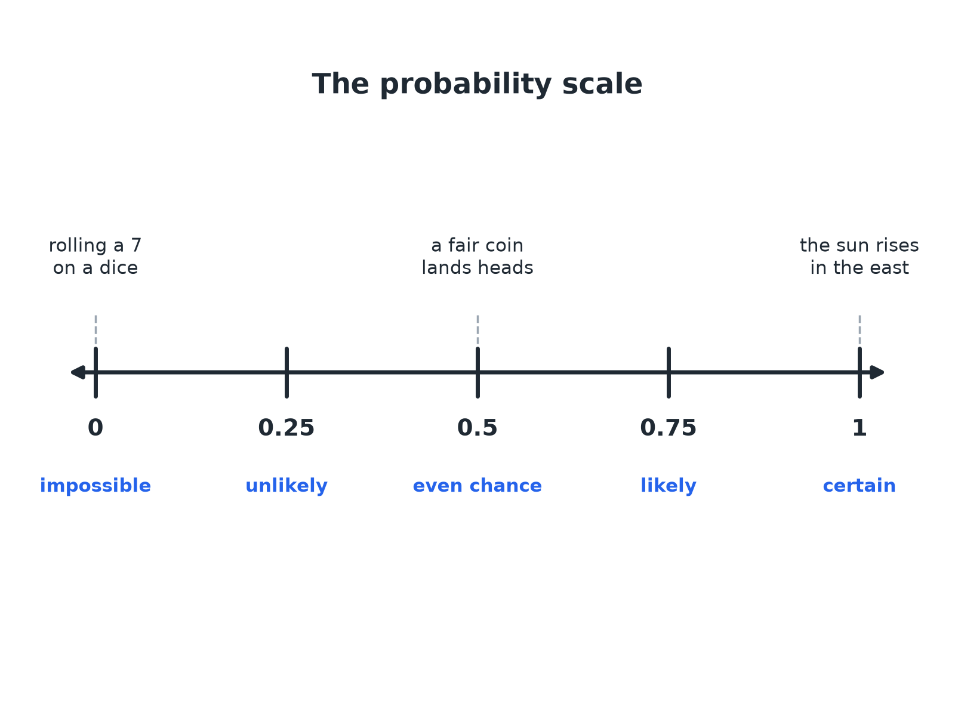

EDEXCEL GCSE MATHS · FOUNDATION & HIGHER
The Probability Scale
Every probability lies between 0 and 1.
Probability
openrevise.com
Lesson 2 of 6

Slide 6

EDEXCEL GCSE MATHS · FOUNDATION & HIGHER
Key Facts
Range
Every probability is between 0 and 1, including 0 and 1.
Total
The probabilities of all the possible outcomes add up to 1.
Not happening
P(not A) = 1 − P(A).
Mutually exclusive
Events that cannot both happen at the same time, such as rolling a 2 and rolling a 5 on one dice.
Probability
openrevise.com
Lesson 2 of 6

Slide 7

EDEXCEL GCSE MATHS · FOUNDATION & HIGHER
THE ADDITION RULE
For mutually exclusive events, P(A or B) = P(A) + P(B).
This only works when A and B cannot happen together.
Probability
openrevise.com
Lesson 2 of 6

Slide 8

EDEXCEL GCSE MATHS · FOUNDATION & HIGHER
Finding a Missing Probability
A biased spinner has probabilities: red 0.3, blue 0.5, green x. Find x, and P(red or blue).
The probabilities add up to 1
0.3 + 0.5 + x = 1
1
Solve
x = 0.2
2
Red and blue are mutually exclusive, so add
0.3 + 0.5 = 0.8
3
ANSWER
x = 0.2 and P(red or blue) = 0.8.
Probability
openrevise.com
Lesson 2 of 6

Slide 9
EDEXCEL GCSE MATHS · FOUNDATION & HIGHER
A Probability Table
A four-sided spinner has P(1) = 0.1, P(2) = 0.25, P(3) = x and P(4) = 0.3. Find x and P(not 4).
Probabilities add up to 1
0.1 + 0.25 + x + 0.3 = 1
1
Solve
0.65 + x = 1, so x = 0.35
2
Not 4
1 − 0.3 = 0.7
3
ANSWER
x = 0.35 and P(not 4) = 0.7.
Probability
openrevise.com
Lesson 2 of 6

Slide 10
EDEXCEL GCSE MATHS · FOUNDATION & HIGHER
Counters in a Bag
A bag has 5 red, 3 blue and 2 green counters. One counter is taken at random. Find the probability that it is red or green.
Total counters
5 + 3 + 2 = 10
1
Red and green cannot both be taken
Mutually exclusive
2
Add the probabilities
5/10 + 2/10 = 7/10
3
ANSWER
7/10
Probability
openrevise.com
Lesson 2 of 6

Slide 11

EDEXCEL GCSE MATHS · FOUNDATION & HIGHER
HIGHER TIER
Events That Can Overlap
When A and B can both happen.
openrevise.com

Slide 12
EDEXCEL GCSE MATHS · FOUNDATION & HIGHER
Not Mutually Exclusive
Higher
P(A) = 0.5, P(B) = 0.4 and P(A and B) = 0.2. Find P(A or B).
Adding counts the overlap twice
0.5 + 0.4 = 0.9
1
Subtract the overlap once
0.9 − 0.2
2
Work it out
0.7
3
ANSWER
P(A or B) = 0.7
Probability
openrevise.com
Lesson 2 of 6

Slide 13

EDEXCEL GCSE MATHS · FOUNDATION & HIGHER
Key Terms
Mutually exclusive
Events that cannot happen at the same time.
Probability scale
A line from 0 (impossible) to 1 (certain).
Complement
The event "not A", with probability 1 − P(A).
Exhaustive
A set of events that covers every possible outcome.
Biased
Not fair; outcomes are not equally likely.
Random
Every item has the same chance of being chosen.
Probability
openrevise.com
Lesson 2 of 6

Slide 14

EDEXCEL GCSE MATHS · FOUNDATION & HIGHER
YOUR TASK
10 minutes
Complete the Table
A biased dice has probabilities: 1: 0.1, 2: 0.15, 3: 0.2, 4: 0.25, 5: x, 6: 2x. Find x, then find the probability of an even number and the probability of not rolling a 6.
1
Use "add to 1".
2
Add for "or".
3
Subtract from 1 for "not".
WHAT A GOOD ANSWER SHOWS
0.1 + 0.15 + 0.2 + 0.25 + 3x = 1, so 3x = 0.3 and x = 0.1. P(6) = 0.2. Even: 0.15 + 0.25 + 0.2 = 0.6. Not 6: 0.8.
Probability
openrevise.com
Lesson 2 of 6

Slide 15

EDEXCEL GCSE MATHS · FOUNDATION & HIGHER
Can I...?
Place an event on the probability scale.
Add probabilities for "or".
Use "add up to 1" to find a missing probability.
Complete a probability table.
Use 1 − P(A).
Work with counters in a bag.
Recognise mutually exclusive events.
Use P(A) + P(B) − P(A and B) (Higher).
Probability
openrevise.com
Lesson 2 of 6

Slide 16
EDEXCEL GCSE MATHS · FOUNDATION & HIGHER
Summary & Exam Focus
All the probabilities add up to 1.
P(not A) = 1 − P(A).
Mutually exclusive: P(A or B) = P(A) + P(B).
Higher: subtract the overlap when events can both happen.
EXAM FOCUS
A bag has 5 red, 3 blue and 2 green counters. A counter is taken at random. Work out the probability that it is red or green. (2 marks)
Red and green cannot both happen, so add the two probabilities. The total number of counters is the denominator.
openrevise.com

