Slide 1

EDEXCEL GCSE MATHS · FOUNDATION & HIGHER
Experimental probability
Probability
Lesson 3 of 6
openrevise.com

Slide 2

EDEXCEL GCSE MATHS · FOUNDATION & HIGHER
Warm-up
Answer each one, then check.
1
Simplify 30/120.
2
Write 18/60 as a decimal.
3
What is the theoretical probability of heads on a fair coin?
4
Work out 500 × 0.3.
5
What is 1/6 as a decimal, to 2 decimal places?
Probability
openrevise.com
Lesson 3 of 6

Slide 3
EDEXCEL GCSE MATHS · FOUNDATION & HIGHER
Warm-up - Answers
Simplify 30/120.
¼
1
Write 18/60 as a decimal.
0.3
2
What is the theoretical probability of heads on a fair coin?
½
3
Work out 500 × 0.3.
150
4
What is 1/6 as a decimal, to 2 decimal places?
0.17
5
Probability
openrevise.com
Lesson 3 of 6

Slide 4

EDEXCEL GCSE MATHS · FOUNDATION & HIGHER
Learning Objectives
Work out relative frequency.
1
Use relative frequency to estimate probability.
2
Predict how many times an event will happen.
3
Decide whether a coin, dice or spinner is fair.
4
Probability
openrevise.com
Lesson 3 of 6

Slide 5

EDEXCEL GCSE MATHS · FOUNDATION & HIGHER
RELATIVE FREQUENCY
Relative frequency is the number of times an event happens divided by the total number of trials.
relative frequency = (frequency of the event)/(total number of trials)
Probability
openrevise.com
Lesson 3 of 6

Slide 6
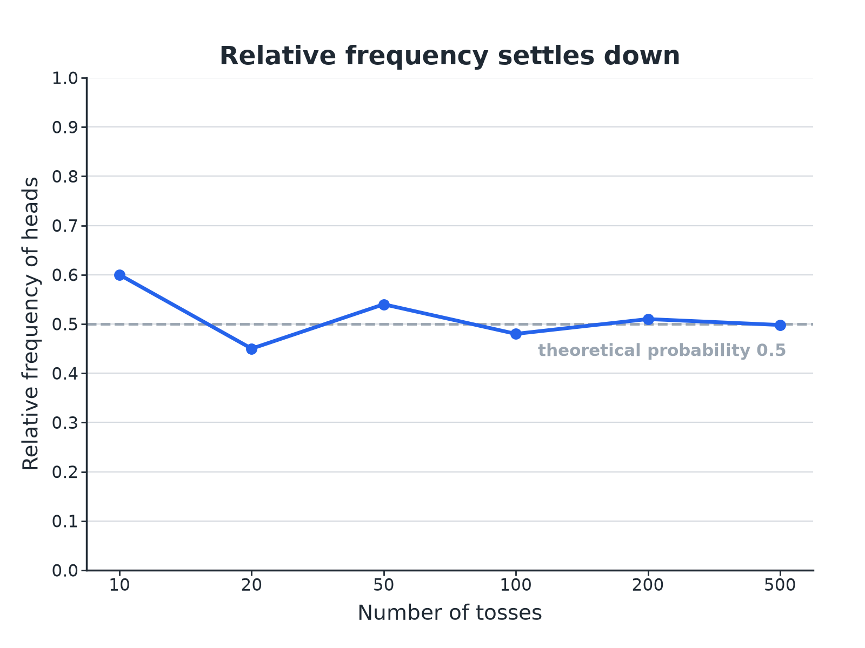

EDEXCEL GCSE MATHS · FOUNDATION & HIGHER
Relative Frequency Settles Down
The more trials, the closer the relative frequency gets to the true probability.
Probability
openrevise.com
Lesson 3 of 6

Slide 7

EDEXCEL GCSE MATHS · FOUNDATION & HIGHER
Relative Frequency
A spinner is spun 60 times. It lands on red 18 times, blue 30 times and green 12 times. Find the relative frequency of each colour.
Red
18/60 = 0.3
1
Blue
30/60 = 0.5
2
Green
12/60 = 0.2
3
ANSWER
Red 0.3, blue 0.5, green 0.2. These add up to 1.
Probability
openrevise.com
Lesson 3 of 6

Slide 8
EDEXCEL GCSE MATHS · FOUNDATION & HIGHER
Predicting Outcomes
Use the spinner results to estimate how many times you would expect blue in 500 spins.
Estimated probability of blue
0.5
1
Multiply by the number of spins
0.5 × 500 = 250
2
ANSWER
About 250 blues.
Probability
openrevise.com
Lesson 3 of 6

Slide 9
EDEXCEL GCSE MATHS · FOUNDATION & HIGHER
Is the Dice Fair?
A dice is rolled 120 times and lands on 6 a total of 30 times. Does this suggest the dice is biased?
Relative frequency of a 6
30/120 = 0.25
1
Expected for a fair dice
1/6 = 0.167, so about 20 sixes
2
Compare
30 is much bigger than 20
3
ANSWER
The relative frequency 0.25 is well above 1/6, which suggests the dice may be biased, but more trials would give a more reliable conclusion.
Probability
openrevise.com
Lesson 3 of 6

Slide 10

EDEXCEL GCSE MATHS · FOUNDATION & HIGHER
Theoretical or Experimental?
THEORETICAL PROBABILITY
EXPERIMENTAL PROBABILITY
• Worked out from equally likely outcomes.
• Example: P(head) = ½.
• Does not change.
• Estimated from the results of trials.
• Example: 18 heads in 40 tosses gives 0.45.
• Changes as you do more trials.
Probability
openrevise.com
Lesson 3 of 6

Slide 11

EDEXCEL GCSE MATHS · FOUNDATION & HIGHER
How Reliable Is an Estimate?
More trials give better estimates.
Small samples
10 tosses might give 7 heads: 0.7 is a poor estimate of 0.5.
Large samples
1000 tosses will usually give a relative frequency very close to 0.5.
Fair
A fair dice or coin should give relative frequencies close to the theoretical values.
Probability
openrevise.com
Lesson 3 of 6

Slide 12

EDEXCEL GCSE MATHS · FOUNDATION & HIGHER
Key Terms
Trial
One repeat of an experiment.
Frequency
How many times an outcome happens.
Relative frequency
Frequency divided by the number of trials.
Theoretical probability
The probability worked out from equally likely outcomes.
Expected number
Probability multiplied by the number of trials.
Fair
Every outcome is equally likely.
Probability
openrevise.com
Lesson 3 of 6

Slide 13

EDEXCEL GCSE MATHS · FOUNDATION & HIGHER
YOUR TASK
15 minutes
Coin Toss Experiment
Toss a coin 10 times and record the number of heads. Combine class results in groups of 10, 50 and 100 tosses. Work out the relative frequency of heads for each total and comment on how close each is to 0.5.
1
Collect results.
2
Combine.
3
Compare.
WHAT A GOOD ANSWER SHOWS
Small groups vary widely (for example 3 or 7 heads out of 10), while the combined class total is very close to 0.5. This shows that relative frequency settles as the number of trials grows.
Probability
openrevise.com
Lesson 3 of 6
Notes:
Draw the class results on a graph like the one in the lesson.

Slide 14

EDEXCEL GCSE MATHS · FOUNDATION & HIGHER
Can I...?
Work out relative frequency.
Say whether a dice looks fair.
Use it as an estimate of probability.
Explain why more trials are better.
Work out an expected number.
Show relative frequencies add to 1.
Compare experimental and theoretical results.
Draw a relative frequency graph.
Probability
openrevise.com
Lesson 3 of 6

Slide 15
EDEXCEL GCSE MATHS · FOUNDATION & HIGHER
Summary & Exam Focus
Relative frequency = frequency/trials.
Expected number = probability × trials.
More trials give a more reliable estimate.
Compare with the theoretical probability to test fairness.
EXAM FOCUS
A spinner is spun 200 times. It lands on red 62 times. Work out an estimate for the probability that it lands on red, and how many reds you expect in 500 spins. (3 marks)
Relative frequency is frequency divided by the number of trials. Multiply by the number of spins for the expected number.
openrevise.com

Slide 16
EDEXCEL GCSE MATHS · FOUNDATION & HIGHER
Exam Practice: Experimental Probability
Answer all questions. Show your working. · 25 minutes
Question 1 · 2 marks · Calculator
A spinner is spun 60 times. It lands on red 18 times. Work out the relative frequency of red.
Question 2 · 3 marks · Calculator
A spinner is spun 200 times. It lands on red 62 times. Work out an estimate for the number of times it will land on red in 500 spins.
Question 3 · 3 marks · Calculator
The graph shows the relative frequency of heads as a coin is tossed more and more times. Use it to explain whether the coin is likely to be…
Probability
openrevise.com
Lesson 3 of 6

Slide 17
EDEXCEL GCSE MATHS · FOUNDATION & HIGHER
Exam Practice: Experimental Probability (cont.)
Question 4 · 3 marks · Calculator
A dice is rolled 120 times. It lands on 6 a total of 30 times. Kim says the dice is biased. Is she right? You must show working.
Question 5 · 3 marks · Calculator
The probability that a bus is late is 0.15. Work out the expected number of late buses in 200 journeys.
Question 6 · 2 marks · Explain
Amy tosses a coin 10 times and gets 7 heads. Ben tosses the same coin 1000 times and gets 505 heads. Whose result gives a better estimate…
Probability
openrevise.com
Lesson 3 of 6

Slide 18
EDEXCEL GCSE MATHS · FOUNDATION & HIGHER
Question 1 · 2 marks · Calculator
“
A spinner is spun 60 times. It lands on red 18 times. Work out the relative frequency of red.
HOW TO ANSWER IT
Command word: Calculator. Worth 2 marks, so plan before writing.
Probability
openrevise.com
Lesson 3 of 6

Slide 19
EDEXCEL GCSE MATHS · FOUNDATION & HIGHER
Question 1 · mark scheme
2 marks available. Award a mark for each point made.
18/60
M1
0.3
A1
Probability
openrevise.com
Lesson 3 of 6

Slide 20
EDEXCEL GCSE MATHS · FOUNDATION & HIGHER
Question 2 · 3 marks · Calculator
“
A spinner is spun 200 times. It lands on red 62 times. Work out an estimate for the number of times it will land on red in 500 spins.
HOW TO ANSWER IT
Command word: Calculator. Worth 3 marks, so plan before writing.
Probability
openrevise.com
Lesson 3 of 6

Slide 21
EDEXCEL GCSE MATHS · FOUNDATION & HIGHER
Question 2 · mark scheme
3 marks available. Award a mark for each point made.
62/200
M1
0.31 × 500
M1
155
A1
Probability
openrevise.com
Lesson 3 of 6

Slide 22
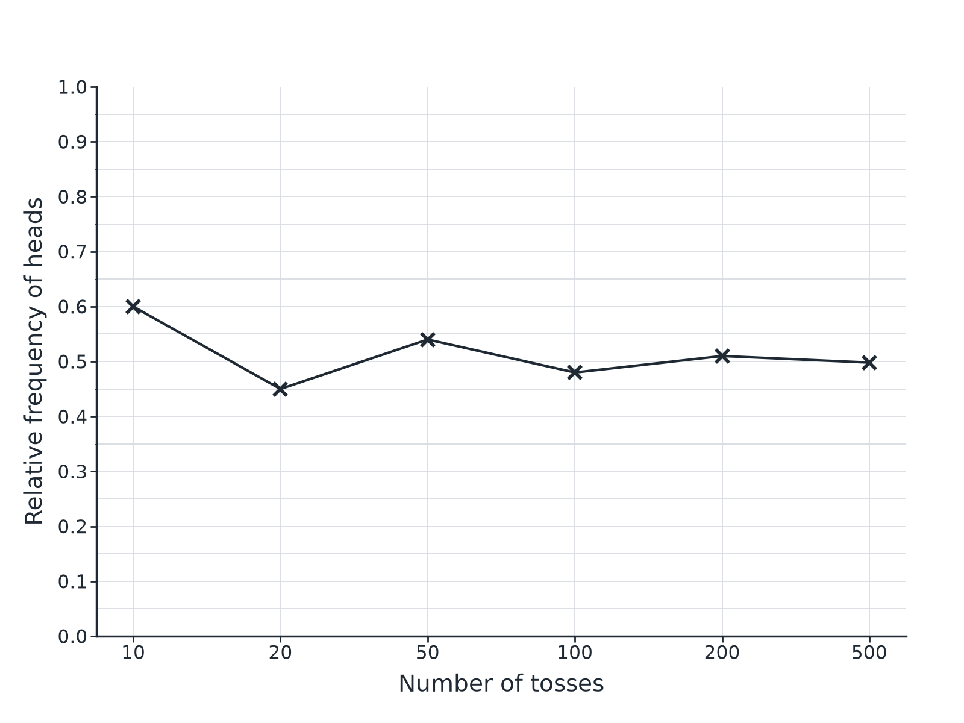
EDEXCEL GCSE MATHS · FOUNDATION & HIGHER
Question 3 · 3 marks · Calculator
The graph shows the relative frequency of heads as a coin is tossed more and more times. Use it to explain whether the coin is likely to be fair. (3 marks)
Probability
openrevise.com
Lesson 3 of 6

Slide 23
EDEXCEL GCSE MATHS · FOUNDATION & HIGHER
Question 3 · mark scheme
3 marks available. Award a mark for each point made.
The relative frequency settles
M1
It is near 0.5
M1
Conclusion that the coin is likely to be fair
C1
Probability
openrevise.com
Lesson 3 of 6

Slide 24
EDEXCEL GCSE MATHS · FOUNDATION & HIGHER
Question 4 · 3 marks · Calculator
“
A dice is rolled 120 times. It lands on 6 a total of 30 times. Kim says the dice is biased. Is she right? You must show working.
HOW TO ANSWER IT
Command word: Calculator. Worth 3 marks, so plan before writing.
Probability
openrevise.com
Lesson 3 of 6

Slide 25
EDEXCEL GCSE MATHS · FOUNDATION & HIGHER
Question 4 · mark scheme
3 marks available. Award a mark for each point made.
30/120 = 0.25 or expected 20
M1
Comparison with 1/6 or 20
M1
A conclusion with a reason
C1
Probability
openrevise.com
Lesson 3 of 6

Slide 26
EDEXCEL GCSE MATHS · FOUNDATION & HIGHER
Question 5 · 3 marks · Calculator
“
The probability that a bus is late is 0.15. Work out the expected number of late buses in 200 journeys.
HOW TO ANSWER IT
Command word: Calculator. Worth 3 marks, so plan before writing.
Probability
openrevise.com
Lesson 3 of 6

Slide 27
EDEXCEL GCSE MATHS · FOUNDATION & HIGHER
Question 5 · mark scheme
3 marks available. Award a mark for each point made.
0.15 × 200
M1
30
A1
A sensible unit or statement
B1
Probability
openrevise.com
Lesson 3 of 6

Slide 28
EDEXCEL GCSE MATHS · FOUNDATION & HIGHER
Question 6 · 2 marks · Explain
“
Amy tosses a coin 10 times and gets 7 heads. Ben tosses the same coin 1000 times and gets 505 heads. Whose result gives a better estimate of the probability of a head? Give a reason.
HOW TO ANSWER IT
Command word: Explain. Worth 2 marks, so plan before writing.
Probability
openrevise.com
Lesson 3 of 6

Slide 29
EDEXCEL GCSE MATHS · FOUNDATION & HIGHER
Question 6 · mark scheme
2 marks available. Award a mark for each point made.
Ben
B1
More trials give a more reliable estimate
C1
Probability
openrevise.com
Lesson 3 of 6

