Slide 1

EDEXCEL GCSE MATHS · FOUNDATION & HIGHER
Independent events and tree diagrams
Probability
Lesson 4 of 6
openrevise.com

Slide 2

EDEXCEL GCSE MATHS · FOUNDATION & HIGHER
Warm-up
Answer each one, then check.
1
Work out 3/5 × 3/5.
2
Work out 0.2 × 0.8.
3
What is 1 − 0.2?
4
Work out 9/25 + 4/25.
5
What do all the probabilities on a set of branches add up to?
Probability
openrevise.com
Lesson 4 of 6

Slide 3
EDEXCEL GCSE MATHS · FOUNDATION & HIGHER
Warm-up - Answers
Work out 3/5 × 3/5.
9/25
1
Work out 0.2 × 0.8.
0.16
2
What is 1 − 0.2?
0.8
3
Work out 9/25 + 4/25.
13/25
4
What do all the probabilities on a set of branches add up to?
1
5
Probability
openrevise.com
Lesson 4 of 6

Slide 4

EDEXCEL GCSE MATHS · FOUNDATION & HIGHER
Learning Objectives
Recognise independent events.
1
Use P(A and B) = P(A) × P(B) for independent events.
2
Draw and complete a tree diagram.
3
Use a tree diagram to find the probability of combined events.
4
Probability
openrevise.com
Lesson 4 of 6

Slide 5

EDEXCEL GCSE MATHS · FOUNDATION & HIGHER
INDEPENDENT EVENTS
Two events are independent if the outcome of one does not affect the outcome of the other.
For independent events, P(A and B) = P(A) × P(B).
Probability
openrevise.com
Lesson 4 of 6

Slide 6

EDEXCEL GCSE MATHS · FOUNDATION & HIGHER
Multiplying Probabilities
The probability that Sam is late for school is 0.3. The probability that it rains is 0.5. These events are independent. Find the probability that Sam is late and it rains.
Independent events, so multiply
0.3 × 0.5
1
Work it out
0.15
2
ANSWER
0.15
Probability
openrevise.com
Lesson 4 of 6

Slide 7
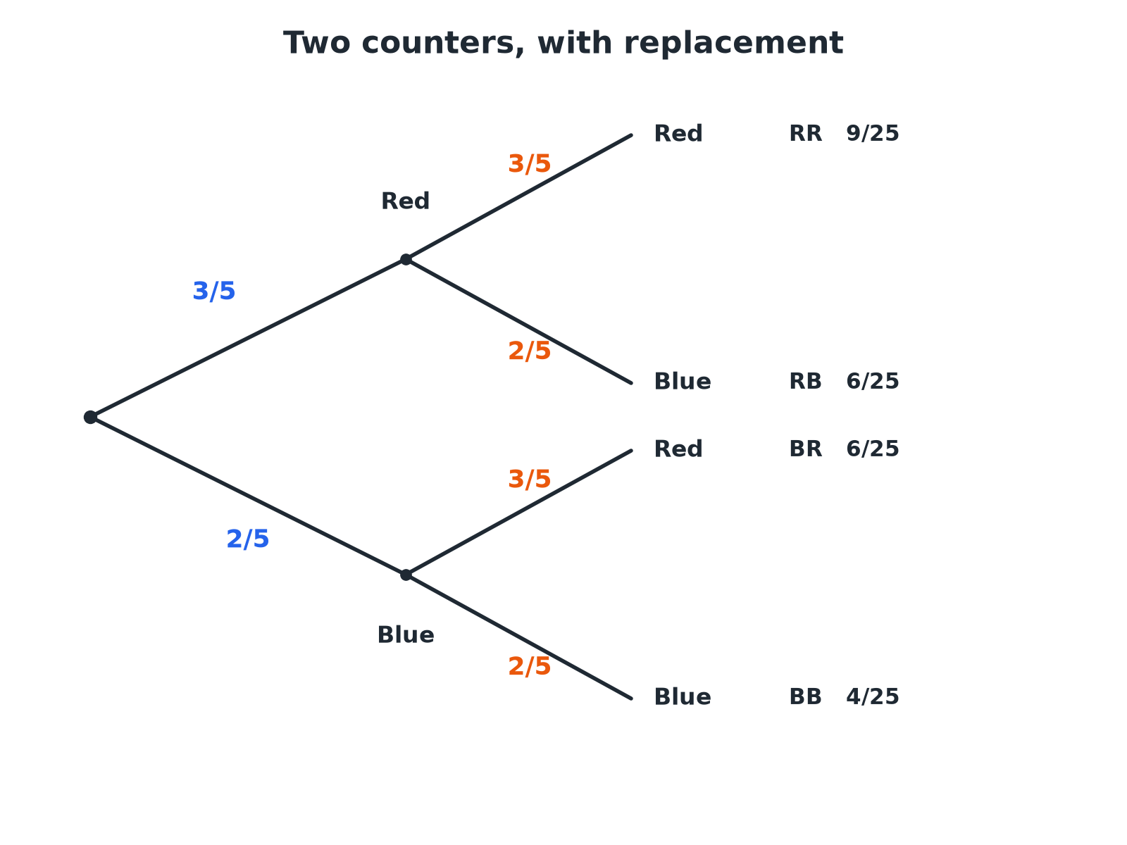

EDEXCEL GCSE MATHS · FOUNDATION & HIGHER
A Tree Diagram
Multiply along the branches; add the outcomes you want.
Probability
openrevise.com
Lesson 4 of 6

Slide 8

EDEXCEL GCSE MATHS · FOUNDATION & HIGHER
Using a Tree Diagram
Two rules do all the work.
1
2
3
4
5
Draw the branches
One set for each event, with the probability on each branch
Check
The probabilities on each set of branches add up to 1
Multiply along the branches
This gives the probability of each combined outcome
Add the outcomes you want
If more than one outcome fits, add their probabilities
Check the total
All the outcomes add up to 1
Probability
openrevise.com
Lesson 4 of 6

Slide 9
EDEXCEL GCSE MATHS · FOUNDATION & HIGHER
Two Counters with Replacement
A bag has 3 red and 2 blue counters. A counter is taken, its colour is noted and it is put back. A second counter is then taken. Find the probability that both counters are the same colour.
Both red
3/5 × 3/5 = 9/25
1
Both blue
2/5 × 2/5 = 4/25
2
Same colour means RR or BB, so add
9/25 + 4/25
3
ANSWER
13/25
Probability
openrevise.com
Lesson 4 of 6

Slide 10
EDEXCEL GCSE MATHS · FOUNDATION & HIGHER
Late Two Days
The probability that Amy is late for school on any day is 0.2, independent of other days. Find (a) the probability she is late on both of two days, (b) late on exactly one of the two days, (c) late on at least one day.
(a) Multiply
0.2 × 0.2 = 0.04
1
(b) Late then not late, or not late then late
0.2 × 0.8 + 0.8 × 0.2 = 0.16 + 0.16 = 0.32
2
(c) Use the complement: never late is 0.8 × 0.8 = 0.64
1 − 0.64 = 0.36
3
ANSWER
(a) 0.04 (b) 0.32 (c) 0.36
Probability
openrevise.com
Lesson 4 of 6

Slide 11

EDEXCEL GCSE MATHS · FOUNDATION & HIGHER
Shortcut: At Least One
"At least one" is easier by subtraction.
Find the opposite
"None" is the outcome where the event never happens.
Subtract from 1
P(at least one) = 1 − P(none).
Saves work
You avoid adding many branches.
Probability
openrevise.com
Lesson 4 of 6

Slide 12

EDEXCEL GCSE MATHS · FOUNDATION & HIGHER
The Four Outcomes
The outcomes of a two-stage tree with replacement.
Outcome
Working
Probability
Red, Red
3/5 × 3/5
9/25
Red, Blue
3/5 × 2/5
6/25
Blue, Red
2/5 × 3/5
6/25
Blue, Blue
2/5 × 2/5
4/25
Total
1
Probability
openrevise.com
Lesson 4 of 6

Slide 13

EDEXCEL GCSE MATHS · FOUNDATION & HIGHER
Key Terms
Independent
The outcome of one event does not change the other.
Tree diagram
A diagram showing the outcomes of events and their probabilities on branches.
Branch
A line on a tree diagram carrying a probability.
With replacement
Putting the item back before the next pick.
Combined event
Two or more events considered together.
Complement
The event "not A".
Probability
openrevise.com
Lesson 4 of 6

Slide 14

EDEXCEL GCSE MATHS · FOUNDATION & HIGHER
YOUR TASK
12 minutes
Free Throws
A basketball player scores a free throw with probability 0.7, independently each time. She takes two throws. Draw a tree diagram and find the probability she scores (a) both (b) exactly one (c) none.
1
Draw the tree.
2
Multiply along branches.
3
Add the outcomes needed.
WHAT A GOOD ANSWER SHOWS
(a) 0.7 × 0.7 = 0.49. (b) 0.7 × 0.3 + 0.3 × 0.7 = 0.42. (c) 0.3 × 0.3 = 0.09. The three add up to 1.
Probability
openrevise.com
Lesson 4 of 6
Notes:
Ask students to check the total is 1.

Slide 15

EDEXCEL GCSE MATHS · FOUNDATION & HIGHER
Can I...?
Decide if events are independent.
Multiply along a path.
Multiply probabilities of independent events.
Add the outcomes I want.
Draw a two-stage tree diagram.
Use "1 minus" for at least one.
Label the branches with probabilities.
Check the total is 1.
Probability
openrevise.com
Lesson 4 of 6

Slide 16
EDEXCEL GCSE MATHS · FOUNDATION & HIGHER
Summary & Exam Focus
Independent: P(A and B) = P(A) × P(B).
Multiply along the branches, add between outcomes.
The branches from a node add up to 1.
At least one = 1 − none.
EXAM FOCUS
The probability that Amy is late on any day is 0.2. Work out the probability that she is late on at least one of two days. (3 marks)
"At least one" means one minus none. Never late on both days is 0.8 × 0.8.
openrevise.com

Slide 17
EDEXCEL GCSE MATHS · FOUNDATION & HIGHER
Exam Practice: Independent Events and Tree Diagrams
Answer all questions. Show your working. · 30 minutes
Question 1 · 2 marks · Non-calculator
A and B are independent events. P(A) = 0.3 and P(B) = 0.5. Work out P(A and B).
Question 2 · 3 marks · Non-calculator
The probability that Amy is late for school on any day is 0.2. The tree diagram shows the probabilities for two days. Complete the tree…
Question 3 · 2 marks · Non-calculator
Using the tree diagram, work out the probability that Amy is late on both days.
Probability
openrevise.com
Lesson 4 of 6

Slide 18
EDEXCEL GCSE MATHS · FOUNDATION & HIGHER
Exam Practice: Independent Events and Tree Diagrams (cont.)
Question 4 · 3 marks · Non-calculator
Using the tree diagram, work out the probability that Amy is late on exactly one of the two days.
Question 5 · 3 marks · Non-calculator
Work out the probability that Amy is late on at least one of the two days.
Question 6 · 4 marks · Non-calculator
A bag contains 3 red counters and 2 blue counters. A counter is taken at random, its colour is noted and it is replaced. A second counter…
Probability
openrevise.com
Lesson 4 of 6

Slide 19
EDEXCEL GCSE MATHS · FOUNDATION & HIGHER
Question 1 · 2 marks · Non-calculator
“
A and B are independent events. P(A) = 0.3 and P(B) = 0.5. Work out P(A and B).
HOW TO ANSWER IT
Command word: Non-calculator. Worth 2 marks, so plan before writing.
Probability
openrevise.com
Lesson 4 of 6

Slide 20
EDEXCEL GCSE MATHS · FOUNDATION & HIGHER
Question 1 · mark scheme
2 marks available. Award a mark for each point made.
0.3 × 0.5
M1
0.15
A1
Probability
openrevise.com
Lesson 4 of 6

Slide 21
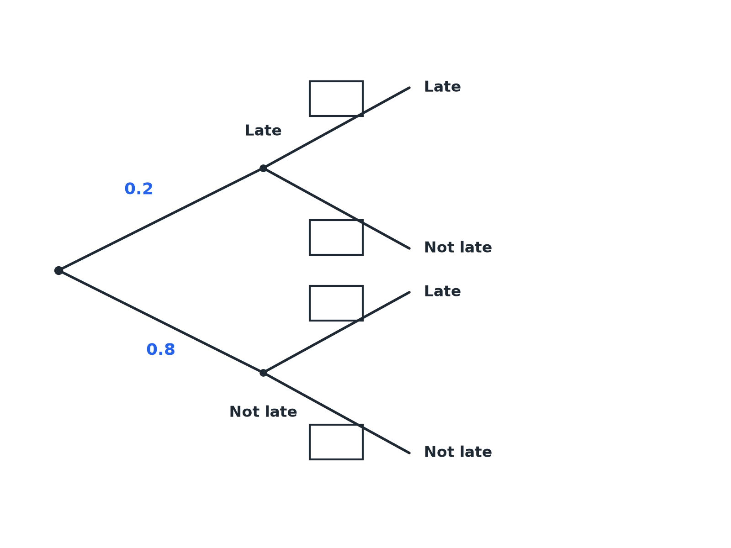
EDEXCEL GCSE MATHS · FOUNDATION & HIGHER
Question 2 · 3 marks · Non-calculator
The probability that Amy is late for school on any day is 0.2. The tree diagram shows the probabilities for two days. Complete the tree diagram. (3 marks)
Probability
openrevise.com
Lesson 4 of 6

Slide 22
EDEXCEL GCSE MATHS · FOUNDATION & HIGHER
Question 2 · mark scheme
3 marks available. Award a mark for each point made.
Late branches 0.2 on day 2
B1
Not late branches 0.8 on day 2
B1
All four correct
B1
Probability
openrevise.com
Lesson 4 of 6

Slide 23
EDEXCEL GCSE MATHS · FOUNDATION & HIGHER
Question 3 · 2 marks · Non-calculator
“
Using the tree diagram, work out the probability that Amy is late on both days.
HOW TO ANSWER IT
Command word: Non-calculator. Worth 2 marks, so plan before writing.
Probability
openrevise.com
Lesson 4 of 6

Slide 24
EDEXCEL GCSE MATHS · FOUNDATION & HIGHER
Question 3 · mark scheme
2 marks available. Award a mark for each point made.
0.2 × 0.2
M1
0.04
A1
Probability
openrevise.com
Lesson 4 of 6

Slide 25
EDEXCEL GCSE MATHS · FOUNDATION & HIGHER
Question 4 · 3 marks · Non-calculator
“
Using the tree diagram, work out the probability that Amy is late on exactly one of the two days.
HOW TO ANSWER IT
Command word: Non-calculator. Worth 3 marks, so plan before writing.
Probability
openrevise.com
Lesson 4 of 6

Slide 26
EDEXCEL GCSE MATHS · FOUNDATION & HIGHER
Question 4 · mark scheme
3 marks available. Award a mark for each point made.
One correct product
M1
Adding the two paths
M1
0.32
A1
Probability
openrevise.com
Lesson 4 of 6

Slide 27
EDEXCEL GCSE MATHS · FOUNDATION & HIGHER
Question 5 · 3 marks · Non-calculator
“
Work out the probability that Amy is late on at least one of the two days.
HOW TO ANSWER IT
Command word: Non-calculator. Worth 3 marks, so plan before writing.
Probability
openrevise.com
Lesson 4 of 6

Slide 28
EDEXCEL GCSE MATHS · FOUNDATION & HIGHER
Question 5 · mark scheme
3 marks available. Award a mark for each point made.
0.8 × 0.8
M1
1 − 0.64
M1
0.36
A1
Probability
openrevise.com
Lesson 4 of 6

Slide 29
EDEXCEL GCSE MATHS · FOUNDATION & HIGHER
Question 6 · 4 marks · Non-calculator
“
A bag contains 3 red counters and 2 blue counters. A counter is taken at random, its colour is noted and it is replaced. A second counter is taken. Work out the probability that the two counters are the same colour.
HOW TO ANSWER IT
Command word: Non-calculator. Worth 4 marks, so plan before writing.
Probability
openrevise.com
Lesson 4 of 6

Slide 30
EDEXCEL GCSE MATHS · FOUNDATION & HIGHER
Question 6 · mark scheme
4 marks available. Award a mark for each point made.
3/5 × 3/5
M1
2/5 × 2/5
M1
Adding the two
M1
13/25
A1
Probability
openrevise.com
Lesson 4 of 6

