Slide 1

EDEXCEL GCSE MATHS · HIGHER
Conditional probability
Probability
Lesson 5 of 6
openrevise.com

Slide 2

EDEXCEL GCSE MATHS · HIGHER
Warm-up
Answer each one, then check.
1
Work out ⅝ × 4/7.
2
Simplify 30/56.
3
Work out 1 − 5/14.
4
What does "independent" mean?
5
What does "with replacement" mean?
Probability
openrevise.com
Lesson 5 of 6

Slide 3
EDEXCEL GCSE MATHS · HIGHER
Warm-up - Answers
Work out ⅝ × 4/7.
5/14
1
Simplify 30/56.
15/28
2
Work out 1 − 5/14.
9/14
3
What does "independent" mean?
One event does not affect the other
4
What does "with replacement" mean?
The item is put back before the next pick
5
Probability
openrevise.com
Lesson 5 of 6

Slide 4

EDEXCEL GCSE MATHS · HIGHER
Learning Objectives
Explain what conditional probability means.
1
Draw a tree diagram for events without replacement.
2
Work out probabilities of combined events without replacement.
3
Find a conditional probability from a two-way table.
4
Probability
openrevise.com
Lesson 5 of 6

Slide 5

EDEXCEL GCSE MATHS · HIGHER
CONDITIONAL PROBABILITY
The probability of an event happening, given that another event has already happened, is a conditional probability.
Without replacement, the numbers change after each pick.
Probability
openrevise.com
Lesson 5 of 6

Slide 6
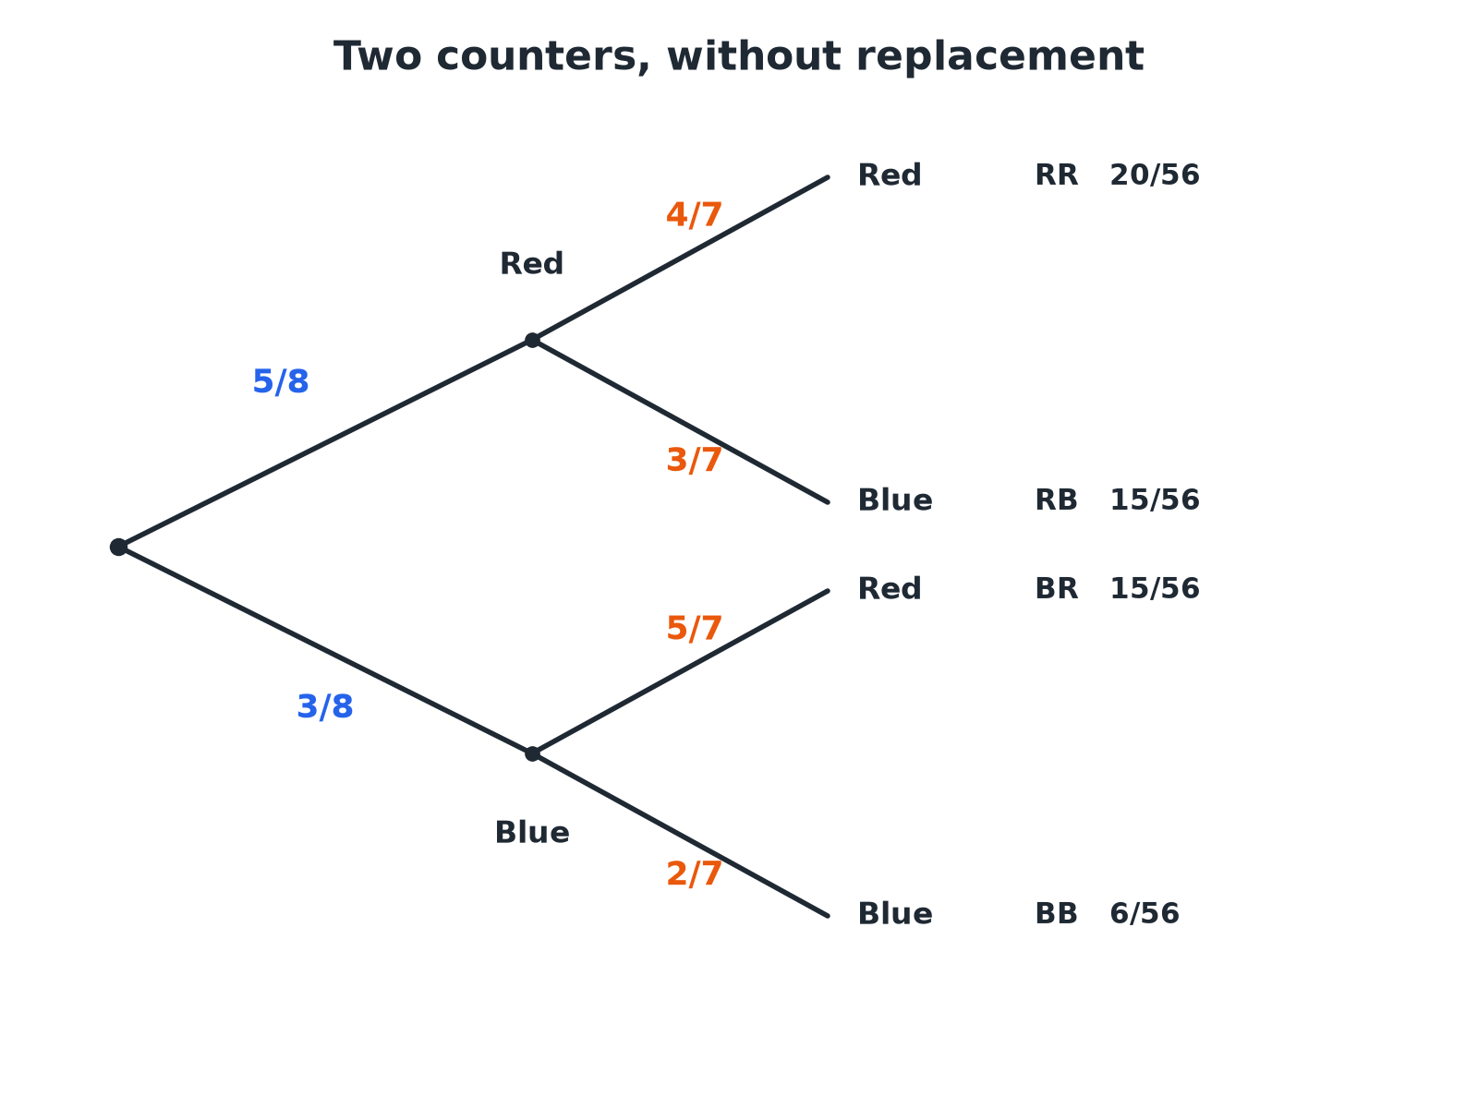

EDEXCEL GCSE MATHS · HIGHER
A Tree Without Replacement
After one counter is taken, only 7 are left, so the second-stage probabilities change.
Probability
openrevise.com
Lesson 5 of 6

Slide 7

EDEXCEL GCSE MATHS · HIGHER
Without Replacement
A bag has 5 red and 3 blue counters. Two counters are taken at random without replacement. Find the probability that both are red.
First counter red
⅝
1
Now 4 red among 7 remaining
4/7
2
Multiply
⅝ × 4/7 = 20/56
3
Simplify
5/14
4
ANSWER
5/14
Probability
openrevise.com
Lesson 5 of 6

Slide 8
EDEXCEL GCSE MATHS · HIGHER
One of Each Colour
For the same bag, find the probability that the two counters are different colours.
Red then blue
⅝ × 3/7 = 15/56
1
Blue then red
⅜ × 5/7 = 15/56
2
Add
30/56
3
Simplify
15/28
4
ANSWER
15/28
Probability
openrevise.com
Lesson 5 of 6

Slide 9
EDEXCEL GCSE MATHS · HIGHER
At Least One Red
A bag has 4 red and 6 blue counters. Two are taken without replacement. Find the probability that at least one is red.
At least one red is the opposite of both blue
Use 1 − P(both blue)
1
Both blue
6/10 × 5/9 = 30/90 = ⅓
2
Subtract from 1
1 − ⅓ = ⅔
3
ANSWER
⅔
Probability
openrevise.com
Lesson 5 of 6

Slide 10

EDEXCEL GCSE MATHS · HIGHER
Two-Way Tables
Conditional probabilities can be read from a table by restricting to a group.
The idea
For "given that", use only the people in that group as the total.
Example
60 students: 35 like football, and 20 of those are boys. Given that a student likes football, the probability that they are a boy is 20/35.
Simplify
20/35 = 4/7.
Probability
openrevise.com
Lesson 5 of 6

Slide 11

EDEXCEL GCSE MATHS · HIGHER
A Two-Way Table
60 students were asked whether they like football.
Likes football
Does not like football
Total
Boys
20
10
30
Girls
15
15
30
Total
35
25
60
Probability
openrevise.com
Lesson 5 of 6

Slide 12
EDEXCEL GCSE MATHS · HIGHER
Given That
Use the table. A student is chosen at random. Find the probability that they are a boy given that they like football.
Restrict to students who like football
35 students
1
Boys among them
20
2
Probability
20/35 = 4/7
3
ANSWER
4/7
Probability
openrevise.com
Lesson 5 of 6

Slide 13

EDEXCEL GCSE MATHS · HIGHER
Key Terms
Conditional probability
The probability of an event given that another has happened.
Without replacement
The item is not put back, so later probabilities change.
Dependent events
Events where one affects the probability of the other.
Tree diagram
A diagram showing outcomes and probabilities on branches.
Two-way table
A table showing two categories at once.
Complement
The event "not A".
Probability
openrevise.com
Lesson 5 of 6

Slide 14

EDEXCEL GCSE MATHS · HIGHER
YOUR TASK
12 minutes
Cards Without Replacement
Three cards are taken from a pack of ten cards numbered 1 to 10, one after another without replacement. Find the probability that the first is even and the second is odd, and that the first two are both greater than 7.
Reduce the numbers after each pick.
1
Multiply along the path.
2
WHAT A GOOD ANSWER SHOWS
First even and second odd: 5/10 × 5/9 = 25/90 = 5/18. Both greater than 7: 3/10 × 2/9 = 6/90 = 1/15.
Probability
openrevise.com
Lesson 5 of 6
Notes:
Ask why the second denominator is 9.

Slide 15

EDEXCEL GCSE MATHS · HIGHER
Can I...?
Explain what conditional means.
Add paths for combined outcomes.
Adjust the numbers after a pick.
Use "1 minus" for at least one.
Draw a tree diagram without replacement.
Find a conditional probability from a table.
Multiply along the branches.
Simplify my fractions.
Probability
openrevise.com
Lesson 5 of 6

Slide 16
EDEXCEL GCSE MATHS · HIGHER
Summary & Exam Focus
Without replacement, probabilities on the second branches change.
Multiply along the branches; add different paths.
"Given that" means restrict to that group.
At least one = 1 − none.
EXAM FOCUS
A bag has 5 red and 3 blue counters. Two counters are taken at random without replacement. Work out the probability that the counters are different colours. (3 marks)
Both orders count: red then blue AND blue then red. Reduce the total by 1 for the second pick.
openrevise.com

Slide 17
EDEXCEL GCSE MATHS · HIGHER
Exam Practice: Conditional Probability
Answer all questions. Show your working. · 30 minutes
Question 1 · 3 marks · Non-calculator
A bag contains 5 red counters and 3 blue counters. Two counters are taken at random without replacement. Work out the probability that both…
Question 2 · 3 marks · Non-calculator
For the same bag, work out the probability that the two counters are different colours.
Question 3 · 3 marks · Non-calculator
A bag contains 4 red counters and 6 blue counters. Two counters are taken at random without replacement. Complete the tree diagram.
Probability
openrevise.com
Lesson 5 of 6

Slide 18
EDEXCEL GCSE MATHS · HIGHER
Exam Practice: Conditional Probability (cont.)
Question 4 · 3 marks · Non-calculator
Using the tree diagram, work out the probability that both counters are blue.
Question 5 · 3 marks · Non-calculator
Using the tree diagram, work out the probability that at least one of the counters is red.
Question 6 · 3 marks · Non-calculator
60 students were asked whether they like football. 35 like football, and 20 of these are boys. 30 of the 60 students are boys. A student is…
Probability
openrevise.com
Lesson 5 of 6

Slide 19
EDEXCEL GCSE MATHS · HIGHER
Question 1 · 3 marks · Non-calculator
“
A bag contains 5 red counters and 3 blue counters. Two counters are taken at random without replacement. Work out the probability that both counters are red.
HOW TO ANSWER IT
Command word: Non-calculator. Worth 3 marks, so plan before writing.
Probability
openrevise.com
Lesson 5 of 6

Slide 20
EDEXCEL GCSE MATHS · HIGHER
Question 1 · mark scheme
3 marks available. Award a mark for each point made.
⅝
M1
⅝ × 4/7
M1
5/14
A1
Probability
openrevise.com
Lesson 5 of 6

Slide 21
EDEXCEL GCSE MATHS · HIGHER
Question 2 · 3 marks · Non-calculator
“
For the same bag, work out the probability that the two counters are different colours.
HOW TO ANSWER IT
Command word: Non-calculator. Worth 3 marks, so plan before writing.
Probability
openrevise.com
Lesson 5 of 6

Slide 22
EDEXCEL GCSE MATHS · HIGHER
Question 2 · mark scheme
3 marks available. Award a mark for each point made.
One correct product
M1
Adding both orders
M1
15/28
A1
Probability
openrevise.com
Lesson 5 of 6

Slide 23
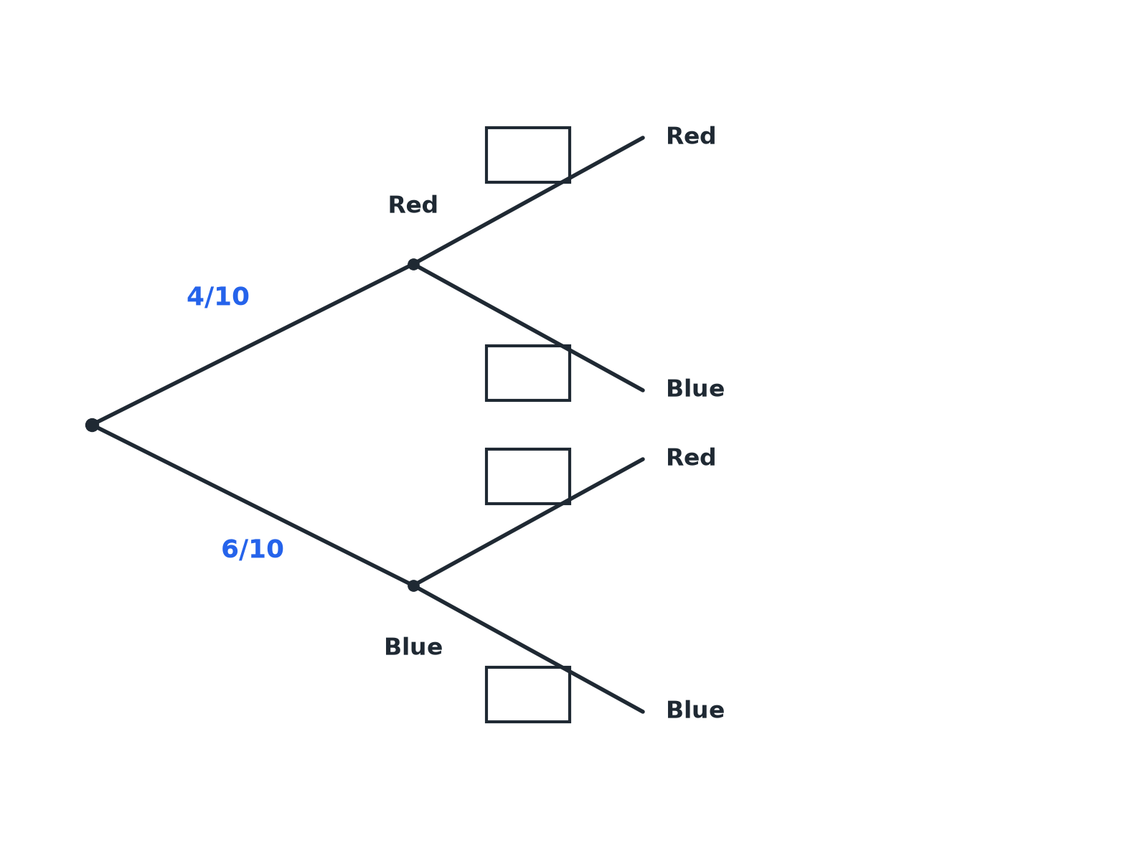
EDEXCEL GCSE MATHS · HIGHER
Question 3 · 3 marks · Non-calculator
A bag contains 4 red counters and 6 blue counters. Two counters are taken at random without replacement. Complete the tree diagram. (3 marks)
Probability
openrevise.com
Lesson 5 of 6

Slide 24
EDEXCEL GCSE MATHS · HIGHER
Question 3 · mark scheme
3 marks available. Award a mark for each point made.
Denominator 9 on all four branches
B1
After red: 3/9, 6/9
B1
After blue: 4/9, 5/9
B1
Probability
openrevise.com
Lesson 5 of 6

Slide 25
EDEXCEL GCSE MATHS · HIGHER
Question 4 · 3 marks · Non-calculator
“
Using the tree diagram, work out the probability that both counters are blue.
HOW TO ANSWER IT
Command word: Non-calculator. Worth 3 marks, so plan before writing.
Probability
openrevise.com
Lesson 5 of 6

Slide 26
EDEXCEL GCSE MATHS · HIGHER
Question 4 · mark scheme
3 marks available. Award a mark for each point made.
6/10 × 5/9
M1
30/90
A1
⅓
A1
Probability
openrevise.com
Lesson 5 of 6

Slide 27
EDEXCEL GCSE MATHS · HIGHER
Question 5 · 3 marks · Non-calculator
“
Using the tree diagram, work out the probability that at least one of the counters is red.
HOW TO ANSWER IT
Command word: Non-calculator. Worth 3 marks, so plan before writing.
Probability
openrevise.com
Lesson 5 of 6

Slide 28
EDEXCEL GCSE MATHS · HIGHER
Question 5 · mark scheme
3 marks available. Award a mark for each point made.
1 − P(both blue)
M1
1 − ⅓
M1
⅔
A1
Probability
openrevise.com
Lesson 5 of 6

Slide 29
EDEXCEL GCSE MATHS · HIGHER
Question 6 · 3 marks · Non-calculator
“
60 students were asked whether they like football. 35 like football, and 20 of these are boys. 30 of the 60 students are boys. A student is chosen at random. Given that the student likes football, work out the probability that they are a boy.
HOW TO ANSWER IT
Command word: Non-calculator. Worth 3 marks, so plan before writing.
Probability
openrevise.com
Lesson 5 of 6

Slide 30
EDEXCEL GCSE MATHS · HIGHER
Question 6 · mark scheme
3 marks available. Award a mark for each point made.
35 as the total
M1
20/35
A1
4/7
A1
Probability
openrevise.com
Lesson 5 of 6

