Slide 1

EDEXCEL GCSE MATHS · FOUNDATION & HIGHER
Growth and decay
Multiplicative reasoning
Lesson 1 of 4
openrevise.com

Slide 2

EDEXCEL GCSE MATHS · FOUNDATION & HIGHER
Warm-up
Answer each one, then check.
1
What is the multiplier for a 15% increase?
2
What is the multiplier for a 20% decrease?
3
Work out 1.1².
4
Increase £200 by 10%.
5
What is 0.5³?
Multiplicative reasoning
openrevise.com
Lesson 1 of 4

Slide 3
EDEXCEL GCSE MATHS · FOUNDATION & HIGHER
Warm-up - Answers
What is the multiplier for a 15% increase?
1.15
1
What is the multiplier for a 20% decrease?
0.8
2
Work out 1.1².
1.21
3
Increase £200 by 10%.
£220
4
What is 0.5³?
0.125
5
Multiplicative reasoning
openrevise.com
Lesson 1 of 4

Slide 4

EDEXCEL GCSE MATHS · FOUNDATION & HIGHER
Learning Objectives
Use multipliers for repeated percentage change.
1
Calculate compound interest and depreciation.
2
Use the formula final = initial × multiplierⁿ.
3
Solve growth and decay problems in context.
4
Multiplicative reasoning
openrevise.com
Lesson 1 of 4

Slide 5

EDEXCEL GCSE MATHS · FOUNDATION & HIGHER
THE KEY IDEA
For repeated percentage change, multiply by the multiplier once for each period.
final amount = original amount × (multiplier)ⁿ
Multiplicative reasoning
openrevise.com
Lesson 1 of 4

Slide 6

EDEXCEL GCSE MATHS · FOUNDATION & HIGHER
Multipliers
Write the multiplier as a decimal.
Change
Multiplier
Type
Increase by 5%
1.05
Growth
Increase by 20%
1.2
Growth
Decrease by 15%
0.85
Decay
Decrease by 40%
0.6
Decay
Halves each time
0.5
Decay
Doubles each time
2
Growth
Multiplicative reasoning
openrevise.com
Lesson 1 of 4

Slide 7

EDEXCEL GCSE MATHS · FOUNDATION & HIGHER
Compound Interest
£5000 is invested at 3% compound interest per year. Work out its value after 4 years.
Multiplier for a 3% increase
1.03
1
Apply it 4 times
5000 × 1.03⁴
2
Work it out
5000 × 1.12550881 = 5627.54
3
ANSWER
£5627.54
Multiplicative reasoning
openrevise.com
Lesson 1 of 4

Slide 8
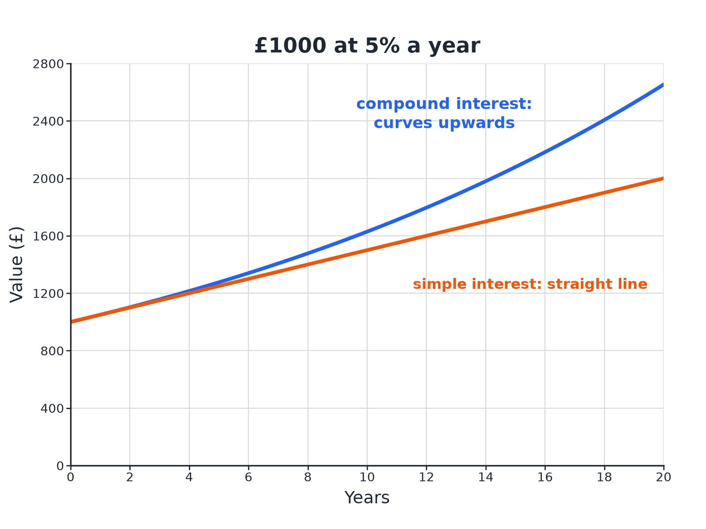

EDEXCEL GCSE MATHS · FOUNDATION & HIGHER
Compound Growth Beats Simple Interest
Compound interest earns interest on interest, so its graph curves upwards.
Multiplicative reasoning
openrevise.com
Lesson 1 of 4

Slide 9
EDEXCEL GCSE MATHS · FOUNDATION & HIGHER
Depreciation
A car worth £12 000 loses 15% of its value each year. Find its value after 3 years.
Multiplier for a 15% decrease
0.85
1
Apply it 3 times
12 000 × 0.85³
2
Work it out
12 000 × 0.614125
3
ANSWER
£7369.50
Multiplicative reasoning
openrevise.com
Lesson 1 of 4

Slide 10
EDEXCEL GCSE MATHS · FOUNDATION & HIGHER
Exponential Growth
A culture of 500 bacteria grows by 20% every hour. Find the number of bacteria after 6 hours, to the nearest whole number.
Multiplier
1.2
1
Apply it 6 times
500 × 1.2⁶
2
Work it out
500 × 2.985984 = 1492.99
3
ANSWER
1493 bacteria
Multiplicative reasoning
openrevise.com
Lesson 1 of 4

Slide 11
EDEXCEL GCSE MATHS · FOUNDATION & HIGHER
Halving Each Time
A radioactive sample has mass 80 g. Its mass halves every 10 days. Find its mass after 30 days.
30 days is three halvings
30 ÷ 10 = 3
1
Multiplier
0.5
2
Apply it 3 times
80 × 0.5³ = 80 × 0.125
3
ANSWER
10 g
Multiplicative reasoning
openrevise.com
Lesson 1 of 4

Slide 12

EDEXCEL GCSE MATHS · FOUNDATION & HIGHER
Growth or Decay?
GROWTH
DECAY
• The multiplier is greater than 1.
• Examples: interest, population increase, inflation.
• The graph curves upwards.
• The multiplier is between 0 and 1.
• Examples: depreciation, radioactive decay, cooling.
• The graph curves down and flattens towards zero.
Multiplicative reasoning
openrevise.com
Lesson 1 of 4

Slide 13

EDEXCEL GCSE MATHS · FOUNDATION & HIGHER
Working Backwards and Solving for Time
Sometimes the unknown is the starting amount or the number of periods.
Original value
Divide by the multiplier: if £441 is after 2 years at 5%, the start is 441 ÷ 1.05² = £400.
Number of periods
Try values of n in initial × multiplierⁿ until you reach the target.
Use the formula
Write the equation first, then substitute.
Multiplicative reasoning
openrevise.com
Lesson 1 of 4

Slide 14

EDEXCEL GCSE MATHS · FOUNDATION & HIGHER
Key Terms
Multiplier
The number you multiply by to increase or decrease.
Compound interest
Interest paid on the original amount and on interest already added.
Depreciation
The fall in value of an item over time.
Exponential growth
Growth by a constant multiplier greater than 1 each period.
Exponential decay
Decay by a constant multiplier between 0 and 1 each period.
Original value
The amount at the start.
Multiplicative reasoning
openrevise.com
Lesson 1 of 4

Slide 15

EDEXCEL GCSE MATHS · FOUNDATION & HIGHER
YOUR TASK
12 minutes
Double Your Money
An investment of £1000 earns 6% compound interest per year. By trying different numbers of years, find how many complete years it takes for the value to reach at least £2000.
Use a table of values.
1
Check the final year carefully.
2
WHAT A GOOD ANSWER SHOWS
1000 × 1.06¹¹ = 1898.30 and 1000 × 1.06¹² = 2012.20. It takes 12 years.
Multiplicative reasoning
openrevise.com
Lesson 1 of 4

Slide 16

EDEXCEL GCSE MATHS · FOUNDATION & HIGHER
Can I...?
Find a multiplier from a percentage change.
Solve exponential growth problems.
Use a power for repeated change.
Solve exponential decay problems.
Calculate compound interest.
Find an original value.
Calculate depreciation.
Find the number of periods by trial.
Multiplicative reasoning
openrevise.com
Lesson 1 of 4

Slide 17
EDEXCEL GCSE MATHS · FOUNDATION & HIGHER
Summary & Exam Focus
Growth multiplier above 1; decay multiplier below 1.
Final = initial × multiplierⁿ.
Compound interest and depreciation use the same idea.
To reverse a change, divide by the multiplier.
EXAM FOCUS
A car is worth £12 000. It loses 15% of its value each year. Work out its value after 3 years. (3 marks)
Write the multiplier, then use the power. Do not calculate 15% three times separately.
openrevise.com

