Slide 1

EDEXCEL GCSE MATHS · FOUNDATION & HIGHER
Similarity
Similarity and congruence
Lesson 3 of 5
openrevise.com

Slide 2

EDEXCEL GCSE MATHS · FOUNDATION & HIGHER
Warm-up
Answer each one, then check.
1
What is the scale factor from 4 cm to 10 cm?
2
Write 3:5 as a fraction of the total.
3
Work out 9 × 1.5.
4
What does congruent mean?
5
What do the angles in a triangle add up to?
Similarity and congruence
openrevise.com
Lesson 3 of 5

Slide 3
EDEXCEL GCSE MATHS · FOUNDATION & HIGHER
Warm-up - Answers
What is the scale factor from 4 cm to 10 cm?
2.5
1
Write 3:5 as a fraction of the total.
⅜ and ⅝
2
Work out 9 × 1.5.
13.5
3
What does congruent mean?
Same shape and size
4
What do the angles in a triangle add up to?
180°
5
Similarity and congruence
openrevise.com
Lesson 3 of 5

Slide 4

EDEXCEL GCSE MATHS · FOUNDATION & HIGHER
Learning Objectives
Explain what similar means.
1
Find scale factors between similar shapes.
2
Find missing lengths in similar shapes.
3
Show that two triangles are similar using equal angles.
4
Similarity and congruence
openrevise.com
Lesson 3 of 5

Slide 5

EDEXCEL GCSE MATHS · FOUNDATION & HIGHER
SIMILAR
Two shapes are similar if they have the same shape but not necessarily the same size: their angles are equal and their lengths are in the same ratio.
The scale factor is the ratio of corresponding lengths.
Similarity and congruence
openrevise.com
Lesson 3 of 5

Slide 6
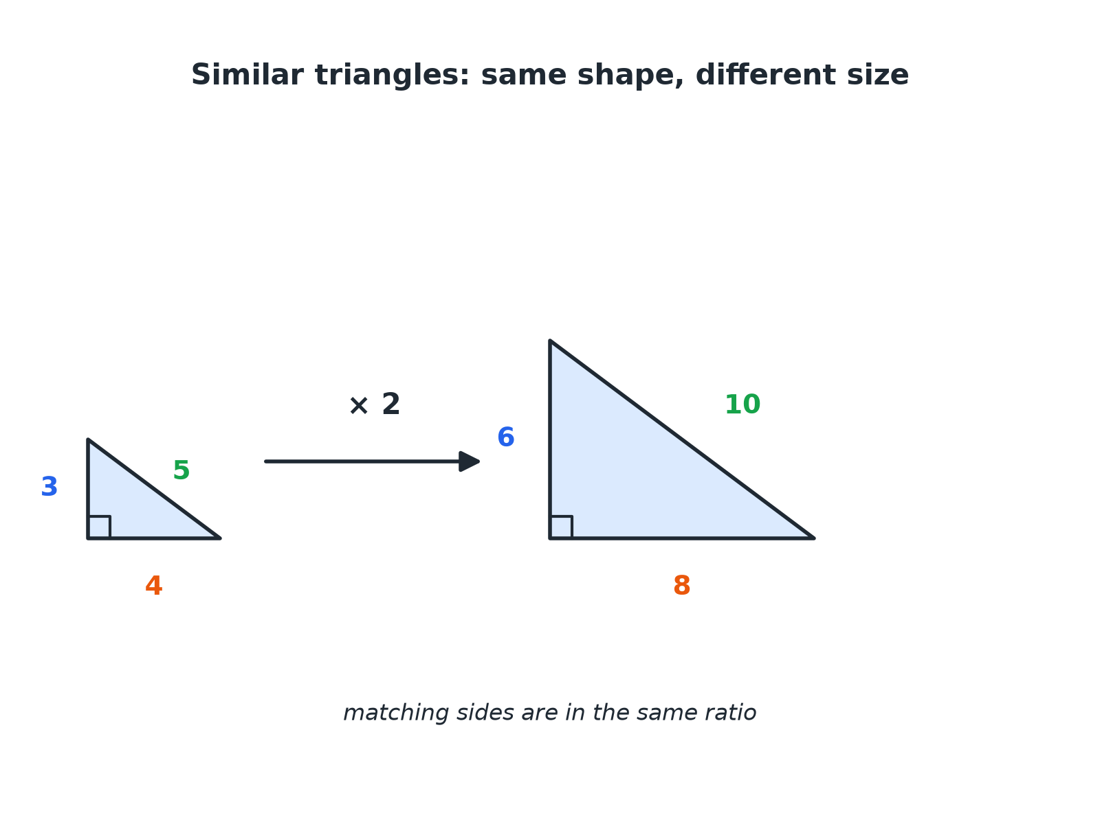

EDEXCEL GCSE MATHS · FOUNDATION & HIGHER
Similar Triangles
Every side is multiplied by the same scale factor.
Similarity and congruence
openrevise.com
Lesson 3 of 5

Slide 7

EDEXCEL GCSE MATHS · FOUNDATION & HIGHER
Facts About Similar Shapes
Angles
All corresponding angles are equal.
Lengths
All corresponding lengths are in the same ratio.
Scale factor
The number you multiply by to go from one shape to the other.
Congruent is a special case
A scale factor of 1.
Similarity and congruence
openrevise.com
Lesson 3 of 5

Slide 8

EDEXCEL GCSE MATHS · FOUNDATION & HIGHER
Finding a Missing Length
Use the scale factor.
1
2
3
4
Match the corresponding sides
Find a pair where both lengths are known
Work out the scale factor
Larger ÷ smaller
Multiply or divide
Depending on the direction you go
Check
The answer should look sensible
Similarity and congruence
openrevise.com
Lesson 3 of 5

Slide 9

EDEXCEL GCSE MATHS · FOUNDATION & HIGHER
A Missing Side
Triangles ABC and DEF are similar. AB = 6 cm, BC = 10 cm and AC = 8 cm. DE = 9 cm. Find EF and DF.
Scale factor
DE/AB = 9/6 = 1.5
1
EF corresponds to BC
10 × 1.5 = 15
2
DF corresponds to AC
8 × 1.5 = 12
3
ANSWER
EF = 15 cm and DF = 12 cm.
Similarity and congruence
openrevise.com
Lesson 3 of 5

Slide 10
EDEXCEL GCSE MATHS · FOUNDATION & HIGHER
Similar Rectangles
Rectangle A is 4 cm by 6 cm. Rectangle B is similar to A and 10 cm long on its shorter side. Find the other side of B.
Scale factor
10 ÷ 4 = 2.5
1
Other side
6 × 2.5
2
ANSWER
15 cm
Similarity and congruence
openrevise.com
Lesson 3 of 5

Slide 11
EDEXCEL GCSE MATHS · FOUNDATION & HIGHER
Showing Triangles Are Similar
In triangle PQR, angle P = 50° and angle Q = 60°. In triangle XYZ, angle X = 50° and angle Z = 70°. Show that the triangles are similar.
Find angle R
180 − 50 − 60 = 70°
1
Find angle Y
180 − 50 − 70 = 60°
2
All three angles match
50°, 60°, 70°
3
ANSWER
The triangles have equal angles, so they are similar.
Similarity and congruence
openrevise.com
Lesson 3 of 5

Slide 12

EDEXCEL GCSE MATHS · FOUNDATION & HIGHER
Similar or Congruent?
SIMILAR
CONGRUENT
• Same shape, possibly different size.
• Equal angles, sides in the same ratio.
• Scale factor may be any number.
• Same shape and same size.
• Equal angles and equal sides.
• Scale factor 1.
Similarity and congruence
openrevise.com
Lesson 3 of 5

Slide 13

EDEXCEL GCSE MATHS · FOUNDATION & HIGHER
Key Terms
Similar
The same shape but a different size.
Scale factor
The multiplier that takes one length to the corresponding length.
Corresponding sides
Sides in matching positions.
Ratio
A comparison of two quantities.
Enlargement
A transformation that produces similar shapes.
Equiangular
Having equal angles.
Similarity and congruence
openrevise.com
Lesson 3 of 5

Slide 14

EDEXCEL GCSE MATHS · FOUNDATION & HIGHER
YOUR TASK
10 minutes
Photo Enlargement
A photograph is 12 cm by 8 cm. It is enlarged to fit a frame that is 30 cm wide. Find the height of the enlargement and the scale factor. Then say whether a 30 cm by 18 cm frame would suit the photograph.
1
Find the scale factor.
2
Apply it to the other side.
3
Compare ratios.
WHAT A GOOD ANSWER SHOWS
Scale factor 30 ÷ 12 = 2.5, so the height is 8 × 2.5 = 20 cm. A 30 by 18 frame is not similar to 12 by 8, because 18 ÷ 8 = 2.25 ≠ 2.5, so the picture would be distorted.
Similarity and congruence
openrevise.com
Lesson 3 of 5
Notes:
Link to aspect ratio on screens.

Slide 15

EDEXCEL GCSE MATHS · FOUNDATION & HIGHER
Can I...?
Say what similar means.
Use scale factors less than 1.
Find a scale factor.
Show triangles are similar by angles.
Find a missing length.
Identify corresponding sides.
Use scale factors greater than 1.
Explain the difference from congruent.
Similarity and congruence
openrevise.com
Lesson 3 of 5

Slide 16
EDEXCEL GCSE MATHS · FOUNDATION & HIGHER
Summary & Exam Focus
Similar shapes have equal angles and proportional sides.
Scale factor = new length ÷ old length.
Match corresponding sides carefully.
Two equal angles are enough to show triangles are similar.
EXAM FOCUS
Triangles ABC and DEF are similar. AB = 6 cm, BC = 10 cm, DE = 9 cm. Work out the length of EF. (3 marks)
Find the scale factor from a pair of sides you know, then use it on the side you need. Make sure the sides really correspond.
openrevise.com

Slide 17
EDEXCEL GCSE MATHS · FOUNDATION & HIGHER
Exam Practice: Similarity
Answer all questions. Show your working. · 25 minutes
Question 1 · 3 marks · Work out
The diagram shows two similar triangles, ABC and DEF. AB = 6 cm, BC = 10 cm, AC = 8 cm and DE = 9 cm. Work out the length of EF.
Question 2 · 2 marks · Work out
For the triangles in the last question, work out the length of DF.
Question 3 · 3 marks · Work out
Rectangle A is 4 cm by 6 cm. Rectangle B is similar to rectangle A. The shorter side of rectangle B is 10 cm. Work out the length of the…
Similarity and congruence
openrevise.com
Lesson 3 of 5

Slide 18
EDEXCEL GCSE MATHS · FOUNDATION & HIGHER
Exam Practice: Similarity (cont.)
Question 4 · 3 marks · Show that
In triangle PQR, angle P = 50° and angle Q = 60°. In triangle XYZ, angle X = 50° and angle Z = 70°. Show that triangles PQR and XYZ are…
Question 5 · 2 marks · Explain
A photograph is 12 cm by 8 cm. It is enlarged so that its width is 30 cm. Work out the height of the enlarged photograph.
Question 6 · 2 marks · Decide
Are a 3 cm by 5 cm rectangle and a 9 cm by 14 cm rectangle similar? Give a reason.
Similarity and congruence
openrevise.com
Lesson 3 of 5

Slide 19
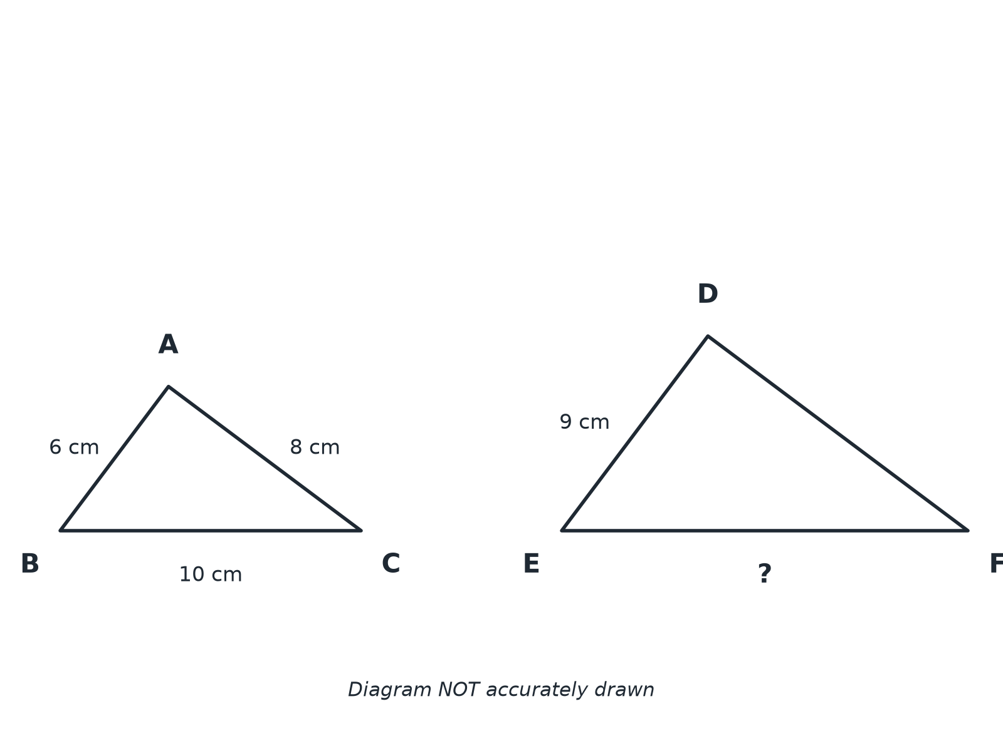
EDEXCEL GCSE MATHS · FOUNDATION & HIGHER
Question 1 · 3 marks · Work out
The diagram shows two similar triangles, ABC and DEF. AB = 6 cm, BC = 10 cm, AC = 8 cm and DE = 9 cm. Work out the length of EF. (3 marks)
Similarity and congruence
openrevise.com
Lesson 3 of 5

Slide 20
EDEXCEL GCSE MATHS · FOUNDATION & HIGHER
Question 1 · mark scheme
3 marks available. Award a mark for each point made.
Scale factor 1.5
M1
10 × 1.5
M1
15
A1
Similarity and congruence
openrevise.com
Lesson 3 of 5

Slide 21
EDEXCEL GCSE MATHS · FOUNDATION & HIGHER
Question 2 · 2 marks · Work out
“
For the triangles in the last question, work out the length of DF.
HOW TO ANSWER IT
Command word: Work out. Worth 2 marks, so plan before writing.
Similarity and congruence
openrevise.com
Lesson 3 of 5

Slide 22
EDEXCEL GCSE MATHS · FOUNDATION & HIGHER
Question 2 · mark scheme
2 marks available. Award a mark for each point made.
8 × 1.5
M1
12
A1
Similarity and congruence
openrevise.com
Lesson 3 of 5

Slide 23
EDEXCEL GCSE MATHS · FOUNDATION & HIGHER
Question 3 · 3 marks · Work out
“
Rectangle A is 4 cm by 6 cm. Rectangle B is similar to rectangle A. The shorter side of rectangle B is 10 cm. Work out the length of the longer side of rectangle B.
HOW TO ANSWER IT
Command word: Work out. Worth 3 marks, so plan before writing.
Similarity and congruence
openrevise.com
Lesson 3 of 5

Slide 24
EDEXCEL GCSE MATHS · FOUNDATION & HIGHER
Question 3 · mark scheme
3 marks available. Award a mark for each point made.
Scale factor 2.5
M1
6 × 2.5
M1
15
A1
Similarity and congruence
openrevise.com
Lesson 3 of 5

Slide 25
EDEXCEL GCSE MATHS · FOUNDATION & HIGHER
Question 4 · 3 marks · Show that
“
In triangle PQR, angle P = 50° and angle Q = 60°. In triangle XYZ, angle X = 50° and angle Z = 70°. Show that triangles PQR and XYZ are similar.
HOW TO ANSWER IT
Command word: Show that. Worth 3 marks, so plan before writing.
Similarity and congruence
openrevise.com
Lesson 3 of 5

Slide 26
EDEXCEL GCSE MATHS · FOUNDATION & HIGHER
Question 4 · mark scheme
3 marks available. Award a mark for each point made.
Finding a third angle
M1
Finding the other third angle
M1
All angles equal, so similar
C1
Similarity and congruence
openrevise.com
Lesson 3 of 5

Slide 27
EDEXCEL GCSE MATHS · FOUNDATION & HIGHER
Question 5 · 2 marks · Explain
“
A photograph is 12 cm by 8 cm. It is enlarged so that its width is 30 cm. Work out the height of the enlarged photograph.
HOW TO ANSWER IT
Command word: Explain. Worth 2 marks, so plan before writing.
Similarity and congruence
openrevise.com
Lesson 3 of 5

Slide 28
EDEXCEL GCSE MATHS · FOUNDATION & HIGHER
Question 5 · mark scheme
2 marks available. Award a mark for each point made.
30 ÷ 12
M1
20
A1
Similarity and congruence
openrevise.com
Lesson 3 of 5

Slide 29
EDEXCEL GCSE MATHS · FOUNDATION & HIGHER
Question 6 · 2 marks · Decide
“
Are a 3 cm by 5 cm rectangle and a 9 cm by 14 cm rectangle similar? Give a reason.
HOW TO ANSWER IT
Command word: Decide. Worth 2 marks, so plan before writing.
Similarity and congruence
openrevise.com
Lesson 3 of 5

Slide 30
EDEXCEL GCSE MATHS · FOUNDATION & HIGHER
Question 6 · mark scheme
2 marks available. Award a mark for each point made.
Comparing the ratios
M1
Not similar with a reason
C1
Similarity and congruence
openrevise.com
Lesson 3 of 5

