Slide 1

EDEXCEL GCSE MATHS · FOUNDATION & HIGHER
Accuracy
More trigonometry
Lesson 1 of 9
openrevise.com

Slide 2

EDEXCEL GCSE MATHS · FOUNDATION & HIGHER
Warm-up
Answer each one, then check.
1
Round 3.47 to 1 decimal place.
2
Round 4650 to the nearest 100.
3
What does < mean?
4
What does ≤ mean?
5
Round 0.0364 to 2 significant figures.
More trigonometry
openrevise.com
Lesson 1 of 9

Slide 3
EDEXCEL GCSE MATHS · FOUNDATION & HIGHER
Warm-up - Answers
Round 3.47 to 1 decimal place.
3.5
1
Round 4650 to the nearest 100.
4700
2
What does < mean?
Less than
3
What does ≤ mean?
Less than or equal to
4
Round 0.0364 to 2 significant figures.
0.036
5
More trigonometry
openrevise.com
Lesson 1 of 9

Slide 4

EDEXCEL GCSE MATHS · FOUNDATION & HIGHER
Learning Objectives
Find the upper and lower bounds of a rounded number.
1
Write an error interval using inequalities.
2
Find bounds for sums, differences, products and quotients (Higher).
3
Choose a sensible degree of accuracy for an answer.
4
More trigonometry
openrevise.com
Lesson 1 of 9

Slide 5

EDEXCEL GCSE MATHS · FOUNDATION & HIGHER
BOUNDS
A rounded value could have started anywhere in a range: half a unit either side of it.
If a number is rounded to the nearest 10, the range is 5 either side. Nearest 1: 0.5 either side. Nearest 0.1: 0.05 either side.
More trigonometry
openrevise.com
Lesson 1 of 9

Slide 6
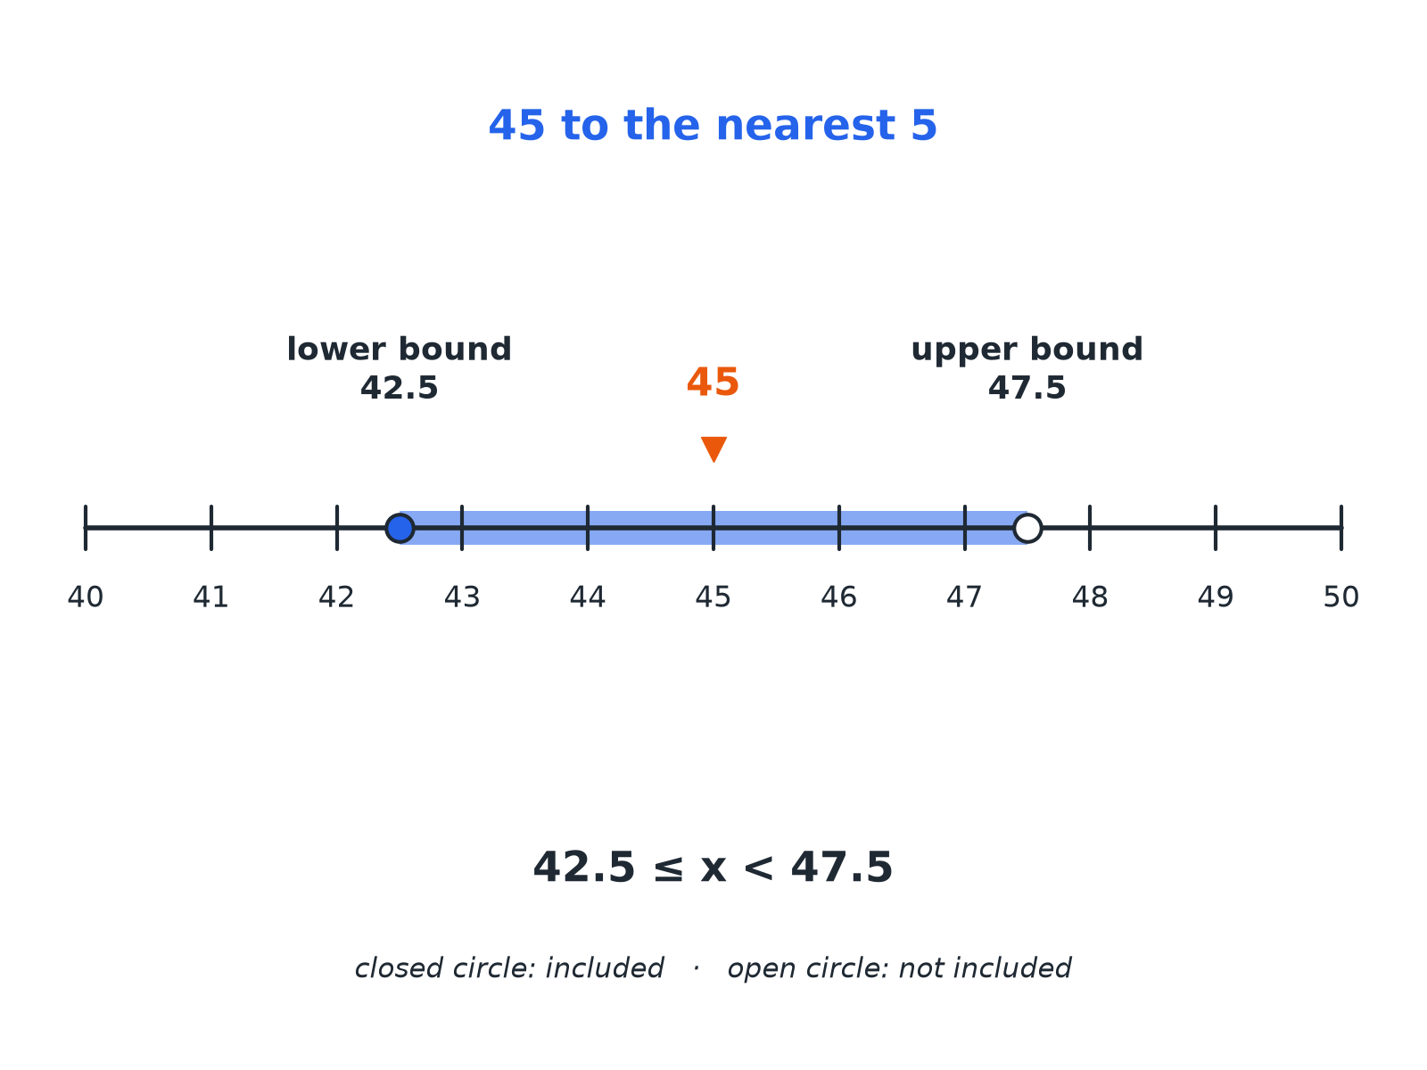

EDEXCEL GCSE MATHS · FOUNDATION & HIGHER
Bounds on a Number Line
Closed circle: included. Open circle: not included.
More trigonometry
openrevise.com
Lesson 1 of 9

Slide 7

EDEXCEL GCSE MATHS · FOUNDATION & HIGHER
Finding Bounds
A length is 8.3 cm, rounded to 1 decimal place. Write down the lower bound and the upper bound.
Rounding unit
0.1, so half a unit is 0.05
1
Lower bound
8.3 − 0.05 = 8.25
2
Upper bound
8.3 + 0.05 = 8.35
3
ANSWER
Lower bound 8.25 cm, upper bound 8.35 cm.
More trigonometry
openrevise.com
Lesson 1 of 9

Slide 8
EDEXCEL GCSE MATHS · FOUNDATION & HIGHER
Writing an Error Interval
n = 350 to the nearest 10. Write the error interval for n.
Half a unit
5
1
Lower bound is included
345 ≤ n
2
Upper bound is not included
n < 355
3
ANSWER
345 ≤ n < 355
More trigonometry
openrevise.com
Lesson 1 of 9

Slide 9

EDEXCEL GCSE MATHS · FOUNDATION & HIGHER
Rounding and Bounds
Half a unit each way.
Rounded to
Value
Error interval
Nearest 10
60
55 ≤ x < 65
Nearest whole number
7
6.5 ≤ x < 7.5
1 decimal place
2.4
2.35 ≤ x < 2.45
2 significant figures
0.83
0.825 ≤ x < 0.835
More trigonometry
openrevise.com
Lesson 1 of 9

Slide 10

EDEXCEL GCSE MATHS · FOUNDATION & HIGHER
Bounds in Calculations (Higher)
BIGGEST POSSIBLE ANSWER
SMALLEST POSSIBLE ANSWER
• Add: use both upper bounds.
• Subtract: upper bound minus lower bound.
• Multiply: upper times upper.
• Divide: upper bound divided by lower bound.
• Add: use both lower bounds.
• Subtract: lower bound minus upper bound.
• Multiply: lower times lower.
• Divide: lower bound divided by upper bound.
More trigonometry
openrevise.com
Lesson 1 of 9

Slide 11
EDEXCEL GCSE MATHS · FOUNDATION & HIGHER
Bounds of a Rectangle's Area (Higher)
A rectangle has length 12 cm and width 5 cm, both to the nearest centimetre. Find the greatest possible area.
Upper bound of length
12.5
1
Upper bound of width
5.5
2
Multiply
12.5 × 5.5 = 68.75
3
ANSWER
68.75 cm²
More trigonometry
openrevise.com
Lesson 1 of 9

Slide 12

EDEXCEL GCSE MATHS · FOUNDATION & HIGHER
Sensible Accuracy
Do not give an answer more accurately than the data allows.
Round at the end
Keep full calculator values until the last step.
Match the data
If measurements are to 2 significant figures, do not quote 6 in the answer.
Bounds agree
If the upper and lower bounds of an answer round to the same value, that value is the answer to that accuracy.
More trigonometry
openrevise.com
Lesson 1 of 9

Slide 13

EDEXCEL GCSE MATHS · FOUNDATION & HIGHER
Key Terms
Lower bound
The smallest value that rounds to the given number.
Upper bound
The value at the top of the range; not itself included.
Error interval
The range of possible values written with inequalities.
Degree of accuracy
How precisely a value is given, e.g. 1 d.p. or 2 s.f.
Truncate
Cut off digits without rounding.
Significant figures
Digits that carry meaning, counting from the first non-zero digit.
More trigonometry
openrevise.com
Lesson 1 of 9

Slide 14

EDEXCEL GCSE MATHS · FOUNDATION & HIGHER
YOUR TASK
10 minutes
Bounds Race
Find the error interval for each value. (a) 6.8 to 1 d.p. (b) 1200 to the nearest 100 (c) 0.05 to 1 significant figure (d) 25 to 2 significant figures.
Find the rounding unit.
1
Halve it and add and subtract.
2
WHAT A GOOD ANSWER SHOWS
(a) 6.75 ≤ x < 6.85 (b) 1150 ≤ x < 1250 (c) 0.045 ≤ x < 0.055 (d) 24.5 ≤ x < 25.5
More trigonometry
openrevise.com
Lesson 1 of 9

Slide 15
EDEXCEL GCSE MATHS · FOUNDATION & HIGHER
Can I...?
Find the rounding unit.
Use the right inequality signs.
Write a lower bound.
Find bounds for an addition or subtraction.
Write an upper bound.
Find bounds for a product or quotient.
Write an error interval.
Choose a sensible accuracy.
More trigonometry
openrevise.com
Lesson 1 of 9

Slide 16
EDEXCEL GCSE MATHS · FOUNDATION & HIGHER
Summary & Exam Focus
Half a unit each side of the rounded value.
Lower bound included, upper bound not.
Bounds calculations: choose the extreme values that make the answer largest or smallest.
Do not round until the final answer.
EXAM FOCUS
x = 7.4 to 1 decimal place. Write down the error interval for x. (2 marks)
Lower bound uses ≤; upper bound uses <.
openrevise.com

