Slide 1
EDEXCEL GCSE MATHS · HIGHER
Solving problems in 3D
More trigonometry
Lesson 7 of 9
openrevise.com

Slide 2

EDEXCEL GCSE MATHS · HIGHER
Warm-up
Answer each one, then check.
1
What is Pythagoras' theorem?
2
What is tan θ in a right-angled triangle?
3
What is a diagonal?
4
What is the volume of a cuboid?
5
Work out √169.
More trigonometry
openrevise.com
Lesson 7 of 9

Slide 3
EDEXCEL GCSE MATHS · HIGHER
Warm-up - Answers
What is Pythagoras' theorem?
a² + b² = c²
1
What is tan θ in a right-angled triangle?
opposite ÷ adjacent
2
What is a diagonal?
A line joining two corners that are not next to each other
3
What is the volume of a cuboid?
l × w × h
4
Work out √169.
13
5
More trigonometry
openrevise.com
Lesson 7 of 9

Slide 4

EDEXCEL GCSE MATHS · HIGHER
Learning Objectives
Find the length of a diagonal of a cuboid.
1
Find the height of a pyramid or a slant edge using Pythagoras.
2
Find the angle between a line and a plane.
3
Draw the right-angled triangle you need out of a 3D shape.
4
More trigonometry
openrevise.com
Lesson 7 of 9

Slide 5

EDEXCEL GCSE MATHS · HIGHER
3D PROBLEMS
To solve a 3D problem, find a right-angled triangle inside the shape, draw it separately, then use Pythagoras or trigonometry.
Sketch the flat triangle with its lengths and angle, and work in that triangle.
More trigonometry
openrevise.com
Lesson 7 of 9

Slide 6
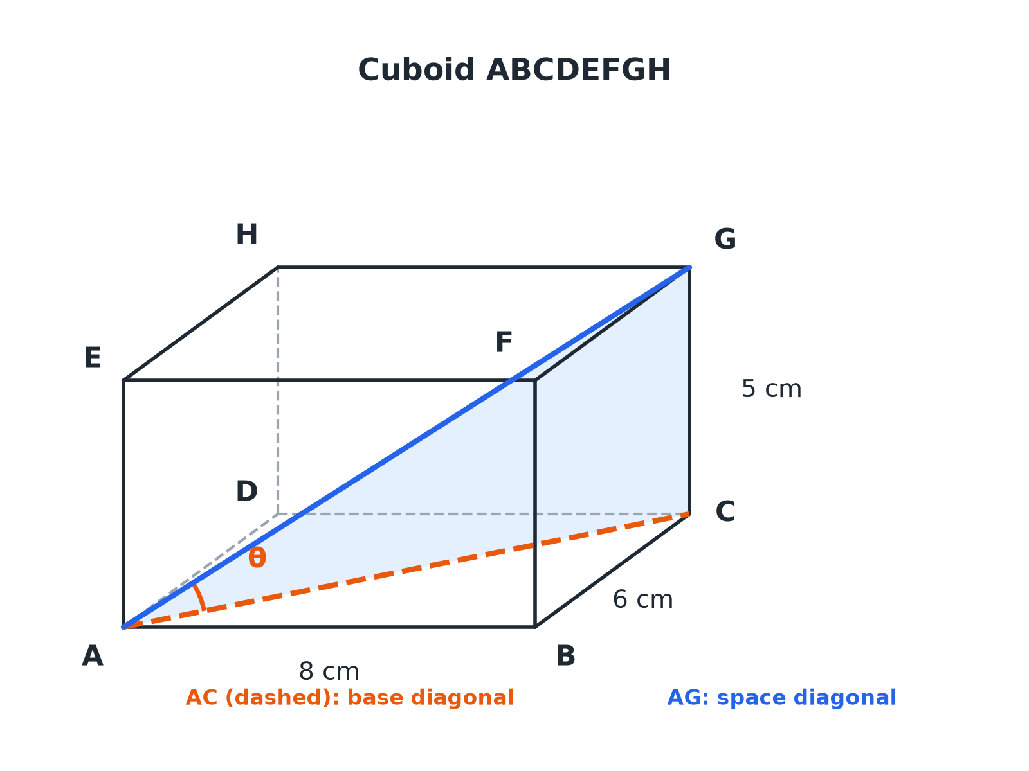

EDEXCEL GCSE MATHS · HIGHER
A Diagonal in a Cuboid
Triangle ACG is right-angled at C. Find AC first, then AG.
More trigonometry
openrevise.com
Lesson 7 of 9

Slide 7

EDEXCEL GCSE MATHS · HIGHER
Diagonal of a Cuboid
Two steps, both using Pythagoras.
1
2
3
4
Base diagonal
AC² = l² + w²
Space diagonal
AG² = AC² + h² = l² + w² + h²
Angle with the base
tan θ= h/AC
Draw it
Sketch triangle ACG separately with its right angle at C
More trigonometry
openrevise.com
Lesson 7 of 9

Slide 8

EDEXCEL GCSE MATHS · HIGHER
Space Diagonal of a Cuboid
A cuboid measures 12 cm by 4 cm by 3 cm. Find the length of its longest diagonal.
Formula
d² = 12² + 4² + 3²
1
Add up
d² = 144 + 16 + 9 = 169
2
Square root
d = 13
3
ANSWER
The longest diagonal is 13 cm.
More trigonometry
openrevise.com
Lesson 7 of 9

Slide 9
EDEXCEL GCSE MATHS · HIGHER
Angle Between a Line and a Plane
A cuboid ABCDEFGH has AB = 8 cm, BC = 6 cm and CG = 5 cm. Find the angle between AG and the base ABCD.
Base diagonal
AC = √(8² + 6²) = 10
1
Right-angled triangle ACG
tan θ= CG/AC = 5/10
2
Inverse tangent
θ= tan ⁻¹(0.5) = 26.6°
3
ANSWER
The angle between AG and the base is 26.6° (1 d.p.).
More trigonometry
openrevise.com
Lesson 7 of 9

Slide 10
EDEXCEL GCSE MATHS · HIGHER
A Square-Based Pyramid
A pyramid has a square base of side 8 cm and a vertical height of 10 cm. The apex is directly above the centre of the base. Find the length of a sloping edge.
Half the base diagonal
√(8² + 8²)/2 = √128/2 = 5.657
1
Triangle with the height
edge² = 10² + 5.657² = 132
2
Square root
edge = 11.5
3
ANSWER
The sloping edge is 11.5 cm (3 s.f.).
More trigonometry
openrevise.com
Lesson 7 of 9

Slide 11

EDEXCEL GCSE MATHS · HIGHER
The Angle Between a Line and a Plane
Always use the right angle.
Drop a perpendicular
From the top of the line straight down to the plane.
Join to the base
Draw the line from the foot of the perpendicular to the bottom of the original line.
The angle
This is the angle between the line and the plane, and the triangle formed has a right angle.
Then
Use sin, cos or tan as usual.
More trigonometry
openrevise.com
Lesson 7 of 9

Slide 12

EDEXCEL GCSE MATHS · HIGHER
Key Terms
Cuboid
A 3D shape with six rectangular faces.
Space diagonal
A diagonal joining opposite corners through the inside of a cuboid.
Plane
A flat surface, such as the base.
Apex
The top point of a pyramid.
Slant edge
An edge from the apex to a base corner.
Angle of elevation
The angle looking up from horizontal.
More trigonometry
openrevise.com
Lesson 7 of 9

Slide 13

EDEXCEL GCSE MATHS · HIGHER
YOUR TASK
12 minutes
Find the Triangle
A cuboid is 9 cm long, 12 cm wide and 8 cm high. (a) Find the base diagonal. (b) Find the space diagonal. (c) Find the angle between the space diagonal and the base.
Work in the base first.
1
Then use the height.
2
WHAT A GOOD ANSWER SHOWS
(a) √(9² + 12²) = 15 cm. (b) √(15² + 8²) = 17 cm. (c) tan ⁻¹(8 ÷ 15) = 28.1°.
More trigonometry
openrevise.com
Lesson 7 of 9

Slide 14
EDEXCEL GCSE MATHS · HIGHER
Can I...?
Draw a right-angled triangle from a 3D shape.
Find a pyramid slant edge.
Find a base diagonal.
Find an angle between a line and a plane.
Find a space diagonal.
Use tangent, sine or cosine.
Use Pythagoras twice.
Give sensible accuracy.
More trigonometry
openrevise.com
Lesson 7 of 9

Slide 15
EDEXCEL GCSE MATHS · HIGHER
Summary & Exam Focus
Space diagonal: d² = l² + w² + h².
Angle with the base: tan θ= height/(base diagonal).
Pyramid: use half the base diagonal with the height.
Always sketch the triangle you are using.
EXAM FOCUS
ABCDEFGH is a cuboid with AB = 8 cm, BC = 6 cm and CG = 5 cm. Work out the angle between AG and the base ABCD. Give your answer correct to 1 decimal place. (4 marks)
Find the base diagonal first, then draw the right-angled triangle with the height.
openrevise.com

