Slide 1

EDEXCEL GCSE MATHS · FOUNDATION & HIGHER
Sampling
Further statistics
Lesson 1 of 6
openrevise.com

Slide 2

EDEXCEL GCSE MATHS · FOUNDATION & HIGHER
Warm-up
Answer each one, then check.
1
What is a percentage of an amount, e.g. 10% of 300?
2
What is the mean of 4, 6 and 8?
3
Simplify the ratio 20 : 30.
4
What does "random" mean?
5
What is a fraction of a total, e.g. ¼ of 80?
Further statistics
openrevise.com
Lesson 1 of 6

Slide 3
EDEXCEL GCSE MATHS · FOUNDATION & HIGHER
Warm-up - Answers
What is a percentage of an amount, e.g. 10% of 300?
30
1
What is the mean of 4, 6 and 8?
6
2
Simplify the ratio 20 : 30.
2 : 3
3
What does "random" mean?
Every item has an equal chance of being chosen
4
What is a fraction of a total, e.g. ¼ of 80?
20
5
Further statistics
openrevise.com
Lesson 1 of 6

Slide 4

EDEXCEL GCSE MATHS · FOUNDATION & HIGHER
Learning Objectives
Explain the difference between a population and a sample.
1
Recognise and describe bias in a sample.
2
Take a random, a systematic and a stratified sample.
3
Estimate a population size using capture-recapture (Higher).
4
Further statistics
openrevise.com
Lesson 1 of 6

Slide 5

EDEXCEL GCSE MATHS · FOUNDATION & HIGHER
SAMPLING
A sample should be a small group that fairly represents the whole population.
A bigger, random sample is more likely to be representative and give reliable results.
Further statistics
openrevise.com
Lesson 1 of 6

Slide 6
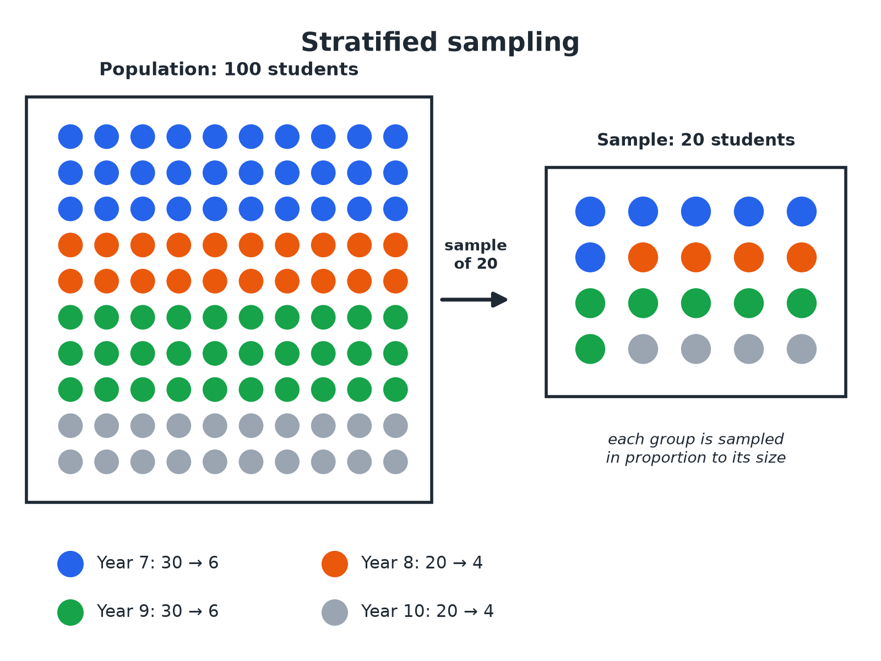

EDEXCEL GCSE MATHS · FOUNDATION & HIGHER
Population and Stratified Sample
A stratified sample keeps the same proportions as the population.
Further statistics
openrevise.com
Lesson 1 of 6

Slide 7

EDEXCEL GCSE MATHS · FOUNDATION & HIGHER
Types of Sample
Know how each one is chosen.
Sample
How it is chosen
Good point
Random
Every member has an equal chance, e.g. numbers from a random number generator
Not biased
Systematic
Every kth member from a list, after a random start
Easy and quick
Stratified
Groups sampled in proportion to their size
Represents every group
Convenience
The people who are easiest to reach
Cheap, but often biased
Further statistics
openrevise.com
Lesson 1 of 6

Slide 8

EDEXCEL GCSE MATHS · FOUNDATION & HIGHER
A Stratified Sample
A school has 200 pupils in Year 9, 160 in Year 10 and 240 in Year 11. A stratified sample of 60 pupils is taken. How many pupils come from each year?
1
Total pupils
200 + 160 + 240 = 600
2
Fraction sampled
60/600 = 1/10
3
Year 9
200 ÷ 10 = 20
4
Year 10
160 ÷ 10 = 16
5
Year 11
240 ÷ 10 = 24
ANSWER
20 from Year 9, 16 from Year 10 and 24 from Year 11.
Further statistics
openrevise.com
Lesson 1 of 6

Slide 9
EDEXCEL GCSE MATHS · FOUNDATION & HIGHER
A Systematic Sample
A list has 800 names. A systematic sample of 40 names is needed. Describe how to take it.
Interval
800 ÷ 40 = 20
1
Random start
Pick a random number from 1 to 20, e.g. 7
2
Then
Take every 20th name: 7, 27, 47, and so on
3
ANSWER
Choose a random start between 1 and 20, then take every 20th name.
Further statistics
openrevise.com
Lesson 1 of 6

Slide 10
EDEXCEL GCSE MATHS · FOUNDATION & HIGHER
Capture-Recapture (Higher)
50 fish are caught, tagged and released. Later, 40 fish are caught and 8 of them are tagged. Estimate the number of fish in the lake.
Proportion tagged in the second sample
8/40
1
Set equal to the proportion tagged in the lake
8/40 = 50/N
2
Rearrange
N = (50 × 40)/8 = 250
3
ANSWER
There are about 250 fish in the lake.
Further statistics
openrevise.com
Lesson 1 of 6

Slide 11

EDEXCEL GCSE MATHS · FOUNDATION & HIGHER
Bias
A sample is biased if some members are more likely to be chosen than others.
Where you ask
Asking only people at a football match about sport is biased.
Who answers
Only those who reply to an online poll may hold stronger views.
Sample too small
Small samples can be unrepresentative just by chance.
Fix it
Use a random method and a large enough sample.
Further statistics
openrevise.com
Lesson 1 of 6

Slide 12

EDEXCEL GCSE MATHS · FOUNDATION & HIGHER
Key Terms
Population
The whole group you want to know about.
Sample
A smaller group taken from the population.
Bias
Unfairness that makes a sample unrepresentative.
Random sample
Every member has an equal chance of selection.
Stratified sample
A sample split into groups in proportion to the population.
Capture-recapture
A method to estimate the size of a wild population.
Further statistics
openrevise.com
Lesson 1 of 6

Slide 13

EDEXCEL GCSE MATHS · FOUNDATION & HIGHER
YOUR TASK
10 minutes
Fair or Biased?
Decide whether each sample is fair or biased and explain why. (a) Asking 20 people leaving a gym how much they exercise. (b) Choosing 30 pupils at random from the register. (c) Asking the first 10 people to arrive at school about school start times.
Ask who might be missing.
1
Suggest a fairer method.
2
WHAT A GOOD ANSWER SHOWS
(a) Biased: gym users exercise more than most people. (b) Fair: random. (c) Biased: early arrivals may have different views (for example they may travel by bus).
Further statistics
openrevise.com
Lesson 1 of 6
Notes:
Ask learners for a fairer way to do (a).

Slide 14
EDEXCEL GCSE MATHS · FOUNDATION & HIGHER
Can I...?
Define population and sample.
Work out a stratified sample.
Spot bias.
Explain why bigger is better.
Take a random sample.
Use capture-recapture.
Take a systematic sample.
Give a reason for my choice.
Further statistics
openrevise.com
Lesson 1 of 6

Slide 15
EDEXCEL GCSE MATHS · FOUNDATION & HIGHER
Summary & Exam Focus
Sample = part of the population.
Random samples avoid bias.
Stratified: number in each group = group/population × sample size.
Capture-recapture: N = (first × second)/(tagged in second).
EXAM FOCUS
A school has 200 pupils in Year 9, 160 in Year 10 and 240 in Year 11. Alex takes a stratified sample of 60 pupils. How many pupils should he take from each year? (3 marks)
Find the fraction sampled, then multiply each group by it.
openrevise.com

Slide 16
EDEXCEL GCSE MATHS · FOUNDATION & HIGHER
Exam Practice: Sampling
Answer all questions. Show your working. · 25 minutes
Question 1 · 3 marks · Work out
A school has 200 pupils in Year 9, 160 in Year 10 and 240 in Year 11. Alex takes a stratified sample of 60 pupils. Work out how many pupils…
Question 2 · 2 marks · Explain
Priya wants to find out how much exercise pupils in her school do. She asks 20 pupils leaving the school gym. Give one reason why her…
Question 3 · 2 marks · Describe
There are 900 pupils on a school register. Describe how to take a systematic sample of 60 pupils.
Further statistics
openrevise.com
Lesson 1 of 6

Slide 17
EDEXCEL GCSE MATHS · FOUNDATION & HIGHER
Exam Practice: Sampling (cont.)
Question 4 · 3 marks · Estimate
60 fish are caught in a lake, tagged and put back. Later, 30 fish are caught and 5 of them are tagged. Estimate the number of fish in the…
Question 5 · 2 marks · Give a reason
Sam takes a random sample of 10 people to find the mean height of adults in a town. Give one way he could improve his sample.
Question 6 · 3 marks · Work out
A club has 30 boys and 20 girls. A stratified sample of 10 members is taken. Work out how many boys and how many girls are in the sample.
Further statistics
openrevise.com
Lesson 1 of 6

Slide 18
EDEXCEL GCSE MATHS · FOUNDATION & HIGHER
Question 1 · 3 marks · Work out
“
A school has 200 pupils in Year 9, 160 in Year 10 and 240 in Year 11. Alex takes a stratified sample of 60 pupils. Work out how many pupils he should take from each year.
HOW TO ANSWER IT
Command word: Work out. Worth 3 marks, so plan before writing.
Further statistics
openrevise.com
Lesson 1 of 6

Slide 19
EDEXCEL GCSE MATHS · FOUNDATION & HIGHER
Question 1 · mark scheme
3 marks available. Award a mark for each point made.
60/600 or equivalent
M1
Any two correct
M1
All three correct
A1
Further statistics
openrevise.com
Lesson 1 of 6

Slide 20
EDEXCEL GCSE MATHS · FOUNDATION & HIGHER
Question 2 · 2 marks · Explain
“
Priya wants to find out how much exercise pupils in her school do. She asks 20 pupils leaving the school gym. Give one reason why her sample may be biased.
HOW TO ANSWER IT
Command word: Explain. Worth 2 marks, so plan before writing.
Further statistics
openrevise.com
Lesson 1 of 6

Slide 21
EDEXCEL GCSE MATHS · FOUNDATION & HIGHER
Question 2 · mark scheme
2 marks available. Award a mark for each point made.
Reason linked to gym users
M1
Not representative
C1
Further statistics
openrevise.com
Lesson 1 of 6

Slide 22
EDEXCEL GCSE MATHS · FOUNDATION & HIGHER
Question 3 · 2 marks · Describe
“
There are 900 pupils on a school register. Describe how to take a systematic sample of 60 pupils.
HOW TO ANSWER IT
Command word: Describe. Worth 2 marks, so plan before writing.
Further statistics
openrevise.com
Lesson 1 of 6

Slide 23
EDEXCEL GCSE MATHS · FOUNDATION & HIGHER
Question 3 · mark scheme
2 marks available. Award a mark for each point made.
15
M1
Random start and every 15th
A1
Further statistics
openrevise.com
Lesson 1 of 6

Slide 24
EDEXCEL GCSE MATHS · FOUNDATION & HIGHER
Question 4 · 3 marks · Estimate
“
60 fish are caught in a lake, tagged and put back. Later, 30 fish are caught and 5 of them are tagged. Estimate the number of fish in the lake.
HOW TO ANSWER IT
Command word: Estimate. Worth 3 marks, so plan before writing.
Further statistics
openrevise.com
Lesson 1 of 6

Slide 25
EDEXCEL GCSE MATHS · FOUNDATION & HIGHER
Question 4 · mark scheme
3 marks available. Award a mark for each point made.
5/30 = 60/N
M1
(60 × 30)/5
M1
360
A1
Further statistics
openrevise.com
Lesson 1 of 6

Slide 26
EDEXCEL GCSE MATHS · FOUNDATION & HIGHER
Question 5 · 2 marks · Give a reason
“
Sam takes a random sample of 10 people to find the mean height of adults in a town. Give one way he could improve his sample.
HOW TO ANSWER IT
Command word: Give a reason. Worth 2 marks, so plan before writing.
Further statistics
openrevise.com
Lesson 1 of 6

Slide 27
EDEXCEL GCSE MATHS · FOUNDATION & HIGHER
Question 5 · mark scheme
2 marks available. Award a mark for each point made.
Larger sample
M1
Random or representative
A1
Further statistics
openrevise.com
Lesson 1 of 6

Slide 28
EDEXCEL GCSE MATHS · FOUNDATION & HIGHER
Question 6 · 3 marks · Work out
“
A club has 30 boys and 20 girls. A stratified sample of 10 members is taken. Work out how many boys and how many girls are in the sample.
HOW TO ANSWER IT
Command word: Work out. Worth 3 marks, so plan before writing.
Further statistics
openrevise.com
Lesson 1 of 6

Slide 29
EDEXCEL GCSE MATHS · FOUNDATION & HIGHER
Question 6 · mark scheme
3 marks available. Award a mark for each point made.
10/50 or ⅕
M1
6
A1
4
A1
Further statistics
openrevise.com
Lesson 1 of 6

