Slide 1

EDEXCEL GCSE MATHS · FOUNDATION & HIGHER
Comparing and describing distributions
Further statistics
Lesson 6 of 6
openrevise.com

Slide 2

EDEXCEL GCSE MATHS · FOUNDATION & HIGHER
Warm-up
Answer each one, then check.
1
Name a measure of average.
2
Name a measure of spread.
3
What is an outlier?
4
Does an outlier affect the median much?
5
Does an outlier affect the mean much?
Further statistics
openrevise.com
Lesson 6 of 6

Slide 3
EDEXCEL GCSE MATHS · FOUNDATION & HIGHER
Warm-up - Answers
Name a measure of average.
Mean, median or mode
1
Name a measure of spread.
Range or interquartile range
2
What is an outlier?
A value far from the others
3
Does an outlier affect the median much?
No
4
Does an outlier affect the mean much?
Yes
5
Further statistics
openrevise.com
Lesson 6 of 6

Slide 4

EDEXCEL GCSE MATHS · FOUNDATION & HIGHER
Learning Objectives
Compare two distributions using an average and a measure of spread.
1
Choose the best average and spread.
2
Describe skew.
3
Write comparisons in context.
4
Further statistics
openrevise.com
Lesson 6 of 6

Slide 5

EDEXCEL GCSE MATHS · FOUNDATION & HIGHER
COMPARING
To compare distributions, compare one average and one measure of spread, using numbers and context.
A higher average means the values are generally bigger. A larger spread means the values are less consistent.
Further statistics
openrevise.com
Lesson 6 of 6

Slide 6
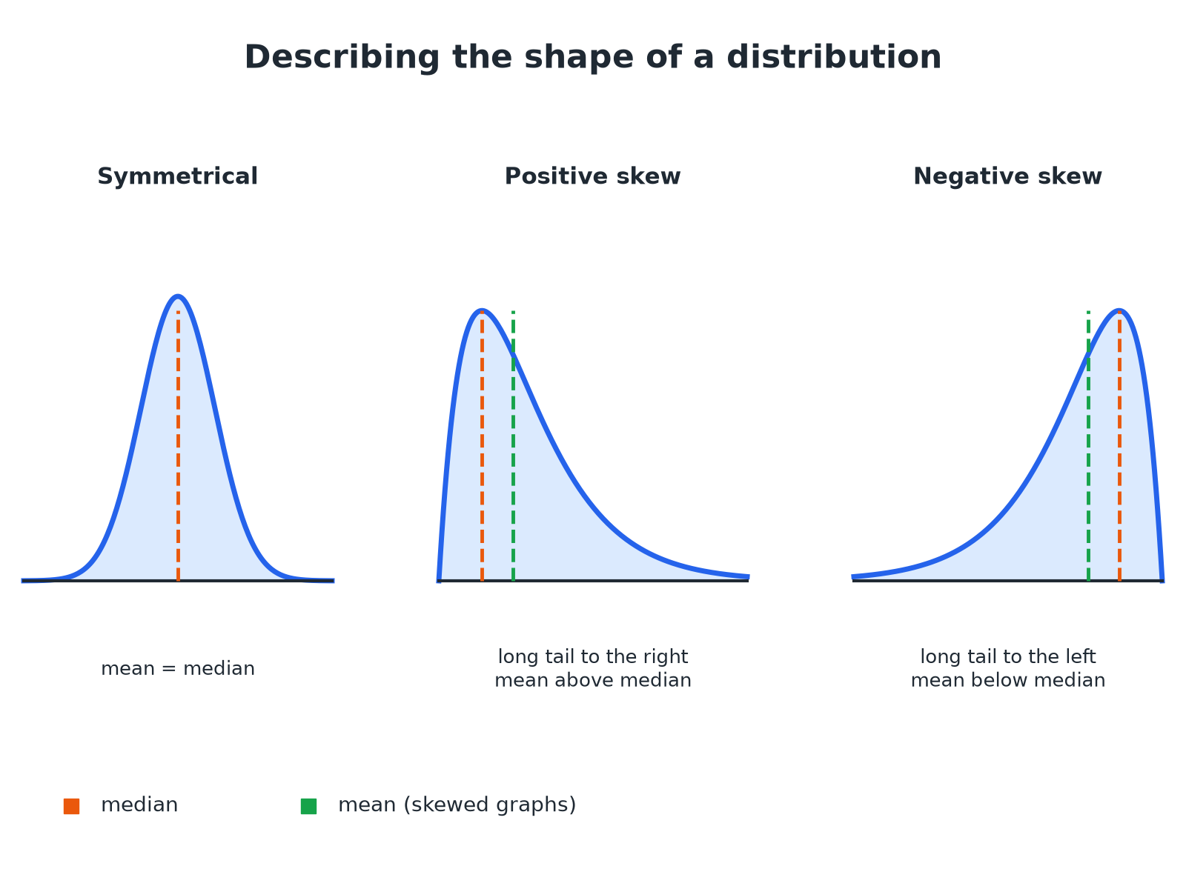

EDEXCEL GCSE MATHS · FOUNDATION & HIGHER
The Shape of a Distribution
The tail shows the direction of the skew.
Further statistics
openrevise.com
Lesson 6 of 6

Slide 7

EDEXCEL GCSE MATHS · FOUNDATION & HIGHER
Choosing Averages and Spreads
AVERAGES
SPREADS
• Mean uses every value, but is affected by outliers.
• Median is not affected by outliers.
• Mode is the most common value.
• Range uses the largest and smallest values only.
• IQR is the spread of the middle 50%.
• IQR is not affected by outliers.
Further statistics
openrevise.com
Lesson 6 of 6

Slide 8

EDEXCEL GCSE MATHS · FOUNDATION & HIGHER
Comparing Two Data Sets
Boys: median 12.4 s, IQR 1.2 s. Girls: median 13.1 s, IQR 2.0 s. Compare the times for the 100 m sprint.
Average
Boys' median 12.4 is lower than girls' 13.1
1
Meaning
On average the boys were faster
2
Spread
Boys' IQR 1.2 is smaller than girls' 2.0
3
Meaning
The boys' times were more consistent
4
ANSWER
On average the boys were faster (median 12.4 s against 13.1 s) and their times were more consistent (IQR 1.2 s against 2.0 s).
Further statistics
openrevise.com
Lesson 6 of 6

Slide 9
EDEXCEL GCSE MATHS · FOUNDATION & HIGHER
Comparing Cumulative Frequency Curves
Two cumulative frequency curves show the times of Group A and Group B (60 people each). Group A: median 28, IQR 16. Group B: median 22, IQR 17. Compare the groups.
Median
B's median is lower
1
Spread
The IQRs are very close
2
Conclusion
Group B were quicker on average, with a similar spread
3
ANSWER
Group B were quicker on average (median 22 against 28) and both groups had a similar spread (IQR 17 against 16).
Further statistics
openrevise.com
Lesson 6 of 6

Slide 10
EDEXCEL GCSE MATHS · FOUNDATION & HIGHER
Describing Skew
The mean is 30 and the median is 25. Describe the skew.
Compare
The mean is greater than the median
1
Shape
The tail is to the right
2
ANSWER
The distribution has positive skew.
Further statistics
openrevise.com
Lesson 6 of 6

Slide 11

EDEXCEL GCSE MATHS · FOUNDATION & HIGHER
Writing Good Comparisons
A full-mark answer has four parts.
An average
Compare medians or means, quoting numbers.
A spread
Compare IQRs or ranges, quoting numbers.
Context
Write in terms of the situation.
A conclusion
For example "so Group B were faster and more consistent".
Further statistics
openrevise.com
Lesson 6 of 6

Slide 12

EDEXCEL GCSE MATHS · FOUNDATION & HIGHER
Key Terms
Distribution
How values are spread across a data set.
Skew
A lack of symmetry; the tail shows the direction.
Symmetrical
The same on both sides of the middle.
Outlier
A value much larger or smaller than the rest.
Consistent
Little variation.
In context
Written using the real situation.
Further statistics
openrevise.com
Lesson 6 of 6

Slide 13

EDEXCEL GCSE MATHS · FOUNDATION & HIGHER
YOUR TASK
12 minutes
Write the Comparison
Set A: mean 24, range 10. Set B: mean 21, range 25. Write a comparison of the two sets.
Compare averages.
1
Compare spreads.
2
WHAT A GOOD ANSWER SHOWS
On average Set A has higher values (mean 24 against 21) and Set A is more consistent (range 10 against 25).
Further statistics
openrevise.com
Lesson 6 of 6

Slide 14
EDEXCEL GCSE MATHS · FOUNDATION & HIGHER
Can I...?
Compare two medians.
Describe skew.
Compare two IQRs.
Write in context.
Compare means and ranges.
Use numbers.
Read a cumulative frequency graph.
Explain the choice of average.
Further statistics
openrevise.com
Lesson 6 of 6

Slide 15
EDEXCEL GCSE MATHS · FOUNDATION & HIGHER
Summary & Exam Focus
Compare one average and one spread.
Median and IQR are best if there are outliers.
Positive skew: long tail to the right, mean above median.
Give numbers and a conclusion.
EXAM FOCUS
The cumulative frequency graph shows the times taken by two groups. Compare the times. (4 marks)
Compare an average and a spread, and use the words of the question.
openrevise.com

