Slide 1

AQA GCSE PHYSICS · PAPER 1 · FOUNDATION & HIGHER
Energy transfers in everyday appliances
Electricity
Lesson 7 of 10
openrevise.com

Slide 2

AQA GCSE PHYSICS · PAPER 1 · FOUNDATION & HIGHER
Warm-up
Answer each one, then check.
1
What is the unit of energy?
2
What is the unit of charge?
3
Convert 3 minutes to seconds.
4
What is P = VI?
5
What does a motor transfer energy to?
Electricity
openrevise.com
Lesson 7 of 10

Slide 3
AQA GCSE PHYSICS · PAPER 1 · FOUNDATION & HIGHER
Warm-up - Answers
What is the unit of energy?
Joule (J)
1
What is the unit of charge?
Coulomb (C)
2
Convert 3 minutes to seconds.
180 s
3
What is P = VI?
Power = pd × current
4
What does a motor transfer energy to?
The kinetic store
5
Electricity
openrevise.com
Lesson 7 of 10

Slide 4

AQA GCSE PHYSICS · PAPER 1 · FOUNDATION & HIGHER
Learning Objectives
Describe how domestic appliances transfer energy from batteries or the mains to kinetic energy stores or heating.
1
Recall and apply E = Pt.
2
Recall and apply E = QV.
3
Relate the power rating of appliances to changes in stored energy.
4
Electricity
openrevise.com
Lesson 7 of 10

Slide 5

AQA GCSE PHYSICS · PAPER 1 · FOUNDATION & HIGHER
ELECTRICAL WORK
energy transferred = power × time E = Pt and energy transferred = charge flow × potential difference E = QV
Work is done when charge flows in a circuit. The energy an appliance transfers depends on how long it is on for and its power.
Electricity
openrevise.com
Lesson 7 of 10

Slide 6
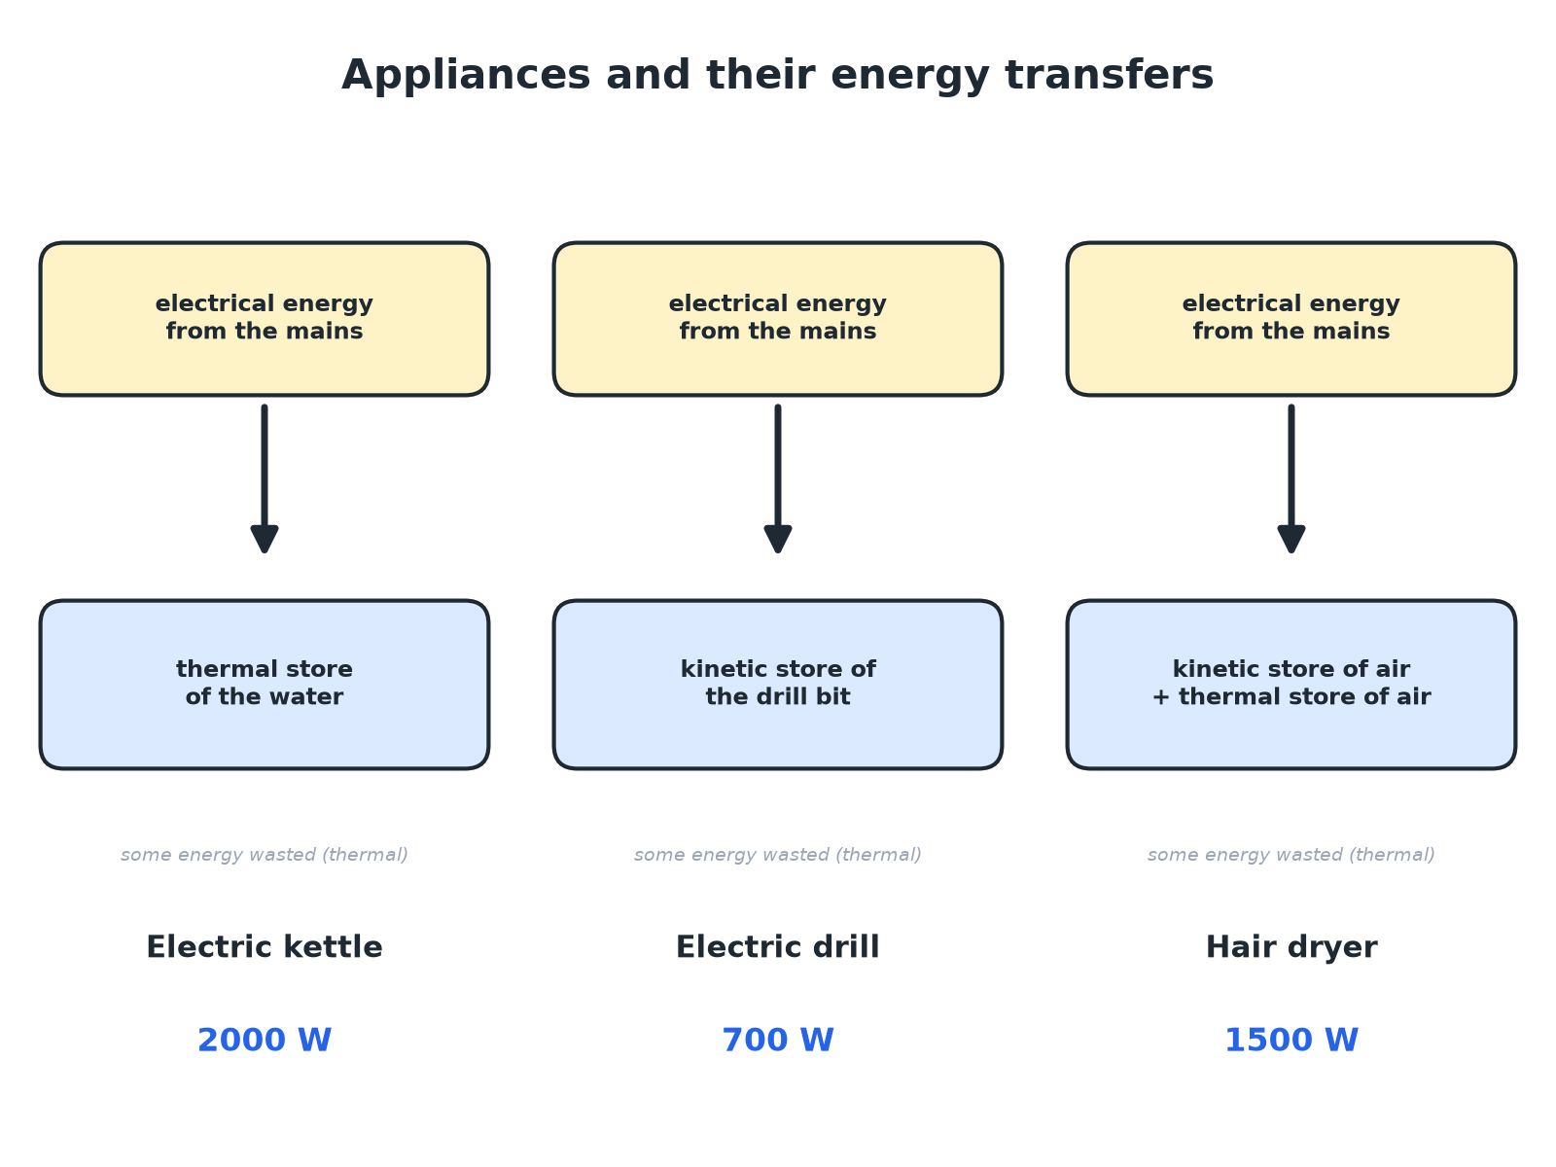

AQA GCSE PHYSICS · PAPER 1 · FOUNDATION & HIGHER
Appliances and Their Energy Transfers
Different appliances give different useful transfers.
Electricity
openrevise.com
Lesson 7 of 10

Slide 7

AQA GCSE PHYSICS · PAPER 1 · FOUNDATION & HIGHER
Energy from Power and Time
A 2000 W kettle is switched on for 3.0 minutes. Calculate the energy it transfers.
Convert the time
3.0 min = 180 s
1
Substitute
E = Pt = 2000 × 180
2
Answer
E = 360 000 J
3
ANSWER
360 000 J (360 kJ)
Electricity
openrevise.com
Lesson 7 of 10

Slide 8
AQA GCSE PHYSICS · PAPER 1 · FOUNDATION & HIGHER
Energy from Charge and pd
500 C of charge flows through a 12 V battery-powered motor. Calculate the energy transferred.
Write the equation
E = QV
1
Substitute
E = 500 × 12
2
Answer
E = 6000 J
3
ANSWER
6000 J
Electricity
openrevise.com
Lesson 7 of 10

Slide 9
AQA GCSE PHYSICS · PAPER 1 · FOUNDATION & HIGHER
Comparing Appliances
A 700 W drill is used for 60 s. A 1500 W hair dryer is used for 60 s. Which transfers more energy?
Drill
700 × 60 = 42 000 J
1
Hair dryer
1500 × 60 = 90 000 J
2
ANSWER
The hair dryer transfers more energy because its power is greater for the same time.
Electricity
openrevise.com
Lesson 7 of 10

Slide 10

AQA GCSE PHYSICS · PAPER 1 · FOUNDATION & HIGHER
Power Ratings
What the rating tells you.
Meaning
The power rating is the energy the appliance transfers each second.
Energy used
Energy depends on the power rating and how long the appliance is on.
Motors
Transfer electrical energy to the kinetic energy store of the motor.
Heaters
Transfer electrical energy to the thermal energy store.
Electricity
openrevise.com
Lesson 7 of 10

Slide 11

AQA GCSE PHYSICS · PAPER 1 · FOUNDATION & HIGHER
Key Terms
Electrical work
Energy transferred when charge flows in a circuit.
Power rating
The power of an appliance in normal use.
Appliance
A device that transfers electrical energy usefully.
Kinetic store
The energy of a moving object.
Thermal store
The energy of hot objects.
Charge
Measured in coulombs.
Electricity
openrevise.com
Lesson 7 of 10

Slide 12

AQA GCSE PHYSICS · PAPER 1 · FOUNDATION & HIGHER
YOUR TASK
12 minutes
Energy Bill
A 3.0 kW electric shower is used for 8.0 minutes. Calculate the energy transferred, in joules. Explain what happens to the energy.
Convert kW and minutes.
1
Multiply.
2
WHAT A GOOD ANSWER SHOWS
3000 × 480 = 1 440 000 J (1.44 MJ). Electrical energy is transferred to the thermal store of the water; some is dissipated.
Electricity
openrevise.com
Lesson 7 of 10

Slide 13
AQA GCSE PHYSICS · PAPER 1 · FOUNDATION & HIGHER
Can I...?
Describe the energy transfer in a kettle.
Convert time to seconds.
Describe the energy transfer in a motor.
Compare appliances.
Recall E = Pt.
Explain power rating.
Recall E = QV.
Give units correctly.
Electricity
openrevise.com
Lesson 7 of 10

Slide 14
AQA GCSE PHYSICS · PAPER 1 · FOUNDATION & HIGHER
Summary & Exam Focus
E = Pt and E = QV.
Kettle: electrical to thermal store.
Motor: electrical to kinetic store.
Power rating: energy per second.
EXAM FOCUS
A 2000 W kettle is on for 3.0 minutes. Calculate the energy transferred. (3 marks)
Convert minutes to seconds first.
openrevise.com

