Slide 1

AQA GCSE PHYSICS · PAPER 1 · FOUNDATION & HIGHER
Resistors and I–V characteristics
Electricity
Lesson 3 of 10
openrevise.com

Slide 2

AQA GCSE PHYSICS · PAPER 1 · FOUNDATION & HIGHER
Warm-up
Answer each one, then check.
1
What is an ohmic conductor?
2
What does I–V stand for?
3
What is a straight line graph through the origin?
4
What happens to a metal when its temperature rises?
5
What does LDR stand for?
Electricity
openrevise.com
Lesson 3 of 10

Slide 3
AQA GCSE PHYSICS · PAPER 1 · FOUNDATION & HIGHER
Warm-up - Answers
What is an ohmic conductor?
A conductor with constant resistance at constant temperature
1
What does I–V stand for?
Current against potential difference
2
What is a straight line graph through the origin?
Directly proportional
3
What happens to a metal when its temperature rises?
Its resistance rises
4
What does LDR stand for?
Light-dependent resistor
5
Electricity
openrevise.com
Lesson 3 of 10

Slide 4

AQA GCSE PHYSICS · PAPER 1 · FOUNDATION & HIGHER
Learning Objectives
Describe the I–V graphs of a resistor, filament lamp and diode.
1
Explain the changes in resistance of a filament lamp, diode, thermistor and LDR.
2
Describe how to investigate I–V characteristics (Required Practical 4).
3
Use graphs to say whether a component is linear or non-linear.
4
Electricity
openrevise.com
Lesson 3 of 10

Slide 5

AQA GCSE PHYSICS · PAPER 1 · FOUNDATION & HIGHER
I–V CHARACTERISTICS
The current through an ohmic conductor at constant temperature is directly proportional to the potential difference across it, so its resistance is constant.
The resistance of a filament lamp, diode, thermistor and LDR is not constant.
Electricity
openrevise.com
Lesson 3 of 10

Slide 6
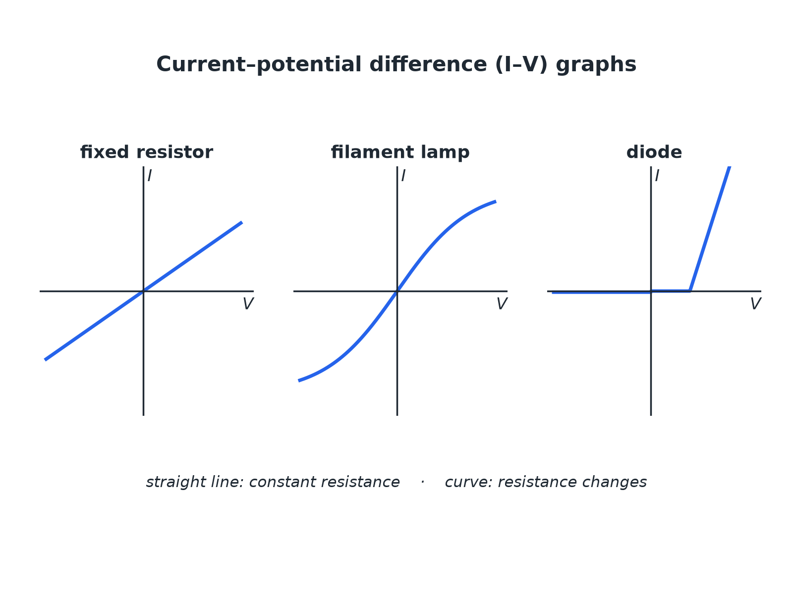

AQA GCSE PHYSICS · PAPER 1 · FOUNDATION & HIGHER
I–V Graphs
Straight line: constant resistance. Curve: changing resistance.
Electricity
openrevise.com
Lesson 3 of 10

Slide 7
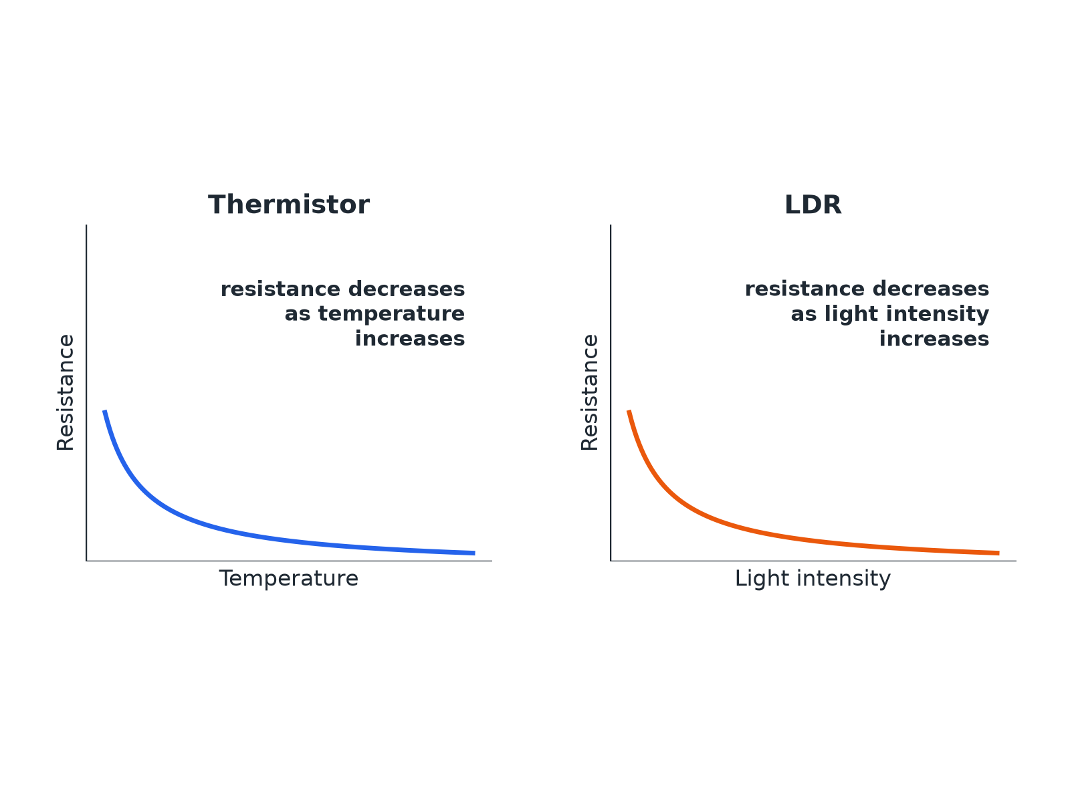
AQA GCSE PHYSICS · PAPER 1 · FOUNDATION & HIGHER
Thermistor and LDR
Both fall as the quantity increases.
Electricity
openrevise.com
Lesson 3 of 10

Slide 8
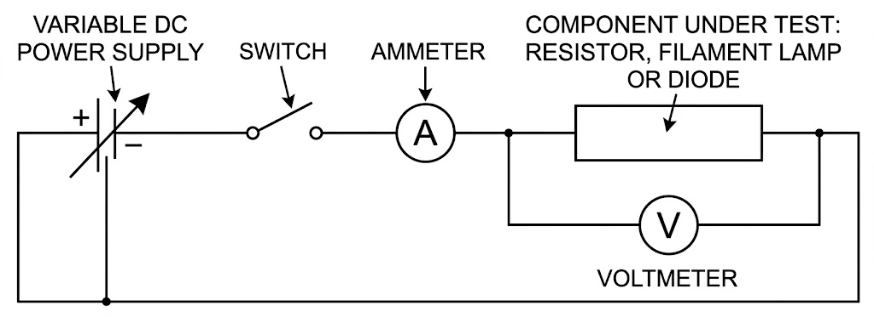
AQA GCSE PHYSICS · PAPER 1 · FOUNDATION & HIGHER
Required Practical 4: I–V Circuit
Vary the pd and measure the current each time.
Electricity
openrevise.com
Lesson 3 of 10

Slide 9

AQA GCSE PHYSICS · PAPER 1 · FOUNDATION & HIGHER
Component Behaviour
Learn each description.
Component
Resistance
Graph or behaviour
Fixed resistor
Constant at constant temperature
Straight line through the origin
Filament lamp
Increases as the filament gets hotter
Curve that flattens; gradient decreases
Diode
Very high in the reverse direction
Current flows in one direction only
Thermistor
Decreases as temperature increases
Used in thermostats and temperature sensors
LDR
Decreases as light intensity increases
Used in automatic lights
Electricity
openrevise.com
Lesson 3 of 10

Slide 10

AQA GCSE PHYSICS · PAPER 1 · FOUNDATION & HIGHER
Required Practical 4: Method
Find the I–V characteristic of a component.
1
2
3
4
5
6
Set up
Connect the component in series with the ammeter and variable resistor, and the voltmeter across the component.
Vary
Change the variable resistor to get different pds.
Record
For each setting record V and I.
Reverse
Swap the connections and repeat to get negative values (not for a diode with a protective resistor).
Plot
Draw current against pd and draw a smooth line.
Repeat
For the filament lamp and the diode.
Electricity
openrevise.com
Lesson 3 of 10

Slide 11

AQA GCSE PHYSICS · PAPER 1 · FOUNDATION & HIGHER
Resistance of a Filament Lamp
The current through a filament lamp is 0.34 A at 2.0 V and 0.62 A at 6.0 V. Calculate the resistance at each pd and explain the difference.
At 2.0 V
R = 2.0 ÷ 0.34 = 5.9 Ω
1
At 6.0 V
R = 6.0 ÷ 0.62 = 9.7 Ω
2
Explain
At the higher pd the current is greater, so the filament is hotter and its resistance is higher
3
ANSWER
5.9 Ω and 9.7 Ω; the resistance increases as the filament gets hotter.
Electricity
openrevise.com
Lesson 3 of 10

Slide 12

AQA GCSE PHYSICS · PAPER 1 · FOUNDATION & HIGHER
Uses in Circuits
Applications you need to know.
Thermistor
In a thermostat: as the temperature rises the resistance falls, changing the pd across it to switch heating off.
LDR
In automatic lights: as it gets dark the resistance rises, which switches the light on.
Diode
Allows current in one direction only, protecting circuits from being connected the wrong way round.
Electricity
openrevise.com
Lesson 3 of 10

Slide 13

AQA GCSE PHYSICS · PAPER 1 · FOUNDATION & HIGHER
Key Terms
Ohmic conductor
A conductor whose resistance is constant at constant temperature.
Filament lamp
A lamp with a thin wire that gets hot and glows.
Diode
A component that lets current flow in one direction only.
Thermistor
A resistor whose resistance decreases when the temperature increases.
LDR
A resistor whose resistance decreases when the light intensity increases.
Linear
Following a straight line graph.
Electricity
openrevise.com
Lesson 3 of 10

Slide 14

AQA GCSE PHYSICS · PAPER 1 · FOUNDATION & HIGHER
YOUR TASK
10 minutes
Match the Graph
Match each component to its I–V graph description: resistor, filament lamp, diode. (1) Curve that flattens as pd increases. (2) Straight line through the origin. (3) Almost no current one way, then a rapid increase the other way.
Look at the shape.
1
Explain the resistance change.
2
WHAT A GOOD ANSWER SHOWS
Resistor: (2). Filament lamp: (1). Diode: (3).
Electricity
openrevise.com
Lesson 3 of 10

Slide 15
AQA GCSE PHYSICS · PAPER 1 · FOUNDATION & HIGHER
Can I...?
Draw and describe the I–V graph of a resistor.
Describe how a thermistor behaves.
Describe the I–V graph of a filament lamp.
Describe how an LDR behaves.
Describe the I–V graph of a diode.
Describe Required Practical 4.
Explain why a filament lamp's resistance increases.
Give one use each of a thermistor and an LDR.
Electricity
openrevise.com
Lesson 3 of 10

Slide 16
AQA GCSE PHYSICS · PAPER 1 · FOUNDATION & HIGHER
Summary & Exam Focus
Resistor: constant resistance, straight line through the origin.
Filament lamp: resistance increases with temperature.
Diode: current in one direction only.
Thermistor and LDR resistances decrease as temperature or light increases.
EXAM FOCUS
Explain why the resistance of a filament lamp increases as the current increases. (3 marks)
Say the filament gets hotter and link it to resistance.
openrevise.com

