Slide 1

AQA GCSE PHYSICS · PAPER 1 · HIGHER TIER ONLY
Increasing the pressure of a gas
Particle model of matter
Lesson 6 of 6
openrevise.com

Slide 2

AQA GCSE PHYSICS · PAPER 1 · HIGHER TIER ONLY
Warm-up
Answer each one, then check.
1
What is work done?
2
What is internal energy?
3
What is the link between temperature and particle energy?
4
What happens to gas pressure when volume decreases?
5
What is a force?
Particle model of matter
openrevise.com
Lesson 6 of 6

Slide 3
AQA GCSE PHYSICS · PAPER 1 · HIGHER TIER ONLY
Warm-up - Answers
What is work done?
Energy transferred by a force
1
What is internal energy?
Total kinetic and potential energy of the particles
2
What is the link between temperature and particle energy?
Higher temperature means more kinetic energy
3
What happens to gas pressure when volume decreases?
It increases
4
What is a force?
A push or a pull
5
Particle model of matter
openrevise.com
Lesson 6 of 6

Slide 4

AQA GCSE PHYSICS · PAPER 1 · HIGHER TIER ONLY
Learning Objectives
Define work as the transfer of energy by a force.
1
Explain that doing work on a gas increases its internal energy.
2
Explain why the temperature of a gas rises when it is compressed, for example in a bicycle pump.
3
Particle model of matter
openrevise.com
Lesson 6 of 6

Slide 5

AQA GCSE PHYSICS · PAPER 1 · HIGHER TIER ONLY
WORK ON A GAS (HIGHER TIER)
Work is the transfer of energy by a force. Doing work on a gas increases the internal energy of the gas and can cause its temperature to rise.
This is why a bicycle pump gets warm when used.
Particle model of matter
openrevise.com
Lesson 6 of 6

Slide 6
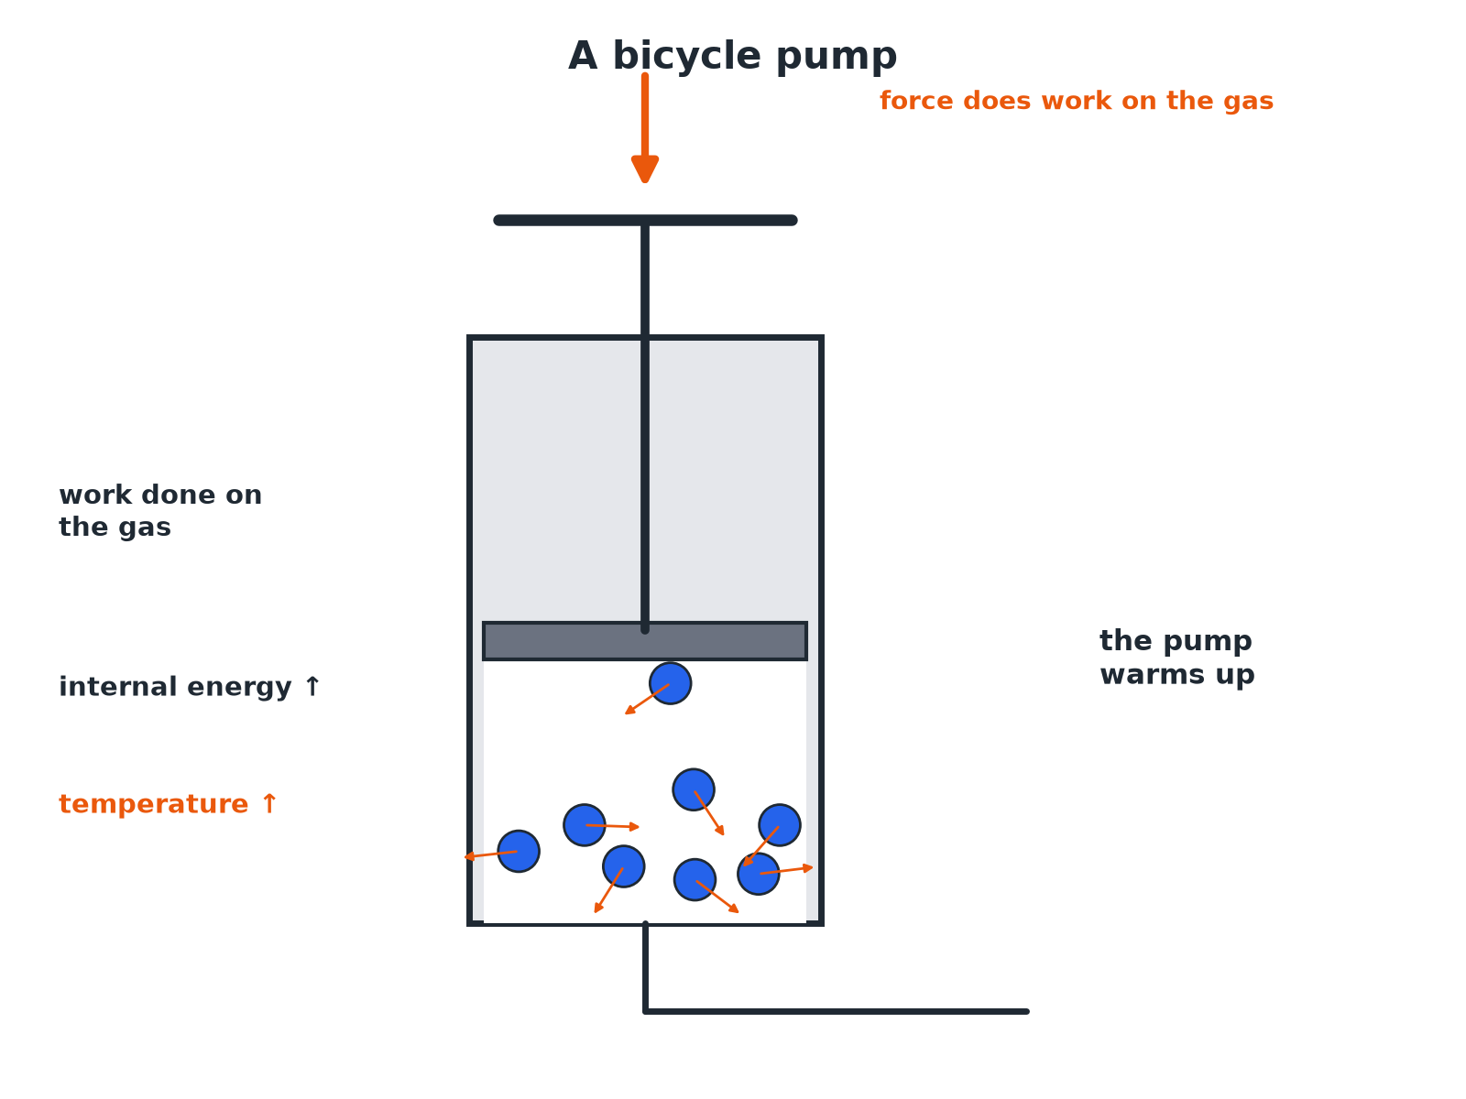

AQA GCSE PHYSICS · PAPER 1 · HIGHER TIER ONLY
A Bicycle Pump
Work done becomes internal energy.
Particle model of matter
openrevise.com
Lesson 6 of 6

Slide 7

AQA GCSE PHYSICS · PAPER 1 · HIGHER TIER ONLY
Why the Gas Warms
A chain of ideas.
1
2
3
4
Push the piston
You apply a force that moves the piston: work is done on the gas.
Energy transferred
The energy is transferred to the gas particles.
Kinetic energy increases
The particles move faster.
Temperature rises
The average kinetic energy of the gas increases.
Particle model of matter
openrevise.com
Lesson 6 of 6

Slide 8

AQA GCSE PHYSICS · PAPER 1 · HIGHER TIER ONLY
Bicycle Pump
Explain why the barrel of a bicycle pump gets hot when the pump is used to inflate a tyre.
Work done
The force on the piston does work on the air inside
1
Internal energy
The internal energy of the air increases as the energy is transferred to its molecules
2
Temperature
The temperature of the air rises, and thermal energy is transferred to the barrel
3
ANSWER
Work is done on the air, increasing its internal energy and temperature, which warms the pump.
Particle model of matter
openrevise.com
Lesson 6 of 6

Slide 9

AQA GCSE PHYSICS · PAPER 1 · HIGHER TIER ONLY
Exam Points
How to score the marks.
Say 'work is done'
Name the force and the energy transfer.
Link to internal energy
Increase in internal energy of the gas.
Link to temperature
Average kinetic energy of the molecules increases, so temperature rises.
Particle model of matter
openrevise.com
Lesson 6 of 6

Slide 10

AQA GCSE PHYSICS · PAPER 1 · HIGHER TIER ONLY
Key Terms
Work
Energy transferred by a force.
Internal energy
Total kinetic and potential energy of particles.
Compression
Squashing a gas into a smaller volume.
Molecule
A group of atoms bonded together.
Enclosed gas
A gas trapped in a container.
Temperature
A measure of average kinetic energy.
Particle model of matter
openrevise.com
Lesson 6 of 6

Slide 11

AQA GCSE PHYSICS · PAPER 1 · HIGHER TIER ONLY
YOUR TASK
8 minutes
Warm Pump
You pump up a tyre and the base of the pump gets warm. Explain why using the ideas of work and internal energy.
Say what is being done to the gas.
1
Link to temperature.
2
WHAT A GOOD ANSWER SHOWS
Work is done on the air by the force pushing the piston. This increases the internal energy of the air (kinetic energy of the molecules), so the temperature increases and the pump warms.
Particle model of matter
openrevise.com
Lesson 6 of 6

Slide 12
AQA GCSE PHYSICS · PAPER 1 · HIGHER TIER ONLY
Can I...?
Define work.
Use the bicycle pump example.
Explain work on a gas.
Write a clear chain of reasoning.
Link work to internal energy.
Use the correct terms.
Link internal energy to temperature.
Explain warming.
Particle model of matter
openrevise.com
Lesson 6 of 6

Slide 13
AQA GCSE PHYSICS · PAPER 1 · HIGHER TIER ONLY
Summary & Exam Focus
Work is energy transferred by a force.
Work done on a gas increases its internal energy.
The temperature of the gas increases.
Example: a bicycle pump.
EXAM FOCUS
Explain why the air in a bicycle pump gets hotter when the pump is used. (3 marks)
Work is done; internal energy rises; temperature rises.
openrevise.com

