Slide 1

AQA GCSE PHYSICS · PAPER 1 · FOUNDATION & HIGHER
The structure of an atom
Atomic structure
Lesson 1 of 10
openrevise.com

Slide 2

AQA GCSE PHYSICS · PAPER 1 · FOUNDATION & HIGHER
Warm-up
Answer each one, then check.
1
What is an atom?
2
What charge does an electron have?
3
What charge does a proton have?
4
What is standard form?
5
What is electromagnetic radiation?
Atomic structure
openrevise.com
Lesson 1 of 10

Slide 3
AQA GCSE PHYSICS · PAPER 1 · FOUNDATION & HIGHER
Warm-up - Answers
What is an atom?
The smallest part of an element that can exist
1
What charge does an electron have?
Negative
2
What charge does a proton have?
Positive
3
What is standard form?
A number written as a × 10ⁿ
4
What is electromagnetic radiation?
Waves such as light and X-rays
5
Atomic structure
openrevise.com
Lesson 1 of 10

Slide 4

AQA GCSE PHYSICS · PAPER 1 · FOUNDATION & HIGHER
Learning Objectives
Describe the basic structure of an atom.
1
Recall the size of an atom and how it compares with the size of a nucleus.
2
State the relative charge and mass of protons, neutrons and electrons.
3
Explain how electrons change energy levels by absorbing or emitting electromagnetic radiation.
4
Atomic structure
openrevise.com
Lesson 1 of 10

Slide 5

AQA GCSE PHYSICS · PAPER 1 · FOUNDATION & HIGHER
THE ATOM
Atoms have a radius of about 1 × 10⁻¹⁰ m. The nucleus has a radius of less than 1/(10 000) of the atom's radius but contains most of the mass.
The nucleus is positively charged (protons and neutrons) and is surrounded by negatively charged electrons at different distances (energy levels).
Atomic structure
openrevise.com
Lesson 1 of 10

Slide 6
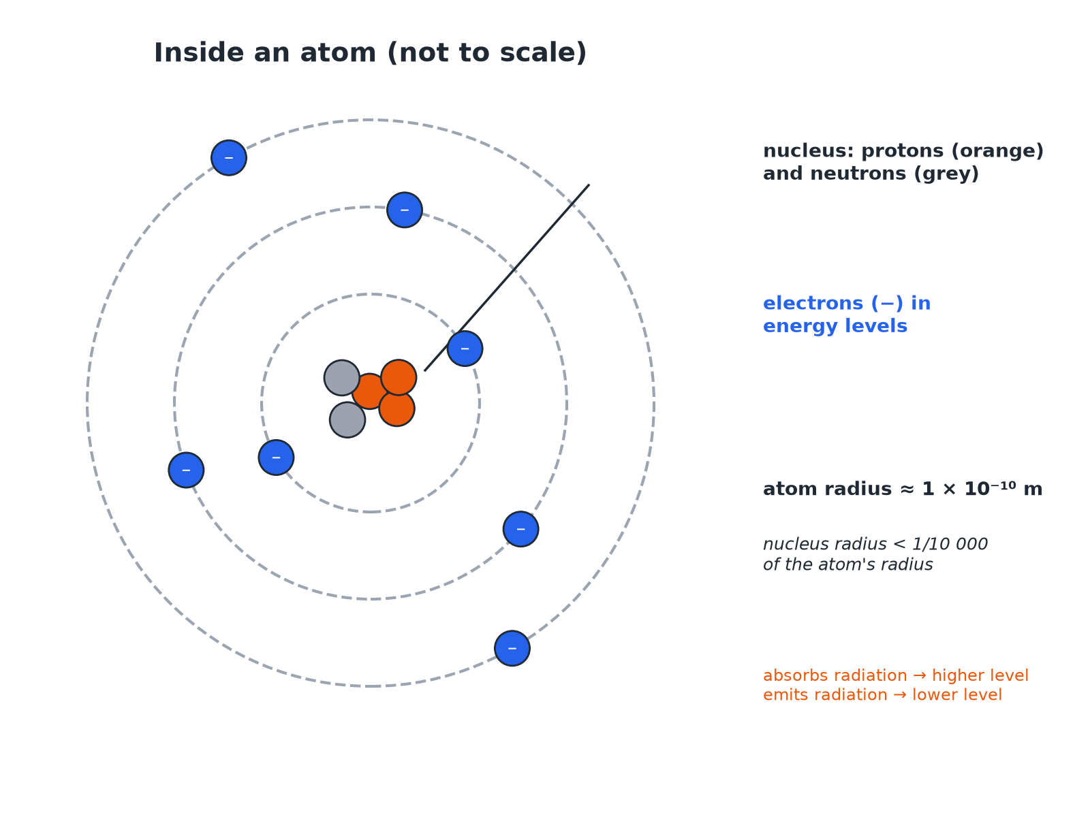

AQA GCSE PHYSICS · PAPER 1 · FOUNDATION & HIGHER
Inside an Atom
The nucleus is tiny compared with the whole atom.
Atomic structure
openrevise.com
Lesson 1 of 10

Slide 7

AQA GCSE PHYSICS · PAPER 1 · FOUNDATION & HIGHER
Particles in an Atom
Learn the relative charge and mass.
Particle
Relative charge
Relative mass
Where
Proton
+1
1
Nucleus
Neutron
0
1
Nucleus
Electron
−1
Very small (about 1/2000)
Energy levels around the nucleus
Atomic structure
openrevise.com
Lesson 1 of 10

Slide 8

AQA GCSE PHYSICS · PAPER 1 · FOUNDATION & HIGHER
Size of the Nucleus
The radius of an atom is about 1 × 10⁻¹⁰ m. The radius of its nucleus is less than 1/10 000 of this. Calculate the largest possible radius of the nucleus.
Divide
(1 × 10⁻¹⁰)/(10 000)
1
Write 10 000 as a power of ten
10 000 = 1 × 10⁴
2
Answer
1 × 10⁻¹⁴ m
3
ANSWER
The nucleus has a radius of less than 1 × 10⁻¹⁴ m.
Atomic structure
openrevise.com
Lesson 1 of 10

Slide 9
AQA GCSE PHYSICS · PAPER 1 · FOUNDATION & HIGHER
Electron Energy Levels
Describe what happens when an electron absorbs electromagnetic radiation.
Energy
The electron gains energy from the radiation
1
Movement
It moves to a higher energy level, further from the nucleus
2
Reverse
If it emits radiation it falls to a lower energy level, closer to the nucleus
3
ANSWER
Absorbing radiation moves an electron further from the nucleus; emitting radiation moves it closer.
Atomic structure
openrevise.com
Lesson 1 of 10

Slide 10

AQA GCSE PHYSICS · PAPER 1 · FOUNDATION & HIGHER
Key Facts
Points examiners ask about.
Neutral atoms
The number of electrons equals the number of protons, so there is no overall charge.
Mass
Most of the mass of an atom is in the nucleus.
Space
Most of an atom is empty space.
Positive ions
An atom that loses one or more outer electrons becomes a positive ion.
Atomic structure
openrevise.com
Lesson 1 of 10

Slide 11

AQA GCSE PHYSICS · PAPER 1 · FOUNDATION & HIGHER
Key Terms
Atom
The smallest part of an element that can exist.
Nucleus
The positively charged centre of an atom containing protons and neutrons.
Proton
A positive particle in the nucleus.
Neutron
A neutral particle in the nucleus.
Electron
A negative particle that orbits the nucleus.
Energy level
A distance from the nucleus at which an electron can be.
Atomic structure
openrevise.com
Lesson 1 of 10

Slide 12

AQA GCSE PHYSICS · PAPER 1 · FOUNDATION & HIGHER
YOUR TASK
10 minutes
Atom Sizes
An atom has a radius of 1 × 10⁻¹⁰ m and a nucleus of radius 1 × 10⁻¹⁵ m. How many times larger is the atom's radius than the nucleus's radius? Where is most of the mass?
Divide the two radii.
1
Use powers of ten.
2
WHAT A GOOD ANSWER SHOWS
The atom is 100 000 times larger (10⁻¹⁰ ÷ 10⁻¹⁵ = 10⁵). Most of the mass is in the nucleus.
Atomic structure
openrevise.com
Lesson 1 of 10

Slide 13
AQA GCSE PHYSICS · PAPER 1 · FOUNDATION & HIGHER
Can I...?
Describe the parts of an atom.
Explain why atoms are neutral.
Give the size of an atom.
Describe electron energy levels.
Compare atom and nucleus sizes.
Say what happens when radiation is absorbed.
State charges and masses.
Use standard form.
Atomic structure
openrevise.com
Lesson 1 of 10

Slide 14
AQA GCSE PHYSICS · PAPER 1 · FOUNDATION & HIGHER
Summary & Exam Focus
Atoms are about 1 × 10⁻¹⁰ m in radius.
The nucleus is less than 1/10 000 of the atom's radius.
Protons +1, neutrons 0, electrons −1.
Electrons move to higher levels by absorbing radiation.
EXAM FOCUS
Describe the structure of an atom. (3 marks)
Nucleus with protons and neutrons; electrons around it.
openrevise.com

