Slide 1
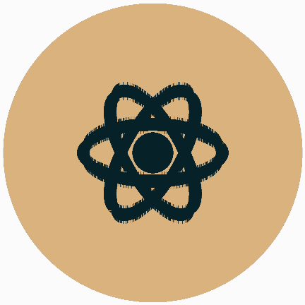
AQA GCSE PHYSICS · PAPER 1 · FOUNDATION & HIGHER
Mass number, atomic number and isotopes
Atomic structure
Lesson 2 of 10
openrevise.com

Slide 2

AQA GCSE PHYSICS · PAPER 1 · FOUNDATION & HIGHER
Warm-up
Answer each one, then check.
1
How many protons does carbon have?
2
What is an element?
3
What is an ion?
4
What does the atomic number tell you?
5
What is a neutron?
Atomic structure
openrevise.com
Lesson 2 of 10

Slide 3
AQA GCSE PHYSICS · PAPER 1 · FOUNDATION & HIGHER
Warm-up - Answers
How many protons does carbon have?
6
1
What is an element?
A substance with only one type of atom
2
What is an ion?
A charged atom
3
What does the atomic number tell you?
The number of protons
4
What is a neutron?
A neutral particle in the nucleus
5
Atomic structure
openrevise.com
Lesson 2 of 10

Slide 4

AQA GCSE PHYSICS · PAPER 1 · FOUNDATION & HIGHER
Learning Objectives
Define atomic number and mass number.
1
Work out the numbers of protons, neutrons and electrons in an atom.
2
Explain what isotopes are and relate differences in isotope symbols to identities, charges and masses.
3
Explain how atoms become positive ions.
4
Atomic structure
openrevise.com
Lesson 2 of 10

Slide 5

AQA GCSE PHYSICS · PAPER 1 · FOUNDATION & HIGHER
ATOMIC NUMBER AND MASS NUMBER
The atomic number is the number of protons in an atom. The mass number is the total number of protons and neutrons.
Isotopes of an element have the same number of protons but different numbers of neutrons.
Atomic structure
openrevise.com
Lesson 2 of 10

Slide 6
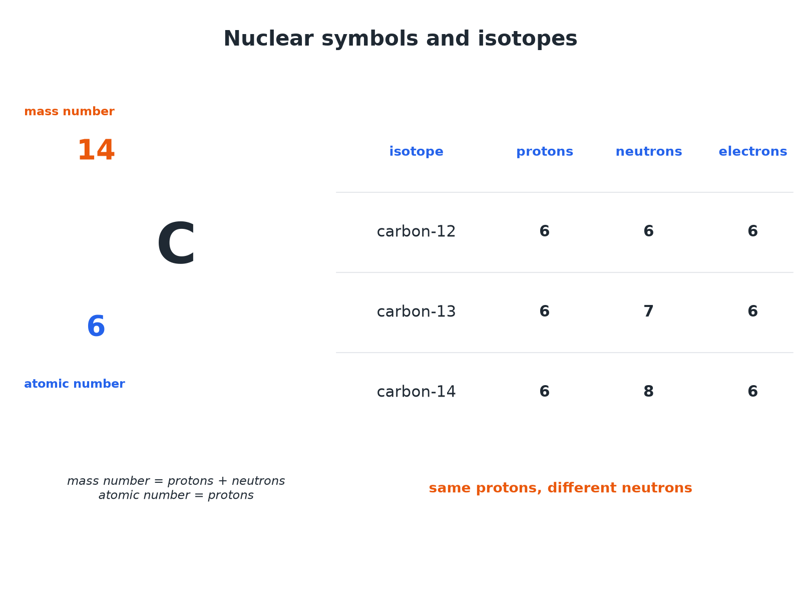

AQA GCSE PHYSICS · PAPER 1 · FOUNDATION & HIGHER
Nuclear Symbols and Isotopes
Same number of protons, different numbers of neutrons.
Atomic structure
openrevise.com
Lesson 2 of 10

Slide 7

AQA GCSE PHYSICS · PAPER 1 · FOUNDATION & HIGHER
Counting Particles
An atom of ¹⁴₆C is neutral. How many protons, neutrons and electrons does it have?
Protons
Atomic number = 6
1
Neutrons
Mass number − atomic number = 14 − 6 = 8
2
Electrons
Same as protons in a neutral atom = 6
3
ANSWER
6 protons, 8 neutrons and 6 electrons.
Atomic structure
openrevise.com
Lesson 2 of 10

Slide 8
AQA GCSE PHYSICS · PAPER 1 · FOUNDATION & HIGHER
Isotopes
Compare the atoms ³⁵₁₇Cl and ³⁷₁₇Cl.
Protons
Both have 17
1
Electrons
Both have 17 if neutral
2
Neutrons
35 − 17 = 18 and 37 − 17 = 20
3
ANSWER
They are isotopes: the same number of protons and electrons but different numbers of neutrons (2 more in chlorine-37).
Atomic structure
openrevise.com
Lesson 2 of 10

Slide 9
AQA GCSE PHYSICS · PAPER 1 · FOUNDATION & HIGHER
Ions
A sodium atom ²³₁₁Na loses one electron. Describe the ion formed.
Protons
Still 11
1
Electrons
Now 10
2
Charge
One more proton than electrons: +1
3
ANSWER
A positive ion, Na⁺, with 11 protons, 12 neutrons and 10 electrons.
Atomic structure
openrevise.com
Lesson 2 of 10

Slide 10

AQA GCSE PHYSICS · PAPER 1 · FOUNDATION & HIGHER
Key Ideas
Learn these.
Element
Determined by the number of protons.
Isotopes
Same element, so same chemical properties, but different masses.
Charge
Ions have an unequal number of protons and electrons.
Symbols
The mass number is the top number; the atomic number is the bottom number.
Atomic structure
openrevise.com
Lesson 2 of 10

Slide 11

AQA GCSE PHYSICS · PAPER 1 · FOUNDATION & HIGHER
Key Terms
Atomic number
The number of protons in an atom.
Mass number
The total number of protons and neutrons.
Isotopes
Atoms of the same element with different numbers of neutrons.
Ion
An atom that has lost or gained electrons.
Element
A substance made of atoms with the same number of protons.
Nuclide
A particular type of nucleus, such as carbon-14.
Atomic structure
openrevise.com
Lesson 2 of 10

Slide 12

AQA GCSE PHYSICS · PAPER 1 · FOUNDATION & HIGHER
YOUR TASK
10 minutes
Fill the Table
For ⁷₃Li and ⁶₃Li, state the number of protons, neutrons and electrons in each neutral atom. Explain why they are isotopes.
Use atomic number for protons.
1
Mass number minus atomic number for neutrons.
2
WHAT A GOOD ANSWER SHOWS
Li-7: 3 protons, 4 neutrons, 3 electrons. Li-6: 3 protons, 3 neutrons, 3 electrons. They have the same number of protons but different numbers of neutrons.
Atomic structure
openrevise.com
Lesson 2 of 10

Slide 13
AQA GCSE PHYSICS · PAPER 1 · FOUNDATION & HIGHER
Can I...?
Define atomic number.
Define isotopes.
Define mass number.
Compare two isotopes.
Work out neutrons.
Explain positive ions.
Read a nuclear symbol.
Say why isotopes react the same.
Atomic structure
openrevise.com
Lesson 2 of 10

Slide 14
AQA GCSE PHYSICS · PAPER 1 · FOUNDATION & HIGHER
Summary & Exam Focus
Atomic number = protons.
Mass number = protons + neutrons.
Isotopes: same protons, different neutrons.
A positive ion has lost electrons.
EXAM FOCUS
An atom has 6 protons and 8 neutrons. State its mass number. (1 mark)
Add protons and neutrons.
openrevise.com

