Slide 1

AQA GCSE PHYSICS · PAPER 1 · FOUNDATION & HIGHER
Nuclear equations
Atomic structure
Lesson 5 of 10
openrevise.com

Slide 2

AQA GCSE PHYSICS · PAPER 1 · FOUNDATION & HIGHER
Warm-up
Answer each one, then check.
1
What is the mass number?
2
What is an alpha particle?
3
What is a beta particle?
4
What is the atomic number?
5
Does gamma change the nucleus's mass or charge?
Atomic structure
openrevise.com
Lesson 5 of 10

Slide 3
AQA GCSE PHYSICS · PAPER 1 · FOUNDATION & HIGHER
Warm-up - Answers
What is the mass number?
Protons plus neutrons
1
What is an alpha particle?
Two protons and two neutrons
2
What is a beta particle?
A fast electron from the nucleus
3
What is the atomic number?
Number of protons
4
Does gamma change the nucleus's mass or charge?
No
5
Atomic structure
openrevise.com
Lesson 5 of 10

Slide 4

AQA GCSE PHYSICS · PAPER 1 · FOUNDATION & HIGHER
Learning Objectives
Use the symbols for common nuclei and particles.
1
Balance mass numbers and atomic numbers in alpha and beta decay equations.
2
Describe the effect of alpha, beta and gamma emission on the nucleus.
3
Atomic structure
openrevise.com
Lesson 5 of 10

Slide 5

AQA GCSE PHYSICS · PAPER 1 · FOUNDATION & HIGHER
NUCLEAR EQUATIONS
Alpha: ⁴₂He. Beta: ⁰₋₁e. In a balanced nuclear equation the mass numbers and the atomic numbers are the same on both sides.
Alpha decay: mass number falls by 4, atomic number falls by 2. Beta decay: mass number unchanged, atomic number rises by 1. Gamma: no change to mass or charge.
Atomic structure
openrevise.com
Lesson 5 of 10

Slide 6
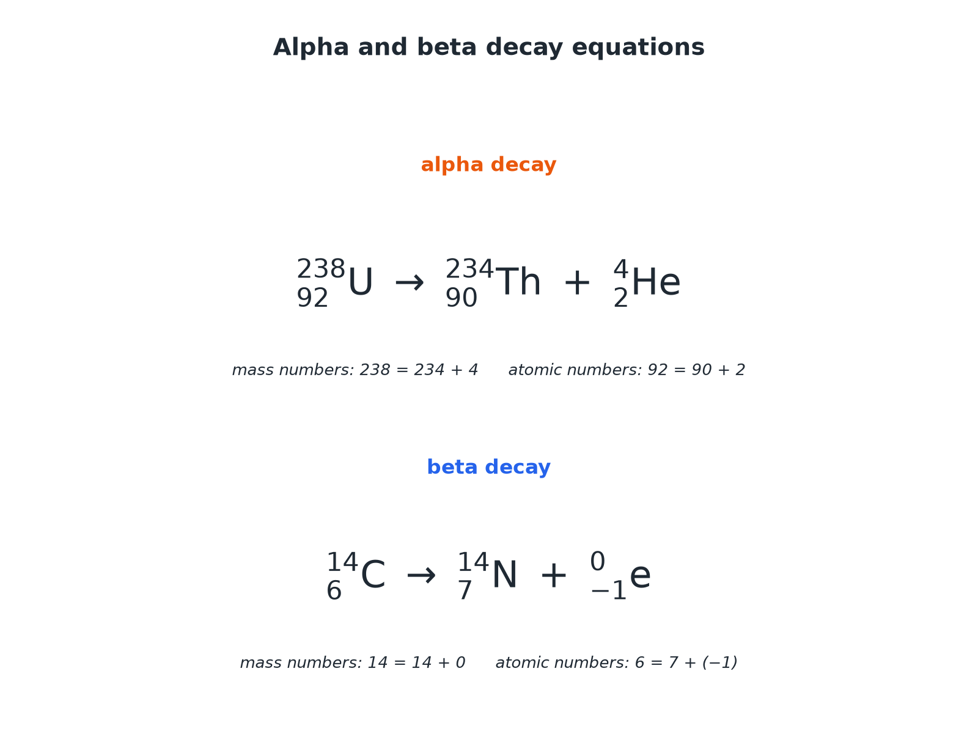

AQA GCSE PHYSICS · PAPER 1 · FOUNDATION & HIGHER
Alpha and Beta Decay Equations
Add up the top numbers and the bottom numbers on each side.
Atomic structure
openrevise.com
Lesson 5 of 10

Slide 7

AQA GCSE PHYSICS · PAPER 1 · FOUNDATION & HIGHER
Effects on the Nucleus
How the numbers change.
Emission
Mass number
Atomic number
Alpha (α)
Decreases by 4
Decreases by 2
Beta (β)
Stays the same
Increases by 1
Gamma (γ)
Stays the same
Stays the same
Atomic structure
openrevise.com
Lesson 5 of 10

Slide 8

AQA GCSE PHYSICS · PAPER 1 · FOUNDATION & HIGHER
Alpha Decay
Radium-226 (²²⁶₈₈Ra) decays by alpha emission. Complete: ²²⁶₈₈Ra → ^A_ZRn + ⁴₂He
Mass numbers
226 = A + 4, so A = 222
1
Atomic numbers
88 = Z + 2, so Z = 86
2
ANSWER
²²⁶₈₈Ra → ²²²₈₆Rn + ⁴₂He
Atomic structure
openrevise.com
Lesson 5 of 10

Slide 9
AQA GCSE PHYSICS · PAPER 1 · FOUNDATION & HIGHER
Beta Decay
Carbon-14 decays by beta emission. Complete: ¹⁴₆C → ¹⁴_ZN + ⁰₋₁e
Mass numbers
14 = 14 + 0, so balanced
1
Atomic numbers
6 = Z + (−1), so Z = 7
2
ANSWER
¹⁴₆C → ¹⁴₇N + ⁰₋₁e
Atomic structure
openrevise.com
Lesson 5 of 10

Slide 10

AQA GCSE PHYSICS · PAPER 1 · FOUNDATION & HIGHER
Why It Works
Understand the changes.
Alpha
Two protons and two neutrons leave the nucleus.
Beta
A neutron turns into a proton and a fast electron is emitted.
Gamma
The nucleus loses energy only.
Checking
Add up the top numbers, then the bottom numbers, on each side.
Atomic structure
openrevise.com
Lesson 5 of 10

Slide 11

AQA GCSE PHYSICS · PAPER 1 · FOUNDATION & HIGHER
Key Terms
Nuclear equation
An equation showing what happens to a nucleus in radioactive decay.
Balanced
The same mass number total and atomic number total on both sides.
Daughter nucleus
The nucleus formed after decay.
Alpha decay
Emission of a helium nucleus.
Beta decay
A neutron changes to a proton and an electron is emitted.
Gamma emission
Release of energy from the nucleus as electromagnetic radiation.
Atomic structure
openrevise.com
Lesson 5 of 10

Slide 12

AQA GCSE PHYSICS · PAPER 1 · FOUNDATION & HIGHER
YOUR TASK
12 minutes
Balance the Equation
Complete: (a) ²³⁸₉₂U → ^A_ZTh + ⁴₂He (b) ⁹⁰₃₈Sr → ⁹⁰_ZY + ⁰₋₁e
Balance the top numbers.
1
Balance the bottom numbers.
2
WHAT A GOOD ANSWER SHOWS
(a) A = 234, Z = 90. (b) Z = 39.
Atomic structure
openrevise.com
Lesson 5 of 10

Slide 13
AQA GCSE PHYSICS · PAPER 1 · FOUNDATION & HIGHER
Can I...?
Write the symbol for alpha.
Complete an alpha decay equation.
Write the symbol for beta.
Complete a beta decay equation.
Balance mass numbers.
State the effect of gamma emission.
Balance atomic numbers.
Explain beta decay.
Atomic structure
openrevise.com
Lesson 5 of 10

Slide 14
AQA GCSE PHYSICS · PAPER 1 · FOUNDATION & HIGHER
Summary & Exam Focus
Alpha decay: mass −4, atomic −2.
Beta decay: mass unchanged, atomic +1.
Gamma: no change.
Balance both rows of numbers.
EXAM FOCUS
Complete ²²⁶₈₈Ra → ^A_ZRn + ⁴₂He. (2 marks)
Balance the top and bottom numbers.
openrevise.com

