Slide 1

AQA GCSE PHYSICS · PAPER 1 · FOUNDATION & HIGHER
Half-lives and the random nature of radioactive decay
Atomic structure
Lesson 6 of 10
openrevise.com

Slide 2

AQA GCSE PHYSICS · PAPER 1 · FOUNDATION & HIGHER
Warm-up
Answer each one, then check.
1
What does random mean?
2
What is half of 800?
3
What is activity measured in?
4
What is a count rate?
5
What does exponential decay look like on a graph?
Atomic structure
openrevise.com
Lesson 6 of 10

Slide 3
AQA GCSE PHYSICS · PAPER 1 · FOUNDATION & HIGHER
Warm-up - Answers
What does random mean?
Cannot be predicted
1
What is half of 800?
400
2
What is activity measured in?
Becquerel (Bq)
3
What is a count rate?
Number of counts per second
4
What does exponential decay look like on a graph?
A curve that falls quickly then more slowly
5
Atomic structure
openrevise.com
Lesson 6 of 10

Slide 4

AQA GCSE PHYSICS · PAPER 1 · FOUNDATION & HIGHER
Learning Objectives
Define half-life.
1
Explain half-life in terms of the random nature of radioactive decay.
2
Determine the half-life of an isotope from a graph or table.
3
Calculate the net decline as a ratio after a given number of half-lives (Higher tier).
4
Atomic structure
openrevise.com
Lesson 6 of 10

Slide 5

AQA GCSE PHYSICS · PAPER 1 · FOUNDATION & HIGHER
HALF-LIFE
The half-life of a radioactive isotope is the time it takes for the number of nuclei of the isotope in a sample to halve, or the time it takes for the count rate (or activity) to fall to half its initial level.
Radioactive decay is random: we cannot say when any one nucleus will decay, but for a large number of nuclei the half-life is predictable.
Atomic structure
openrevise.com
Lesson 6 of 10

Slide 6
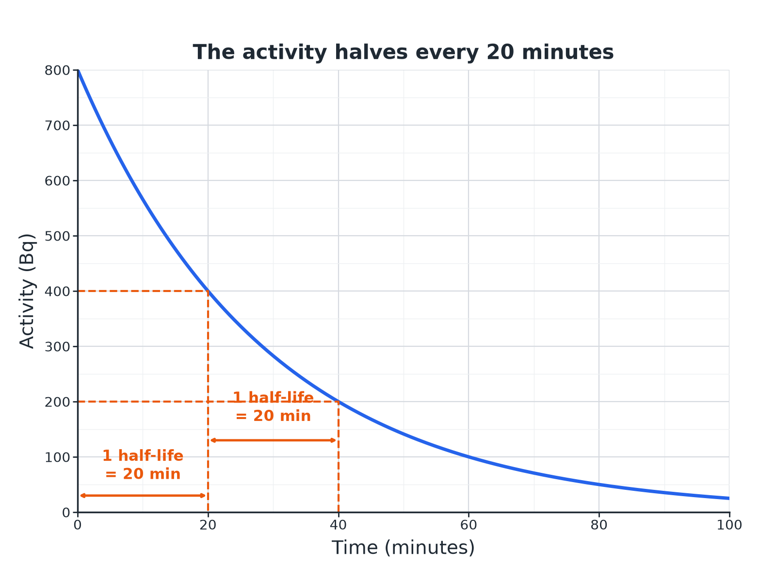

AQA GCSE PHYSICS · PAPER 1 · FOUNDATION & HIGHER
A Decay Curve
Each half-life the activity halves.
Atomic structure
openrevise.com
Lesson 6 of 10

Slide 7

AQA GCSE PHYSICS · PAPER 1 · FOUNDATION & HIGHER
Number of Half-Lives
Higher tier: net decline as a ratio.
Half-lives
Fraction left
Ratio of final to initial
0
1
1 : 1
1
1/2
1 : 2
2
1/4
1 : 4
3
1/8
1 : 8
4
1/16
1 : 16
Atomic structure
openrevise.com
Lesson 6 of 10

Slide 8

AQA GCSE PHYSICS · PAPER 1 · FOUNDATION & HIGHER
Finding a Half-Life from a Graph
The activity of a sample falls from 800 Bq to 400 Bq in 20 minutes and to 200 Bq after 40 minutes. What is the half-life?
800 to 400
Halved in 20 minutes
1
400 to 200
Halved again in the next 20 minutes
2
ANSWER
The half-life is 20 minutes.
Atomic structure
openrevise.com
Lesson 6 of 10

Slide 9
AQA GCSE PHYSICS · PAPER 1 · FOUNDATION & HIGHER
Activity After Several Half-Lives
A source has an activity of 800 Bq and a half-life of 6 hours. Find its activity after 24 hours.
Number of half-lives
24 ÷ 6 = 4
1
Halve four times
800 → 400 → 200 → 100 → 50
2
ANSWER
50 Bq
Atomic structure
openrevise.com
Lesson 6 of 10

Slide 10
AQA GCSE PHYSICS · PAPER 1 · FOUNDATION & HIGHER
Net Decline as a Ratio (Higher)
Calculate the ratio of the final activity to the initial activity after 3 half-lives.
Each half-life
Halve the activity
1
After 3
(½)³ = ⅛
2
ANSWER
The activity falls to 1/8 of its initial value, a ratio of 1 : 8.
Atomic structure
openrevise.com
Lesson 6 of 10

Slide 11

AQA GCSE PHYSICS · PAPER 1 · FOUNDATION & HIGHER
Random Decay
How to explain it.
One nucleus
It is impossible to predict when a particular nucleus will decay.
Many nuclei
The number decaying in a given time follows a pattern, so half-life is a reliable measure.
Count rate
Count rate is also random, so it varies slightly between measurements.
Background
Correct for background radiation to find the true count rate.
Atomic structure
openrevise.com
Lesson 6 of 10

Slide 12

AQA GCSE PHYSICS · PAPER 1 · FOUNDATION & HIGHER
Key Terms
Half-life
The time for the number of nuclei (or the activity) to halve.
Random
Cannot be predicted for a single nucleus.
Count rate
The number of decays detected each second.
Activity
The rate of decay of a source, in becquerel.
Decay curve
A graph showing how activity falls with time.
Background
The radiation that is always around us.
Atomic structure
openrevise.com
Lesson 6 of 10

Slide 13

AQA GCSE PHYSICS · PAPER 1 · FOUNDATION & HIGHER
YOUR TASK
10 minutes
Halve It
A sample has a count rate of 640 counts per minute. Its half-life is 3 hours. What is the count rate after 12 hours? What is the ratio of final to initial count rate?
Work out the number of half-lives.
1
Halve each time.
2
WHAT A GOOD ANSWER SHOWS
12 ÷ 3 = 4 half-lives: 640 → 320 → 160 → 80 → 40 counts per minute. The ratio is 1 : 16.
Atomic structure
openrevise.com
Lesson 6 of 10

Slide 14
AQA GCSE PHYSICS · PAPER 1 · FOUNDATION & HIGHER
Can I...?
Define half-life.
Work out the number of half-lives.
Explain random decay.
State the ratio after several half-lives.
Find half-life from a graph.
Explain why decay is random.
Halve repeatedly.
Use correct units.
Atomic structure
openrevise.com
Lesson 6 of 10

Slide 15
AQA GCSE PHYSICS · PAPER 1 · FOUNDATION & HIGHER
Summary & Exam Focus
Half-life: time for activity to halve.
Random decay but a predictable half-life for many nuclei.
After n half-lives: fraction (1/2)ⁿ.
Read half-life from a graph.
EXAM FOCUS
A radioactive source has a half-life of 20 minutes and an activity of 800 Bq. Find its activity after 60 minutes. (2 marks)
Three half-lives: halve three times.
openrevise.com

