Slide 1

AQA GCSE PHYSICS · PAPER 2 · FOUNDATION & HIGHER
Scalars, vectors and forces
Forces
Lesson 1 of 20
openrevise.com

Slide 2

AQA GCSE PHYSICS · PAPER 2 · FOUNDATION & HIGHER
Warm-up
Answer each one, then check.
1
What is a force?
2
What is the unit of force?
3
Give an example of a quantity with direction.
4
What is friction?
5
What does a longer arrow mean on a force diagram?
Forces
openrevise.com
Lesson 1 of 20

Slide 3
AQA GCSE PHYSICS · PAPER 2 · FOUNDATION & HIGHER
Warm-up - Answers
What is a force?
A push or a pull
1
What is the unit of force?
The newton (N)
2
Give an example of a quantity with direction.
Velocity
3
What is friction?
A force that opposes motion between surfaces
4
What does a longer arrow mean on a force diagram?
A bigger force
5
Forces
openrevise.com
Lesson 1 of 20

Slide 4

AQA GCSE PHYSICS · PAPER 2 · FOUNDATION & HIGHER
Learning Objectives
Distinguish scalar quantities from vector quantities.
1
Represent a vector using an arrow.
2
Describe contact and non-contact forces with examples.
3
Describe the interaction between pairs of objects that produce a force on each object.
4
Forces
openrevise.com
Lesson 1 of 20

Slide 5

AQA GCSE PHYSICS · PAPER 2 · FOUNDATION & HIGHER
SCALARS AND VECTORS
Scalar quantities have magnitude only. Vector quantities have magnitude and direction.
A vector is drawn as an arrow: the length shows the magnitude and the arrowhead shows the direction. Force is a vector quantity.
Forces
openrevise.com
Lesson 1 of 20

Slide 6
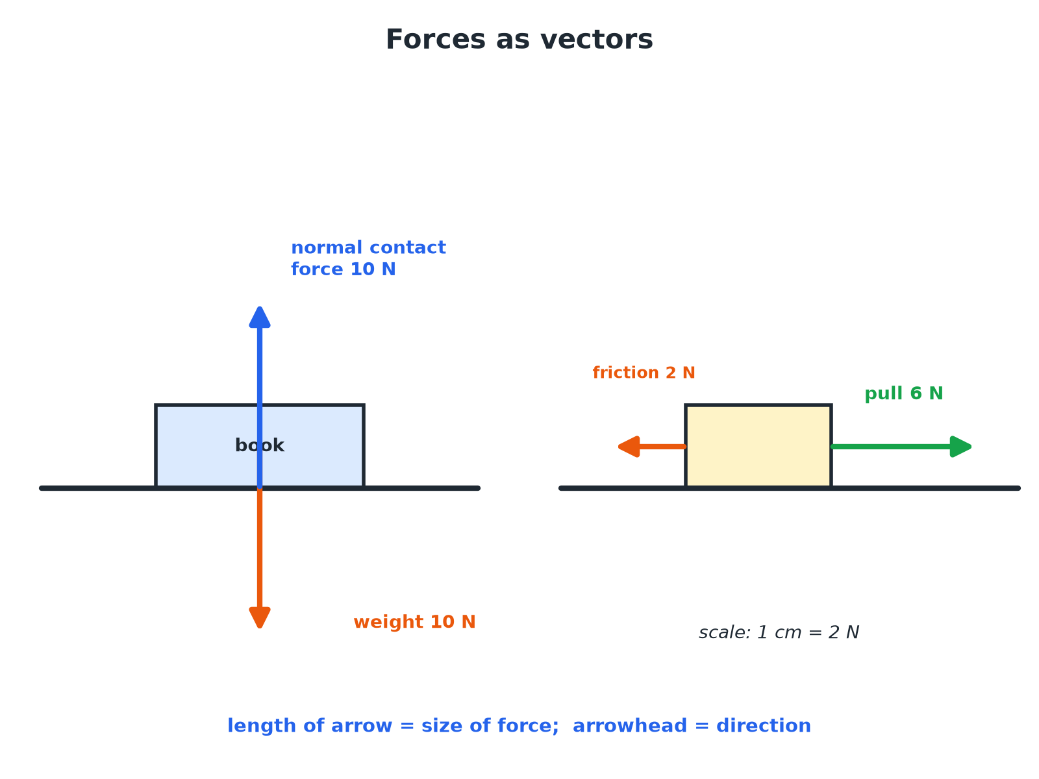

AQA GCSE PHYSICS · PAPER 2 · FOUNDATION & HIGHER
Forces as Vectors
The longer the arrow, the larger the force.
Forces
openrevise.com
Lesson 1 of 20

Slide 7

AQA GCSE PHYSICS · PAPER 2 · FOUNDATION & HIGHER
Scalar or Vector?
Learn which is which.
Scalar (size only)
Vector (size and direction)
Distance
Displacement
Speed
Velocity
Mass
Force and weight
Energy, time, temperature
Acceleration and momentum
Forces
openrevise.com
Lesson 1 of 20

Slide 8

AQA GCSE PHYSICS · PAPER 2 · FOUNDATION & HIGHER
Contact or Non-contact?
CONTACT FORCES (OBJECTS TOUCHING)
NON-CONTACT FORCES (OBJECTS SEPARATED)
• Friction.
• Air resistance.
• Tension.
• Normal contact force.
• Gravitational force.
• Electrostatic force.
• Magnetic force.
Forces
openrevise.com
Lesson 1 of 20

Slide 9

AQA GCSE PHYSICS · PAPER 2 · FOUNDATION & HIGHER
Drawing a Force Vector
Draw an arrow to represent a force of 6 N to the right. Use a scale of 1 cm = 2 N.
Length
6 ÷ 2 = 3 cm
1
Direction
An arrowhead pointing right
2
ANSWER
A 3 cm arrow pointing to the right.
Forces
openrevise.com
Lesson 1 of 20

Slide 10
AQA GCSE PHYSICS · PAPER 2 · FOUNDATION & HIGHER
Interaction Pairs
Two magnets are brought close together with their north poles facing. Describe the forces.
Force on each magnet
Each magnet exerts a force on the other
1
Direction
Like poles repel, so each force points away from the other magnet
2
Type
Non-contact, because the magnets are not touching
3
ANSWER
Each magnet pushes the other away: equal and opposite non-contact forces.
Forces
openrevise.com
Lesson 1 of 20

Slide 11

AQA GCSE PHYSICS · PAPER 2 · FOUNDATION & HIGHER
Key Points
Use the right words.
Force is a vector
It has a size in newtons and a direction.
Pairs of forces
When two objects interact, each exerts a force on the other.
Scale
Choose a scale so the arrows fit on the page.
Examples
Name the force and its direction: 'friction to the left'.
Forces
openrevise.com
Lesson 1 of 20

Slide 12

AQA GCSE PHYSICS · PAPER 2 · FOUNDATION & HIGHER
Key Terms
Scalar
A quantity with magnitude only.
Vector
A quantity with magnitude and direction.
Contact force
A force between objects that are touching.
Non-contact force
A force between objects that are separated.
Magnitude
The size of a quantity.
Newton
The unit of force.
Forces
openrevise.com
Lesson 1 of 20

Slide 13

AQA GCSE PHYSICS · PAPER 2 · FOUNDATION & HIGHER
YOUR TASK
8 minutes
Sort Them
Sort into scalar and vector: mass, velocity, distance, acceleration, time, force. Then say whether each of these forces is contact or non-contact: friction, gravity, magnetic force, tension.
Does it have direction?
1
Are the objects touching?
2
WHAT A GOOD ANSWER SHOWS
Scalars: mass, distance, time. Vectors: velocity, acceleration, force. Contact: friction, tension. Non-contact: gravity, magnetic force.
Forces
openrevise.com
Lesson 1 of 20
Notes:
Ask why speed is a scalar but velocity is a vector.

Slide 14
AQA GCSE PHYSICS · PAPER 2 · FOUNDATION & HIGHER
Can I...?
Define scalar and vector.
List non-contact forces.
Give examples of each.
Describe an interaction pair.
Draw a vector arrow to scale.
Use the word magnitude.
List contact forces.
Write force directions.
Forces
openrevise.com
Lesson 1 of 20

Slide 15
AQA GCSE PHYSICS · PAPER 2 · FOUNDATION & HIGHER
Summary & Exam Focus
Scalar: magnitude only. Vector: magnitude and direction.
Force is a vector.
Contact: friction, tension, air resistance, normal contact force.
Non-contact: gravity, electrostatic, magnetic.
EXAM FOCUS
State whether velocity is a scalar or a vector quantity. (1 mark)
Vector: it has direction.
openrevise.com

Slide 16
AQA GCSE PHYSICS · PAPER 2 · FOUNDATION & HIGHER
Exam Practice: Scalars, vectors and forces
Answer all questions. Use the mark allocation as a guide to how much to write. · 13 minutes
Question 1 · 2 marks · State
Give one example of a scalar quantity and one example of a vector quantity.
Question 2 · 3 marks · Complete
Some forces are contact forces and some are non-contact forces. Give one example of each.
Question 3 · 2 marks · Draw
A force of 6 N acts to the right on an object. Draw an arrow to represent this force. Use a scale of 1 cm = 2 N.
Forces
openrevise.com
Lesson 1 of 20

Slide 17
AQA GCSE PHYSICS · PAPER 2 · FOUNDATION & HIGHER
Exam Practice: Scalars, vectors and forces (cont.)
Question 4 · 2 marks · Explain
Explain the difference between speed and velocity.
Question 5 · 3 marks · Describe
A book rests on a table. Describe the forces acting on the book. State the type of each force.
Forces
openrevise.com
Lesson 1 of 20

Slide 18
AQA GCSE PHYSICS · PAPER 2 · FOUNDATION & HIGHER
Question 1 · 2 marks · State
“
Give one example of a scalar quantity and one example of a vector quantity.
HOW TO ANSWER IT
Command word: State. Worth 2 marks, so plan before writing.
Forces
openrevise.com
Lesson 1 of 20

Slide 19
AQA GCSE PHYSICS · PAPER 2 · FOUNDATION & HIGHER
Question 1 · mark scheme
2 marks available. Award a mark for each point made.
A scalar quantity
1 mark
A vector quantity
1 mark
Forces
openrevise.com
Lesson 1 of 20

Slide 20
AQA GCSE PHYSICS · PAPER 2 · FOUNDATION & HIGHER
Question 2 · 3 marks · Complete
“
Some forces are contact forces and some are non-contact forces. Give one example of each.
HOW TO ANSWER IT
Command word: Complete. Worth 3 marks, so plan before writing.
Forces
openrevise.com
Lesson 1 of 20

Slide 21
AQA GCSE PHYSICS · PAPER 2 · FOUNDATION & HIGHER
Question 2 · mark scheme
3 marks available. Award a mark for each point made.
Contact example
1 mark
Non-contact example
1 mark
Correct link to touching or separated
1 mark
Forces
openrevise.com
Lesson 1 of 20

Slide 22
AQA GCSE PHYSICS · PAPER 2 · FOUNDATION & HIGHER
Question 3 · 2 marks · Draw
“
A force of 6 N acts to the right on an object. Draw an arrow to represent this force. Use a scale of 1 cm = 2 N.
HOW TO ANSWER IT
Command word: Draw. Worth 2 marks, so plan before writing.
Forces
openrevise.com
Lesson 1 of 20

Slide 23
AQA GCSE PHYSICS · PAPER 2 · FOUNDATION & HIGHER
Question 3 · mark scheme
2 marks available. Award a mark for each point made.
Length 3 cm
1 mark
Arrowhead pointing right
1 mark
Forces
openrevise.com
Lesson 1 of 20

Slide 24
AQA GCSE PHYSICS · PAPER 2 · FOUNDATION & HIGHER
Question 4 · 2 marks · Explain
“
Explain the difference between speed and velocity.
HOW TO ANSWER IT
Command word: Explain. Worth 2 marks, so plan before writing.
Forces
openrevise.com
Lesson 1 of 20

Slide 25
AQA GCSE PHYSICS · PAPER 2 · FOUNDATION & HIGHER
Question 4 · mark scheme
2 marks available. Award a mark for each point made.
Speed has no direction
1 mark
Velocity has direction
1 mark
Forces
openrevise.com
Lesson 1 of 20

Slide 26
AQA GCSE PHYSICS · PAPER 2 · FOUNDATION & HIGHER
Question 5 · 3 marks · Describe
“
A book rests on a table. Describe the forces acting on the book. State the type of each force.
HOW TO ANSWER IT
Command word: Describe. Worth 3 marks, so plan before writing.
Forces
openrevise.com
Lesson 1 of 20

Slide 27
AQA GCSE PHYSICS · PAPER 2 · FOUNDATION & HIGHER
Question 5 · mark scheme
3 marks available. Award a mark for each point made.
Weight downwards, non-contact gravitational
1 mark
Normal contact force upwards, contact
1 mark
Equal in size or balanced
1 mark
Forces
openrevise.com
Lesson 1 of 20

