Slide 1

AQA GCSE PHYSICS · PAPER 2 · FOUNDATION & HIGHER
Pressure in a fluid
Forces
Lesson 7 of 20
openrevise.com

Slide 2

AQA GCSE PHYSICS · PAPER 2 · FOUNDATION & HIGHER
Warm-up
Answer each one, then check.
1
What is area?
2
What is the unit of area?
3
What is a fluid?
4
What is the unit of force?
5
What is the unit of pressure?
Forces
openrevise.com
Lesson 7 of 20

Slide 3
AQA GCSE PHYSICS · PAPER 2 · FOUNDATION & HIGHER
Warm-up - Answers
What is area?
The amount of surface
1
What is the unit of area?
Square metres (m²)
2
What is a fluid?
A liquid or a gas
3
What is the unit of force?
Newton
4
What is the unit of pressure?
Pascal (Pa)
5
Forces
openrevise.com
Lesson 7 of 20

Slide 4

AQA GCSE PHYSICS · PAPER 2 · FOUNDATION & HIGHER
Learning Objectives
Define pressure and recall that a fluid can be a liquid or a gas.
1
Recall and apply p = F ÷ A.
2
Explain that pressure in a fluid causes a force at right angles to any surface.
3
Explain examples where force is spread over a large or small area.
4
Forces
openrevise.com
Lesson 7 of 20

Slide 5

AQA GCSE PHYSICS · PAPER 2 · FOUNDATION & HIGHER
PRESSURE
pressure = force normal to a surface ÷ area of that surface p = F/A
Pressure is in pascals (Pa), force in newtons (N) and area in square metres (m²). 1 Pa = 1 N/m².
Forces
openrevise.com
Lesson 7 of 20

Slide 6
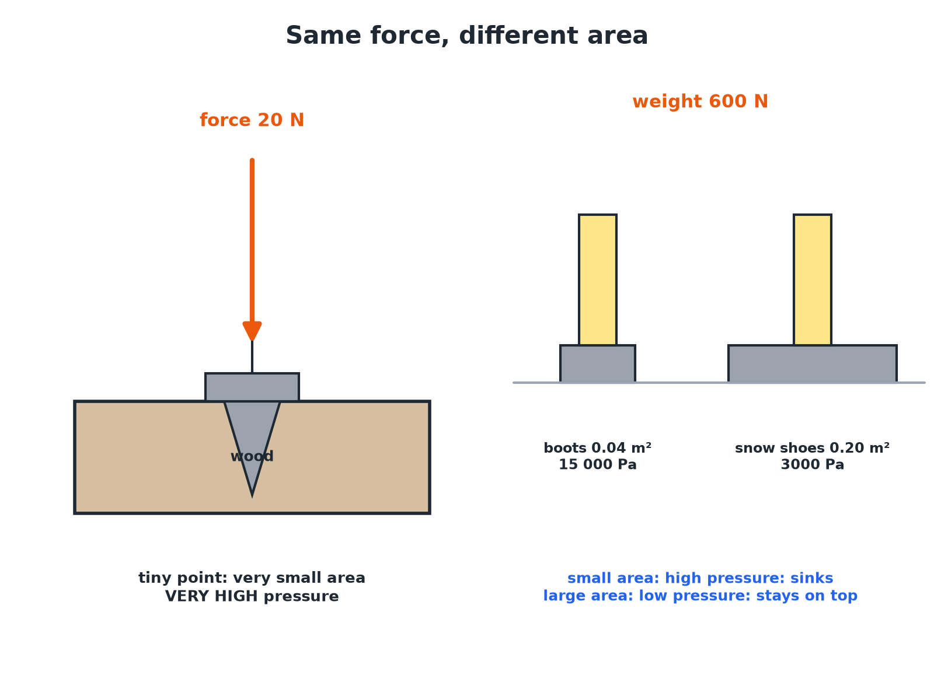

AQA GCSE PHYSICS · PAPER 2 · FOUNDATION & HIGHER
Same Force, Different Pressure
A smaller area gives a greater pressure for the same force.
Forces
openrevise.com
Lesson 7 of 20

Slide 7

AQA GCSE PHYSICS · PAPER 2 · FOUNDATION & HIGHER
Calculating Pressure
A person of weight 600 N stands on an area of 0.04 m². Calculate the pressure on the ground.
Write the equation
p = F ÷ A
1
Substitute
p = 600 ÷ 0.04
2
Answer
p = 15 000 Pa
3
ANSWER
15 000 Pa
Forces
openrevise.com
Lesson 7 of 20

Slide 8
AQA GCSE PHYSICS · PAPER 2 · FOUNDATION & HIGHER
Finding the Force
A pressure of 2000 Pa acts on a surface of area 0.50 m². Calculate the force.
Rearrange
F = pA
1
Substitute
F = 2000 × 0.50
2
Answer
F = 1000 N
3
ANSWER
1000 N
Forces
openrevise.com
Lesson 7 of 20

Slide 9
AQA GCSE PHYSICS · PAPER 2 · FOUNDATION & HIGHER
Explaining Everyday Examples
Explain why a sharp knife cuts better than a blunt one.
Same force
The same force is applied to both
1
Sharp edge
Has a very small area
2
Pressure
A small area gives a large pressure, so it cuts
3
ANSWER
The sharp knife has a smaller area, so for the same force it exerts a higher pressure.
Forces
openrevise.com
Lesson 7 of 20

Slide 10

AQA GCSE PHYSICS · PAPER 2 · FOUNDATION & HIGHER
Pressure in Fluids
Liquids and gases.
Direction
Pressure in a fluid causes a force normal (at right angles) to any surface.
Gases
Produced by collisions of particles with surfaces.
Liquids
Particles collide with the container walls in all directions.
Uses
Tyres, hydraulics and sealed containers use fluid pressure.
Forces
openrevise.com
Lesson 7 of 20

Slide 11

AQA GCSE PHYSICS · PAPER 2 · FOUNDATION & HIGHER
Key Terms
Pressure
Force per unit area.
Pascal
The unit of pressure; 1 N/m².
Fluid
A liquid or a gas.
Normal
At right angles to a surface.
Area
The size of a surface.
Force
A push or pull.
Forces
openrevise.com
Lesson 7 of 20

Slide 12

AQA GCSE PHYSICS · PAPER 2 · FOUNDATION & HIGHER
YOUR TASK
10 minutes
Shoe Pressure
A 500 N person wears stiletto heels of total area 0.0004 m² and then flat shoes of area 0.04 m². Calculate the pressure each exerts and explain which damages a floor.
Calculate each pressure.
1
Compare.
2
WHAT A GOOD ANSWER SHOWS
Heels: 500 ÷ 0.0004 = 1 250 000 Pa. Flat: 500 ÷ 0.04 = 12 500 Pa. The heels exert 100 times more pressure, so they damage the floor.
Forces
openrevise.com
Lesson 7 of 20
Notes:
Ask about tractors with wide tyres.

Slide 13
AQA GCSE PHYSICS · PAPER 2 · FOUNDATION & HIGHER
Can I...?
Define pressure.
Explain sharp and blunt objects.
Use p = F ÷ A.
Explain wide tyres.
Rearrange for force or area.
State the direction of fluid pressure.
Convert cm² to m².
Give the unit.
Forces
openrevise.com
Lesson 7 of 20

Slide 14
AQA GCSE PHYSICS · PAPER 2 · FOUNDATION & HIGHER
Summary & Exam Focus
p = F ÷ A.
Smaller area, larger pressure.
Fluid pressure acts at right angles to surfaces.
1 Pa = 1 N/m².
EXAM FOCUS
A person of weight 600 N stands on 0.04 m² of ground. Calculate the pressure. (2 marks)
Divide force by area.
openrevise.com

Slide 15
AQA GCSE PHYSICS · PAPER 2 · FOUNDATION & HIGHER
Exam Practice: Pressure in a fluid
Answer all questions. Use the mark allocation as a guide to how much to write. · 15 minutes
Question 1 · 2 marks · Calculate
A person weighs 600 N and stands on an area of 0.04 m². Calculate the pressure on the ground. Use the equation: pressure = force ÷ area
Question 2 · 2 marks · Explain
A nail has a sharp point. Explain why it is easier to push into wood than a blunt object.
Question 3 · 3 marks · Explain
A tractor with wide tyres does not sink into soft ground as much as a car with narrow tyres of the same weight. Explain why.
Forces
openrevise.com
Lesson 7 of 20

Slide 16
AQA GCSE PHYSICS · PAPER 2 · FOUNDATION & HIGHER
Exam Practice: Pressure in a fluid (cont.)
Question 4 · 3 marks · Calculate
A pressure of 2000 Pa acts on a surface of area 0.50 m². Calculate the force on the surface.
Question 5 · 4 marks · Calculate
A 500 N person wears shoes with a total area of 0.0004 m² on a floor. Calculate the pressure. Then state how many times greater it is than…
Forces
openrevise.com
Lesson 7 of 20

Slide 17
AQA GCSE PHYSICS · PAPER 2 · FOUNDATION & HIGHER
Question 1 · 2 marks · Calculate
“
A person weighs 600 N and stands on an area of 0.04 m². Calculate the pressure on the ground. Use the equation: pressure = force ÷ area
HOW TO ANSWER IT
Command word: Calculate. Worth 2 marks, so plan before writing.
Forces
openrevise.com
Lesson 7 of 20

Slide 18
AQA GCSE PHYSICS · PAPER 2 · FOUNDATION & HIGHER
Question 1 · mark scheme
2 marks available. Award a mark for each point made.
Correct substitution
1 mark
15 000 Pa
1 mark
Forces
openrevise.com
Lesson 7 of 20

Slide 19
AQA GCSE PHYSICS · PAPER 2 · FOUNDATION & HIGHER
Question 2 · 2 marks · Explain
“
A nail has a sharp point. Explain why it is easier to push into wood than a blunt object.
HOW TO ANSWER IT
Command word: Explain. Worth 2 marks, so plan before writing.
Forces
openrevise.com
Lesson 7 of 20

Slide 20
AQA GCSE PHYSICS · PAPER 2 · FOUNDATION & HIGHER
Question 2 · mark scheme
2 marks available. Award a mark for each point made.
Small area
1 mark
Greater pressure for the same force
1 mark
Forces
openrevise.com
Lesson 7 of 20

Slide 21
AQA GCSE PHYSICS · PAPER 2 · FOUNDATION & HIGHER
Question 3 · 3 marks · Explain
“
A tractor with wide tyres does not sink into soft ground as much as a car with narrow tyres of the same weight. Explain why.
HOW TO ANSWER IT
Command word: Explain. Worth 3 marks, so plan before writing.
Forces
openrevise.com
Lesson 7 of 20

Slide 22
AQA GCSE PHYSICS · PAPER 2 · FOUNDATION & HIGHER
Question 3 · mark scheme
3 marks available. Award a mark for each point made.
Weight is the same
1 mark
Larger area
1 mark
Smaller pressure
1 mark
Forces
openrevise.com
Lesson 7 of 20

Slide 23
AQA GCSE PHYSICS · PAPER 2 · FOUNDATION & HIGHER
Question 4 · 3 marks · Calculate
“
A pressure of 2000 Pa acts on a surface of area 0.50 m². Calculate the force on the surface.
HOW TO ANSWER IT
Command word: Calculate. Worth 3 marks, so plan before writing.
Forces
openrevise.com
Lesson 7 of 20

Slide 24
AQA GCSE PHYSICS · PAPER 2 · FOUNDATION & HIGHER
Question 4 · mark scheme
3 marks available. Award a mark for each point made.
Rearranges to F = pA
1 mark
Correct substitution
1 mark
1000 N
1 mark
Forces
openrevise.com
Lesson 7 of 20

Slide 25
AQA GCSE PHYSICS · PAPER 2 · FOUNDATION & HIGHER
Question 5 · 4 marks · Calculate
“
A 500 N person wears shoes with a total area of 0.0004 m² on a floor. Calculate the pressure. Then state how many times greater it is than the pressure from flat shoes of area 0.04 m².
HOW TO ANSWER IT
Command word: Calculate. Worth 4 marks, so plan before writing.
Forces
openrevise.com
Lesson 7 of 20

Slide 26
AQA GCSE PHYSICS · PAPER 2 · FOUNDATION & HIGHER
Question 5 · mark scheme
4 marks available. Award a mark for each point made.
1 250 000 Pa
1 mark
12 500 Pa
1 mark
Ratio 100
1 mark
States 100 times greater
1 mark
Forces
openrevise.com
Lesson 7 of 20

