Slide 1

AQA GCSE PHYSICS · PAPER 2 · FOUNDATION & HIGHER
Acceleration and velocity–time graphs
Forces
Lesson 12 of 20
openrevise.com

Slide 2

AQA GCSE PHYSICS · PAPER 2 · FOUNDATION & HIGHER
Warm-up
Answer each one, then check.
1
What is velocity?
2
What is the unit of acceleration?
3
What does deceleration mean?
4
What is the gradient of a graph?
5
What is the acceleration of free fall near Earth?
Forces
openrevise.com
Lesson 12 of 20

Slide 3
AQA GCSE PHYSICS · PAPER 2 · FOUNDATION & HIGHER
Warm-up - Answers
What is velocity?
Speed in a given direction
1
What is the unit of acceleration?
Metres per second squared (m/s²)
2
What does deceleration mean?
Slowing down
3
What is the gradient of a graph?
Change in y divided by change in x
4
What is the acceleration of free fall near Earth?
About 9.8 m/s²
5
Forces
openrevise.com
Lesson 12 of 20

Slide 4

AQA GCSE PHYSICS · PAPER 2 · FOUNDATION & HIGHER
Learning Objectives
Recall and apply a = Δv ÷ t.
1
Draw and interpret velocity–time graphs.
2
Use the gradient to find acceleration.
3
Use the area under a velocity–time graph to find distance (Higher tier).
4
Apply v² − u² = 2as.
5
Forces
openrevise.com
Lesson 12 of 20

Slide 5

AQA GCSE PHYSICS · PAPER 2 · FOUNDATION & HIGHER
ACCELERATION
acceleration = change in velocity ÷ time taken a = Δv/t
For uniform acceleration v² − u² = 2as (given on the equation sheet). Near Earth's surface a freely falling object accelerates at about 9.8 m/s².
Forces
openrevise.com
Lesson 12 of 20

Slide 6
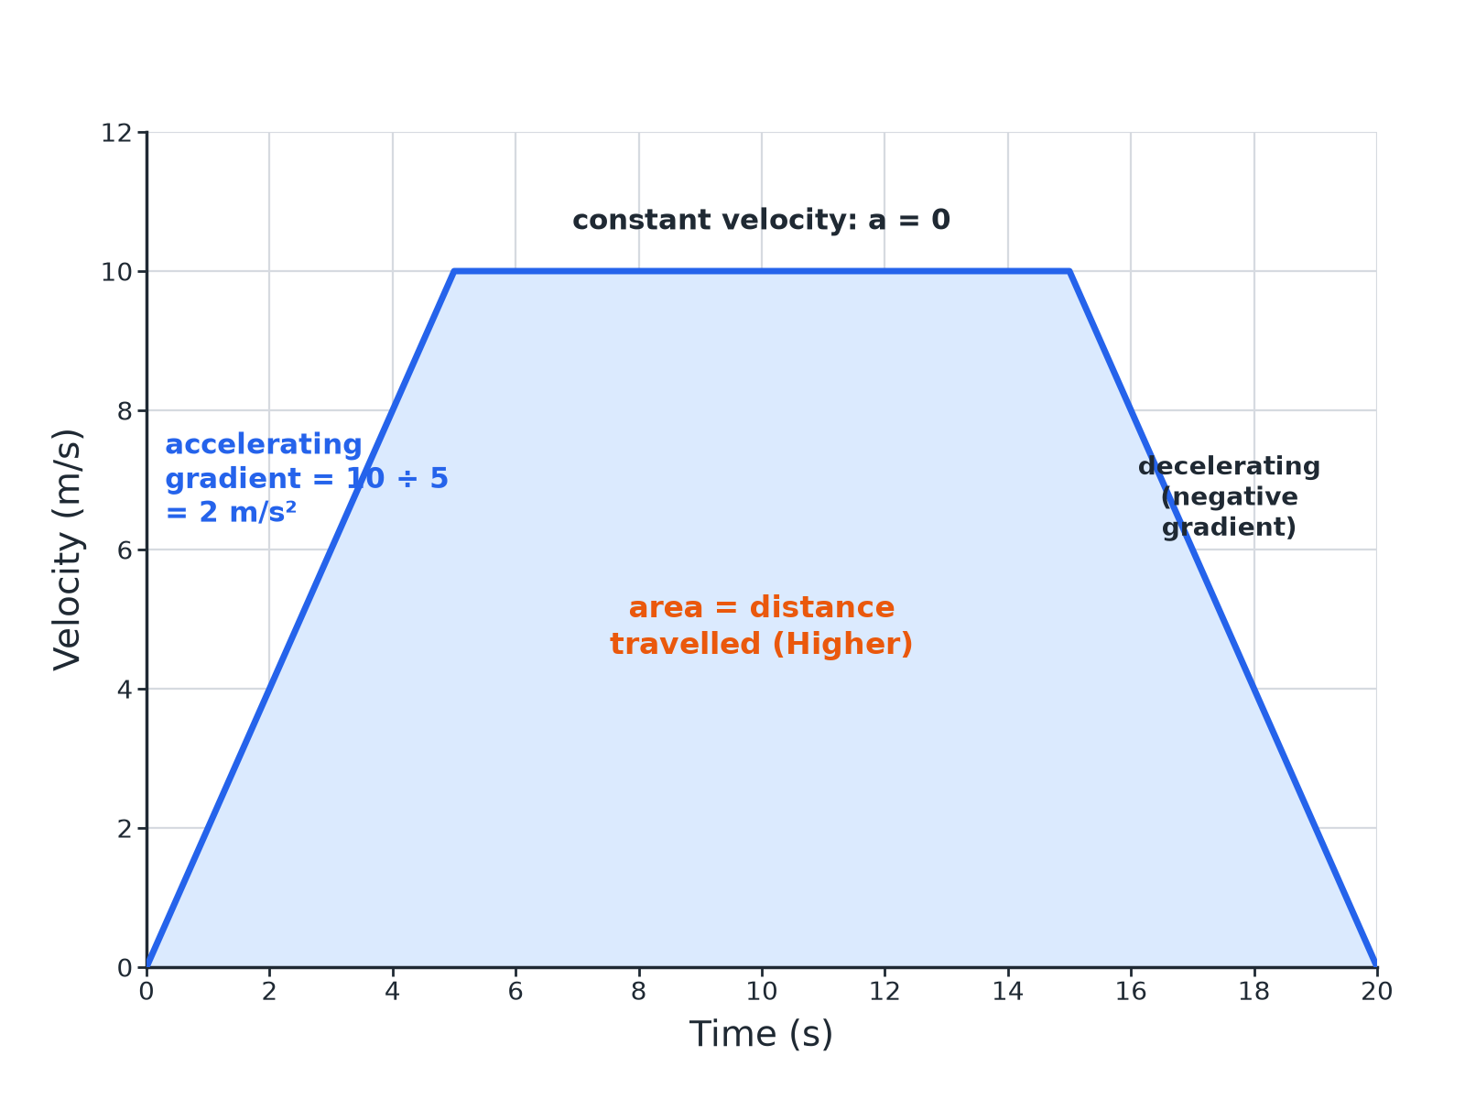

AQA GCSE PHYSICS · PAPER 2 · FOUNDATION & HIGHER
A Velocity–Time Graph
Gradient = acceleration; area = distance.
Forces
openrevise.com
Lesson 12 of 20

Slide 7

AQA GCSE PHYSICS · PAPER 2 · FOUNDATION & HIGHER
Calculating Acceleration
A car accelerates from rest to 12 m/s in 4.0 s. Calculate its acceleration.
Change in velocity
12 − 0 = 12 m/s
1
Substitute
a = 12 ÷ 4.0
2
Answer
a = 3.0 m/s²
3
ANSWER
3.0 m/s²
Forces
openrevise.com
Lesson 12 of 20

Slide 8
AQA GCSE PHYSICS · PAPER 2 · FOUNDATION & HIGHER
Using v² − u² = 2as
A car starts at 10 m/s and accelerates at 2.0 m/s² over a distance of 100 m. Calculate the final speed.
Write the equation
v² − u² = 2as
1
Substitute
v² − 10² = 2 × 2.0 × 100
2
Rearrange
v² = 100 + 400 = 500
3
Square root
v = 22.4 m/s
4
ANSWER
22 m/s (2 s.f.)
Forces
openrevise.com
Lesson 12 of 20

Slide 9
AQA GCSE PHYSICS · PAPER 2 · FOUNDATION & HIGHER
Area Under a Graph (Higher)
Use the graph (accelerating from 0 to 10 m/s in 5 s, constant for 10 s, then stopping in 5 s) to find the distance travelled.
Section 1 (triangle)
½ × 5 × 10 = 25 m
1
Section 2 (rectangle)
10 × 10 = 100 m
2
Section 3 (triangle)
½ × 5 × 10 = 25 m
3
Total
25 + 100 + 25 = 150 m
4
ANSWER
150 m
Forces
openrevise.com
Lesson 12 of 20

Slide 10
AQA GCSE PHYSICS · PAPER 2 · FOUNDATION & HIGHER
Free Fall
A ball is dropped from rest from a height of 20 m. Ignoring air resistance, calculate its speed on landing. a = 9.8 m/s².
Write the equation
v² = 2as
1
Substitute
v² = 2 × 9.8 × 20 = 392
2
Answer
v = 19.8 m/s
3
ANSWER
19.8 m/s
Forces
openrevise.com
Lesson 12 of 20

Slide 11

AQA GCSE PHYSICS · PAPER 2 · FOUNDATION & HIGHER
Reading the Graph
Key features.
Gradient
The acceleration; negative gradient means deceleration.
Horizontal line
Constant velocity (zero acceleration).
Area
Distance travelled (Higher tier); count squares for curves.
Units
m/s for velocity, m/s² for acceleration.
Forces
openrevise.com
Lesson 12 of 20

Slide 12

AQA GCSE PHYSICS · PAPER 2 · FOUNDATION & HIGHER
Key Terms
Acceleration
The rate of change of velocity.
Deceleration
Slowing down.
Velocity–time graph
A graph of velocity against time.
Uniform acceleration
Constant acceleration.
Free fall
Falling under gravity alone.
Gradient
How steep a line is.
Forces
openrevise.com
Lesson 12 of 20

Slide 13

AQA GCSE PHYSICS · PAPER 2 · FOUNDATION & HIGHER
YOUR TASK
12 minutes
Acceleration Practice
A train slows from 30 m/s to 10 m/s in 50 s. Calculate its acceleration. What does the sign tell you?
Change in velocity.
1
Divide by time.
2
WHAT A GOOD ANSWER SHOWS
a = (10 − 30) ÷ 50 = −0.40 m/s². The negative value shows deceleration.
Forces
openrevise.com
Lesson 12 of 20
Notes:
Ask about the gradient on a graph.

Slide 14
AQA GCSE PHYSICS · PAPER 2 · FOUNDATION & HIGHER
Can I...?
Recall a = Δv ÷ t.
Use v² − u² = 2as.
Calculate acceleration.
Estimate everyday accelerations.
Use the gradient of a v–t graph.
Give units.
Use the area under a v–t graph.
Read a graph.
Forces
openrevise.com
Lesson 12 of 20

Slide 15
AQA GCSE PHYSICS · PAPER 2 · FOUNDATION & HIGHER
Summary & Exam Focus
a = Δv ÷ t.
v² − u² = 2as.
v–t gradient = acceleration; area = distance.
Free fall: a ≈ 9.8 m/s².
EXAM FOCUS
A car accelerates from rest to 12 m/s in 4.0 s. Calculate the acceleration. (2 marks)
Divide the change in velocity by time.
openrevise.com

Slide 16
AQA GCSE PHYSICS · PAPER 2 · FOUNDATION & HIGHER
Exam Practice: Acceleration and velocity–time graphs
Answer all questions. Use the mark allocation as a guide to how much to write. · 16 minutes
Question 1 · 2 marks · Calculate
A car accelerates from rest to a velocity of 12 m/s in 4.0 s. Calculate the acceleration of the car. Use the equation: acceleration =…
Question 2 · 4 marks · Use the graph
The graph shows the velocity of a cyclist. (a) Calculate the acceleration in the first 5 s. (b) Describe the motion between 5 s and 15 s.
Question 3 · 3 marks · Calculate
A car starts at 10 m/s and accelerates uniformly at 2.0 m/s² over a distance of 100 m. Calculate its final velocity. Use the equation…
Forces
openrevise.com
Lesson 12 of 20

Slide 17
AQA GCSE PHYSICS · PAPER 2 · FOUNDATION & HIGHER
Exam Practice: Acceleration and velocity–time graphs (cont.)
Question 4 · 3 marks · Calculate
Use the velocity–time graph in question 2 to calculate the total distance travelled by the cyclist.
Question 5 · 3 marks · Calculate
A ball is dropped from rest from a height of 20 m. Assume no air resistance. The acceleration of free fall is 9.8 m/s². Calculate the speed…
Forces
openrevise.com
Lesson 12 of 20

Slide 18
AQA GCSE PHYSICS · PAPER 2 · FOUNDATION & HIGHER
Question 1 · 2 marks · Calculate
“
A car accelerates from rest to a velocity of 12 m/s in 4.0 s. Calculate the acceleration of the car. Use the equation: acceleration = change in velocity ÷ time taken
HOW TO ANSWER IT
Command word: Calculate. Worth 2 marks, so plan before writing.
Forces
openrevise.com
Lesson 12 of 20

Slide 19
AQA GCSE PHYSICS · PAPER 2 · FOUNDATION & HIGHER
Question 1 · mark scheme
2 marks available. Award a mark for each point made.
Correct substitution
1 mark
3.0 m/s²
1 mark
Forces
openrevise.com
Lesson 12 of 20

Slide 20
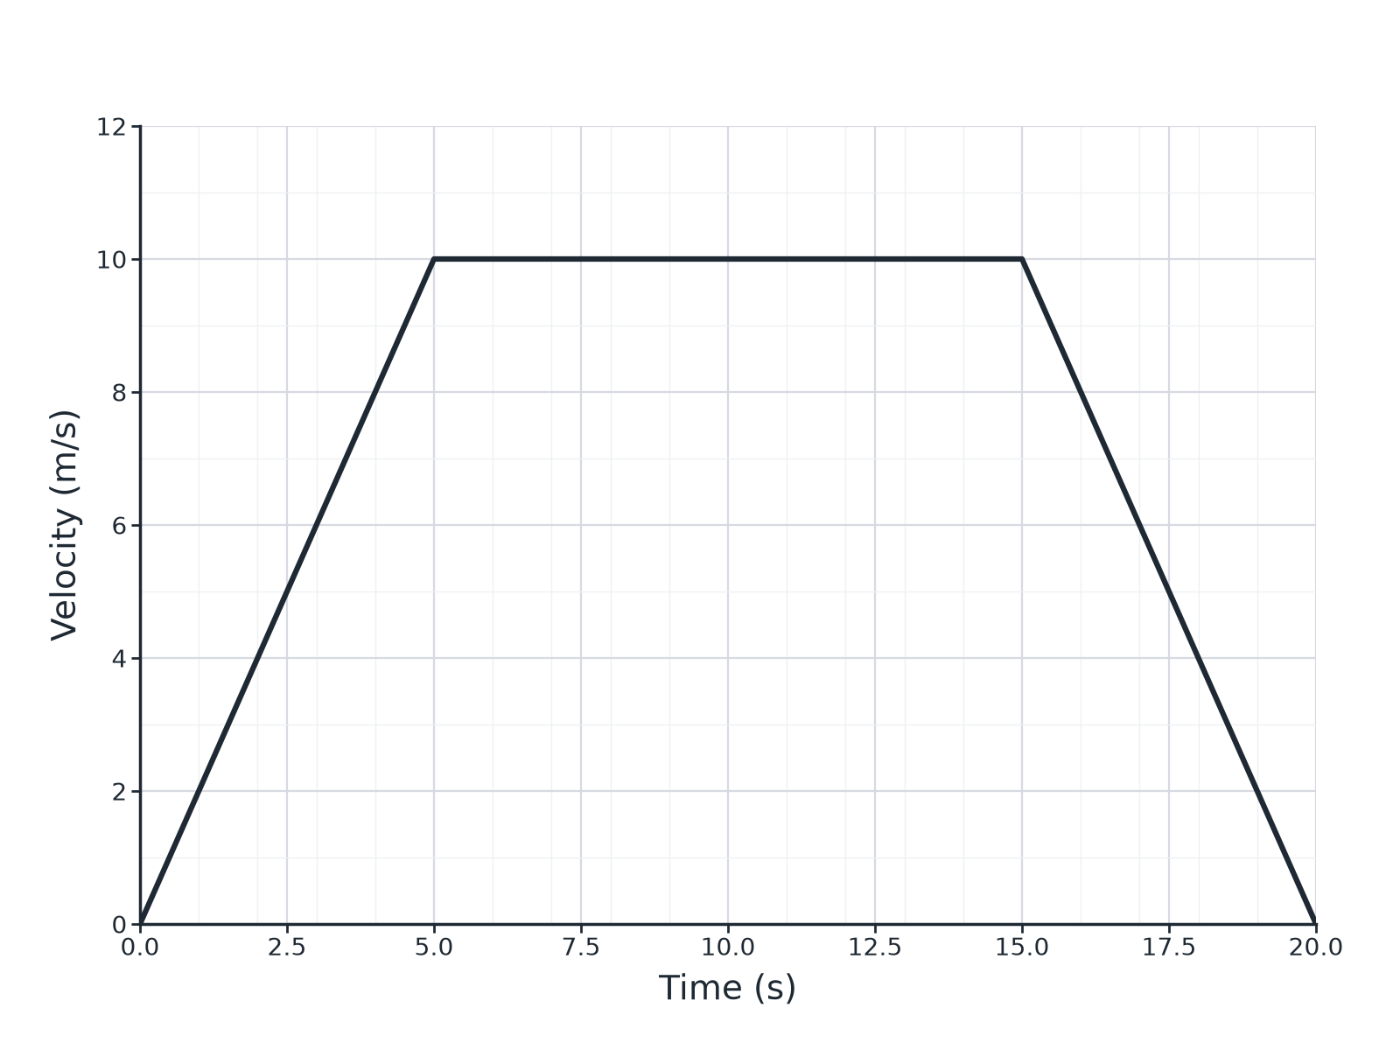
AQA GCSE PHYSICS · PAPER 2 · FOUNDATION & HIGHER
Question 2 · 4 marks · Use the graph
The graph shows the velocity of a cyclist. (a) Calculate the acceleration in the first 5 s. (b) Describe the motion between 5 s and 15 s. (4 marks)
Forces
openrevise.com
Lesson 12 of 20

Slide 21
AQA GCSE PHYSICS · PAPER 2 · FOUNDATION & HIGHER
Question 2 · mark scheme
4 marks available. Award a mark for each point made.
Change in velocity 10 m/s
1 mark
2.0 m/s²
1 mark
Constant velocity
1 mark
10 m/s
1 mark
Forces
openrevise.com
Lesson 12 of 20

Slide 22
AQA GCSE PHYSICS · PAPER 2 · FOUNDATION & HIGHER
Question 3 · 3 marks · Calculate
“
A car starts at 10 m/s and accelerates uniformly at 2.0 m/s² over a distance of 100 m. Calculate its final velocity. Use the equation: (final velocity)² − (initial velocity)² = 2 × acceleration × distance
HOW TO ANSWER IT
Command word: Calculate. Worth 3 marks, so plan before writing.
Forces
openrevise.com
Lesson 12 of 20

Slide 23
AQA GCSE PHYSICS · PAPER 2 · FOUNDATION & HIGHER
Question 3 · mark scheme
3 marks available. Award a mark for each point made.
Correct substitution
1 mark
v² = 500
1 mark
22 m/s
1 mark
Forces
openrevise.com
Lesson 12 of 20

Slide 24
AQA GCSE PHYSICS · PAPER 2 · FOUNDATION & HIGHER
Question 4 · 3 marks · Calculate
“
Use the velocity–time graph in question 2 to calculate the total distance travelled by the cyclist.
HOW TO ANSWER IT
Command word: Calculate. Worth 3 marks, so plan before writing.
Forces
openrevise.com
Lesson 12 of 20

Slide 25
AQA GCSE PHYSICS · PAPER 2 · FOUNDATION & HIGHER
Question 4 · mark scheme
3 marks available. Award a mark for each point made.
Areas of the three sections
1 mark
25 + 100 + 25
1 mark
150 m
1 mark
Forces
openrevise.com
Lesson 12 of 20

Slide 26
AQA GCSE PHYSICS · PAPER 2 · FOUNDATION & HIGHER
Question 5 · 3 marks · Calculate
“
A ball is dropped from rest from a height of 20 m. Assume no air resistance. The acceleration of free fall is 9.8 m/s². Calculate the speed of the ball when it lands.
HOW TO ANSWER IT
Command word: Calculate. Worth 3 marks, so plan before writing.
Forces
openrevise.com
Lesson 12 of 20

Slide 27
AQA GCSE PHYSICS · PAPER 2 · FOUNDATION & HIGHER
Question 5 · mark scheme
3 marks available. Award a mark for each point made.
Uses v² = 2as
1 mark
392
1 mark
19.8 m/s
1 mark
Forces
openrevise.com
Lesson 12 of 20

