Slide 1
AQA GCSE PHYSICS · PAPER 2 · FOUNDATION & HIGHER
Reflection of waves
Waves
Lesson 3 of 12
openrevise.com

Slide 2

AQA GCSE PHYSICS · PAPER 2 · FOUNDATION & HIGHER
Warm-up
Answer each one, then check.
1
What is a ray?
2
What is a mirror?
3
What is a normal?
4
What is an angle?
5
Name a material that light passes through.
Waves
openrevise.com
Lesson 3 of 12

Slide 3
AQA GCSE PHYSICS · PAPER 2 · FOUNDATION & HIGHER
Warm-up - Answers
What is a ray?
A straight line showing the path of light
1
What is a mirror?
A smooth shiny surface that reflects light
2
What is a normal?
A line at right angles to a surface
3
What is an angle?
A measure of turn, in degrees
4
Name a material that light passes through.
Glass or water
5
Waves
openrevise.com
Lesson 3 of 12

Slide 4

AQA GCSE PHYSICS · PAPER 2 · FOUNDATION & HIGHER
Learning Objectives
Describe reflection, absorption and transmission of waves at a boundary.
1
State and apply the law of reflection.
2
Construct ray diagrams showing reflection at a surface.
3
Describe how to investigate the reflection of light by different surfaces.
4
Waves
openrevise.com
Lesson 3 of 12

Slide 5

AQA GCSE PHYSICS · PAPER 2 · FOUNDATION & HIGHER
REFLECTION
Waves can be reflected, absorbed or transmitted at the boundary between two materials. The angle of incidence equals the angle of reflection.
Angles are measured between the ray and the normal, a line at right angles to the surface at the point where the ray strikes it.
Waves
openrevise.com
Lesson 3 of 12

Slide 6
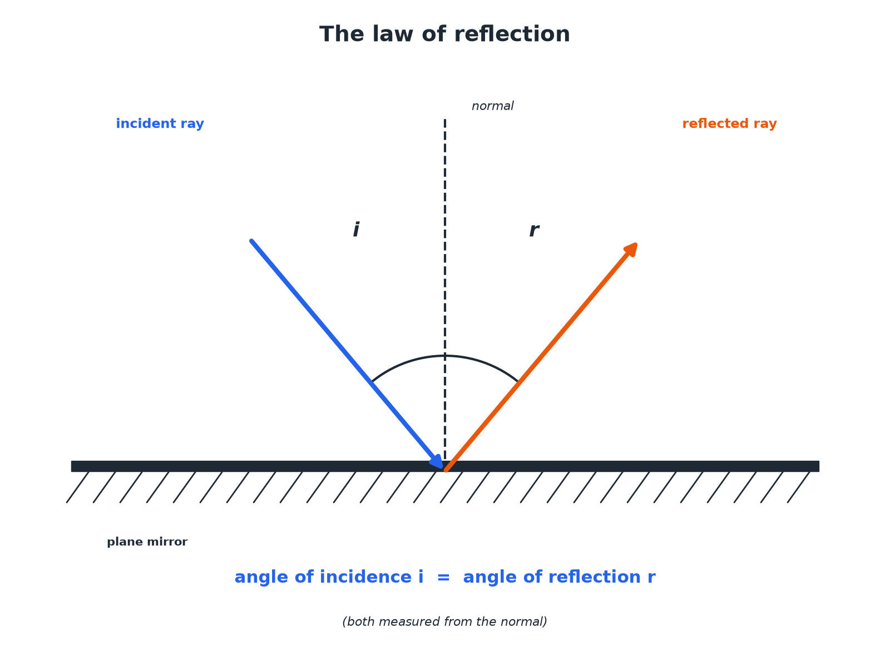

AQA GCSE PHYSICS · PAPER 2 · FOUNDATION & HIGHER
The Law of Reflection
Measure both angles from the normal.
Waves
openrevise.com
Lesson 3 of 12

Slide 7
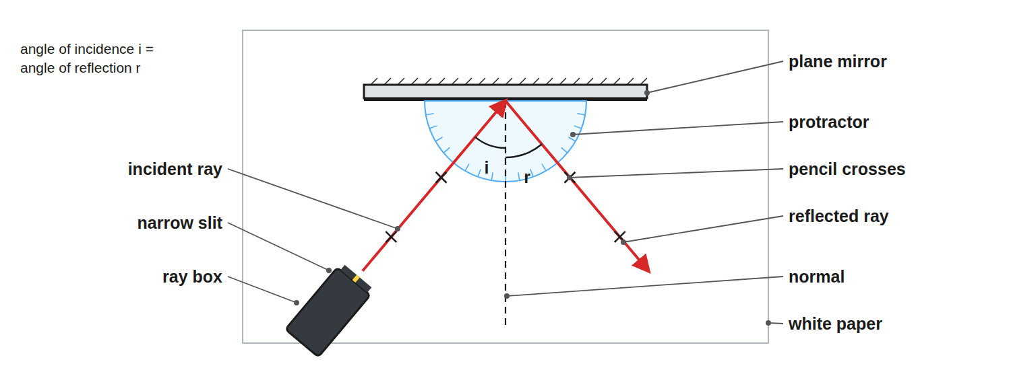
AQA GCSE PHYSICS · PAPER 2 · FOUNDATION & HIGHER
Required Practical 9: Reflection with a Ray Box
Draw the normal, then measure both angles from it.
Waves
openrevise.com
Lesson 3 of 12

Slide 8

AQA GCSE PHYSICS · PAPER 2 · FOUNDATION & HIGHER
How to Draw a Reflection Ray Diagram
Follow the steps.
1
2
3
4
5
Draw the mirror
A straight line.
Draw the normal
A dashed line at 90° to the mirror at the point of incidence.
Draw the incident ray
Toward the point, with an arrow.
Measure the angle of incidence
Between the ray and the normal.
Draw the reflected ray
At the same angle on the other side of the normal, with an arrow.
Waves
openrevise.com
Lesson 3 of 12

Slide 9

AQA GCSE PHYSICS · PAPER 2 · FOUNDATION & HIGHER
What Happens at a Boundary
Waves can do three things.
Effect
What it means
Example
Reflection
The wave bounces off the surface
Light from a mirror; an echo
Absorption
The wave's energy is transferred to the material
Black paper absorbs light and warms up
Transmission
The wave passes through the material
Light passing through glass
Waves
openrevise.com
Lesson 3 of 12

Slide 10

AQA GCSE PHYSICS · PAPER 2 · FOUNDATION & HIGHER
Finding Angles
A ray strikes a plane mirror so that the angle between the ray and the mirror surface is 50°. Find the angle of reflection.
Angle to the normal
90°− 50°= 40°
1
Law of reflection
Angle of reflection = angle of incidence
2
ANSWER
40°, measured from the normal.
Waves
openrevise.com
Lesson 3 of 12

Slide 11

AQA GCSE PHYSICS · PAPER 2 · FOUNDATION & HIGHER
Practical Tips
Get accurate results.
Narrow beam
Use a single slit so the ray is thin.
Mark the ray
Put a cross on the ray at two points and draw a line through them.
Repeat
Measure for several angles of incidence.
Conclusion
The angle of incidence equals the angle of reflection.
Waves
openrevise.com
Lesson 3 of 12

Slide 12

AQA GCSE PHYSICS · PAPER 2 · FOUNDATION & HIGHER
Reflection, Absorption or Transmission?
Which one happens depends on the wavelength and the material.
Glass and light
Glass transmits most visible light, reflects a little (you see a faint reflection in a window) and absorbs very little.
Wavelength matters
The same material can behave differently for different waves. Glass transmits visible light but absorbs much of the ultraviolet.
Sound
Hard, smooth walls reflect sound and cause echoes; soft materials like curtains and foam absorb it, which is why concert halls use them.
Waves
openrevise.com
Lesson 3 of 12

Slide 13

AQA GCSE PHYSICS · PAPER 2 · FOUNDATION & HIGHER
Images in a Plane Mirror
PROPERTIES OF THE IMAGE
WHERE IT APPEARS
• Virtual: it cannot be put on a screen.
• Upright, the same way up as the object.
• The same size as the object.
• Laterally inverted: left and right are swapped.
• The same distance behind the mirror as the object is in front.
• On a line through the object at right angles to the mirror.
• Found by extending reflected rays backwards as dashed lines.
Waves
openrevise.com
Lesson 3 of 12

Slide 14

AQA GCSE PHYSICS · PAPER 2 · FOUNDATION & HIGHER
CASE STUDY
Periscopes
A periscope uses two plane mirrors, each at 45°. Light from an object hits the top mirror at 45° to the normal and reflects straight down the tube. The bottom mirror reflects it at 45° again, out to the viewer's eye. It lets someone see over a wall or out of a submarine.
45°
2
Angle of each mirror to the tube
Reflections, so the image is the right way up
Waves
openrevise.com
Lesson 3 of 12

Slide 15

AQA GCSE PHYSICS · PAPER 2 · FOUNDATION & HIGHER
Key Terms
Reflection
When a wave bounces off a surface.
Absorption
When a wave's energy is taken in by a material.
Transmission
When a wave passes through a material.
Normal
A line at right angles to a surface.
Angle of incidence
The angle between the incident ray and the normal.
Angle of reflection
The angle between the reflected ray and the normal.
Waves
openrevise.com
Lesson 3 of 12

Slide 16
AQA GCSE PHYSICS · PAPER 2 · FOUNDATION & HIGHER
Key Terms (cont.)
Plane mirror
A flat mirror.
Incident ray
The ray travelling towards a surface.
Ray box
A lamp with a slit that produces a narrow beam of light.
Waves
openrevise.com
Lesson 3 of 12

Slide 17

AQA GCSE PHYSICS · PAPER 2 · FOUNDATION & HIGHER
YOUR TASK
10 minutes
Reflect It
A ray hits a mirror at an angle of incidence of 35°. Draw a ray diagram. State the angle between the reflected ray and the mirror surface.
Draw the normal first.
1
Mirror the angle.
2
WHAT A GOOD ANSWER SHOWS
The angle of reflection is 35°. The angle to the mirror is 90° − 35° = 55°.
Waves
openrevise.com
Lesson 3 of 12
Notes:
Ask what would happen at 0°.

Slide 18
AQA GCSE PHYSICS · PAPER 2 · FOUNDATION & HIGHER
Can I...?
Define reflection.
Measure angles from the normal.
Define absorption and transmission.
Draw a reflected ray.
State the law of reflection.
Describe the practical.
Draw a normal.
Find an angle to the mirror.
Waves
openrevise.com
Lesson 3 of 12

Slide 19
AQA GCSE PHYSICS · PAPER 2 · FOUNDATION & HIGHER
Summary & Exam Focus
Angle of incidence = angle of reflection.
Angles measured from the normal.
Reflection, absorption, transmission.
Use a ray box, mirror and protractor.
A plane mirror image is virtual, upright and the same size.
EXAM FOCUS
State the law of reflection. (1 mark)
Write the full rule: angle of incidence = angle of reflection. Then remember both angles are measured to the normal, not to the mirror surface.
openrevise.com

Slide 20
AQA GCSE PHYSICS · PAPER 2 · FOUNDATION & HIGHER
Exam Practice: Reflection of waves
Answer all questions. Use the mark allocation as a guide to how much to write. · 15 minutes
Question 1 · 2 marks · State
State what happens to a wave when it is reflected, absorbed and transmitted at the boundary between two materials.
Question 2 · 3 marks · Complete the diagram
The diagram shows a ray of light striking a plane mirror. Complete the diagram to show the reflected ray. Label the angle of incidence and…
Question 3 · 2 marks · Calculate
A ray of light hits a plane mirror. The angle between the ray and the surface of the mirror is 50°. Calculate the angle of reflection.
Waves
openrevise.com
Lesson 3 of 12

Slide 21
AQA GCSE PHYSICS · PAPER 2 · FOUNDATION & HIGHER
Exam Practice: Reflection of waves (cont.)
Question 4 · 5 marks · Describe
Describe how you would investigate the law of reflection using a ray box and a plane mirror. Your answer should include the measurements…
Question 5 · 2 marks · Explain
Explain why a black surface gets hot in sunlight.
Waves
openrevise.com
Lesson 3 of 12

Slide 22
AQA GCSE PHYSICS · PAPER 2 · FOUNDATION & HIGHER
Question 1 · 2 marks · State
“
State what happens to a wave when it is reflected, absorbed and transmitted at the boundary between two materials.
HOW TO ANSWER IT
Command word: State. Worth 2 marks, so plan before writing.
Waves
openrevise.com
Lesson 3 of 12

Slide 23
AQA GCSE PHYSICS · PAPER 2 · FOUNDATION & HIGHER
Question 1 · mark scheme
2 marks available. Award a mark for each point made.
Reflected
1 mark
Absorbed or transmitted explained
1 mark
Waves
openrevise.com
Lesson 3 of 12

Slide 24
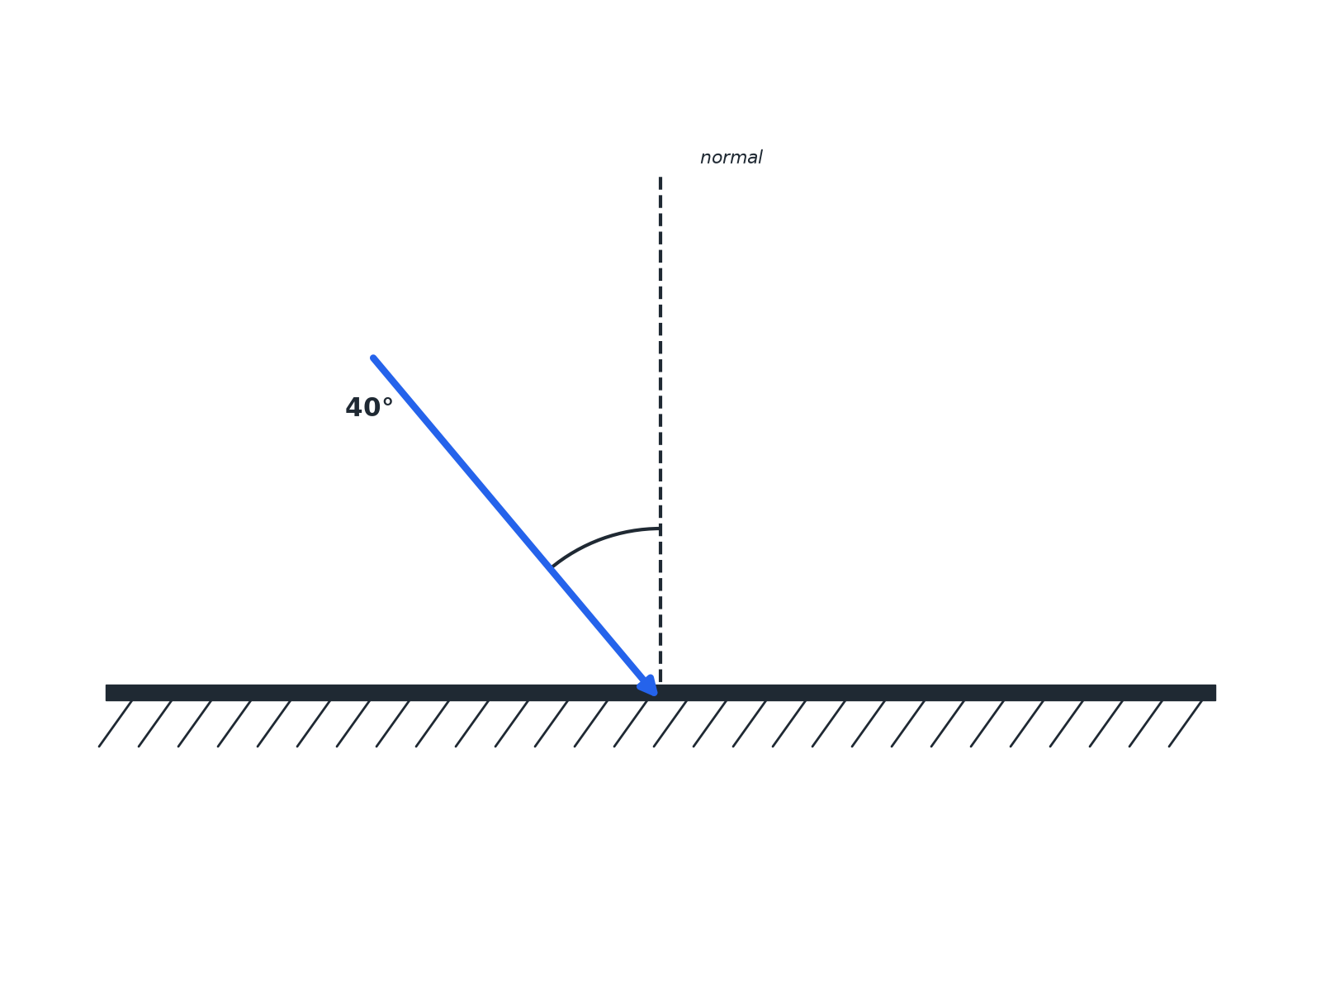
AQA GCSE PHYSICS · PAPER 2 · FOUNDATION & HIGHER
Question 2 · 3 marks · Complete the diagram
The diagram shows a ray of light striking a plane mirror. Complete the diagram to show the reflected ray. Label the angle of incidence and the angle of reflection. (3 marks)
Waves
openrevise.com
Lesson 3 of 12

Slide 25
AQA GCSE PHYSICS · PAPER 2 · FOUNDATION & HIGHER
Question 2 · mark scheme
3 marks available. Award a mark for each point made.
Normal drawn or used
1 mark
Reflected ray at 40° on the far side of the normal
1 mark
Angles labelled
1 mark
Waves
openrevise.com
Lesson 3 of 12

Slide 26
AQA GCSE PHYSICS · PAPER 2 · FOUNDATION & HIGHER
Question 3 · 2 marks · Calculate
“
A ray of light hits a plane mirror. The angle between the ray and the surface of the mirror is 50°. Calculate the angle of reflection.
HOW TO ANSWER IT
Command word: Calculate. Worth 2 marks, so plan before writing.
Waves
openrevise.com
Lesson 3 of 12

Slide 27
AQA GCSE PHYSICS · PAPER 2 · FOUNDATION & HIGHER
Question 3 · mark scheme
2 marks available. Award a mark for each point made.
90 − 50 = 40
1 mark
40° (angle of reflection = angle of incidence)
1 mark
Waves
openrevise.com
Lesson 3 of 12

Slide 28
AQA GCSE PHYSICS · PAPER 2 · FOUNDATION & HIGHER
Question 4 · 5 marks · Describe
“
Describe how you would investigate the law of reflection using a ray box and a plane mirror. Your answer should include the measurements you would take and the result you would expect.
HOW TO ANSWER IT
Command word: Describe. Worth 5 marks, so plan before writing.
Waves
openrevise.com
Lesson 3 of 12

Slide 29
AQA GCSE PHYSICS · PAPER 2 · FOUNDATION & HIGHER
Question 4 · mark scheme
5 marks available. Award a mark for each point made.
Ray box with a narrow beam at a mirror on paper
1 mark
Normal drawn
1 mark
Rays marked and angles measured from the normal
1 mark
Waves
openrevise.com
Lesson 3 of 12

Slide 30
AQA GCSE PHYSICS · PAPER 2 · FOUNDATION & HIGHER
Question 4 · mark scheme (cont.)
Repeat for different angles
1 mark
Angle of incidence equals angle of reflection
1 mark
Waves
openrevise.com
Lesson 3 of 12

Slide 31
AQA GCSE PHYSICS · PAPER 2 · FOUNDATION & HIGHER
Question 5 · 2 marks · Explain
“
Explain why a black surface gets hot in sunlight.
HOW TO ANSWER IT
Command word: Explain. Worth 2 marks, so plan before writing.
Waves
openrevise.com
Lesson 3 of 12

Slide 32
AQA GCSE PHYSICS · PAPER 2 · FOUNDATION & HIGHER
Question 5 · mark scheme
2 marks available. Award a mark for each point made.
Absorbs the radiation
1 mark
Energy transferred to thermal store
1 mark
Waves
openrevise.com
Lesson 3 of 12

