Slide 1

EDEXCEL GCSE HISTORY · PAPER 1 · CRIME & PUNISHMENT
Crime and Punishment in Anglo-Saxon England
c1000-1066
Chapter 1: Crime and punishment in medieval England, c1000-1066
Lesson 1 of 4
openrevise.com

Slide 2

EDEXCEL GCSE HISTORY · PAPER 1 · CRIME & PUNISHMENT
What Do You Already Think?
Answer before the lesson, then check your ideas at the end.
Who would catch a thief in a village with no police?
1
How could a court decide guilt with no evidence?
2
Were there prisons?
3
Who made the laws?
4
Chapter 1: Crime and punishment in medieval England, c1000-1066
openrevise.com
Lesson 1 of 4

Slide 3
EDEXCEL GCSE HISTORY · PAPER 1 · CRIME & PUNISHMENT
What Do You Already Think? - Answers
Who would catch a thief in a village with no police?
The villagers themselves, through the hue and cry and the tithing.
1
How could a court decide guilt with no evidence?
Oaths from respected neighbours, or trial by ordeal - letting God decide.
2
Were there prisons?
Hardly any. Gaols held people awaiting trial; prison was not a punishment.
3
Who made the laws?
The king, through written law codes, with local custom alongside.
4
Chapter 1: Crime and punishment in medieval England, c1000-1066
openrevise.com
Lesson 1 of 4

Slide 4

EDEXCEL GCSE HISTORY · PAPER 1 · CRIME & PUNISHMENT
Learning Objectives
Identify crimes against the person, property and authority in Anglo-Saxon England.
1
Explain how tithings, the hue and cry and the local courts kept order without a police force.
2
Describe how guilt was decided, including oaths and trial by ordeal.
3
Explain the aims of Anglo-Saxon punishments, including wergild.
4
Chapter 1: Crime and punishment in medieval England, c1000-1066
openrevise.com
Lesson 1 of 4

Slide 5

EDEXCEL GCSE HISTORY · PAPER 1 · CRIME & PUNISHMENT
Setting the Scene
Around 1000, England was a Christian kingdom of small villages where almost everyone knew everyone. The king kept the King's Peace by issuing law codes, but he had no police force and few officials. Law and order depended on the community: villagers were expected to catch, accuse and bring wrongdoers to court themselves.
c1000
c1008
c1020
1066
England is divided into shires, and each shire into hundreds, each with its own court.
King Aethelred's law codes set out the duties of free men and the penalties for crime.
King Cnut's law codes restate the tithing, the hue and cry and wergild.
The Norman conquest - the end of the Anglo-Saxon system as a system of its own.
Chapter 1: Crime and punishment in medieval England, c1000-1066
openrevise.com
Lesson 1 of 4

Slide 6

EDEXCEL GCSE HISTORY · PAPER 1 · CRIME & PUNISHMENT
Types of Crime
Historians sort medieval crime into three kinds - the exam expects you to use them.
Crimes against the person
Murder, assault, rape. Treated as harm done to a family, who expected compensation.
Crimes against property
Theft, robbery, arson, poaching. Theft was by far the most common crime.
Crimes against authority
Treason - betraying the king or your lord - and rebellion. The most serious crime of all.
Moral crimes
Adultery, drunkenness, failing to attend church. Dealt with by the Church.
Why theft dominated
Most people were poor farmers; a stolen animal or tools could ruin a family.
The King's Peace
A crime was increasingly seen as a breach of the king's peace, not only harm to a victim.
Chapter 1: Crime and punishment in medieval England, c1000-1066
openrevise.com
Lesson 1 of 4

Slide 7

EDEXCEL GCSE HISTORY · PAPER 1 · CRIME & PUNISHMENT
Keeping Order Without a Police Force
Every free man was part of a system that made his neighbours responsible for him.
Tithings
Groups of ten men over the age of twelve who were responsible for each other's behaviour. If one broke the law, the others had to bring him to court or pay a fine.
Hue and cry
A victim or witness raised the alarm and every man in the village had to stop work and chase the suspect. A village that failed to join in could be fined.
The reeve
The king's local official. The shire-reeve - later the sheriff - brought suspects to court and collected fines.
Collective responsibility
Because the whole community paid if it failed, everyone had a reason to keep watch on everyone else.
Chapter 1: Crime and punishment in medieval England, c1000-1066
openrevise.com
Lesson 1 of 4

Slide 8

EDEXCEL GCSE HISTORY · PAPER 1 · CRIME & PUNISHMENT
From Crime to Court
Every stage depended on ordinary people, not officials.
1
2
3
4
5
Hue and cry
The alarm is raised and the village chases the suspect.
Tithing answers
If he escapes, his tithing must produce him at court or pay.
Court meets
The hundred court (monthly) or shire court (twice a year) hears the accusation in the open.
Oath-helpers
Respected men swear to the accused's good character - enough oaths could clear him.
Ordeal
If oaths could not settle it, the case went to God through trial by ordeal.
Chapter 1: Crime and punishment in medieval England, c1000-1066
openrevise.com
Lesson 1 of 4

Slide 9

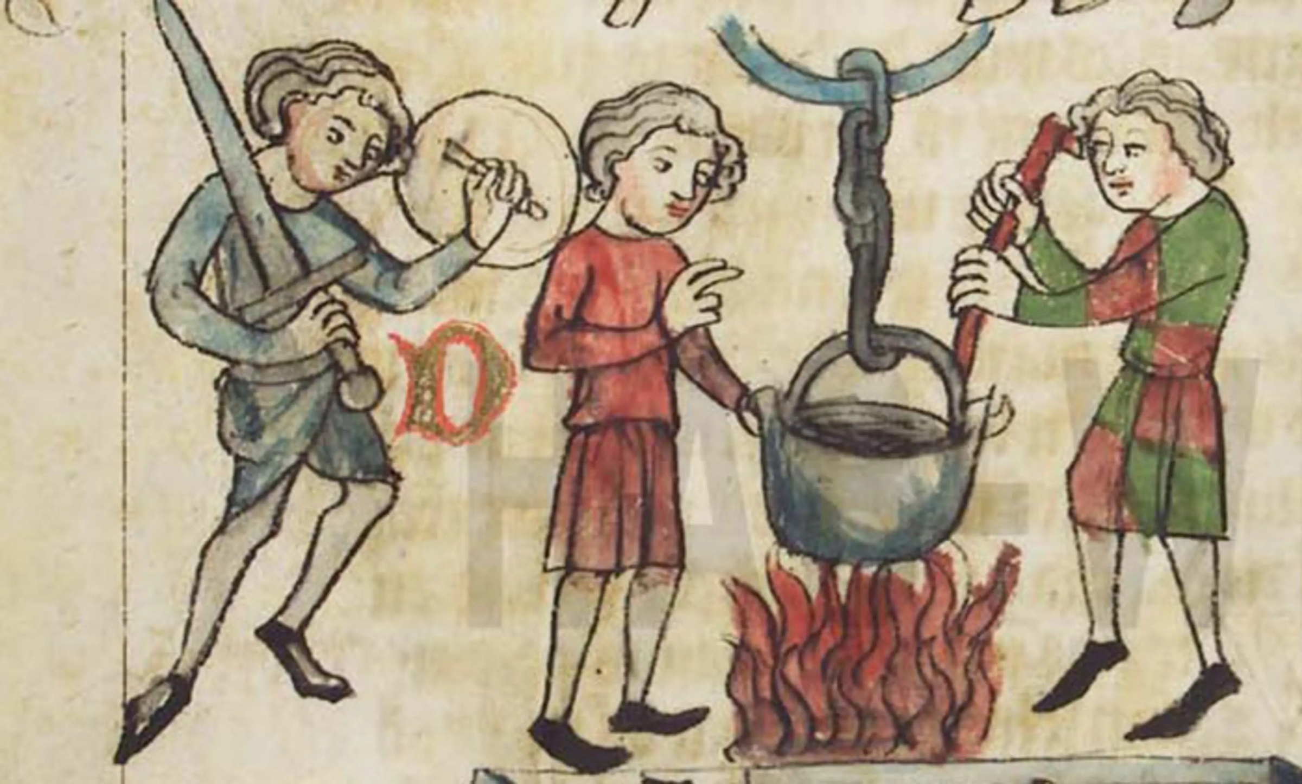
EDEXCEL GCSE HISTORY · PAPER 1 · CRIME & PUNISHMENT
Trial by Ordeal
When a court could not decide, it asked God. Ordeals took place in or near a church, after the accused had fasted and heard Mass, and a priest blessed the water or the iron.
THE FOUR ORDEALS
Hot iron
Carry a red-hot iron bar three paces. If the bandaged burn healed cleanly after three days, innocent.
Hot water
Pick a stone out of boiling water. Judged by the healing of the hand, as with hot iron.
Cold water
Lowered into blessed water: sinking meant innocent, floating meant the water had rejected you.
Consecrated bread
For priests. Choke on the blessed bread and you were guilty.
Guilt was left for God to reveal.
Medieval manuscript illustration; look for a public domain copy on Wikimedia Commons.
Chapter 1: Crime and punishment in medieval England, c1000-1066
openrevise.com
Lesson 1 of 4

Slide 10

EDEXCEL GCSE HISTORY · PAPER 1 · CRIME & PUNISHMENT
How Offenders Were Punished
Punishment aimed at compensation and deterrence, not reform.
Punishment
Used for
Why
Wergild
Murder and injury
Compensation to the family, set by the victim's rank, to stop blood feuds
Fines
Most minor crimes
Paid to the victim, and increasingly to the king
Stocks and pillory
Petty crimes
Public humiliation as a warning to others
Mutilation
Repeat offenders
Cutting off a hand, ear or nose - a lasting mark and deterrent
Execution
Treason, repeat theft
Hanging, for crimes that threatened the king or the community
Chapter 1: Crime and punishment in medieval England, c1000-1066
openrevise.com
Lesson 1 of 4

Slide 11

EDEXCEL GCSE HISTORY · PAPER 1 · CRIME & PUNISHMENT
The Law in the King's Own Words
“
And if anyone flees from the hue and cry, let him pay the wergild of the man he has slain, and let his tithing answer for him.
— Adapted from the law code of King Cnut, c1020
WHAT IT SHOWS
Even the king's written law works through the tithing and the hue and cry - Anglo-Saxon justice depended on the community rather than on royal officials.
Chapter 1: Crime and punishment in medieval England, c1000-1066
openrevise.com
Lesson 1 of 4

Slide 12

EDEXCEL GCSE HISTORY · PAPER 1 · CRIME & PUNISHMENT
Key Terms
Tithing
A group of ten men over twelve who were responsible for each other's behaviour.
Hue and cry
The duty of every villager to chase a suspect once the alarm was raised.
Wergild
"Man price": compensation paid to a victim's family, set by the victim's rank.
Trial by ordeal
A religious test asking God to show whether the accused was guilty.
Oath-helpers
Men who swore to the good character of the accused.
King's Peace
The idea that the king was responsible for keeping order across his kingdom.
Reeve
A local royal official; the shire-reeve became the sheriff.
Chapter 1: Crime and punishment in medieval England, c1000-1066
openrevise.com
Lesson 1 of 4

Slide 13
EDEXCEL GCSE HISTORY · PAPER 1 · CRIME & PUNISHMENT
Summary & Exam Focus
Theft was the most common crime; treason the most serious.
Order depended on the community: tithings, the hue and cry and local courts.
Where oaths could not decide guilt, trial by ordeal left it to God.
Punishments aimed at compensation (wergild) and deterrence, not prison.
EXAM FOCUS
Explain why the community played such an important role in law enforcement in Anglo-Saxon England. (12 marks)
Give at least three reasons, each explained with specific detail - and include one that goes beyond the stimulus points.
openrevise.com

Slide 14

EDEXCEL GCSE HISTORY · PAPER 1 · CRIME & PUNISHMENT
Exam Practice - Anglo-Saxon England
Answer all questions. Use specific names, dates and examples in every answer. · 35 minutes
Question 1 · 4 marks · Explain one way
Explain one way in which the role of the community in law enforcement in Anglo-Saxon England was different from the role of the community…
Question 2 · 12 marks · Explain why
Explain why the community played such an important role in law enforcement in Anglo-Saxon England. You may use the following in your…
Question 3 · 16 marks · How far do you agree?
"The main aim of punishment in Anglo-Saxon England was to deter people from committing crime." How far do you agree? Explain your answer…
Chapter 1: Crime and punishment in medieval England, c1000-1066
openrevise.com
Lesson 1 of 4

Slide 15
EDEXCEL GCSE HISTORY · PAPER 1 · CRIME & PUNISHMENT
Question 1 · 4 marks · Explain one way
“
Explain one way in which the role of the community in law enforcement in Anglo-Saxon England was different from the role of the community in law enforcement in the period c1200-c1500.
HOW TO ANSWER IT
Command word: Explain one way. Worth 4 marks, so plan before writing.
Chapter 1: Crime and punishment in medieval England, c1000-1066
openrevise.com
Lesson 1 of 4

Slide 16

EDEXCEL GCSE HISTORY · PAPER 1 · CRIME & PUNISHMENT
Question 1 · mark scheme
4 marks available. Award a mark for each point made.
A valid difference identified
1-2 marks
Supported with specific knowledge of both periods
3-4 marks
Chapter 1: Crime and punishment in medieval England, c1000-1066
openrevise.com
Lesson 1 of 4

Slide 17
EDEXCEL GCSE HISTORY · PAPER 1 · CRIME & PUNISHMENT
Question 2 · 12 marks · Explain why
“
Explain why the community played such an important role in law enforcement in Anglo-Saxon England. You may use the following in your answer: tithings; the hue and cry. You must also use information of your own.
HOW TO ANSWER IT
Command word: Explain why. Worth 12 marks, so plan before writing.
Chapter 1: Crime and punishment in medieval England, c1000-1066
openrevise.com
Lesson 1 of 4

Slide 18
EDEXCEL GCSE HISTORY · PAPER 1 · CRIME & PUNISHMENT
Question 2 · mark scheme
12 marks available. Award a mark for each point made.
Level 1 (1-3)
A simple or general answer
Level 2 (4-6)
Some explanation of one or more reasons, with some knowledge
Level 3 (7-9)
A developed explanation linked to the question, with accurate knowledge
Level 4 (10-12)
An analytical explanation of several reasons, with knowledge that goes beyond the stimulus points
Chapter 1: Crime and punishment in medieval England, c1000-1066
openrevise.com
Lesson 1 of 4

Slide 19
EDEXCEL GCSE HISTORY · PAPER 1 · CRIME & PUNISHMENT
Question 3 · 16 marks · How far do you agree?
“
"The main aim of punishment in Anglo-Saxon England was to deter people from committing crime." How far do you agree? Explain your answer. You may use the following in your answer: the stocks and pillory; wergild. You must also use information of your own. (16 marks, plus 4 for spelling…
HOW TO ANSWER IT
Command word: How far do you agree?. Worth 16 marks, so plan before writing.
Chapter 1: Crime and punishment in medieval England, c1000-1066
openrevise.com
Lesson 1 of 4

Slide 20
EDEXCEL GCSE HISTORY · PAPER 1 · CRIME & PUNISHMENT
Question 3 · mark scheme
16 marks available. Award a mark for each point made.
Level 1 (1-4)
A simple or generalised answer
Level 2 (5-8)
Some analysis, with a judgement that is asserted
Level 3 (9-12)
Analysis of both sides with accurate knowledge and a supported judgement
Chapter 1: Crime and punishment in medieval England, c1000-1066
openrevise.com
Lesson 1 of 4

Slide 21
EDEXCEL GCSE HISTORY · PAPER 1 · CRIME & PUNISHMENT
Question 3 · mark scheme (cont.)
Level 4 (13-16)
Sustained analysis, knowledge beyond the stimulus, and a clear, justified judgement
SPaG (4)
Accurate spelling, punctuation and grammar, with specialist terms such as wergild and tithing
Chapter 1: Crime and punishment in medieval England, c1000-1066
openrevise.com
Lesson 1 of 4

