Slide 1

EDEXCEL GCSE HISTORY · PAPER 1 · CRIME & PUNISHMENT
Crime and Punishment in Norman England
1066-c1200
Chapter 1: Crime and punishment in medieval England, 1066-c1200
Lesson 2 of 4
openrevise.com

Slide 2

EDEXCEL GCSE HISTORY · PAPER 1 · CRIME & PUNISHMENT
Starter: Anglo-Saxon Recap
Pair each term with its meaning.
Term
Meaning
A
Tithing
Neighbours who swore to your character
1
B
Hue and cry
Letting God decide guilt
2
C
Wergild
Ten men responsible for each other
3
D
Oath-helpers
The village chases the suspect
4
E
Ordeal
Compensation paid to the victim's family
5
Chapter 1: Crime and punishment in medieval England, 1066-c1200
openrevise.com
Lesson 2 of 4

Slide 3

EDEXCEL GCSE HISTORY · PAPER 1 · CRIME & PUNISHMENT
Learning Objectives
Explain why William I needed to control a hostile Anglo-Saxon population.
1
Describe the new crimes and punishments the Normans introduced, including the Forest Laws and the murdrum fine.
2
Explain the continuity in Norman law enforcement, and assess how much changed after 1066.
3
Chapter 1: Crime and punishment in medieval England, 1066-c1200
openrevise.com
Lesson 2 of 4

Slide 4

EDEXCEL GCSE HISTORY · PAPER 1 · CRIME & PUNISHMENT
Setting the Scene
In 1066 William of Normandy won the Battle of Hastings, but around 10,000 Normans now had to rule about two million English people who resented them. Rebellions followed, and William crushed them brutally in the Harrying of the North (1069-70). His laws were designed to protect his power and his followers.
1066
1069-70
1079
1086
1166
Battle of Hastings: William becomes king.
Harrying of the North: rebellion crushed by laying waste to the land.
The New Forest is created as a royal hunting forest.
The Domesday Book records who holds the land - and owes the king service.
Henry II's Assize of Clarendon strengthens royal justice.
Chapter 1: Crime and punishment in medieval England, 1066-c1200
openrevise.com
Lesson 2 of 4

Slide 5

EDEXCEL GCSE HISTORY · PAPER 1 · CRIME & PUNISHMENT
The Feudal System
Crime against your lord was now a crime against the whole structure of power.
Owned all the land; granted it in return for loyalty
The king
Held land from the king; supplied knights
Barons and bishops
Held land from barons; fought when called
Knights
Worked the land; owed labour and obedience to their lord
Peasants
Chapter 1: Crime and punishment in medieval England, 1066-c1200
openrevise.com
Lesson 2 of 4

Slide 6

EDEXCEL GCSE HISTORY · PAPER 1 · CRIME & PUNISHMENT
What Changed and What Stayed the Same
CONTINUITY FROM THE ANGLO-SAXONS
NORMAN CHANGES
• Tithings and the hue and cry still made communities police themselves.
• Hundred and shire courts still heard most cases.
• Trial by ordeal continued, run by the Church.
• Stocks, pillory, fines and execution were all still used.
• The Forest Laws created new crimes on royal land.
• The murdrum fine punished a hundred for a Norman's murder.
• Trial by combat was introduced.
• Wergild ended: fines went to the king, not the victim's family.
Chapter 1: Crime and punishment in medieval England, 1066-c1200
openrevise.com
Lesson 2 of 4

Slide 7

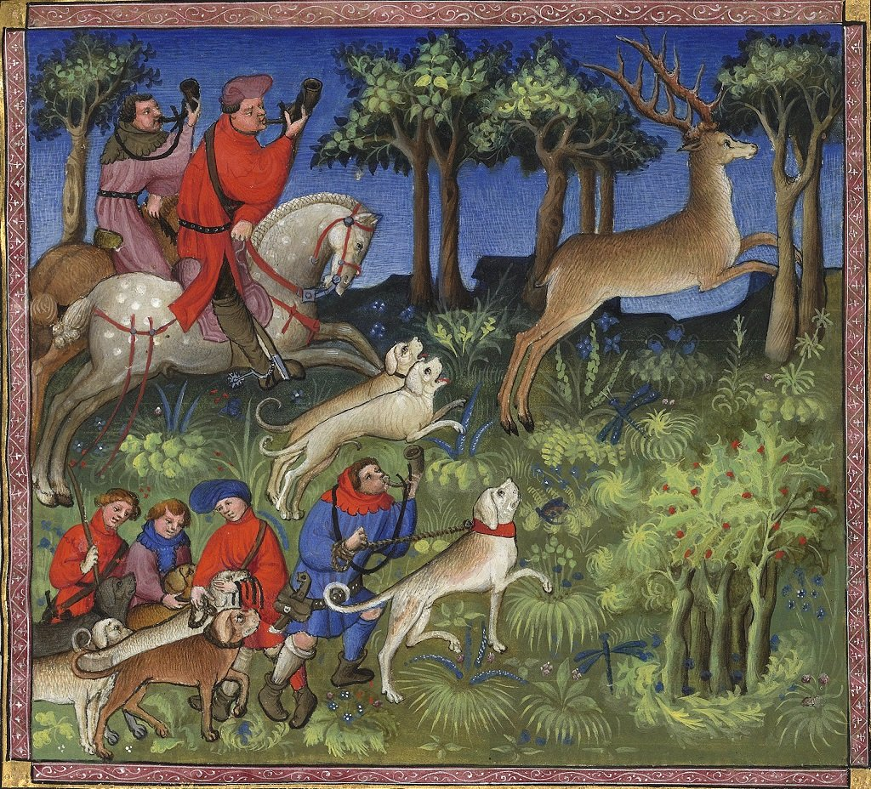
EDEXCEL GCSE HISTORY · PAPER 1 · CRIME & PUNISHMENT
The Forest Laws
William declared large areas of England, including the New Forest, to be royal forest. People who had lived there for generations were suddenly criminals for doing what they had always done.
WHAT BECAME A CRIME
Hunting
Killing deer or boar on royal land - poaching.
Everyday life
Cutting wood, grazing animals or carrying a bow in the forest.
Harsh penalties
Poaching a deer could be punished by blinding or mutilation.
A social crime
Most people did not see poaching as really wrong, so many helped poachers.
Royal forests covered a large part of England by 1200.
Medieval manuscript illustration; public domain copies on Wikimedia Commons.
Chapter 1: Crime and punishment in medieval England, 1066-c1200
openrevise.com
Lesson 2 of 4

Slide 8

EDEXCEL GCSE HISTORY · PAPER 1 · CRIME & PUNISHMENT
CASE STUDY
The Murdrum Fine
Normans were being killed by resentful English people, and the killers were hard to find because locals protected each other. William's answer was the murdrum fine: if a Norman was found murdered and the killer was not handed over, the whole hundred where the body lay had to pay a very large fine. It used the Anglo-Saxon idea of collective responsibility, but turned it into a way of protecting the conquerors.
Hundred
1066-1340
The area that paid if the killer was not produced
The murdrum fine stayed in use for nearly 300 years
Chapter 1: Crime and punishment in medieval England, 1066-c1200
openrevise.com
Lesson 2 of 4

Slide 9

EDEXCEL GCSE HISTORY · PAPER 1 · CRIME & PUNISHMENT
Punishment Under the Normans
The Normans made punishment serve the king.
Wergild ends
Fines were now paid to the king rather than to the victim's family, so crime became an offence against royal authority.
More capital crimes
Execution was used more, especially for crimes against the king such as rebellion.
Mutilation
William preferred mutilation to execution for many crimes: blinding and castration were used, partly to show that offenders still had time to repent.
Trial by combat
The accuser and accused fought, often to the death, until one gave in. The loser was hanged if he survived.
Chapter 1: Crime and punishment in medieval England, 1066-c1200
openrevise.com
Lesson 2 of 4

Slide 10

EDEXCEL GCSE HISTORY · PAPER 1 · CRIME & PUNISHMENT
Law Enforcement and Courts
The machinery barely changed, but the authority behind it did.
Sheriffs
The sheriff became more powerful, collecting fines and taxes and bringing criminals to court for the king.
Church courts
William created separate Church courts, which dealt with clergy and moral crimes.
Henry II
The Assize of Clarendon (1166) sent royal judges round the country and used juries of local men to report suspects, and ordered new gaols to be built.
Castles
Around 500 castles built by 1100 were a constant reminder of Norman power.
Chapter 1: Crime and punishment in medieval England, 1066-c1200
openrevise.com
Lesson 2 of 4

Slide 11

EDEXCEL GCSE HISTORY · PAPER 1 · CRIME & PUNISHMENT
How Much Did 1066 Change?
Place each development on the line.
Tithings and hue and cry
Unchanged: communities still policed themselves
Courts and sheriffs
Same system, more royal control
Forest Laws and murdrum
Brand new crimes to protect Norman power
CONTINUITY
CHANGE
Trial by ordeal
Unchanged, though now alongside combat
Punishments
Wergild gone; fines to the king
Chapter 1: Crime and punishment in medieval England, 1066-c1200
openrevise.com
Lesson 2 of 4

Slide 12

EDEXCEL GCSE HISTORY · PAPER 1 · CRIME & PUNISHMENT
THE BIG IDEA
The Normans changed who justice served more than how it worked.
The tithing, the hue and cry and the ordeal all survived - but now they protected the king and the conquerors.
Chapter 1: Crime and punishment in medieval England, 1066-c1200
openrevise.com
Lesson 2 of 4

Slide 13

EDEXCEL GCSE HISTORY · PAPER 1 · CRIME & PUNISHMENT
Key Terms
Forest Laws
Laws making hunting and gathering wood on royal land a crime.
Poaching
Illegally hunting animals on land that belonged to someone else.
Social crime
A crime most people do not think is really wrong, such as poaching.
Murdrum fine
A fine on a whole hundred if a Norman was murdered and the killer not found.
Trial by combat
The accuser and accused fought to decide guilt.
Feudal system
Land held from the king in return for loyalty and service.
Assize of Clarendon
Henry II's law of 1166 that strengthened royal justice.
Chapter 1: Crime and punishment in medieval England, 1066-c1200
openrevise.com
Lesson 2 of 4

Slide 14
EDEXCEL GCSE HISTORY · PAPER 1 · CRIME & PUNISHMENT
Summary & Exam Focus
William needed to control a hostile population, so his laws protected Norman power.
New crimes: the Forest Laws and the murdrum fine.
Tithings, the hue and cry and trial by ordeal continued.
Wergild ended - fines now went to the king.
EXAM FOCUS
"The Norman Conquest brought major changes to crime and punishment in England." How far do you agree? (16 marks)
Argue both sides with specific examples, then judge: continuity in methods, change in whose authority they served.
openrevise.com

Slide 15

EDEXCEL GCSE HISTORY · PAPER 1 · CRIME & PUNISHMENT
Exam Practice - Norman England
Answer all questions. Use specific names, dates and examples in every answer. · 35 minutes
Question 1 · 4 marks · Explain one way
Explain one way in which punishments in Anglo-Saxon England were similar to punishments in Norman England.
Question 2 · 12 marks · Explain why
Explain why the Normans introduced new laws after 1066. You may use the following in your answer: the Forest Laws; the murdrum fine. You…
Question 3 · 16 marks · How far do you agree?
"The Norman Conquest brought major changes to crime and punishment in England." How far do you agree? Explain your answer. You may use the…
Chapter 1: Crime and punishment in medieval England, 1066-c1200
openrevise.com
Lesson 2 of 4

Slide 16
EDEXCEL GCSE HISTORY · PAPER 1 · CRIME & PUNISHMENT
Question 1 · 4 marks · Explain one way
“
Explain one way in which punishments in Anglo-Saxon England were similar to punishments in Norman England.
HOW TO ANSWER IT
Command word: Explain one way. Worth 4 marks, so plan before writing.
Chapter 1: Crime and punishment in medieval England, 1066-c1200
openrevise.com
Lesson 2 of 4

Slide 17

EDEXCEL GCSE HISTORY · PAPER 1 · CRIME & PUNISHMENT
Question 1 · mark scheme
4 marks available. Award a mark for each point made.
A valid similarity identified
1-2 marks
Supported with specific knowledge of both periods
3-4 marks
Chapter 1: Crime and punishment in medieval England, 1066-c1200
openrevise.com
Lesson 2 of 4

Slide 18
EDEXCEL GCSE HISTORY · PAPER 1 · CRIME & PUNISHMENT
Question 2 · 12 marks · Explain why
“
Explain why the Normans introduced new laws after 1066. You may use the following in your answer: the Forest Laws; the murdrum fine. You must also use information of your own.
HOW TO ANSWER IT
Command word: Explain why. Worth 12 marks, so plan before writing.
Chapter 1: Crime and punishment in medieval England, 1066-c1200
openrevise.com
Lesson 2 of 4

Slide 19
EDEXCEL GCSE HISTORY · PAPER 1 · CRIME & PUNISHMENT
Question 2 · mark scheme
12 marks available. Award a mark for each point made.
Level 1 (1-3)
A simple or general answer
Level 2 (4-6)
Some explanation of one or more reasons, with some knowledge
Level 3 (7-9)
A developed explanation linked to the question, with accurate knowledge
Level 4 (10-12)
An analytical explanation of several reasons, with knowledge that goes beyond the stimulus points
Chapter 1: Crime and punishment in medieval England, 1066-c1200
openrevise.com
Lesson 2 of 4

Slide 20
EDEXCEL GCSE HISTORY · PAPER 1 · CRIME & PUNISHMENT
Question 3 · 16 marks · How far do you agree?
“
"The Norman Conquest brought major changes to crime and punishment in England." How far do you agree? Explain your answer. You may use the following in your answer: trial by ordeal; the Forest Laws. You must also use information of your own. (16 marks, plus 4 for spelling, punctuation, grammar and…
HOW TO ANSWER IT
Command word: How far do you agree?. Worth 16 marks, so plan before writing.
Chapter 1: Crime and punishment in medieval England, 1066-c1200
openrevise.com
Lesson 2 of 4

Slide 21
EDEXCEL GCSE HISTORY · PAPER 1 · CRIME & PUNISHMENT
Question 3 · mark scheme
16 marks available. Award a mark for each point made.
Level 1 (1-4)
A simple or generalised answer
Level 2 (5-8)
Some analysis, with a judgement that is asserted
Level 3 (9-12)
Analysis of both sides with accurate knowledge and a supported judgement
Chapter 1: Crime and punishment in medieval England, 1066-c1200
openrevise.com
Lesson 2 of 4

Slide 22
EDEXCEL GCSE HISTORY · PAPER 1 · CRIME & PUNISHMENT
Question 3 · mark scheme (cont.)
Level 4 (13-16)
Sustained analysis, knowledge beyond the stimulus, and a clear, justified judgement
SPaG (4)
Accurate spelling, punctuation and grammar, with specialist terms such as murdrum and feudal
Chapter 1: Crime and punishment in medieval England, 1066-c1200
openrevise.com
Lesson 2 of 4

