Slide 1

EDEXCEL GCSE HISTORY · PAPER 1 · CRIME & PUNISHMENT
Crime and Punishment in the Later Middle Ages
c1200-c1500
Chapter 1: Crime and punishment in medieval England, c1200-c1500
Lesson 4 of 4
openrevise.com

Slide 2

EDEXCEL GCSE HISTORY · PAPER 1 · CRIME & PUNISHMENT
Learning Objectives
Describe the new royal officials who enforced the law after 1200.
1
Explain why new crimes were created, including the Statute of Labourers and the heresy laws.
2
Assess how far crime and punishment changed across the whole period c1000-c1500.
3
Chapter 1: Crime and punishment in medieval England, c1200-c1500
openrevise.com
Lesson 4 of 4

Slide 3

EDEXCEL GCSE HISTORY · PAPER 1 · CRIME & PUNISHMENT
Setting the Scene
After 1200 English kings built up a much larger system of royal justice. Towns were growing, and the country was shaken by the Black Death (1348-49), which killed around a third of the population. New problems led to new laws - and the king's officials, not just the village, now did much of the work of enforcing them.
1194
1195
1285
1348
Coroners are appointed to investigate suspicious deaths.
Richard I appoints Keepers of the Peace.
Statute of Winchester: watchmen in towns and the hue and cry reinforced.
The Black Death reaches England.
Chapter 1: Crime and punishment in medieval England, c1200-c1500
openrevise.com
Lesson 4 of 4

Slide 4
EDEXCEL GCSE HISTORY · PAPER 1 · CRIME & PUNISHMENT
Setting the Scene (cont.)
1351
1361
1401
Statute of Labourers and the Treason Act.
Justices of the Peace are established in every county.
De Heretico Comburendo: heretics can be burned.
Chapter 1: Crime and punishment in medieval England, c1200-c1500
openrevise.com
Lesson 4 of 4

Slide 5

EDEXCEL GCSE HISTORY · PAPER 1 · CRIME & PUNISHMENT
New Royal Officials
Law enforcement was still local, but the king's officials took on more of it.
Coroners
From 1194, coroners investigated any unexpected or suspicious death, holding an inquest with a jury.
Keepers of the Peace
Appointed from 1195 to keep order in troublesome areas; in 1361 they became Justices of the Peace (JPs).
Justices of the Peace
Local landowners who heard minor cases and kept order in each county - still the backbone of local justice in 1500.
Royal judges
Judges travelled on circuits to hear serious cases at the assizes, and the King's Bench court sat in Westminster.
Chapter 1: Crime and punishment in medieval England, c1200-c1500
openrevise.com
Lesson 4 of 4

Slide 6

EDEXCEL GCSE HISTORY · PAPER 1 · CRIME & PUNISHMENT
Law Enforcement in Towns and Villages
The community was still expected to play its part.
Statute of Winchester
In 1285 Edward I ordered towns to have watchmen at their gates at night and made every man keep weapons to join the hue and cry.
Tithings and hue and cry
Still used, especially in the countryside - a clear sign of continuity from Anglo-Saxon times.
Parish constables
Local men chosen for a year to keep order and bring suspects to the JPs.
Trial by jury
Juries of local men now decided guilt instead of the ordeal.
Chapter 1: Crime and punishment in medieval England, c1200-c1500
openrevise.com
Lesson 4 of 4

Slide 7

EDEXCEL GCSE HISTORY · PAPER 1 · CRIME & PUNISHMENT
New Crimes, c1200-c1500
Each new law was a response to a problem the authorities feared.
Law
Date
What it did
Why
Statute of Labourers
1351
Capped wages at pre-plague levels; peasants could not leave their lord
The Black Death caused a labour shortage and peasants demanded more pay
Treason Act
1351
Defined high treason, punished by hanging, drawing and quartering
Kings wanted to protect their authority
De Heretico Comburendo
1401
Heretics who refused to recant could be burned
The Lollards challenged the Church
Poaching laws
Throughout
Hunting on private or royal land punished
Landowners protected their game
Chapter 1: Crime and punishment in medieval England, c1200-c1500
openrevise.com
Lesson 4 of 4

Slide 8

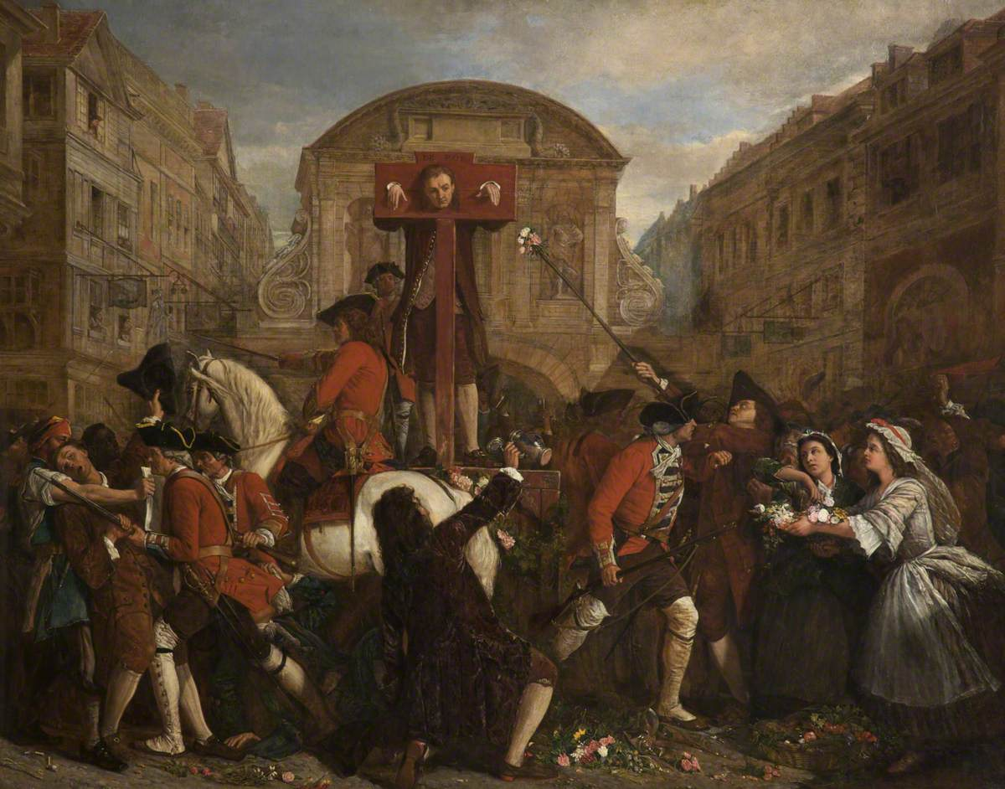
EDEXCEL GCSE HISTORY · PAPER 1 · CRIME & PUNISHMENT
Punishment in Public
Punishments in the later Middle Ages were still public and aimed at deterrence and retribution. Prison was still mainly for holding people before trial or for debtors.
PUNISHMENTS, C1200-C1500
Fines
The most common punishment for minor crimes.
Stocks and pillory
Public humiliation for crimes such as cheating customers.
Hanging
For serious crimes, including theft of goods worth more than 12 pence.
Hanging, drawing and quartering
For treason - the harshest punishment of all.
Public punishment was meant to shame and deter.
Medieval manuscript illustration; public domain copies on Wikimedia Commons.
Chapter 1: Crime and punishment in medieval England, c1200-c1500
openrevise.com
Lesson 4 of 4

Slide 9


EDEXCEL GCSE HISTORY · PAPER 1 · CRIME & PUNISHMENT
Crime and Punishment c1000-c1500
Crimes
▸ Theft most common
▸ treason most serious
▸ poaching
▸ moral crimes
▸ heresy
Punishments
▸ Wergild
▸ fines
▸ stocks and pillory
▸ mutilation
▸ hanging
▸ burning heretics
Enforcement
▸ Tithings
▸ hue and cry
▸ sheriffs
▸ coroners
▸ JPs
▸ watchmen
Medieval justice
The Church
▸ Church courts
▸ sanctuary
▸ benefit of clergy
▸ end of ordeal
Trials
▸ Oath-helpers
▸ ordeal until 1215
▸ combat
▸ juries
The king
▸ King's Peace
▸ Forest Laws
▸ murdrum
▸ royal judges
▸ new statutes
Chapter 1: Crime and punishment in medieval England, c1200-c1500
openrevise.com
Lesson 4 of 4

Slide 10

EDEXCEL GCSE HISTORY · PAPER 1 · CRIME & PUNISHMENT
Can I...?
Tick off what you can already do for the exam.
Explain the difference between crimes against the person, property and authority
Explain how tithings and the hue and cry worked
Describe the Forest Laws and the murdrum fine
Explain sanctuary and benefit of clergy
Explain why trial by ordeal ended in 1215
Describe the roles of coroners and JPs
Explain why the Statute of Labourers was introduced
Judge how far crime and punishment changed c1000-c1500
Chapter 1: Crime and punishment in medieval England, c1200-c1500
openrevise.com
Lesson 4 of 4

Slide 11

EDEXCEL GCSE HISTORY · PAPER 1 · CRIME & PUNISHMENT
Key Terms
Coroner
An official who investigated suspicious deaths, from 1194.
Justice of the Peace (JP)
A local landowner appointed to keep order and try minor cases, from 1361.
Statute of Labourers
A 1351 law capping wages after the Black Death.
Treason Act
A 1351 law defining high treason.
Heresy
Holding religious beliefs that go against the Church's teaching.
Lollards
Followers of John Wycliffe who challenged the Church.
Assizes
Courts where travelling royal judges heard serious cases.
Chapter 1: Crime and punishment in medieval England, c1200-c1500
openrevise.com
Lesson 4 of 4

Slide 12
EDEXCEL GCSE HISTORY · PAPER 1 · CRIME & PUNISHMENT
Summary & Exam Focus
Royal officials - coroners, Keepers of the Peace and JPs - took on more of law enforcement.
The community still mattered: the hue and cry, watchmen and juries.
New crimes followed new fears: the Black Death, treason and heresy.
Punishment stayed public, harsh and aimed at deterrence.
EXAM FOCUS
Explain why there were changes in the definition of crime in the period c1200-c1500. (12 marks)
Link each new law to the problem that caused it - the Black Death, the Lollards, the protection of royal authority.
openrevise.com

Slide 13

EDEXCEL GCSE HISTORY · PAPER 1 · CRIME & PUNISHMENT
Exam Practice - The Later Middle Ages
Answer all questions. Use specific names, dates and examples in every answer. · 40 minutes
Question 1 · 4 marks · Explain one way
Explain one way in which law enforcement in the period c1200-c1500 was similar to law enforcement in Anglo-Saxon England.
Question 2 · 12 marks · Explain why
Explain why there were changes in the definition of crime in the period c1200-c1500. You may use the following in your answer: the Black…
Question 3 · 16 marks · How far do you agree?
"The role of the authorities in law enforcement changed very little in the period c1000-c1500." How far do you agree? Explain your answer…
Chapter 1: Crime and punishment in medieval England, c1200-c1500
openrevise.com
Lesson 4 of 4

Slide 14
EDEXCEL GCSE HISTORY · PAPER 1 · CRIME & PUNISHMENT
Question 1 · 4 marks · Explain one way
“
Explain one way in which law enforcement in the period c1200-c1500 was similar to law enforcement in Anglo-Saxon England.
HOW TO ANSWER IT
Command word: Explain one way. Worth 4 marks, so plan before writing.
Chapter 1: Crime and punishment in medieval England, c1200-c1500
openrevise.com
Lesson 4 of 4

Slide 15
EDEXCEL GCSE HISTORY · PAPER 1 · CRIME & PUNISHMENT
Question 1 · mark scheme
4 marks available. Award a mark for each point made.
A valid similarity identified
1-2 marks
Supported with specific knowledge of both periods
3-4 marks
Chapter 1: Crime and punishment in medieval England, c1200-c1500
openrevise.com
Lesson 4 of 4

Slide 16
EDEXCEL GCSE HISTORY · PAPER 1 · CRIME & PUNISHMENT
Question 2 · 12 marks · Explain why
“
Explain why there were changes in the definition of crime in the period c1200-c1500. You may use the following in your answer: the Black Death; the Lollards. You must also use information of your own.
HOW TO ANSWER IT
Command word: Explain why. Worth 12 marks, so plan before writing.
Chapter 1: Crime and punishment in medieval England, c1200-c1500
openrevise.com
Lesson 4 of 4

Slide 17
EDEXCEL GCSE HISTORY · PAPER 1 · CRIME & PUNISHMENT
Question 2 · mark scheme
12 marks available. Award a mark for each point made.
Level 1 (1-3)
A simple or general answer
Level 2 (4-6)
Some explanation of one or more reasons, with some knowledge
Level 3 (7-9)
A developed explanation linked to the question, with accurate knowledge
Level 4 (10-12)
An analytical explanation of several reasons, with knowledge that goes beyond the stimulus points
Chapter 1: Crime and punishment in medieval England, c1200-c1500
openrevise.com
Lesson 4 of 4

Slide 18
EDEXCEL GCSE HISTORY · PAPER 1 · CRIME & PUNISHMENT
Question 3 · 16 marks · How far do you agree?
“
"The role of the authorities in law enforcement changed very little in the period c1000-c1500." How far do you agree? Explain your answer. You may use the following in your answer: the hue and cry; Justices of the Peace. You must also use information of your own. (16 marks, plus 4 for spelling…
HOW TO ANSWER IT
Command word: How far do you agree?. Worth 16 marks, so plan before writing.
Chapter 1: Crime and punishment in medieval England, c1200-c1500
openrevise.com
Lesson 4 of 4

Slide 19
EDEXCEL GCSE HISTORY · PAPER 1 · CRIME & PUNISHMENT
Question 3 · mark scheme
16 marks available. Award a mark for each point made.
Level 1 (1-4)
A simple or generalised answer
Level 2 (5-8)
Some analysis, with a judgement that is asserted
Level 3 (9-12)
Analysis of both sides with accurate knowledge and a supported judgement
Chapter 1: Crime and punishment in medieval England, c1200-c1500
openrevise.com
Lesson 4 of 4

Slide 20
EDEXCEL GCSE HISTORY · PAPER 1 · CRIME & PUNISHMENT
Question 3 · mark scheme (cont.)
Level 4 (13-16)
Sustained analysis, knowledge beyond the stimulus, and a clear, justified judgement
SPaG (4)
Accurate spelling, punctuation and grammar, with specialist terms such as coroner and Justice of the Peace
Chapter 1: Crime and punishment in medieval England, c1200-c1500
openrevise.com
Lesson 4 of 4

