Slide 1

EDEXCEL GCSE HISTORY · PAPER 1 · CRIME & PUNISHMENT
Heresy and its Punishment
c1500-c1700
Chapter 2: Crime and punishment in early modern England, c1500-c1700
Lesson 2 of 5
openrevise.com

Slide 2

EDEXCEL GCSE HISTORY · PAPER 1 · CRIME & PUNISHMENT
Learning Objectives
Define heresy and explain why it was seen as such a serious crime.
1
Describe how heretics were tried and punished, including burning at the stake.
2
Explain how and why the treatment of heresy changed between 1500 and 1700.
3
Chapter 2: Crime and punishment in early modern England, c1500-c1700
openrevise.com
Lesson 2 of 5

Slide 3

EDEXCEL GCSE HISTORY · PAPER 1 · CRIME & PUNISHMENT
Setting the Scene
Heresy meant holding religious beliefs that went against the official teaching of the Church. People believed a heretic's soul was damned - and that a heretic could lead others to damnation too. Because the official religion kept changing, the same belief could be heresy under one monarch and the law under the next.
1530s
1547
1555
1556
Henry VIII burns Protestants who deny Catholic beliefs about the Mass.
Edward VI repeals the old heresy laws.
Mary I begins burning Protestants; Bishops Latimer and Ridley burned at Oxford.
Archbishop Thomas Cranmer is burned.
Chapter 2: Crime and punishment in early modern England, c1500-c1700
openrevise.com
Lesson 2 of 5

Slide 4
EDEXCEL GCSE HISTORY · PAPER 1 · CRIME & PUNISHMENT
Setting the Scene (cont.)
1563
1612
John Foxe publishes his Book of Martyrs.
The last burnings for heresy in England.
Chapter 2: Crime and punishment in early modern England, c1500-c1700
openrevise.com
Lesson 2 of 5

Slide 5

EDEXCEL GCSE HISTORY · PAPER 1 · CRIME & PUNISHMENT
Why Heresy Was So Serious
To people at the time, heresy was worse than murder: it killed the soul, not just the body.
Damnation
People believed heretics would go to Hell, and that heresy could spread and damn whole communities.
Order
The Church taught obedience; rejecting its teaching seemed to threaten order and the authority of the monarch.
Example
Punishment was public so that others would be frightened away from the heretic's ideas.
Chance to recant
Accused heretics were urged to recant - take back their beliefs - and many who did were spared.
Chapter 2: Crime and punishment in early modern England, c1500-c1700
openrevise.com
Lesson 2 of 5

Slide 6

EDEXCEL GCSE HISTORY · PAPER 1 · CRIME & PUNISHMENT
How a Heretic Was Dealt With
Church and state worked together.
1
2
3
4
5
Accused
A suspect was reported to the Church authorities.
Questioned
Church officials examined their beliefs, often over weeks or months.
Urged to recant
They were given the chance to take back their beliefs publicly.
Condemned
If they refused, the Church handed them to the state.
Burned
The state carried out the sentence: burning at the stake in public.
Chapter 2: Crime and punishment in early modern England, c1500-c1700
openrevise.com
Lesson 2 of 5

Slide 7

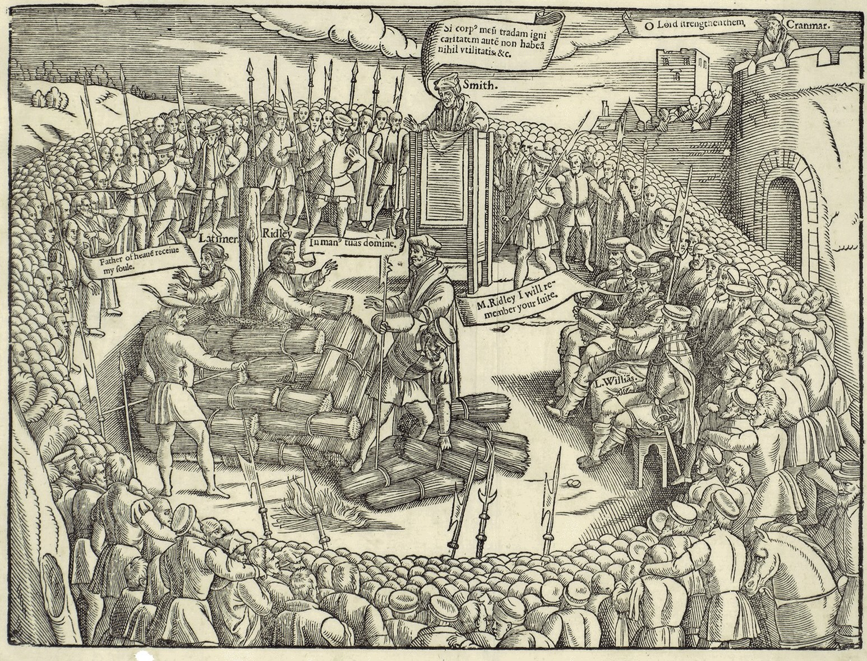
EDEXCEL GCSE HISTORY · PAPER 1 · CRIME & PUNISHMENT
Foxe's Book of Martyrs
John Foxe's Book of Martyrs described the Protestants burned under Mary I in vivid detail. It was placed in many churches and shaped how English Protestants remembered her reign.
WHY IT MATTERS AS A SOURCE
Detailed
Names, places and dates for hundreds of executions.
Biased
Written by a Protestant to show Catholics as cruel.
Influential
Helped create the name "Bloody Mary".
Protestant martyrs, as shown by John Foxe.
John Foxe, Actes and Monuments (1563); public domain copies on Wikimedia Commons.
Chapter 2: Crime and punishment in early modern England, c1500-c1700
openrevise.com
Lesson 2 of 5

Slide 8

EDEXCEL GCSE HISTORY · PAPER 1 · CRIME & PUNISHMENT
How Heresy Changed, 1500-1700
Heresy did not disappear - but it was increasingly replaced by treason as the way to punish religious opponents.
Henry VIII
Burned both Protestants who denied Catholic teaching and Catholics who denied his supremacy - the second as traitors.
Mary I
Revived the heresy laws in 1554 and burned around 280 Protestants in under four years.
Elizabeth I
Burned only a handful of heretics; she mainly punished Catholics for treason instead.
James I
The last burnings for heresy in England took place in 1612.
Chapter 2: Crime and punishment in early modern England, c1500-c1700
openrevise.com
Lesson 2 of 5

Slide 9

EDEXCEL GCSE HISTORY · PAPER 1 · CRIME & PUNISHMENT
Latimer at the Stake
“
Be of good comfort, Master Ridley, and play the man. We shall this day light such a candle, by God's grace, in England, as I trust shall never be put out.
— Hugh Latimer to Nicholas Ridley as they were burned at Oxford, 1555, as reported by John Foxe
WHAT IT SHOWS
Burning heretics was meant to stamp out their ideas - but the martyrs' courage, retold by Foxe, helped spread Protestantism instead.
Chapter 2: Crime and punishment in early modern England, c1500-c1700
openrevise.com
Lesson 2 of 5

Slide 10

EDEXCEL GCSE HISTORY · PAPER 1 · CRIME & PUNISHMENT
Key Terms
Heresy
Holding religious beliefs that go against the official teaching of the Church.
Heretic
A person found guilty of heresy.
Recant
To take back your beliefs publicly.
Martyr
Someone who dies for their beliefs.
Burning at the stake
The punishment for heresy: death by fire in public.
Book of Martyrs
John Foxe's 1563 account of Protestants burned under Mary I.
Chapter 2: Crime and punishment in early modern England, c1500-c1700
openrevise.com
Lesson 2 of 5

Slide 11
EDEXCEL GCSE HISTORY · PAPER 1 · CRIME & PUNISHMENT
Summary & Exam Focus
Heresy was seen as a threat to people's souls and to order.
Heretics were questioned by the Church and burned by the state.
Mary I burned around 280 Protestants; Elizabeth mostly used treason instead.
The last heresy burnings in England were in 1612.
EXAM FOCUS
Explain why heresy was punished so severely in the period c1500-c1700. (12 marks)
Explain the religious reasons (souls, damnation) and the political reasons (the monarch's authority), then support each with a specific example.
openrevise.com

Slide 12

EDEXCEL GCSE HISTORY · PAPER 1 · CRIME & PUNISHMENT
Exam Practice - Heresy
Answer all questions. Use specific names, dates and examples in every answer. · 35 minutes
Question 1 · 4 marks · Explain one way
Explain one way in which the punishment of heresy under Henry VIII was similar to the punishment of heresy under Mary I.
Question 2 · 12 marks · Explain why
Explain why heresy was punished so severely in the period c1500-c1700. You may use the following in your answer: the burnings under Mary I…
Question 3 · 16 marks · How far do you agree?
"The main reason religious opponents were punished in the period c1500-c1700 was to protect the authority of the monarch." How far do you…
Chapter 2: Crime and punishment in early modern England, c1500-c1700
openrevise.com
Lesson 2 of 5

Slide 13
EDEXCEL GCSE HISTORY · PAPER 1 · CRIME & PUNISHMENT
Question 1 · 4 marks · Explain one way
“
Explain one way in which the punishment of heresy under Henry VIII was similar to the punishment of heresy under Mary I.
HOW TO ANSWER IT
Command word: Explain one way. Worth 4 marks, so plan before writing.
Chapter 2: Crime and punishment in early modern England, c1500-c1700
openrevise.com
Lesson 2 of 5

Slide 14

EDEXCEL GCSE HISTORY · PAPER 1 · CRIME & PUNISHMENT
Question 1 · mark scheme
4 marks available. Award a mark for each point made.
A valid similarity identified
1-2 marks
Supported with specific knowledge of both reigns
3-4 marks
Chapter 2: Crime and punishment in early modern England, c1500-c1700
openrevise.com
Lesson 2 of 5

Slide 15
EDEXCEL GCSE HISTORY · PAPER 1 · CRIME & PUNISHMENT
Question 2 · 12 marks · Explain why
“
Explain why heresy was punished so severely in the period c1500-c1700. You may use the following in your answer: the burnings under Mary I; the authority of the monarch. You must also use information of your own.
HOW TO ANSWER IT
Command word: Explain why. Worth 12 marks, so plan before writing.
Chapter 2: Crime and punishment in early modern England, c1500-c1700
openrevise.com
Lesson 2 of 5

Slide 16
EDEXCEL GCSE HISTORY · PAPER 1 · CRIME & PUNISHMENT
Question 2 · mark scheme
12 marks available. Award a mark for each point made.
Level 1 (1-3)
A simple or general answer
Level 2 (4-6)
Some explanation of one or more reasons, with some knowledge
Level 3 (7-9)
A developed explanation linked to the question, with accurate knowledge
Level 4 (10-12)
An analytical explanation of several reasons, with knowledge that goes beyond the stimulus points
Chapter 2: Crime and punishment in early modern England, c1500-c1700
openrevise.com
Lesson 2 of 5

Slide 17
EDEXCEL GCSE HISTORY · PAPER 1 · CRIME & PUNISHMENT
Question 3 · 16 marks · How far do you agree?
“
"The main reason religious opponents were punished in the period c1500-c1700 was to protect the authority of the monarch." How far do you agree? Explain your answer. You may use the following in your answer: Mary I; recusancy. You must also use information of your own. (16 marks, plus 4 for…
HOW TO ANSWER IT
Command word: How far do you agree?. Worth 16 marks, so plan before writing.
Chapter 2: Crime and punishment in early modern England, c1500-c1700
openrevise.com
Lesson 2 of 5

Slide 18
EDEXCEL GCSE HISTORY · PAPER 1 · CRIME & PUNISHMENT
Question 3 · mark scheme
16 marks available. Award a mark for each point made.
Level 1 (1-4)
A simple or generalised answer
Level 2 (5-8)
Some analysis, with a judgement that is asserted
Level 3 (9-12)
Analysis of both sides with accurate knowledge and a supported judgement
Chapter 2: Crime and punishment in early modern England, c1500-c1700
openrevise.com
Lesson 2 of 5

Slide 19
EDEXCEL GCSE HISTORY · PAPER 1 · CRIME & PUNISHMENT
Question 3 · mark scheme (cont.)
Level 4 (13-16)
Sustained analysis, knowledge beyond the stimulus, and a clear, justified judgement
SPaG (4)
Accurate spelling, punctuation and grammar, with specialist terms such as heresy and recusancy
Chapter 2: Crime and punishment in early modern England, c1500-c1700
openrevise.com
Lesson 2 of 5

