Slide 1

EDEXCEL GCSE HISTORY · PAPER 1 · CRIME & PUNISHMENT
The Gunpowder Plot, 1605
1605-1606
Chapter 2: Crime and punishment in early modern England, 1605-1606
Lesson 5 of 5
openrevise.com

Slide 2

EDEXCEL GCSE HISTORY · PAPER 1 · CRIME & PUNISHMENT
Learning Objectives
Explain why a group of Catholics plotted to kill James I in 1605.
1
Describe how the plot was discovered and how the plotters were punished.
2
Explain why the punishment was so severe, and what the consequences were for Catholics.
3
Chapter 2: Crime and punishment in early modern England, 1605-1606
openrevise.com
Lesson 5 of 5

Slide 3

EDEXCEL GCSE HISTORY · PAPER 1 · CRIME & PUNISHMENT
Setting the Scene
When James I became king in 1603, English Catholics hoped he would treat them better than Elizabeth had. He did not, and recusancy fines continued. A small group of Catholics led by Robert Catesby decided to kill the king, his government and Parliament in one explosion, and put a Catholic monarch on the throne.
1603
1604
26 Oct 1605
4-5 Nov 1605
James I becomes king of England.
The plotters rent a cellar beneath the House of Lords.
Lord Monteagle receives an anonymous warning letter.
Guy Fawkes is caught guarding 36 barrels of gunpowder.
Chapter 2: Crime and punishment in early modern England, 1605-1606
openrevise.com
Lesson 5 of 5

Slide 4
EDEXCEL GCSE HISTORY · PAPER 1 · CRIME & PUNISHMENT
Setting the Scene (cont.)
8 Nov 1605
Jan 1606
Catesby and Thomas Percy are killed at Holbeach House.
The surviving plotters are tried and executed.
Chapter 2: Crime and punishment in early modern England, 1605-1606
openrevise.com
Lesson 5 of 5

Slide 5

EDEXCEL GCSE HISTORY · PAPER 1 · CRIME & PUNISHMENT
How the Plot Unravelled
The plot failed before it could be carried out.
1
2
3
4
5
The plan
Blow up the House of Lords at the State Opening of Parliament on 5 November 1605, killing the king.
The warning
Lord Monteagle, a Catholic, received an anonymous letter telling him to stay away from Parliament.
The search
The cellars were searched late on 4 November, and Guy Fawkes was found with 36 barrels of gunpowder.
Interrogation
James I allowed Fawkes to be tortured in the Tower of London; he gave up the names of the other plotters.
Capture
The plotters fled to the Midlands; Catesby and Percy were killed at Holbeach House on 8 November.
Chapter 2: Crime and punishment in early modern England, 1605-1606
openrevise.com
Lesson 5 of 5

Slide 6

EDEXCEL GCSE HISTORY · PAPER 1 · CRIME & PUNISHMENT
The Monteagle Letter
“
I would advise you, as you tender your life, to devise some excuse to shift your attendance at this parliament... they shall receive a terrible blow this parliament and yet they shall not see who hurts them.
— The anonymous letter sent to Lord Monteagle, 26 October 1605
WHAT IT SHOWS
The letter warned a Catholic lord to stay away - and when it was shown to the government, it led directly to the search that caught Guy Fawkes.
Chapter 2: Crime and punishment in early modern England, 1605-1606
openrevise.com
Lesson 5 of 5

Slide 7

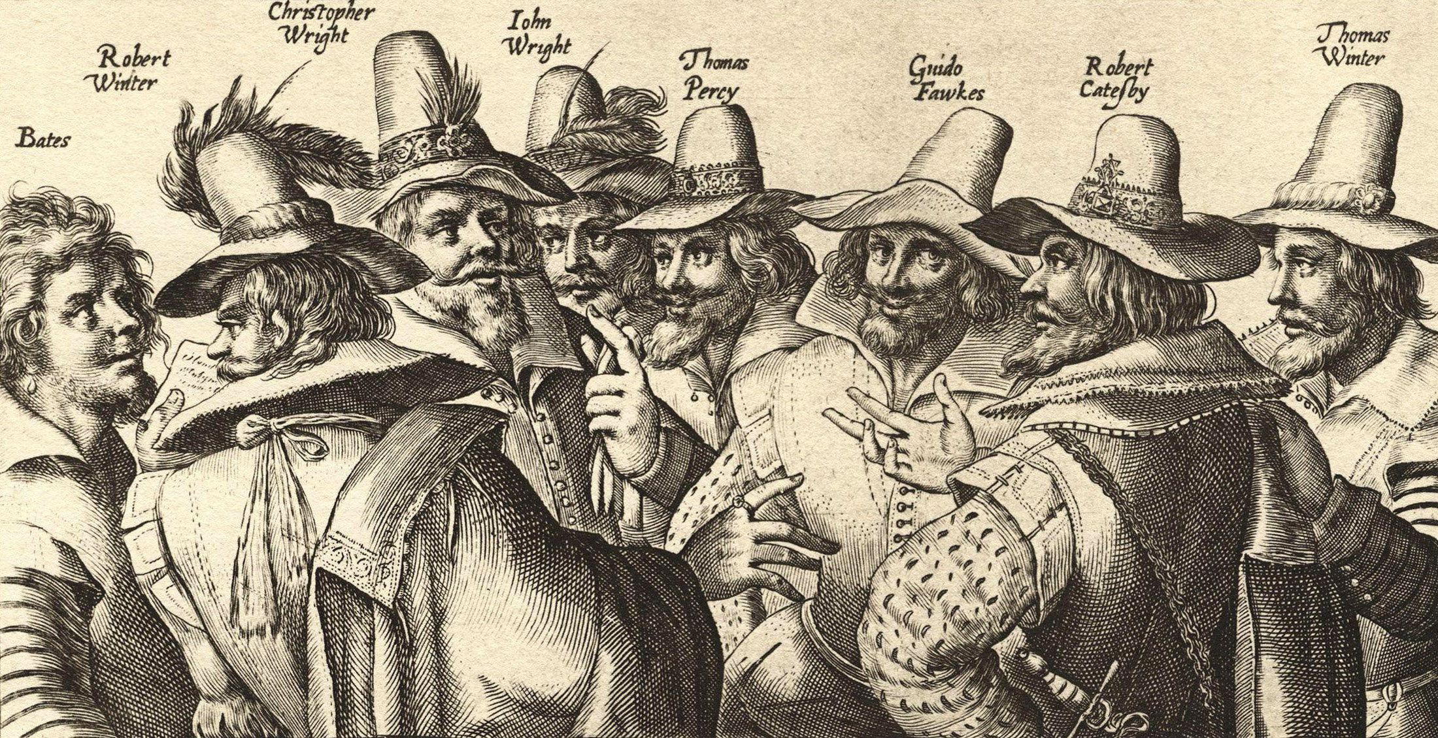
EDEXCEL GCSE HISTORY · PAPER 1 · CRIME & PUNISHMENT
The Conspirators
The plot involved thirteen conspirators. Robert Catesby was the leader; Guy Fawkes, an experienced soldier, was chosen to guard and light the gunpowder.
KEY PLOTTERS
Robert Catesby
Leader of the plot; killed at Holbeach House.
Guy Fawkes
Caught with the gunpowder; tortured and executed.
Eight of the thirteen conspirators, engraved in 1605.
Thomas Percy
Rented the cellar; killed at Holbeach House.
Crispijn van de Passe the Elder, 1605; public domain copies on Wikimedia Commons.
Chapter 2: Crime and punishment in early modern England, 1605-1606
openrevise.com
Lesson 5 of 5

Slide 8

EDEXCEL GCSE HISTORY · PAPER 1 · CRIME & PUNISHMENT
Trial and Punishment
The punishment was designed to be seen.
The trial
The surviving plotters were tried in Westminster Hall on 27 January 1606 and all were found guilty of high treason.
The sentence
They were sentenced to be hanged, drawn and quartered - the traditional punishment for treason.
The executions
Four were executed in St Paul's Churchyard on 30 January and four, including Fawkes, at Westminster on 31 January 1606.
Display
Their heads were put on display in London as a warning to others.
Chapter 2: Crime and punishment in early modern England, 1605-1606
openrevise.com
Lesson 5 of 5

Slide 9

EDEXCEL GCSE HISTORY · PAPER 1 · CRIME & PUNISHMENT
Why Was the Punishment So Severe?
Several reasons combined.
Treason
Plotting to kill the monarch was the most serious crime of all, and hanging, drawing and quartering was its set punishment.
The scale
The plot aimed to kill the king, his family, the government and Parliament in one blow.
Deterrence
A public, brutal execution warned other Catholics not to try anything similar.
Royal authority
James wanted to show his power as a new king from Scotland.
Chapter 2: Crime and punishment in early modern England, 1605-1606
openrevise.com
Lesson 5 of 5

Slide 10

EDEXCEL GCSE HISTORY · PAPER 1 · CRIME & PUNISHMENT
Consequences for Catholics
The actions of a few were used to justify harsher treatment of all Catholics.
Popish Recusants Act
The Popish Recusants Act of 1606 made Catholics swear an oath of allegiance to the king and increased pressure on recusants.
Restrictions
Catholics were barred from professions such as the law, and from holding office.
Suspicion
Catholics were seen as potential traitors for the rest of the century.
Celebration
The Observance of 5th November Act (1606) ordered an annual day of thanksgiving for the king's survival.
Chapter 2: Crime and punishment in early modern England, 1605-1606
openrevise.com
Lesson 5 of 5

Slide 11

EDEXCEL GCSE HISTORY · PAPER 1 · CRIME & PUNISHMENT
Key Terms
Gunpowder Plot
The 1605 Catholic plan to blow up James I and Parliament.
High treason
Plotting to harm or overthrow the monarch.
Hanged, drawn and quartered
The punishment for treason: hanged, cut open and cut into four.
Monteagle letter
The anonymous warning that led to the plot's discovery.
Popish Recusants Act
The 1606 law that increased restrictions on Catholics.
Oath of allegiance
A promise of loyalty to the king that Catholics had to swear.
Chapter 2: Crime and punishment in early modern England, 1605-1606
openrevise.com
Lesson 5 of 5

Slide 12
EDEXCEL GCSE HISTORY · PAPER 1 · CRIME & PUNISHMENT
Summary & Exam Focus
Catholic plotters led by Catesby tried to blow up James I on 5 November 1605.
The Monteagle letter led to the discovery of Guy Fawkes and the gunpowder.
The plotters were hanged, drawn and quartered for high treason in January 1606.
The plot led to harsher laws against Catholics, including the Popish Recusants Act.
EXAM FOCUS
Explain why the Gunpowder plotters were punished so severely. (12 marks)
Go beyond "it was treason" - explain why this treason was seen as so dangerous and what the government wanted the punishment to achieve.
openrevise.com

Slide 13

EDEXCEL GCSE HISTORY · PAPER 1 · CRIME & PUNISHMENT
Exam Practice - The Gunpowder Plot
Answer all questions. Use specific names, dates and examples in every answer. · 35 minutes
Question 1 · 4 marks · Explain one way
Explain one way in which the punishment of the Gunpowder plotters in 1606 was similar to the punishment of Catholic priests under Elizabeth…
Question 2 · 12 marks · Explain why
Explain why the Gunpowder plotters were punished so severely. You may use the following in your answer: the crime of treason; the Monteagle…
Question 3 · 16 marks · How far do you agree?
"The main consequence of the Gunpowder Plot was harsher treatment of Catholics." How far do you agree? Explain your answer. You may use the…
Chapter 2: Crime and punishment in early modern England, 1605-1606
openrevise.com
Lesson 5 of 5

Slide 14
EDEXCEL GCSE HISTORY · PAPER 1 · CRIME & PUNISHMENT
Question 1 · 4 marks · Explain one way
“
Explain one way in which the punishment of the Gunpowder plotters in 1606 was similar to the punishment of Catholic priests under Elizabeth I.
HOW TO ANSWER IT
Command word: Explain one way. Worth 4 marks, so plan before writing.
Chapter 2: Crime and punishment in early modern England, 1605-1606
openrevise.com
Lesson 5 of 5

Slide 15

EDEXCEL GCSE HISTORY · PAPER 1 · CRIME & PUNISHMENT
Question 1 · mark scheme
4 marks available. Award a mark for each point made.
A valid similarity identified
1-2 marks
Supported with specific knowledge of both
3-4 marks
Chapter 2: Crime and punishment in early modern England, 1605-1606
openrevise.com
Lesson 5 of 5

Slide 16
EDEXCEL GCSE HISTORY · PAPER 1 · CRIME & PUNISHMENT
Question 2 · 12 marks · Explain why
“
Explain why the Gunpowder plotters were punished so severely. You may use the following in your answer: the crime of treason; the Monteagle letter. You must also use information of your own.
HOW TO ANSWER IT
Command word: Explain why. Worth 12 marks, so plan before writing.
Chapter 2: Crime and punishment in early modern England, 1605-1606
openrevise.com
Lesson 5 of 5

Slide 17
EDEXCEL GCSE HISTORY · PAPER 1 · CRIME & PUNISHMENT
Question 2 · mark scheme
12 marks available. Award a mark for each point made.
Level 1 (1-3)
A simple or general answer
Level 2 (4-6)
Some explanation of one or more reasons, with some knowledge
Level 3 (7-9)
A developed explanation linked to the question, with accurate knowledge
Level 4 (10-12)
An analytical explanation of several reasons, with knowledge that goes beyond the stimulus points
Chapter 2: Crime and punishment in early modern England, 1605-1606
openrevise.com
Lesson 5 of 5

Slide 18
EDEXCEL GCSE HISTORY · PAPER 1 · CRIME & PUNISHMENT
Question 3 · 16 marks · How far do you agree?
“
"The main consequence of the Gunpowder Plot was harsher treatment of Catholics." How far do you agree? Explain your answer. You may use the following in your answer: the Popish Recusants Act (1606); the Observance of 5th November Act (1606). You must also use information of your own. (16 marks…
HOW TO ANSWER IT
Command word: How far do you agree?. Worth 16 marks, so plan before writing.
Chapter 2: Crime and punishment in early modern England, 1605-1606
openrevise.com
Lesson 5 of 5

Slide 19
EDEXCEL GCSE HISTORY · PAPER 1 · CRIME & PUNISHMENT
Question 3 · mark scheme
16 marks available. Award a mark for each point made.
Level 1 (1-4)
A simple or generalised answer
Level 2 (5-8)
Some analysis, with a judgement that is asserted
Level 3 (9-12)
Analysis of both sides with accurate knowledge and a supported judgement
Chapter 2: Crime and punishment in early modern England, 1605-1606
openrevise.com
Lesson 5 of 5

Slide 20
EDEXCEL GCSE HISTORY · PAPER 1 · CRIME & PUNISHMENT
Question 3 · mark scheme (cont.)
Level 4 (13-16)
Sustained analysis, knowledge beyond the stimulus, and a clear, justified judgement
SPaG (4)
Accurate spelling, punctuation and grammar, with specialist terms such as treason and recusant
Chapter 2: Crime and punishment in early modern England, 1605-1606
openrevise.com
Lesson 5 of 5

