Slide 1

EDEXCEL GCSE HISTORY · PAPER 1 · CRIME & PUNISHMENT
Prisons and Prison Reform
c1700-c1900
Chapter 3: Crime and punishment in Britain, c1700-c1900, c1700-c1900
Lesson 3 of 4
openrevise.com

Slide 2

EDEXCEL GCSE HISTORY · PAPER 1 · CRIME & PUNISHMENT
Learning Objectives
Describe conditions in eighteenth-century prisons.
1
Explain the work of John Howard, Elizabeth Fry and Robert Peel in reforming prisons.
2
Explain how the separate system worked at Pentonville, and assess whether it succeeded.
3
Chapter 3: Crime and punishment in Britain, c1700-c1900, c1700-c1900
openrevise.com
Lesson 3 of 4

Slide 3

EDEXCEL GCSE HISTORY · PAPER 1 · CRIME & PUNISHMENT
Setting the Scene
In the 1700s prisons were mainly used to hold people awaiting trial, and debtors. They were run for profit by gaolers, who charged prisoners for food and bedding. As the Bloody Code and transportation declined, prison became the main punishment for serious crime, and reformers pushed for prisons that would change criminals rather than simply hold them.
1777
1813
1823
1842
John Howard publishes The State of the Prisons.
Elizabeth Fry first visits the women's section of Newgate Prison.
Robert Peel's Gaols Act reforms prisons.
Pentonville Prison opens, using the separate system.
Chapter 3: Crime and punishment in Britain, c1700-c1900, c1700-c1900
openrevise.com
Lesson 3 of 4

Slide 4
EDEXCEL GCSE HISTORY · PAPER 1 · CRIME & PUNISHMENT
Setting the Scene (cont.)
1865
1877
Prison Act introduces harsher conditions: "hard labour, hard fare, hard board".
The government takes control of all prisons.
Chapter 3: Crime and punishment in Britain, c1700-c1900, c1700-c1900
openrevise.com
Lesson 3 of 4

Slide 5

EDEXCEL GCSE HISTORY · PAPER 1 · CRIME & PUNISHMENT
Prisons Before Reform
Eighteenth-century gaols were dirty, crowded and corrupt.
Profit
Gaolers were not paid a wage; they charged prisoners fees for food, bedding and even for being released.
Mixing
Men, women, children, debtors and murderers were often kept together.
Disease
Gaol fever (typhus) spread quickly in filthy, crowded conditions.
Schools of crime
First-time offenders learned from hardened criminals.
Chapter 3: Crime and punishment in Britain, c1700-c1900, c1700-c1900
openrevise.com
Lesson 3 of 4

Slide 6

EDEXCEL GCSE HISTORY · PAPER 1 · CRIME & PUNISHMENT
The Reformers
Three people who changed how prisons were run.
John Howard
A sheriff in Bedfordshire who inspected prisons across Britain and Europe and published The State of the Prisons in 1777.
Elizabeth Fry
A Quaker who from 1813 worked with women prisoners at Newgate, teaching them reading, sewing and the Bible.
Robert Peel
As Home Secretary he passed the Gaols Act of 1823, putting some of the reformers' ideas into law.
Howard's ideas
Gaolers should be paid a wage, prisons inspected, and prisoners kept clean and healthy.
Fry's ideas
Women warders for women prisoners, education, useful work and religious teaching.
Peel's Gaols Act
Paid gaolers, regular visits by chaplains, women warders, and education for prisoners.
Chapter 3: Crime and punishment in Britain, c1700-c1900, c1700-c1900
openrevise.com
Lesson 3 of 4

Slide 7

EDEXCEL GCSE HISTORY · PAPER 1 · CRIME & PUNISHMENT
The Separate and Silent Systems
Two competing ideas for how to reform prisoners.
Separate system
Prisoners were kept in their own cells almost all the time, so they could reflect on their crimes and could not be corrupted by others.
Silent system
Prisoners worked together but were forbidden to speak, and were punished if they did.
Hard labour
Prisoners did pointless, exhausting work such as the treadwheel, the crank or picking oakum.
The aim
To make prison hard enough to deter, while giving prisoners the chance to reform.
Chapter 3: Crime and punishment in Britain, c1700-c1900, c1700-c1900
openrevise.com
Lesson 3 of 4

Slide 8

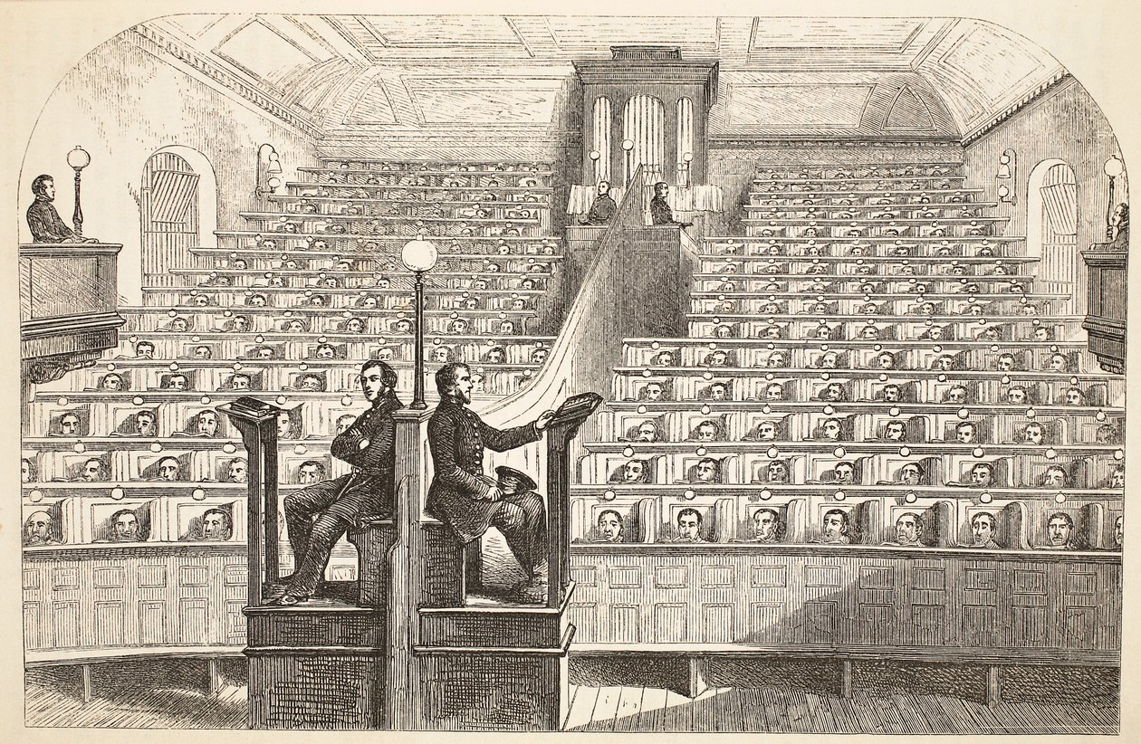
EDEXCEL GCSE HISTORY · PAPER 1 · CRIME & PUNISHMENT
Pentonville Prison
Pentonville opened in London in 1842 as a model of the separate system. Each of its 520 prisoners had his own cell, where he ate, slept and worked alone.
LIFE AT PENTONVILLE
Cells
Each prisoner had a cell with a toilet, a hammock and work such as weaving or shoemaking.
Masks
Prisoners wore masks or peaked caps outside their cells so they could not recognise each other.
Chapel
Prisoners sat in separate cubicles in chapel.
Effects
Long isolation caused mental illness and suicides.
The chapel at Pentonville: separate even in church.
Henry Mayhew and John Binny, The Criminal Prisons of London (1862); public domain copies on Wikimedia Commons.
Chapter 3: Crime and punishment in Britain, c1700-c1900, c1700-c1900
openrevise.com
Lesson 3 of 4

Slide 9

EDEXCEL GCSE HISTORY · PAPER 1 · CRIME & PUNISHMENT
Did Pentonville Succeed?
SUCCESSES
FAILURES
• Cleaner and healthier than eighteenth-century gaols.
• Kept first-time offenders away from hardened criminals.
• Gave prisoners work, religious teaching and time to reflect.
• Became a model for dozens of new prisons.
• Isolation caused mental illness and suicides.
• It did not clearly reduce reoffending.
• It was expensive to build and run.
• The separate system was gradually abandoned later in the century.
Chapter 3: Crime and punishment in Britain, c1700-c1900, c1700-c1900
openrevise.com
Lesson 3 of 4

Slide 10

EDEXCEL GCSE HISTORY · PAPER 1 · CRIME & PUNISHMENT
Key Terms
Gaoler
The person who ran a prison.
Gaols Act
Peel's 1823 law reforming how prisons were run.
Separate system
Keeping prisoners alone in their cells to reflect and reform.
Silent system
Prisoners worked together but were not allowed to speak.
Hard labour
Exhausting, often pointless work such as the treadwheel or the crank.
Treadwheel
A large wheel prisoners had to walk on for hours.
Pentonville
The model prison opened in London in 1842.
Chapter 3: Crime and punishment in Britain, c1700-c1900, c1700-c1900
openrevise.com
Lesson 3 of 4

Slide 11
EDEXCEL GCSE HISTORY · PAPER 1 · CRIME & PUNISHMENT
Summary & Exam Focus
Eighteenth-century gaols were dirty, mixed and run for profit.
John Howard and Elizabeth Fry campaigned for cleaner, fairer prisons.
Peel's Gaols Act of 1823 put reform into law.
Pentonville (1842) used the separate system - with mixed results.
EXAM FOCUS
Explain why there were changes to prisons in the period c1700-c1900. (12 marks)
Link the changes to causes - reformers, the decline of the Bloody Code and transportation, new ideas about reform.
openrevise.com

Slide 12

EDEXCEL GCSE HISTORY · PAPER 1 · CRIME & PUNISHMENT
Exam Practice - Prisons and Prison Reform
Answer all questions. Use specific names, dates and examples in every answer. · 35 minutes
Question 1 · 4 marks · Explain one way
Explain one way in which prisons in the eighteenth century were different from prisons in the late nineteenth century.
Question 2 · 12 marks · Explain why
Explain why there were changes to prisons in the period c1700-c1900. You may use the following in your answer: John Howard; the end of…
Question 3 · 16 marks · How far do you agree?
"The separate system at Pentonville was a failure." How far do you agree? Explain your answer. You may use the following in your answer…
Chapter 3: Crime and punishment in Britain, c1700-c1900, c1700-c1900
openrevise.com
Lesson 3 of 4

Slide 13
EDEXCEL GCSE HISTORY · PAPER 1 · CRIME & PUNISHMENT
Question 1 · 4 marks · Explain one way
“
Explain one way in which prisons in the eighteenth century were different from prisons in the late nineteenth century.
HOW TO ANSWER IT
Command word: Explain one way. Worth 4 marks, so plan before writing.
Chapter 3: Crime and punishment in Britain, c1700-c1900, c1700-c1900
openrevise.com
Lesson 3 of 4

Slide 14

EDEXCEL GCSE HISTORY · PAPER 1 · CRIME & PUNISHMENT
Question 1 · mark scheme
4 marks available. Award a mark for each point made.
A valid difference identified
1-2 marks
Supported with specific knowledge of both periods
3-4 marks
Chapter 3: Crime and punishment in Britain, c1700-c1900, c1700-c1900
openrevise.com
Lesson 3 of 4

Slide 15
EDEXCEL GCSE HISTORY · PAPER 1 · CRIME & PUNISHMENT
Question 2 · 12 marks · Explain why
“
Explain why there were changes to prisons in the period c1700-c1900. You may use the following in your answer: John Howard; the end of transportation. You must also use information of your own.
HOW TO ANSWER IT
Command word: Explain why. Worth 12 marks, so plan before writing.
Chapter 3: Crime and punishment in Britain, c1700-c1900, c1700-c1900
openrevise.com
Lesson 3 of 4

Slide 16
EDEXCEL GCSE HISTORY · PAPER 1 · CRIME & PUNISHMENT
Question 2 · mark scheme
12 marks available. Award a mark for each point made.
Level 1 (1-3)
A simple or general answer
Level 2 (4-6)
Some explanation of one or more reasons, with some knowledge
Level 3 (7-9)
A developed explanation linked to the question, with accurate knowledge
Level 4 (10-12)
An analytical explanation of several reasons, with knowledge that goes beyond the stimulus points
Chapter 3: Crime and punishment in Britain, c1700-c1900, c1700-c1900
openrevise.com
Lesson 3 of 4

Slide 17
EDEXCEL GCSE HISTORY · PAPER 1 · CRIME & PUNISHMENT
Question 3 · 16 marks · How far do you agree?
“
"The separate system at Pentonville was a failure." How far do you agree? Explain your answer. You may use the following in your answer: prisoners' cells; mental illness. You must also use information of your own. (16 marks, plus 4 for spelling, punctuation, grammar and specialist terminology)
HOW TO ANSWER IT
Command word: How far do you agree?. Worth 16 marks, so plan before writing.
Chapter 3: Crime and punishment in Britain, c1700-c1900, c1700-c1900
openrevise.com
Lesson 3 of 4

Slide 18
EDEXCEL GCSE HISTORY · PAPER 1 · CRIME & PUNISHMENT
Question 3 · mark scheme
16 marks available. Award a mark for each point made.
Level 1 (1-4)
A simple or generalised answer
Level 2 (5-8)
Some analysis, with a judgement that is asserted
Level 3 (9-12)
Analysis of both sides with accurate knowledge and a supported judgement
Chapter 3: Crime and punishment in Britain, c1700-c1900, c1700-c1900
openrevise.com
Lesson 3 of 4

Slide 19
EDEXCEL GCSE HISTORY · PAPER 1 · CRIME & PUNISHMENT
Question 3 · mark scheme (cont.)
Level 4 (13-16)
Sustained analysis, knowledge beyond the stimulus, and a clear, justified judgement
SPaG (4)
Accurate spelling, punctuation and grammar, with specialist terms such as separate system and hard labour
Chapter 3: Crime and punishment in Britain, c1700-c1900, c1700-c1900
openrevise.com
Lesson 3 of 4

