Slide 1

EDEXCEL GCSE HISTORY · PAPER 1 · CRIME & PUNISHMENT
The Metropolitan Police, 1829
c1700-c1900
Chapter 3: Crime and punishment in Britain, c1700-c1900, c1700-c1900
Lesson 4 of 4
openrevise.com

Slide 2

EDEXCEL GCSE HISTORY · PAPER 1 · CRIME & PUNISHMENT
Learning Objectives
Describe law enforcement before 1829, including watchmen and the Bow Street Runners.
1
Explain why the Metropolitan Police was set up in 1829.
2
Explain how policing developed after 1829, and why the police were at first unpopular.
3
Chapter 3: Crime and punishment in Britain, c1700-c1900, c1700-c1900
openrevise.com
Lesson 4 of 4

Slide 3

EDEXCEL GCSE HISTORY · PAPER 1 · CRIME & PUNISHMENT
Setting the Scene
In 1700 there was still no professional police force. Towns relied on unpaid parish constables and night watchmen, who were often old, poorly paid and easily bribed. As London grew into the largest city in the world, it became clear that this system could not cope.
1749
1805
1829
1842
Henry Fielding sets up the Bow Street Runners in London.
The Bow Street Horse Patrol guards the roads around London.
Robert Peel's Metropolitan Police Act creates the Metropolitan Police.
The Metropolitan Police sets up a Detective Department.
Chapter 3: Crime and punishment in Britain, c1700-c1900, c1700-c1900
openrevise.com
Lesson 4 of 4

Slide 4
EDEXCEL GCSE HISTORY · PAPER 1 · CRIME & PUNISHMENT
Setting the Scene (cont.)
1856
1878
The County and Borough Police Act makes every area have a police force.
The Criminal Investigation Department (CID) is formed.
Chapter 3: Crime and punishment in Britain, c1700-c1900, c1700-c1900
openrevise.com
Lesson 4 of 4

Slide 5

EDEXCEL GCSE HISTORY · PAPER 1 · CRIME & PUNISHMENT
Law Enforcement Before 1829
A patchy system that relied on individuals rather than an organised force.
Watchmen
Night watchmen patrolled towns, but were often old, badly paid and mocked as "Charleys".
Constables
Parish constables were ordinary men who served for a year, usually unpaid and untrained.
Thief-takers
Private individuals who caught criminals for rewards - some, like Jonathan Wild, were criminals themselves.
Bow Street Runners
Set up in 1749 by magistrate Henry Fielding and his half-brother John: a small, paid team who investigated crimes and caught criminals.
Chapter 3: Crime and punishment in Britain, c1700-c1900, c1700-c1900
openrevise.com
Lesson 4 of 4

Slide 6

EDEXCEL GCSE HISTORY · PAPER 1 · CRIME & PUNISHMENT
Why Was the Metropolitan Police Set Up?
Several pressures came together in the 1820s.
A growing city
London's population had grown enormously, and the old system could not cope.
Rising crime
Crime appeared to be rising, and the Bloody Code was not stopping it.
Fear of unrest
Riots and protests made the government want better control of the streets.
Bow Street's success
The Runners showed that a paid, organised force could work.
Robert Peel
As Home Secretary, Peel persuaded Parliament to act.
Prevention
Peel wanted to prevent crime by having police visible on the streets.
Chapter 3: Crime and punishment in Britain, c1700-c1900, c1700-c1900
openrevise.com
Lesson 4 of 4

Slide 7

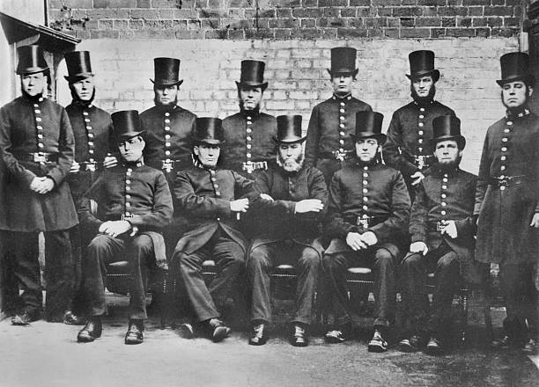
EDEXCEL GCSE HISTORY · PAPER 1 · CRIME & PUNISHMENT
The First Police Officers
The Metropolitan Police began in 1829 with around 3,200 constables. They were deliberately made to look different from soldiers, to reassure a public that feared a military-style force.
THE FIRST "PEELERS"
Uniform
A blue tailcoat and top hat, not a red army coat.
Equipment
A wooden truncheon and a rattle to call for help.
Beats
Constables walked set routes, or beats, around the clock.
Discipline
Strict rules - many early recruits were sacked for drunkenness.
A "Peeler" of the 1830s.
Nineteenth-century illustration; public domain copies on Wikimedia Commons.
Chapter 3: Crime and punishment in Britain, c1700-c1900, c1700-c1900
openrevise.com
Lesson 4 of 4

Slide 8

EDEXCEL GCSE HISTORY · PAPER 1 · CRIME & PUNISHMENT
Opposition to the New Police
Not everyone welcomed the "Peelers" or "Bobbies".
Cost
People resented paying for the police through local taxes.
Liberty
Many feared the police would be used to spy on people, like the police in France.
Early problems
Many early recruits were dismissed, often for drunkenness.
Gaining trust
Over time, the police's focus on preventing crime and keeping order helped them gain acceptance.
Chapter 3: Crime and punishment in Britain, c1700-c1900, c1700-c1900
openrevise.com
Lesson 4 of 4

Slide 9

EDEXCEL GCSE HISTORY · PAPER 1 · CRIME & PUNISHMENT
How Policing Spread
The Metropolitan Police became a model for the whole country.
1
2
3
4
5
1829
Metropolitan Police set up in London.
1839
Counties were allowed, but not forced, to set up police forces.
1842
The Met set up a Detective Department to investigate crimes.
1856
The County and Borough Police Act made police forces compulsory across the country.
1878
The Criminal Investigation Department (CID) was formed.
Chapter 3: Crime and punishment in Britain, c1700-c1900, c1700-c1900
openrevise.com
Lesson 4 of 4

Slide 10

EDEXCEL GCSE HISTORY · PAPER 1 · CRIME & PUNISHMENT
Key Terms
Watchman
A man paid to patrol a town at night, often old and ineffective.
Parish constable
An unpaid local man who kept order for a year.
Thief-taker
A private individual who caught criminals for rewards.
Bow Street Runners
A small paid force set up by Henry Fielding in London in 1749.
Metropolitan Police
London's professional police force, set up by Robert Peel in 1829.
Peelers / Bobbies
Nicknames for the first police officers, after Robert Peel.
CID
The Criminal Investigation Department, formed in 1878.
Chapter 3: Crime and punishment in Britain, c1700-c1900, c1700-c1900
openrevise.com
Lesson 4 of 4

Slide 11
EDEXCEL GCSE HISTORY · PAPER 1 · CRIME & PUNISHMENT
Summary & Exam Focus
Before 1829, law enforcement relied on watchmen, constables and thief-takers.
The Bow Street Runners (1749) showed that paid officers could work.
Robert Peel created the Metropolitan Police in 1829 to prevent crime.
By 1856 every area had to have a police force.
EXAM FOCUS
Explain why the Metropolitan Police was set up in 1829. (12 marks)
Explain several factors - London's growth, crime, fear of unrest, Peel - and link each one to the decision.
openrevise.com

