Slide 1

EDEXCEL GCSE BUSINESS · PAPER 1
The dynamic nature of business
Enterprise and entrepreneurship
Lesson 1 of 3
openrevise.com

Slide 2

EDEXCEL GCSE BUSINESS · PAPER 1
What Do You Already Know?
Jot your answers down before we look at them.
Name a business you use that did not exist fifteen years ago.
1
Name a product your parents used that hardly anyone buys now.
2
What does "dynamic" mean?
3
Why might a business that sells exactly the same thing for twenty years get into trouble?
4
Enterprise and entrepreneurship
openrevise.com
Lesson 1 of 3
Notes:
Ninety seconds. This is about getting them thinking about businesses they already use, not about right answers.

Slide 3
EDEXCEL GCSE BUSINESS · PAPER 1
What Do You Already Know? - Answers
Name a business you use that did not exist fifteen years ago.
Examples: Deliveroo, TikTok Shop, Uber, Spotify, Monzo - all made possible by smartphones and apps.
1
Name a product your parents used that hardly anyone buys now.
Examples: DVDs, CDs, film cameras, satellite navigation boxes, landline phones.
2
What does "dynamic" mean?
Constantly changing and developing.
3
Why might a business that sells exactly the same thing for twenty years get into trouble?
Customers' wants, technology and competitors all change around it.
4
Enterprise and entrepreneurship
openrevise.com
Lesson 1 of 3
Notes:
Ninety seconds. This is about getting them thinking about businesses they already use, not about right answers.

Slide 4

EDEXCEL GCSE BUSINESS · PAPER 1
Learning Objectives
Explain what is meant by the dynamic nature of business.
1
Explain why new business ideas come about: changes in technology, changes in what consumers want, and products and services becoming obsolete.
2
Explain how new business ideas come about: original ideas, and adapting existing products, services and ideas.
3
Apply these reasons to real businesses in an exam answer.
4
Enterprise and entrepreneurship
openrevise.com
Lesson 1 of 3

Slide 5

EDEXCEL GCSE BUSINESS · PAPER 1
THE BIG IDEA
Markets never stand still, so neither can the businesses in them.
Every change in technology or in what people want is a threat to one business and an opportunity for another.
Enterprise and entrepreneurship
openrevise.com
Lesson 1 of 3

Slide 6

EDEXCEL GCSE BUSINESS · PAPER 1
What Does "Dynamic" Mean?
A dynamic market is one that is constantly changing.
Constant change
The business world changes all the time: new technology is invented, customers' tastes shift, and new competitors arrive.
Threats
A business that does not keep up can lose its customers to rivals who do, and eventually close.
Opportunities
Every change creates a gap that an entrepreneur can fill with a new product or service.
Why it matters
Businesses must keep watching their market and be ready to adapt what they sell and how they sell it.
Enterprise and entrepreneurship
openrevise.com
Lesson 1 of 3

Slide 7


EDEXCEL GCSE BUSINESS · PAPER 1
Where Do New Ideas Come From?
New business ideas do not appear out of nowhere. Something in the world changes, somebody notices a gap it has left, and they come up with a product or service to fill it - either something completely new or a better version of something that already exists.
Most new businesses begin as one idea talked through around a table.
Enterprise and entrepreneurship
openrevise.com
Lesson 1 of 3

Slide 8

EDEXCEL GCSE BUSINESS · PAPER 1
PART ONE
Why New Business Ideas Come About
Three kinds of change create the gaps that new businesses fill.
openrevise.com

Slide 9


EDEXCEL GCSE BUSINESS · PAPER 1
Why new business ideas come about
Changes in technology
▸ new products (smartphones, electric cars)
▸ new ways to sell (online, apps)
▸ new services (streaming, ride-hailing)
Why new business ideas come about
Products becoming obsolete
▸ DVDs replaced by streaming
▸ film cameras by phone cameras
▸ paper maps by sat-nav and apps
Changes in consumer wants
▸ healthier eating
▸ ethical and sustainable products
▸ convenience
▸ new fashions and trends
Enterprise and entrepreneurship
openrevise.com
Lesson 1 of 3

Slide 10

EDEXCEL GCSE BUSINESS · PAPER 1
Changes in Technology
New technology makes new products, and new ways of selling, possible.
New products
Technology allows products that could not exist before, such as smartphones, smart watches, electric cars and video doorbells.
New services
The smartphone made app-based services possible: food delivery (Deliveroo, Just Eat), ride-hailing (Uber) and music streaming (Spotify).
New ways of selling
The internet lets even a tiny business sell to customers across the country through its own website, Etsy, eBay or social media.
Lower costs
Technology can make production cheaper, so a small business can compete - for example 3D printing, or online tools for design and accounts.
Enterprise and entrepreneurship
openrevise.com
Lesson 1 of 3

Slide 11

EDEXCEL GCSE BUSINESS · PAPER 1
Technology Creates New Businesses
Before smartphones, ordering a takeaway meant phoning the restaurant, and most restaurants did not deliver at all. Delivery apps link customers, restaurants and riders in one place - a whole new business that technology created.
THE SAME CHANGE CREATED OTHER BUSINESSES TOO
Dark kitchens
Kitchens with no dining room that cook only for delivery.
Riders
Self-employed riders working for several apps.
Restaurants
Able to reach customers without paying for more tables.
App-based delivery only became possible once most people carried a smartphone.
Enterprise and entrepreneurship
openrevise.com
Lesson 1 of 3

Slide 12

EDEXCEL GCSE BUSINESS · PAPER 1
Changes in Consumer Wants
What customers want changes over time, and new businesses spring up to supply it.
Healthier lifestyles
Growing interest in health has created demand for gyms, protein snacks, low-sugar drinks and fitness apps.
Ethical and green choices
Customers increasingly want products that are sustainable, recyclable, plant-based or fairly traded - opening markets for refill shops and vegan food brands.
Convenience
Busy lives mean customers will pay for things that save time: meal kits, next-day delivery, click-and-collect.
Fashions and trends
Tastes change quickly, often driven by social media, so a product that is popular this year may not be next year.
Enterprise and entrepreneurship
openrevise.com
Lesson 1 of 3

Slide 13

EDEXCEL GCSE BUSINESS · PAPER 1
Products and Services Becoming Obsolete
Obsolete means out of date - no longer wanted because something better has replaced it.
What happens
When a product becomes obsolete, demand for it falls, often very quickly, and businesses that rely on it may fail.
Why it happens
Usually because new technology produces a better product, or because consumer wants have changed.
The opportunity
Every obsolete product leaves customers who still have the need, so an entrepreneur can supply the replacement.
Examples
DVDs and CDs replaced by streaming, film cameras by phone cameras, paper road maps by sat-nav and map apps.
Enterprise and entrepreneurship
openrevise.com
Lesson 1 of 3

Slide 14

EDEXCEL GCSE BUSINESS · PAPER 1
Case in Point: Watching Films at Home
The way people watch films at home has been replaced three times in forty years. Each change made one business model obsolete and created a new one.
1980s
1997
2007
2012
2013
Video shops rent out VHS tapes and become a feature of every high street.
DVDs go on sale, and Netflix is founded in the USA to post DVDs to customers.
Netflix launches streaming, using faster broadband to play films online.
Netflix launches in the UK.
Blockbuster's UK stores close: renting a disc from a shop is now obsolete.
Enterprise and entrepreneurship
openrevise.com
Lesson 1 of 3

Slide 15
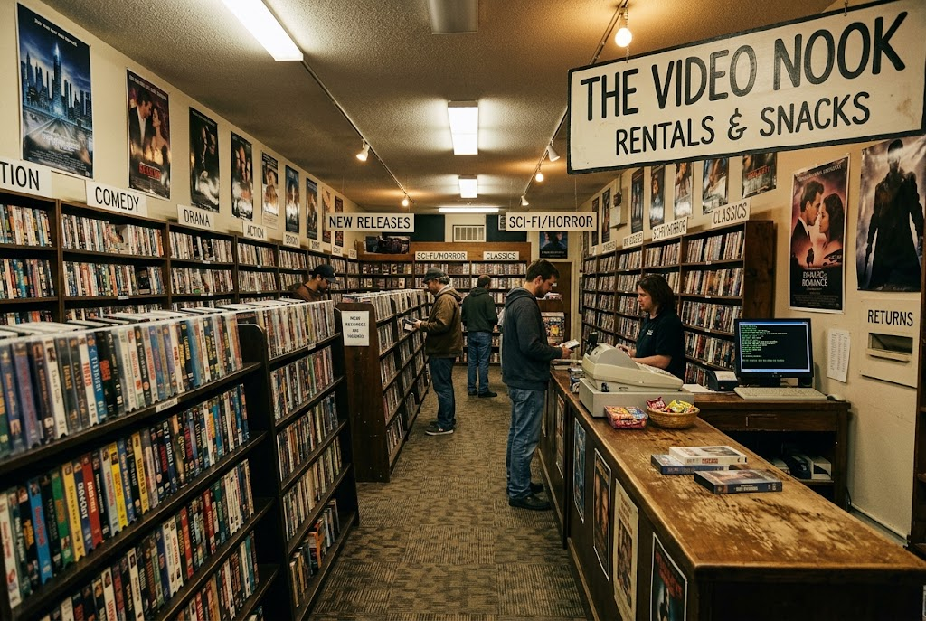

EDEXCEL GCSE BUSINESS · PAPER 1
From Obsolete to New
The same need - watching a film at home - met in two very different ways.
Renting a disc from a shop: now obsolete.
Streaming: the service that replaced it.
Enterprise and entrepreneurship
openrevise.com
Lesson 1 of 3

Slide 16
EDEXCEL GCSE BUSINESS · PAPER 1
PART TWO
How New Business Ideas Come About
Once a gap appears, an entrepreneur can fill it in one of two ways.
openrevise.com

Slide 17

EDEXCEL GCSE BUSINESS · PAPER 1
Original Ideas or Adapting Existing Ones?
ORIGINAL IDEAS
ADAPTING EXISTING IDEAS
• Something genuinely new that has not been done before.
• Often comes from new technology or an invention.
• Can give the business the whole market to itself at first.
• Riskier: nobody knows yet whether customers will want it.
• Example: Dyson's bagless vacuum cleaner.
• Taking a product, service or idea that already exists and changing it.
• Often comes from spotting a weakness in what is already on offer.
• Customers already understand the product, so it is easier to sell.
• Less risky, but there will already be competitors.
• Example: a café adding vegan options, or a gym opening 24 hours a day.
Enterprise and entrepreneurship
openrevise.com
Lesson 1 of 3

Slide 18

EDEXCEL GCSE BUSINESS · PAPER 1
Original Ideas
An original idea is a completely new product or service.
What it is
An idea that has not been done before, often the result of an invention or a new use of technology.
Advantage
The business may be first into the market with no direct competitors, and can often charge a higher price.
Disadvantage
It is risky: there is no proof that customers want it, and developing something new can be expensive and slow.
Example
James Dyson invented a vacuum cleaner that did not need a bag, which no other manufacturer offered at the time.
Enterprise and entrepreneurship
openrevise.com
Lesson 1 of 3

Slide 19

EDEXCEL GCSE BUSINESS · PAPER 1
Adapting Existing Products, Services and Ideas
Most new businesses do not invent something new - they improve something that already exists.
Improving a product
Making it better, cheaper, faster, healthier or more convenient than what is already sold.
A new market
Taking an idea that works in one place or for one group of customers and offering it somewhere else or to someone else.
Combining ideas
Putting two existing ideas together, for example a bookshop with a café in it.
Why it works
Customers already understand the product, so there is less risk - but the business must find a way to stand out from existing competitors.
Enterprise and entrepreneurship
openrevise.com
Lesson 1 of 3

Slide 20

EDEXCEL GCSE BUSINESS · PAPER 1
CASE STUDY
Netflix: Adapting to Survive
Netflix began in 1997 by adapting an existing idea: instead of customers going to a shop to rent a DVD, it posted the DVDs to them. When faster broadband arrived, Netflix adapted again and moved to streaming in 2007, making its own DVD-by-post business out of date before a competitor could. Blockbuster, which did not adapt quickly enough, closed its UK shops in 2013. Netflix shows all three reasons for new ideas at once: new technology (broadband), changing consumer wants (instant, on-demand viewing) and an obsolete product (the rented disc).
1997
2007
Founded as a DVD-by-post service
Moved into streaming
Enterprise and entrepreneurship
openrevise.com
Lesson 1 of 3

Slide 21

EDEXCEL GCSE BUSINESS · PAPER 1
Key Terms
Dynamic
Constantly changing. Business markets are dynamic because technology, customer wants and competition keep changing.
Obsolete
Out of date and no longer wanted, usually because a better product has replaced it.
Consumer wants
The goods and services that customers would like to buy.
Original idea
A completely new product or service that has not been offered before.
Adapting
Changing an existing product, service or idea to improve it or to suit different customers.
Innovation
Turning a new idea into a product or service that is actually sold.
Enterprise and entrepreneurship
openrevise.com
Lesson 1 of 3

Slide 22
EDEXCEL GCSE BUSINESS · PAPER 1
Match the Change to the Business
Which reason explains each new business?
New business
Why it came about
A
A refill shop selling loose pasta and washing-up liquid
Changing consumer wants: more people eating less meat
1
B
A phone repair stall in a shopping centre
Changing technology: the switch to electric cars
2
C
A music streaming app
Changing consumer wants: less plastic packaging
3
D
A vegan burger range
Changing technology: almost everyone owns a smartphone
4
E
An electric car charging company
A product becoming obsolete: CDs replaced by streaming
5
Enterprise and entrepreneurship
openrevise.com
Lesson 1 of 3

Slide 23

EDEXCEL GCSE BUSINESS · PAPER 1
YOUR TASK
10 minutes
Spot the Gap
Choose three products or services you or your family have stopped using in the last five years. For each one, say what replaced it, which reason for new business ideas explains the change, and whether the new business was an original idea or an adaptation.
1
Name the old product and what replaced it.
2
Name the reason for the change.
3
Decide: original idea or adaptation? Explain why.
WHAT A GOOD ANSWER SHOWS
Three examples, each linked to a named reason (technology, consumer wants or obsolescence) and a judgement of original or adapted, with a reason.
Enterprise and entrepreneurship
openrevise.com
Lesson 1 of 3
Notes:
Push them to explain WHY the change happened, not just name it - that is the analysis marks in the exam.

Slide 24

EDEXCEL GCSE BUSINESS · PAPER 1
Can I...?
Explain what is meant by the dynamic nature of business.
Explain how changes in technology lead to new business ideas.
Explain how changes in consumer wants lead to new business ideas.
Explain what obsolete means and how it creates new business ideas.
Explain the difference between an original idea and an adapted idea.
Use a real example for each.
Enterprise and entrepreneurship
openrevise.com
Lesson 1 of 3

Slide 25
EDEXCEL GCSE BUSINESS · PAPER 1
Summary & Exam Focus
Business is dynamic: technology, customer wants and competition change all the time.
New ideas come about because of changes in technology, changes in consumer wants and products becoming obsolete.
New ideas are either original or adaptations of existing products, services and ideas.
Adapting is less risky than an original idea, but there is more competition.
EXAM FOCUS
Outline one reason why new business ideas come about. (2 marks)
Outline questions are worth 2 marks: 1 for the reason and 1 for developing it. Name the reason, then add a linked point that shows why it leads to a new business idea - an example helps.
openrevise.com

Slide 26
EDEXCEL GCSE BUSINESS · PAPER 1
Exam Practice: The Dynamic Nature of Business
Answer all questions. Use the context of the business in the question where one is given. · 20 minutes
Question 1 · 1 mark · Define
Define the term 'obsolete'.
Question 2 · 1 mark · State
State one reason why new business ideas come about.
Question 3 · 2 marks · Outline
Outline one reason why new business ideas come about.
Enterprise and entrepreneurship
openrevise.com
Lesson 1 of 3

Slide 27
EDEXCEL GCSE BUSINESS · PAPER 1
Exam Practice: The Dynamic Nature of Business (cont.)
Question 4 · 2 marks · Outline
Outline one way an entrepreneur can come up with a new business idea.
Question 5 · 3 marks · Explain
Explain one risk to a business of its product becoming obsolete.
Enterprise and entrepreneurship
openrevise.com
Lesson 1 of 3

Slide 28
EDEXCEL GCSE BUSINESS · PAPER 1
Question 1 · 1 mark · Define
“
Define the term 'obsolete'.
HOW TO ANSWER IT
Command word: Define. Worth 1 mark, so plan before writing.
Enterprise and entrepreneurship
openrevise.com
Lesson 1 of 3

Slide 29
EDEXCEL GCSE BUSINESS · PAPER 1
Question 1 · mark scheme
1 mark available. Award a mark for each point made.
Out of date / no longer wanted or used
1 mark
Enterprise and entrepreneurship
openrevise.com
Lesson 1 of 3

Slide 30
EDEXCEL GCSE BUSINESS · PAPER 1
Question 2 · 1 mark · State
“
State one reason why new business ideas come about.
HOW TO ANSWER IT
Command word: State. Worth 1 mark, so plan before writing.
Enterprise and entrepreneurship
openrevise.com
Lesson 1 of 3

Slide 31
EDEXCEL GCSE BUSINESS · PAPER 1
Question 2 · mark scheme
1 mark available. Award a mark for each point made.
Any one of: changes in technology; changes in consumer wants; products or services becoming obsolete
1 mark
Enterprise and entrepreneurship
openrevise.com
Lesson 1 of 3

Slide 32
EDEXCEL GCSE BUSINESS · PAPER 1
Question 3 · 2 marks · Outline
“
Outline one reason why new business ideas come about.
HOW TO ANSWER IT
Command word: Outline. Worth 2 marks, so plan before writing.
Enterprise and entrepreneurship
openrevise.com
Lesson 1 of 3

Slide 33
EDEXCEL GCSE BUSINESS · PAPER 1
Question 3 · mark scheme
2 marks available. Award a mark for each point made.
A reason identified, e.g. changes in technology / consumer wants / products becoming obsolete
1 mark
Developed: why this leads to a new business idea
1 mark
Enterprise and entrepreneurship
openrevise.com
Lesson 1 of 3

Slide 34
EDEXCEL GCSE BUSINESS · PAPER 1
Question 4 · 2 marks · Outline
“
Outline one way an entrepreneur can come up with a new business idea.
HOW TO ANSWER IT
Command word: Outline. Worth 2 marks, so plan before writing.
Enterprise and entrepreneurship
openrevise.com
Lesson 1 of 3

Slide 35
EDEXCEL GCSE BUSINESS · PAPER 1
Question 4 · mark scheme
2 marks available. Award a mark for each point made.
A way identified: an original idea / adapting an existing product, service or idea
1 mark
Developed: how this produces a business idea
1 mark
Enterprise and entrepreneurship
openrevise.com
Lesson 1 of 3

Slide 36
EDEXCEL GCSE BUSINESS · PAPER 1
Question 5 · 3 marks · Explain
“
Explain one risk to a business of its product becoming obsolete.
HOW TO ANSWER IT
Command word: Explain. Worth 3 marks, so plan before writing.
Enterprise and entrepreneurship
openrevise.com
Lesson 1 of 3

Slide 37
EDEXCEL GCSE BUSINESS · PAPER 1
Question 5 · mark scheme
3 marks available. Award a mark for each point made.
A risk identified, e.g. falling sales / revenue / business failure
1 mark
First linked point of explanation
1 mark
Second linked point of explanation
1 mark
Enterprise and entrepreneurship
openrevise.com
Lesson 1 of 3

