Slide 1

EDEXCEL GCSE BUSINESS · PAPER 1
The role of business enterprise
Enterprise and entrepreneurship
Lesson 3 of 3
openrevise.com

Slide 2

EDEXCEL GCSE BUSINESS · PAPER 1
Last Lesson
Answer from memory before the answers appear.
Name the three risks of starting a business.
1
Name the three rewards.
2
What is profit?
3
Give one way an entrepreneur can reduce risk.
4
Enterprise and entrepreneurship
openrevise.com
Lesson 3 of 3

Slide 3
EDEXCEL GCSE BUSINESS · PAPER 1
Last Lesson - Answers
Name the three risks of starting a business.
Business failure, financial loss and lack of security.
1
Name the three rewards.
Business success, profit and independence.
2
What is profit?
Total revenue minus total costs.
3
Give one way an entrepreneur can reduce risk.
Market research, a business plan, starting small, or limiting borrowing.
4
Enterprise and entrepreneurship
openrevise.com
Lesson 3 of 3

Slide 4

EDEXCEL GCSE BUSINESS · PAPER 1
Learning Objectives
Explain the purpose of business activity: producing goods or services, meeting customer needs and adding value.
1
Explain the role of the entrepreneur: organising resources, making decisions and taking risks.
2
Define added value and calculate it.
3
Explain how entrepreneurs add value through convenience, branding, quality, design and a unique selling point.
4
Enterprise and entrepreneurship
openrevise.com
Lesson 3 of 3

Slide 5
EDEXCEL GCSE BUSINESS · PAPER 1
The Purpose of Business Activity
Why do businesses exist at all?
To produce goods or services
Goods are physical products you can touch, such as trainers or a phone. Services are things done for you, such as a haircut or a bus journey.
To meet customer needs
A business will only survive if it sells something customers want at a price they are willing to pay.
To add value
A business turns inputs into something worth more to the customer than the inputs cost - which is how it makes a profit.
To make a profit
For most businesses, adding value and meeting needs is how they make the profit that rewards the owner.
Enterprise and entrepreneurship
openrevise.com
Lesson 3 of 3

Slide 6

EDEXCEL GCSE BUSINESS · PAPER 1
How a Business Turns Inputs into Outputs
Every business, from a café to a car factory, does the same thing.
1
2
3
4
Inputs
Resources: raw materials, staff, equipment, premises and money.
The business process
The entrepreneur organises the inputs to make a product or provide a service.
Outputs
Goods or services sold to customers.
Added value
The outputs are worth more than the inputs cost - the difference is the value added.
Enterprise and entrepreneurship
openrevise.com
Lesson 3 of 3

Slide 7

EDEXCEL GCSE BUSINESS · PAPER 1
The Role of the Entrepreneur
Organises resources
Brings together the inputs a business needs: materials, staff, equipment, premises and money.
Makes business decisions
Decides what to sell, how to make it, what price to charge and who to sell it to.
Takes risks
Puts their own time and money into the business, knowing it could fail.
Enterprise and entrepreneurship
openrevise.com
Lesson 3 of 3

Slide 8

EDEXCEL GCSE BUSINESS · PAPER 1
PART TWO
Adding Value
The difference between what a business pays for its inputs and what a customer pays for the product.
openrevise.com

Slide 9

EDEXCEL GCSE BUSINESS · PAPER 1
What Is Added Value?
Added value = selling price - cost of bought-in materials and components.
What it means
The extra amount a customer is willing to pay for a product over and above what its materials cost.
Why it matters
Added value is used to pay the business's other costs, such as wages and rent. What is left is profit.
More value, more choice
A business that adds more value can charge a higher price, or attract more customers at the same price.
Not the same as profit
Added value is before the business's other costs are paid; profit is what is left after all costs.
Enterprise and entrepreneurship
openrevise.com
Lesson 3 of 3

Slide 10

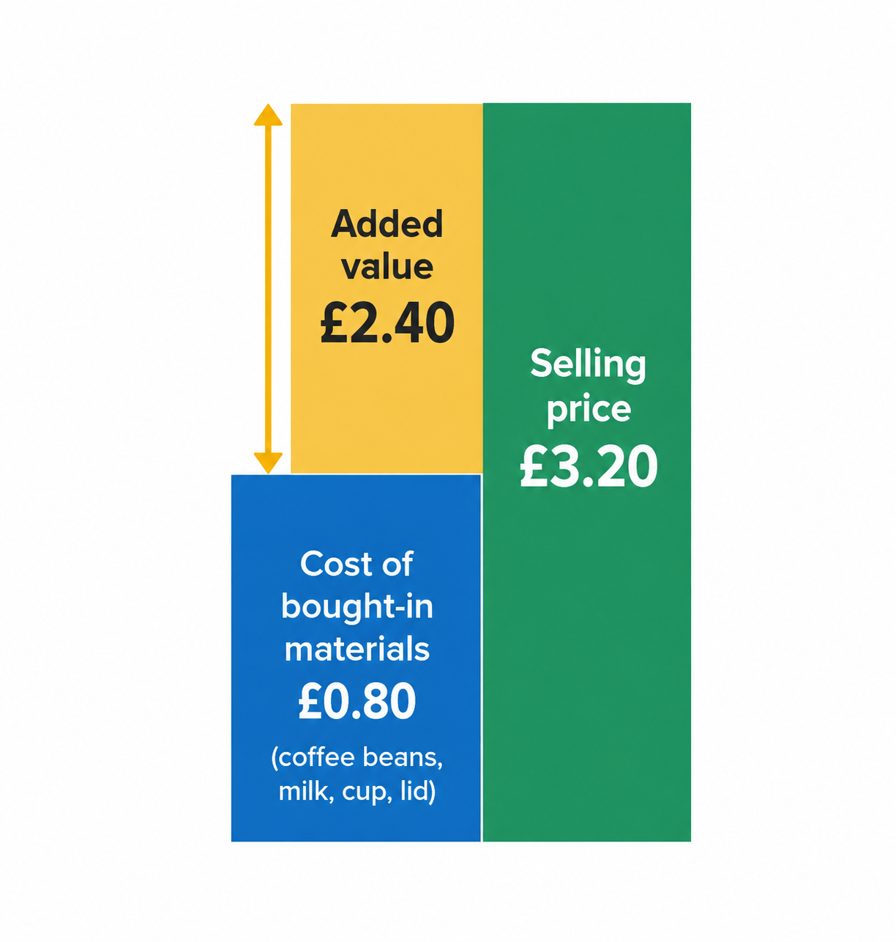
EDEXCEL GCSE BUSINESS · PAPER 1
Added Value, Drawn Out
The coffee beans, milk and cup in a takeaway coffee cost the café about 80p. The customer pays £3.20. The £2.40 difference is the value the café has added - through the barista's skill, the convenience of the location, the brand and the quality of the coffee.
Added value = selling price (£3.20) - cost of bought-in materials (£0.80) = £2.40.
Enterprise and entrepreneurship
openrevise.com
Lesson 3 of 3

Slide 11

EDEXCEL GCSE BUSINESS · PAPER 1
Calculating Added Value
Edexcel "Calculate" questions: show your working for the method mark.
A bakery sells a birthday cake for £24. The flour, eggs, butter, sugar, decorations and box cost £7.50. Calculate the added value.
Write the formula
Added value = selling price - cost of bought-in materials
1
Put in the numbers
Added value = £24.00 - £7.50
2
Work it out
= £16.50
3
ANSWER
Added value = £16.50
Enterprise and entrepreneurship
openrevise.com
Lesson 3 of 3

Slide 12
EDEXCEL GCSE BUSINESS · PAPER 1
PART THREE
How Entrepreneurs Add Value
Five ways to make customers willing to pay more.
openrevise.com

Slide 13


EDEXCEL GCSE BUSINESS · PAPER 1
Ways to add value
Convenience
▸ open late
▸ close by
▸ home delivery
▸ easy online ordering
Design
▸ looks good
▸ easy to use
▸ stands out on the shelf
Branding
▸ a recognisable name and logo
▸ a strong image
▸ customer loyalty
Ways to add value
Unique selling point
▸ something no competitor offers
▸ makes the product stand out
Quality
▸ better materials
▸ reliability
▸ excellent service
Enterprise and entrepreneurship
openrevise.com
Lesson 3 of 3

Slide 14

EDEXCEL GCSE BUSINESS · PAPER 1
Convenience
Making the product easier or quicker to buy or use.
What it is
Saving the customer time or effort: a good location, long opening hours, home delivery, or ordering on an app.
Why it adds value
Customers will pay more to save time, which is why a sandwich costs more at a station than in a supermarket.
Example
Ready-to-eat meals and meal kits cost more than the ingredients because the customer does not have to prepare them.
Enterprise and entrepreneurship
openrevise.com
Lesson 3 of 3

Slide 15

EDEXCEL GCSE BUSINESS · PAPER 1
Branding
Giving the product a name, logo and image customers recognise and trust.
What it is
A brand is a name, symbol or design that makes a product recognisable and different from its rivals.
Why it adds value
A strong brand builds trust and loyalty, so customers will pay more for the branded product than for an unbranded one that is almost the same.
Example
Branded trainers and branded cola sell for far more than supermarket own-label versions.
Enterprise and entrepreneurship
openrevise.com
Lesson 3 of 3

Slide 16
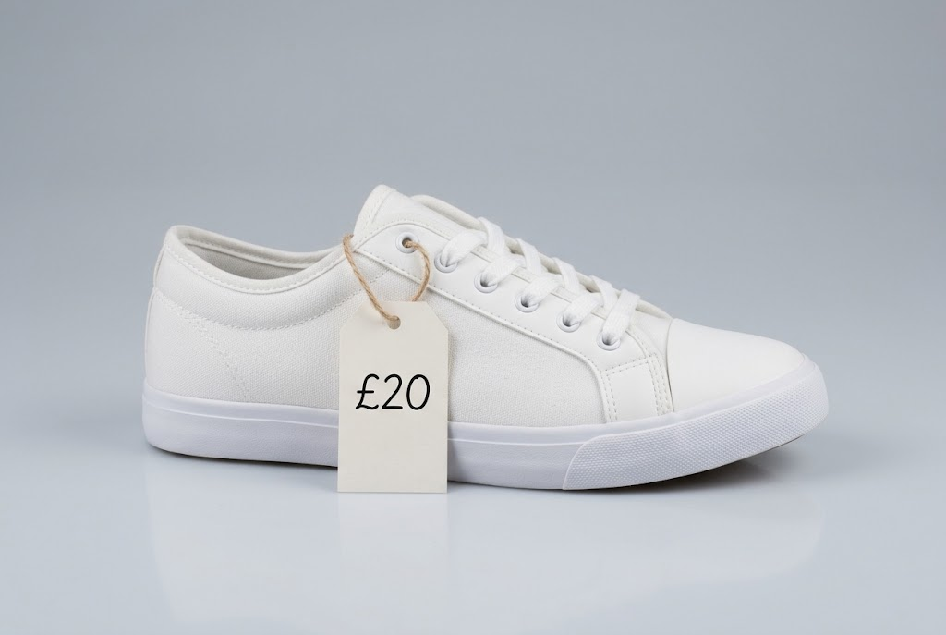
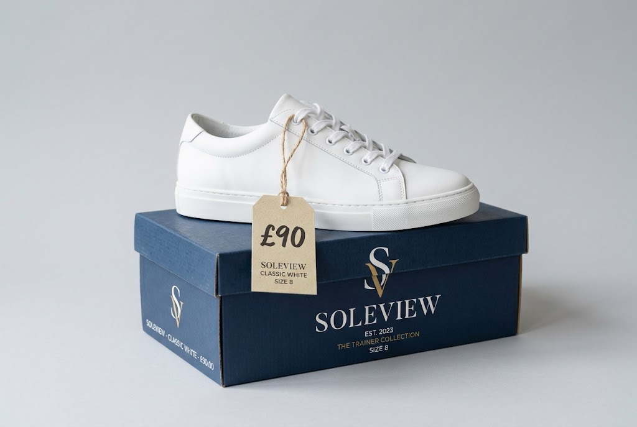
EDEXCEL GCSE BUSINESS · PAPER 1
Same Shoe, Different Value
What is a brand worth?
Unbranded: £20
Branded: £90
Enterprise and entrepreneurship
openrevise.com
Lesson 3 of 3

Slide 17

EDEXCEL GCSE BUSINESS · PAPER 1
Quality
Making a product that is better made, lasts longer or comes with better service.
What it is
Using better materials, making the product more reliable, or giving excellent customer service.
Why it adds value
Customers will pay more for something they believe will last longer or work better.
Example
Hand-made furniture, or a restaurant with fresh local ingredients, charges more than mass-produced alternatives.
Enterprise and entrepreneurship
openrevise.com
Lesson 3 of 3

Slide 18
EDEXCEL GCSE BUSINESS · PAPER 1
Design
Making a product that looks good and is easy to use.
What it is
How a product looks, how it works and how easy it is to use.
Why it adds value
An attractive, well-designed product stands out from its rivals and customers will pay more for it.
Example
Dyson products are designed to look different from other vacuum cleaners, and sell at a premium price.
Enterprise and entrepreneurship
openrevise.com
Lesson 3 of 3

Slide 19

EDEXCEL GCSE BUSINESS · PAPER 1
Unique Selling Point (USP)
The feature that makes a product different from every competitor's.
What it is
Something about a product or service that no competitor offers, which makes it stand out.
Why it adds value
If customers cannot buy it anywhere else, the business can charge a higher price and win customers from rivals.
Examples
Dyson's bagless vacuum when it was launched; a café that is the only one in town open 24 hours.
Protecting it
A USP is valuable only as long as it lasts: competitors will copy a successful one, so businesses must keep adding value.
Enterprise and entrepreneurship
openrevise.com
Lesson 3 of 3

Slide 20
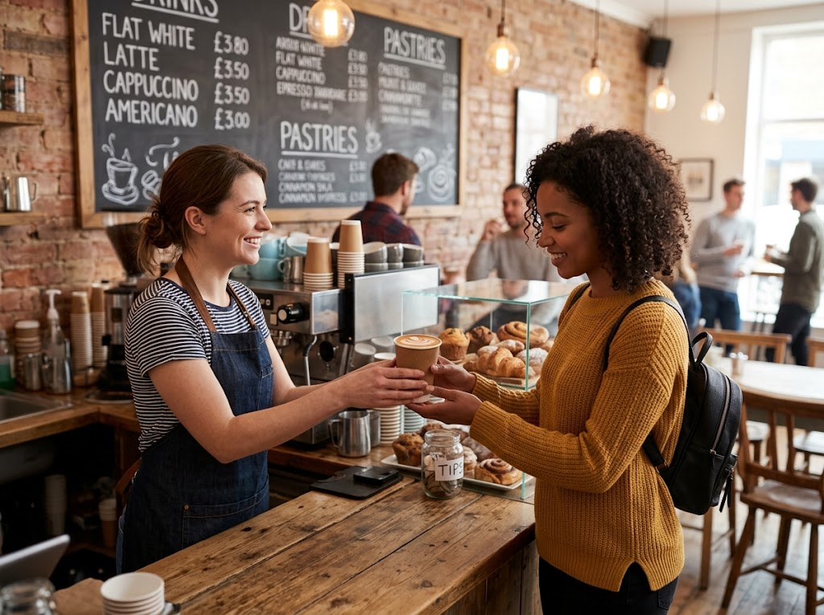
EDEXCEL GCSE BUSINESS · PAPER 1
Adding Value in Practice
ONE COFFEE, THREE WAYS OF ADDING VALUE
Convenience
A shop on the way to work, ready in two minutes.
Quality
Skilled baristas and better beans.
Branding
A name and cup customers recognise and trust.
A coffee shop adds value through convenience, quality and branding at once.
Enterprise and entrepreneurship
openrevise.com
Lesson 3 of 3

Slide 21

EDEXCEL GCSE BUSINESS · PAPER 1
CASE STUDY
Innocent Drinks: Adding Value to Fruit
Innocent was started in 1999 by three friends who tested their smoothies at a London music festival, asking customers to throw their empty bottles into a bin marked YES or NO to say whether they should give up their jobs. The YES bin won. Innocent adds value to fruit through branding (a friendly, jokey brand with chatty labels), quality (no added sugar or concentrates in its smoothies), design (simple, recognisable bottles) and convenience (a healthy drink ready to grab from a shop fridge). Coca-Cola began buying the business in 2009 and later took full control.
1999
2009
Innocent founded after testing smoothies at a festival
Coca-Cola begins buying the business
Enterprise and entrepreneurship
openrevise.com
Lesson 3 of 3

Slide 22
EDEXCEL GCSE BUSINESS · PAPER 1
Ways of Adding Value at a Glance
Way
What it means
Example
Convenience
Saving the customer time or effort
Food delivery apps
Branding
A recognised name, logo and image
Branded trainers
Quality
Better materials, reliability or service
Hand-made furniture
Design
Looks good and easy to use
Dyson vacuum cleaners
USP
Something no competitor offers
A 24-hour café in a small town
Enterprise and entrepreneurship
openrevise.com
Lesson 3 of 3

Slide 23

EDEXCEL GCSE BUSINESS · PAPER 1
Key Terms
Goods
Physical products that can be touched, such as a phone or a pair of trainers.
Services
Things done for a customer, such as a haircut or a taxi journey.
Added value
The difference between the selling price of a product and the cost of the bought-in materials used to make it.
Convenience
Making a product quicker or easier for customers to buy or use.
Brand
A name, symbol or design that makes a product recognisable and different from its competitors.
Quality
How well a product meets customers' needs: how well made and reliable it is.
Enterprise and entrepreneurship
openrevise.com
Lesson 3 of 3

Slide 24
EDEXCEL GCSE BUSINESS · PAPER 1
Key Terms (cont.)
Design
How a product looks, works and is used.
Unique selling point (USP)
A feature of a product or service that makes it different from all its competitors.
Enterprise and entrepreneurship
openrevise.com
Lesson 3 of 3

Slide 25

EDEXCEL GCSE BUSINESS · PAPER 1
YOUR TASK
10 minutes
Add Value to a Plain Bottle of Water
A plain 500ml bottle of water costs a business 10p to produce and sells for 50p. Using at least three of the five ways of adding value, explain how a new business could sell its bottled water for £1.50.
1
Name the way of adding value.
2
Say exactly what the business would change.
3
Explain why customers would pay more.
WHAT A GOOD ANSWER SHOWS
Three ways named, each with a specific change to the product and an explanation of why customers would pay more for it.
Enterprise and entrepreneurship
openrevise.com
Lesson 3 of 3

Slide 26
EDEXCEL GCSE BUSINESS · PAPER 1
Can I...?
Explain the purpose of business activity.
Explain how convenience adds value.
Describe the role of the entrepreneur.
Explain how branding adds value.
Define added value.
Explain how quality adds value.
Calculate added value.
Explain how design adds value.
Enterprise and entrepreneurship
openrevise.com
Lesson 3 of 3

Slide 27
EDEXCEL GCSE BUSINESS · PAPER 1
Can I...? (cont.)
Explain what a USP is and why it adds value.
Enterprise and entrepreneurship
openrevise.com
Lesson 3 of 3

Slide 28
EDEXCEL GCSE BUSINESS · PAPER 1
Summary & Exam Focus
Businesses exist to produce goods or services, meet customer needs and add value.
Entrepreneurs organise resources, make business decisions and take risks.
Added value = selling price - cost of bought-in materials.
Value is added through convenience, branding, quality, design and a USP.
EXAM FOCUS
Explain one way an entrepreneur could add value to a product. (3 marks)
Name one way only - an answer that lists several with no explanation earns 1 mark. Then explain how it makes customers willing to pay more, and link that to higher revenue or profit for the business.
openrevise.com

