Slide 1

EDEXCEL GCSE BUSINESS · PAPER 1
Customer needs
Spotting a business opportunity
Lesson 1 of 5
openrevise.com

Slide 2

EDEXCEL GCSE BUSINESS · PAPER 1
Last Chapter
Answer from memory before the answers appear.
Give the three reasons why new business ideas come about.
1
Name the three rewards of starting a business.
2
What is added value?
3
Name two ways a business can add value.
4
Spotting a business opportunity
openrevise.com
Lesson 1 of 5

Slide 3
EDEXCEL GCSE BUSINESS · PAPER 1
Last Chapter - Answers
Give the three reasons why new business ideas come about.
Changes in technology, changes in consumer wants, and products or services becoming obsolete.
1
Name the three rewards of starting a business.
Business success, profit and independence.
2
What is added value?
Selling price minus the cost of bought-in materials.
3
Name two ways a business can add value.
Any two of: convenience, branding, quality, design, a unique selling point.
4
Spotting a business opportunity
openrevise.com
Lesson 1 of 5

Slide 4

EDEXCEL GCSE BUSINESS · PAPER 1
Learning Objectives
Explain what is meant by customer needs.
1
Explain the four main customer needs: price, quality, choice and convenience.
2
Explain why identifying and understanding customer needs generates sales.
3
Explain why meeting customer needs is vital for a business's survival.
4
Spotting a business opportunity
openrevise.com
Lesson 1 of 5

Slide 5

EDEXCEL GCSE BUSINESS · PAPER 1
THE BIG IDEA
No customers, no business.
Every successful business starts by working out what its customers need - and then giving it to them better than anyone else.
Spotting a business opportunity
openrevise.com
Lesson 1 of 5

Slide 6

EDEXCEL GCSE BUSINESS · PAPER 1
What Are Customer Needs?
A customer need is what a customer requires from a product or service.
Customers
The people or businesses that buy a product. They are not always the same as consumers, who use it - a parent buying a child's toy is the customer; the child is the consumer.
Needs
What customers require before they will buy: a price they can pay, a quality they expect, a choice they like and a way of buying that suits them.
Different customers, different needs
A student, a family and a retired couple buying the same product may want very different things from it.
The business's job
Find out what customers need, then provide a product that meets those needs better than competitors do.
Spotting a business opportunity
openrevise.com
Lesson 1 of 5

Slide 7


EDEXCEL GCSE BUSINESS · PAPER 1
Every Shopper Wants Something Different
Walk down any high street and every shopper is looking for something slightly different. Some want the cheapest option, some want the best quality, some want lots to choose from and some just want whatever is quickest. A business has to know which of these customers it is serving - and what they need.
Every one of these shoppers has different needs.
Spotting a business opportunity
openrevise.com
Lesson 1 of 5

Slide 8

EDEXCEL GCSE BUSINESS · PAPER 1
PART ONE
The Four Customer Needs
What customers look for before they buy.
openrevise.com

Slide 9

EDEXCEL GCSE BUSINESS · PAPER 1
What Customers Need
Price
The amount customers are willing and able to pay. It must feel like good value for money.
Quality
How well the product is made and how well it works - it must meet or beat what the customer expects.
Choice
A range of products, sizes, colours or options, so customers can find exactly what suits them.
Convenience
How easy it is to buy and use the product: location, opening hours, delivery and ordering online.
Spotting a business opportunity
openrevise.com
Lesson 1 of 5

Slide 10

EDEXCEL GCSE BUSINESS · PAPER 1
Price
Customers want a price that they think is fair for what they get.
Value for money
Customers compare the price with the benefits they get. A higher price is acceptable if the quality or convenience is higher too.
What they can afford
Customers on low incomes may choose the cheapest option; others will pay more for quality or a brand.
Competition
Customers can easily compare prices, especially online, so a business charging more than rivals must give a reason to pay it.
Example
Discount supermarkets such as Aldi and Lidl have grown quickly by meeting customers' need for low prices.
Spotting a business opportunity
openrevise.com
Lesson 1 of 5

Slide 11

EDEXCEL GCSE BUSINESS · PAPER 1
Quality
Customers want a product that does what it should and lasts.
What it means
A product is good quality if it meets customers' expectations - not necessarily the most luxurious version.
Reliability
Customers want products that work and do not break, and services that are delivered properly every time.
Reputation
A reputation for quality brings customers back and encourages them to recommend the business.
Example
Customers expect a £5 umbrella to keep them dry; they expect a £50 umbrella to last for years.
Spotting a business opportunity
openrevise.com
Lesson 1 of 5

Slide 12
EDEXCEL GCSE BUSINESS · PAPER 1
Choice
Customers like to be able to choose.
Range
Different sizes, flavours, colours or versions of the product.
Personal taste
Choice lets each customer find something that suits them exactly.
Too much choice
Too many options can confuse customers and increase a business's costs of holding stock.
Example
A coffee shop offers different sizes, milks, syrups and decaffeinated options to suit every customer.
Spotting a business opportunity
openrevise.com
Lesson 1 of 5

Slide 13

EDEXCEL GCSE BUSINESS · PAPER 1
Convenience
Customers want buying and using a product to be quick and easy.
Location
Shops close to home, work or school, or on the way to them.
Opening hours
Being open when customers want to shop - early, late or at weekends.
Online and delivery
Ordering on a website or app, next-day delivery and click-and-collect.
Example
Convenience stores charge higher prices than large supermarkets, but customers pay because the shop is nearby and open late.
Spotting a business opportunity
openrevise.com
Lesson 1 of 5

Slide 14
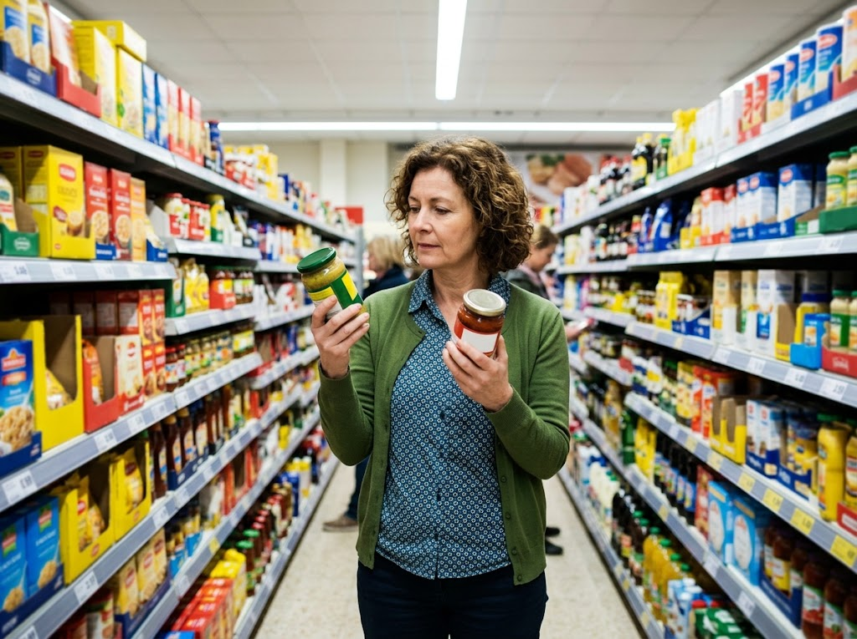
EDEXCEL GCSE BUSINESS · PAPER 1
Weighing Up the Choice
WHAT THE SHOPPER IS THINKING
Price
Which one is better value?
Quality
Which one will taste or work better?
Choice
Is there something else on the shelf that suits me more?
Price, quality and choice, weighed up in a few seconds.
Spotting a business opportunity
openrevise.com
Lesson 1 of 5

Slide 15
EDEXCEL GCSE BUSINESS · PAPER 1
PART TWO
Why Customer Needs Matter
Understanding customers is not optional - it decides whether a business sells anything at all.
openrevise.com

Slide 16

EDEXCEL GCSE BUSINESS · PAPER 1
From Understanding to Survival
Each step depends on the one before it.
1
2
3
4
Identify customer needs
Find out what customers want, usually through market research.
Provide a product that meets them
Get the price, quality, choice and convenience right.
Generate sales
Customers buy the product, and come back to buy again.
Business survival
Enough sales mean enough revenue to cover costs and make a profit, so the business survives.
Spotting a business opportunity
openrevise.com
Lesson 1 of 5

Slide 17

EDEXCEL GCSE BUSINESS · PAPER 1
Meeting Needs, or Missing Them
A BUSINESS THAT MEETS CUSTOMER NEEDS
A BUSINESS THAT MISSES THEM
• Customers buy the product, so sales rise.
• Customers come back and become loyal.
• Happy customers recommend it to others.
• It can often charge a higher price.
• It is more likely to survive and grow.
• Customers buy from competitors instead.
• Sales fall and stock is left unsold.
• Unhappy customers post bad reviews.
• It may have to cut prices to sell anything.
• It is more likely to fail.
Spotting a business opportunity
openrevise.com
Lesson 1 of 5

Slide 18

EDEXCEL GCSE BUSINESS · PAPER 1
CASE STUDY
Greggs: Meeting Customer Needs
Greggs, the bakery chain, meets several customer needs at once. Its prices are low compared with coffee shops and sandwich chains, its shops are on high streets, at stations and in retail parks for convenience, and it offers choice from breakfast rolls to sausage rolls to salads. In January 2019 it responded to a change in what its customers wanted by launching a vegan sausage roll, which became one of its best-selling products. By listening to its customers, Greggs has grown to more than 2,000 shops across the UK.
2019
2,000+
The vegan sausage roll launched
Greggs shops across the UK
Spotting a business opportunity
openrevise.com
Lesson 1 of 5

Slide 19

EDEXCEL GCSE BUSINESS · PAPER 1
Key Terms
Customer
A person or business that buys a product.
Consumer
The person who uses a product. They may not be the customer who bought it.
Customer needs
What customers require from a product: the right price, quality, choice and convenience.
Value for money
When customers feel the benefits of a product are worth the price they pay.
Convenience
How quick and easy it is for customers to buy and use a product.
Customer loyalty
When customers keep buying from the same business rather than switching to competitors.
Spotting a business opportunity
openrevise.com
Lesson 1 of 5

Slide 20

EDEXCEL GCSE BUSINESS · PAPER 1
YOUR TASK
10 minutes
Needs Detective
Pick three businesses you have bought from this month - for example a supermarket, a takeaway and an online shop. For each one, decide which customer need it meets best (price, quality, choice or convenience) and explain how.
1
Name the business.
2
Name the customer need it meets best.
3
Give one piece of evidence to back it up.
WHAT A GOOD ANSWER SHOWS
Three businesses, each linked to one customer need with a specific piece of evidence, such as opening hours, a price or the size of the range.
Spotting a business opportunity
openrevise.com
Lesson 1 of 5
Notes:
Push for evidence, not assertion: "it's cheap" is not enough - "a meal deal is £3.50 compared with £6 elsewhere" is.

Slide 21

EDEXCEL GCSE BUSINESS · PAPER 1
Can I...?
Explain what customer needs are.
Explain how price, quality, choice and convenience are customer needs.
Explain why meeting customer needs generates sales.
Explain why meeting customer needs helps a business survive.
Use a real business as an example.
Spotting a business opportunity
openrevise.com
Lesson 1 of 5

Slide 22
EDEXCEL GCSE BUSINESS · PAPER 1
Summary & Exam Focus
Customers need the right price, quality, choice and convenience.
Different customers have different needs.
Meeting customer needs generates sales and customer loyalty.
A business that does not meet customer needs is unlikely to survive.
EXAM FOCUS
Explain one reason why it is important for a business to identify customer needs. (3 marks)
Explain questions are worth 3 marks: 1 for the reason, then 2 for linked steps of explanation. Take the chain all the way to sales, revenue or survival.
openrevise.com

Slide 23
EDEXCEL GCSE BUSINESS · PAPER 1
Exam Practice: Customer Needs
Answer all questions. Use the context of the business in the question where one is given. · 20 minutes
Question 1 · 1 mark · State
State one customer need.
Question 2 · 1 mark · Define
Define the term 'customer needs'.
Question 3 · 2 marks · Outline
Outline one way a business could meet customers' need for convenience.
Spotting a business opportunity
openrevise.com
Lesson 1 of 5

Slide 24
EDEXCEL GCSE BUSINESS · PAPER 1
Exam Practice: Customer Needs (cont.)
Question 4 · 3 marks · Explain
Explain one reason why it is important for a business to identify customer needs.
Question 5 · 6 marks · Analyse
Analyse the importance to Maya of meeting her customers' need for convenience.
Spotting a business opportunity
openrevise.com
Lesson 1 of 5

Slide 25
EDEXCEL GCSE BUSINESS · PAPER 1
Question 1 · 1 mark · State
“
State one customer need.
HOW TO ANSWER IT
Command word: State. Worth 1 mark, so plan before writing.
Spotting a business opportunity
openrevise.com
Lesson 1 of 5

Slide 26
EDEXCEL GCSE BUSINESS · PAPER 1
Question 1 · mark scheme
1 mark available. Award a mark for each point made.
Any one of: price; quality; choice; convenience
1 mark
Spotting a business opportunity
openrevise.com
Lesson 1 of 5

Slide 27
EDEXCEL GCSE BUSINESS · PAPER 1
Question 2 · 1 mark · Define
“
Define the term 'customer needs'.
HOW TO ANSWER IT
Command word: Define. Worth 1 mark, so plan before writing.
Spotting a business opportunity
openrevise.com
Lesson 1 of 5

Slide 28
EDEXCEL GCSE BUSINESS · PAPER 1
Question 2 · mark scheme
1 mark available. Award a mark for each point made.
What customers want or require from a product / service
1 mark
Spotting a business opportunity
openrevise.com
Lesson 1 of 5

Slide 29
EDEXCEL GCSE BUSINESS · PAPER 1
Question 3 · 2 marks · Outline
“
Outline one way a business could meet customers' need for convenience.
HOW TO ANSWER IT
Command word: Outline. Worth 2 marks, so plan before writing.
Spotting a business opportunity
openrevise.com
Lesson 1 of 5

Slide 30
EDEXCEL GCSE BUSINESS · PAPER 1
Question 3 · mark scheme
2 marks available. Award a mark for each point made.
A way identified, e.g. location / opening hours / online ordering / delivery
1 mark
Developed: how this makes buying easier for customers
1 mark
Spotting a business opportunity
openrevise.com
Lesson 1 of 5

Slide 31
EDEXCEL GCSE BUSINESS · PAPER 1
Question 4 · 3 marks · Explain
“
Explain one reason why it is important for a business to identify customer needs.
HOW TO ANSWER IT
Command word: Explain. Worth 3 marks, so plan before writing.
Spotting a business opportunity
openrevise.com
Lesson 1 of 5

Slide 32
EDEXCEL GCSE BUSINESS · PAPER 1
Question 4 · mark scheme
3 marks available. Award a mark for each point made.
A reason identified, e.g. generate sales / survival / customer loyalty / beat competitors
1 mark
First linked point of explanation
1 mark
Second linked point of explanation
1 mark
Spotting a business opportunity
openrevise.com
Lesson 1 of 5

Slide 33
EDEXCEL GCSE BUSINESS · PAPER 1
Question 5 · 6 marks · Analyse
“
Analyse the importance to Maya of meeting her customers' need for convenience.
— Maya runs a small sandwich shop near a busy train station. Most of her customers are commuters buying breakfast and lunch on their way to work. A new supermarket has opened next…
HOW TO ANSWER IT
Command word: Analyse. Worth 6 marks, so plan before writing.
Spotting a business opportunity
openrevise.com
Lesson 1 of 5

Slide 34
EDEXCEL GCSE BUSINESS · PAPER 1
Question 5 · mark scheme
6 marks available. Award a mark for each point made.
AO2 (Application, 3 marks): uses the context - commuters, the station, the supermarket's lower prices
Level 1-3
AO3a (Analysis, 3 marks): chains of reasoning showing why convenience matters to Maya's sales and survival
Level 1-3
Spotting a business opportunity
openrevise.com
Lesson 1 of 5

