Slide 1

EDEXCEL GCSE BUSINESS · PAPER 1
Market research
Spotting a business opportunity
Lesson 2 of 5
openrevise.com

Slide 2

EDEXCEL GCSE BUSINESS · PAPER 1
Last Lesson
Answer from memory before the answers appear.
Name the four customer needs.
1
What is the difference between a customer and a consumer?
2
Why does meeting customer needs help a business survive?
3
How might a business find out what customers need?
4
Spotting a business opportunity
openrevise.com
Lesson 2 of 5

Slide 3
EDEXCEL GCSE BUSINESS · PAPER 1
Last Lesson - Answers
Name the four customer needs.
Price, quality, choice and convenience.
1
What is the difference between a customer and a consumer?
The customer buys the product; the consumer uses it.
2
Why does meeting customer needs help a business survive?
It generates sales and revenue to cover costs.
3
How might a business find out what customers need?
By asking them - market research.
4
Spotting a business opportunity
openrevise.com
Lesson 2 of 5

Slide 4

EDEXCEL GCSE BUSINESS · PAPER 1
Learning Objectives
1
Explain the purpose of market research.
2
Compare primary and secondary market research and their methods.
3
Explain the difference between qualitative and quantitative data.
4
Explain the role of social media in collecting market research.
5
Explain how sample size and bias affect the reliability of market research.
Spotting a business opportunity
openrevise.com
Lesson 2 of 5

Slide 5
EDEXCEL GCSE BUSINESS · PAPER 1
What Is Market Research?
Market research is the process of collecting information about customers, competitors and the market.
To identify and understand customer needs
Find out what customers want, how much they will pay and where they want to buy.
To identify gaps in the market
Spot needs that no business is currently meeting.
To reduce risk
Check that there is demand before spending money on a new product, so the business is less likely to fail.
To inform decisions
Help the business decide on price, product, location and promotion using evidence instead of guesswork.
Spotting a business opportunity
openrevise.com
Lesson 2 of 5

Slide 6

EDEXCEL GCSE BUSINESS · PAPER 1
PART ONE
Primary and Secondary Research
Collecting new information, or using information that already exists.
openrevise.com

Slide 7

EDEXCEL GCSE BUSINESS · PAPER 1
Primary or Secondary?
PRIMARY RESEARCH
SECONDARY RESEARCH
• New information collected first-hand by the business itself.
• Also called field research.
• Specific to the business's own questions.
• Up to date, and competitors do not have it.
• Expensive and time-consuming to collect.
• Information that already exists, collected by someone else.
• Also called desk research.
• Quick and cheap, often free.
• May be out of date or not quite what the business needs.
• Competitors can see it too.
Spotting a business opportunity
openrevise.com
Lesson 2 of 5

Slide 8

EDEXCEL GCSE BUSINESS · PAPER 1
Methods of Primary Research
Survey and questionnaire
A set of questions answered by customers, in person, by phone, by post or online. Can reach lots of people cheaply.
Focus group
A small group of customers discuss a product in depth, led by a researcher. Gives detailed opinions, but only from a few people.
Observation
Watching how customers behave - for example counting how many people walk past a shop at lunchtime.
Interviews and product testing
Asking customers one to one, or letting them try a product and give feedback.
Spotting a business opportunity
openrevise.com
Lesson 2 of 5

Slide 9

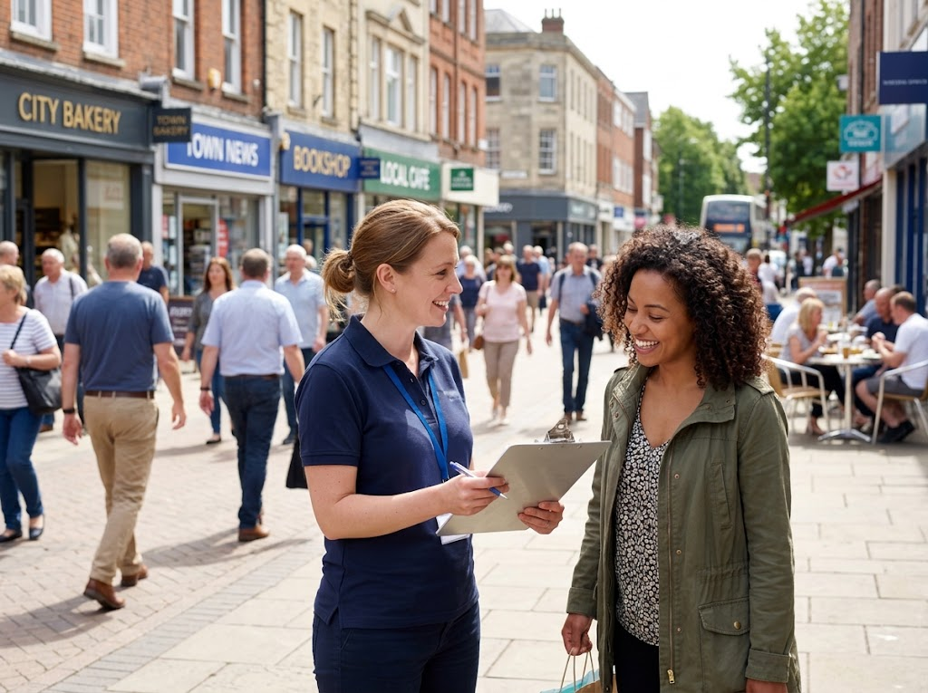
EDEXCEL GCSE BUSINESS · PAPER 1
Asking the Customers
A street survey is one of the simplest kinds of primary research. The business writes its own questions, so every answer is about exactly what it needs to know - but it takes time to collect enough answers to rely on.
A street survey: primary research, collected first-hand.
Spotting a business opportunity
openrevise.com
Lesson 2 of 5

Slide 10
EDEXCEL GCSE BUSINESS · PAPER 1
Methods of Secondary Research
The internet
Competitors' websites, prices and customer reviews, and news articles about the market.
Market reports
Detailed reports on a market written by specialist research companies. Useful, but often expensive to buy.
Government publications
Free statistics, for example from the Office for National Statistics and the census, about population, incomes and spending.
Newspapers and trade magazines
Articles about trends, new products and changes in an industry.
Spotting a business opportunity
openrevise.com
Lesson 2 of 5

Slide 11
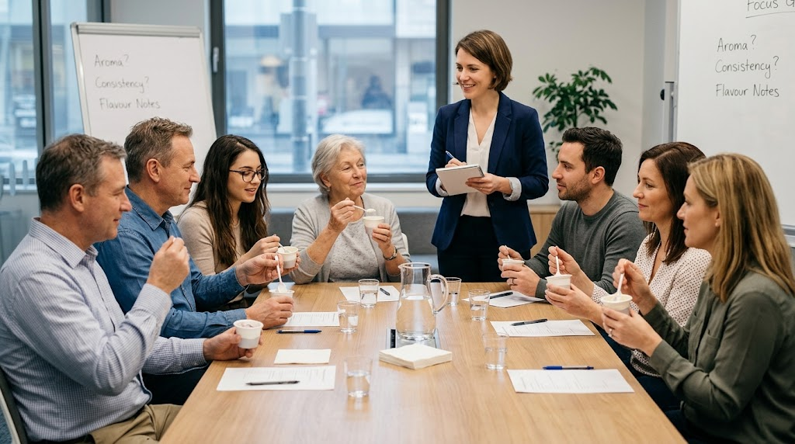
EDEXCEL GCSE BUSINESS · PAPER 1
Digging Deeper
FOCUS GROUPS
Strength
Detailed opinions and reasons, not just ticks in boxes.
Weakness
A small group may not represent all customers.
Weakness
One loud person can sway the rest of the group.
A focus group gives detailed opinions - but only from a handful of people.
Spotting a business opportunity
openrevise.com
Lesson 2 of 5

Slide 12
EDEXCEL GCSE BUSINESS · PAPER 1
PART TWO
Qualitative and Quantitative Data
Numbers, or opinions?
openrevise.com

Slide 13
EDEXCEL GCSE BUSINESS · PAPER 1
Quantitative or Qualitative?
QUANTITATIVE DATA
QUALITATIVE DATA
• Numerical data that can be counted and measured.
• Comes from closed questions, e.g. "How many times a week do you buy coffee?"
• Easy to put into graphs, charts and percentages.
• Easy to compare and analyse.
• Does not explain why customers think or behave as they do.
• Opinions, feelings and reasons, in words.
• Comes from open questions and focus groups, e.g. "What do you like about our coffee?"
• Explains why customers behave as they do.
• Gives detail and new ideas.
• Hard to analyse and compare, and can be interpreted differently.
Spotting a business opportunity
openrevise.com
Lesson 2 of 5

Slide 14

EDEXCEL GCSE BUSINESS · PAPER 1
The Role of Social Media
Social media gives even the smallest business a cheap way to research its market.
Quick polls
Businesses can run polls and questions on Instagram, TikTok or Facebook and get answers within hours.
Comments and reviews
Customers say what they think in comments, messages and reviews, which the business can read for free.
Following trends
Businesses can see what customers are talking about and what competitors are doing.
Limitation
Only followers reply, so the answers may not represent all customers, and some comments are not honest.
Spotting a business opportunity
openrevise.com
Lesson 2 of 5

Slide 15
EDEXCEL GCSE BUSINESS · PAPER 1
PART THREE
Can You Trust the Results?
Research is only useful if it is reliable.
openrevise.com

Slide 16

EDEXCEL GCSE BUSINESS · PAPER 1
Reliability, Sample Size and Bias
Reliable research gives results the business can trust to make decisions.
Sample
The group of people who take part in the research, chosen to represent the whole market.
Sample size
The bigger the sample, the more reliable the results usually are - asking 10 people tells you far less than asking 500. But larger samples cost more time and money.
Bias
Research is biased when the results are pushed in one direction - for example asking only friends and family, or asking a leading question such as "Don't you agree our cakes are delicious?"
Spotting a business opportunity
openrevise.com
Lesson 2 of 5

Slide 17
EDEXCEL GCSE BUSINESS · PAPER 1
Reliability, Sample Size and Bias (cont.)
Representative
The sample should reflect the business's real customers in age, gender, location and income. An online survey only reaches people who choose to answer.
Out of date
Secondary data may no longer be true, especially in a fast-changing market.
Spotting a business opportunity
openrevise.com
Lesson 2 of 5

Slide 18

EDEXCEL GCSE BUSINESS · PAPER 1
Working Out a Percentage from a Survey
Edexcel "Calculate" questions often use survey results. Show your working.
A café asked 250 customers whether they would buy a new vegan breakfast. 90 said yes. What percentage of customers said yes?
Write the formula
Percentage = (number who said yes ÷ total asked) × 100
1
Put in the numbers
= (90 ÷ 250) × 100
2
Work it out
= 0.36 × 100 = 36%
3
ANSWER
36% of customers said yes.
Spotting a business opportunity
openrevise.com
Lesson 2 of 5

Slide 19

EDEXCEL GCSE BUSINESS · PAPER 1
CASE STUDY
Tesco Clubcard: Research Every Time You Shop
Tesco launched its Clubcard loyalty scheme in 1995. Every time a customer scans the card, Tesco records what they buy, when and where. This gives Tesco a huge amount of quantitative data about its customers' needs, which it uses to decide what to stock in each store, which offers to send each customer and which new products to develop. Customers get points and lower Clubcard prices in return - and Tesco gets market research on millions of shoppers without having to ask a single question.
1995
Millions
Clubcard launched
Of shoppers' purchases recorded
Spotting a business opportunity
openrevise.com
Lesson 2 of 5

Slide 20

EDEXCEL GCSE BUSINESS · PAPER 1
Key Terms
Market research
Collecting information about customers, competitors and the market to help make business decisions.
Primary research
New information collected first-hand by the business. Also called field research.
Secondary research
Information that already exists, collected by someone else. Also called desk research.
Quantitative data
Numerical data that can be counted and measured.
Qualitative data
Data about opinions, feelings and reasons.
Focus group
A small group of customers who discuss a product in depth.
Spotting a business opportunity
openrevise.com
Lesson 2 of 5

Slide 21
EDEXCEL GCSE BUSINESS · PAPER 1
Key Terms (cont.)
Sample
The group of people chosen to take part in market research.
Bias
When research results are distorted, so they do not give a true picture of the market.
Reliability
How far the results of market research can be trusted.
Spotting a business opportunity
openrevise.com
Lesson 2 of 5

Slide 22

EDEXCEL GCSE BUSINESS · PAPER 1
YOUR TASK
15 minutes
Design a Survey
A new juice bar wants to open near your school. Write five questions for a survey of students. Include at least three closed questions (for quantitative data) and one open question (for qualitative data). Then explain how you would choose your sample to avoid bias.
1
Write three closed questions.
2
Write at least one open question.
3
Check none of them is a leading question.
Explain who you would ask, and how many.
4
WHAT A GOOD ANSWER SHOWS
Five clear, non-leading questions labelled closed or open, and a sampling plan that explains its size and why it represents the juice bar's customers.
Spotting a business opportunity
openrevise.com
Lesson 2 of 5
Notes:
Watch for leading questions - "Wouldn't you love a juice bar?" - and samples of only their friends. Both are bias.

Slide 23

EDEXCEL GCSE BUSINESS · PAPER 1
Can I...?
Explain the purpose of market research.
Explain qualitative and quantitative data.
Give methods of primary research.
Explain the role of social media.
Give methods of secondary research.
Explain how sample size affects reliability.
Compare primary and secondary research.
Explain what bias is and how to avoid it.
Spotting a business opportunity
openrevise.com
Lesson 2 of 5

Slide 24
EDEXCEL GCSE BUSINESS · PAPER 1
Can I...? (cont.)
Calculate a percentage from survey results.
Spotting a business opportunity
openrevise.com
Lesson 2 of 5

Slide 25
EDEXCEL GCSE BUSINESS · PAPER 1
Summary & Exam Focus
Market research finds out about customers, competitors and the market, to reduce risk.
Primary research is new and specific but costly; secondary research is cheap but may be out of date.
Quantitative data is numerical; qualitative data is opinions and reasons.
Social media is a cheap way to research, but may not be representative.
A large, unbiased sample makes research more reliable.
EXAM FOCUS
Explain one disadvantage to a business of using primary market research. (3 marks)
Name one disadvantage, then link two steps of explanation. Always finish by saying what it means for the business - its costs, its decisions or its risk.
openrevise.com

Slide 26
EDEXCEL GCSE BUSINESS · PAPER 1
Exam Practice: Market Research
Answer all questions. Show your working in calculations. · 25 minutes
Question 1 · 1 mark · Define
Define the term 'secondary market research'.
Question 2 · 1 mark · State
State one method of primary market research.
Question 3 · 2 marks · Calculate
A gym surveyed 400 people. 120 said they would join if the gym opened 24 hours a day. Calculate the percentage of people who said they…
Spotting a business opportunity
openrevise.com
Lesson 2 of 5

Slide 27
EDEXCEL GCSE BUSINESS · PAPER 1
Exam Practice: Market Research (cont.)
Question 4 · 2 marks · Outline
Outline one benefit to a business of using social media for market research.
Question 5 · 3 marks · Explain
Explain one disadvantage to a business of using primary market research.
Question 6 · 3 marks · Explain
Explain one reason why the size of a sample affects the reliability of market research.
Spotting a business opportunity
openrevise.com
Lesson 2 of 5

Slide 28
EDEXCEL GCSE BUSINESS · PAPER 1
Question 1 · 1 mark · Define
“
Define the term 'secondary market research'.
HOW TO ANSWER IT
Command word: Define. Worth 1 mark, so plan before writing.
Spotting a business opportunity
openrevise.com
Lesson 2 of 5

Slide 29
EDEXCEL GCSE BUSINESS · PAPER 1
Question 1 · mark scheme
1 mark available. Award a mark for each point made.
Using existing data / data collected by others
1 mark
Spotting a business opportunity
openrevise.com
Lesson 2 of 5

Slide 30
EDEXCEL GCSE BUSINESS · PAPER 1
Question 2 · 1 mark · State
“
State one method of primary market research.
HOW TO ANSWER IT
Command word: State. Worth 1 mark, so plan before writing.
Spotting a business opportunity
openrevise.com
Lesson 2 of 5

Slide 31
EDEXCEL GCSE BUSINESS · PAPER 1
Question 2 · mark scheme
1 mark available. Award a mark for each point made.
Any one of: survey / questionnaire; focus group; observation; interview; product testing
1 mark
Spotting a business opportunity
openrevise.com
Lesson 2 of 5

Slide 32
EDEXCEL GCSE BUSINESS · PAPER 1
Question 3 · 2 marks · Calculate
“
A gym surveyed 400 people. 120 said they would join if the gym opened 24 hours a day. Calculate the percentage of people who said they would join. You are advised to show your working.
HOW TO ANSWER IT
Command word: Calculate. Worth 2 marks, so plan before writing.
Spotting a business opportunity
openrevise.com
Lesson 2 of 5

Slide 33
EDEXCEL GCSE BUSINESS · PAPER 1
Question 3 · mark scheme
2 marks available. Award a mark for each point made.
Correct method: (120 ÷ 400) × 100
1 mark
Correct answer: 30%
1 mark (award 2 marks for the correct answer with no working)
Spotting a business opportunity
openrevise.com
Lesson 2 of 5

Slide 34
EDEXCEL GCSE BUSINESS · PAPER 1
Question 4 · 2 marks · Outline
“
Outline one benefit to a business of using social media for market research.
HOW TO ANSWER IT
Command word: Outline. Worth 2 marks, so plan before writing.
Spotting a business opportunity
openrevise.com
Lesson 2 of 5

Slide 35
EDEXCEL GCSE BUSINESS · PAPER 1
Question 4 · mark scheme
2 marks available. Award a mark for each point made.
A benefit identified, e.g. cheap / quick / reaches many customers / real-time feedback
1 mark
Developed: why this helps the business
1 mark
Spotting a business opportunity
openrevise.com
Lesson 2 of 5

Slide 36
EDEXCEL GCSE BUSINESS · PAPER 1
Question 5 · 3 marks · Explain
“
Explain one disadvantage to a business of using primary market research.
HOW TO ANSWER IT
Command word: Explain. Worth 3 marks, so plan before writing.
Spotting a business opportunity
openrevise.com
Lesson 2 of 5

Slide 37
EDEXCEL GCSE BUSINESS · PAPER 1
Question 5 · mark scheme
3 marks available. Award a mark for each point made.
A disadvantage identified, e.g. expensive / time-consuming / risk of bias with a small sample
1 mark
First linked point of explanation
1 mark
Second linked point of explanation
1 mark
Spotting a business opportunity
openrevise.com
Lesson 2 of 5

Slide 38
EDEXCEL GCSE BUSINESS · PAPER 1
Question 6 · 3 marks · Explain
“
Explain one reason why the size of a sample affects the reliability of market research.
HOW TO ANSWER IT
Command word: Explain. Worth 3 marks, so plan before writing.
Spotting a business opportunity
openrevise.com
Lesson 2 of 5

Slide 39
EDEXCEL GCSE BUSINESS · PAPER 1
Question 6 · mark scheme
3 marks available. Award a mark for each point made.
A reason identified, e.g. small samples are less representative
1 mark
First linked point of explanation
1 mark
Second linked point of explanation
1 mark
Spotting a business opportunity
openrevise.com
Lesson 2 of 5

