Slide 1

EDEXCEL GCSE BUSINESS · PAPER 1
Market mapping
Spotting a business opportunity
Lesson 4 of 5
openrevise.com

Slide 2

EDEXCEL GCSE BUSINESS · PAPER 1
Last Lesson
Answer from memory before the answers appear.
What is market segmentation?
1
Name the five ways to segment a market.
2
What is a target market?
3
Give one benefit of segmentation.
4
Spotting a business opportunity
openrevise.com
Lesson 4 of 5

Slide 3
EDEXCEL GCSE BUSINESS · PAPER 1
Last Lesson - Answers
What is market segmentation?
Dividing a market into groups of customers with similar needs.
1
Name the five ways to segment a market.
Location, demographics, lifestyle, income and age.
2
What is a target market?
The segment a business aims its product and marketing at.
3
Give one benefit of segmentation.
Better meets needs, targeted marketing, spots gaps, or higher sales.
4
Spotting a business opportunity
openrevise.com
Lesson 4 of 5

Slide 4

EDEXCEL GCSE BUSINESS · PAPER 1
Learning Objectives
Explain what a market map is.
1
Construct and interpret a market map.
2
Explain how a market map can identify a gap in the market and the competition.
3
Evaluate the benefits and limitations of market mapping.
4
Spotting a business opportunity
openrevise.com
Lesson 4 of 5

Slide 5

EDEXCEL GCSE BUSINESS · PAPER 1
What Is a Market Map?
A market map is a diagram that shows where the products or businesses in a market are positioned.
Two axes
The map has two lines crossing in the middle, each showing a feature customers care about - for example low to high price, and low to high quality.
Plotting competitors
Each business or product is placed on the map according to how customers see it on both features.
Four areas
The axes split the map into four areas, such as high price and high quality, or low price and low quality.
The purpose
To see where competitors are crowded together, and where there is space that nobody is filling.
Spotting a business opportunity
openrevise.com
Lesson 4 of 5

Slide 6

EDEXCEL GCSE BUSINESS · PAPER 1
How to Draw a Market Map
Five steps, from a blank page to a possible opportunity.
1
2
3
4
5
Choose two features
Pick two things customers care about, such as price and quality, or healthy and unhealthy.
Draw the axes
Draw two lines crossing in the middle and label each end, such as Low price and High price.
Research competitors
Use market research to find out how customers see each business on both features.
Plot each business
Place each competitor on the map where it belongs.
Look for gaps
Find areas of the map with few or no businesses in them.
Spotting a business opportunity
openrevise.com
Lesson 4 of 5

Slide 7

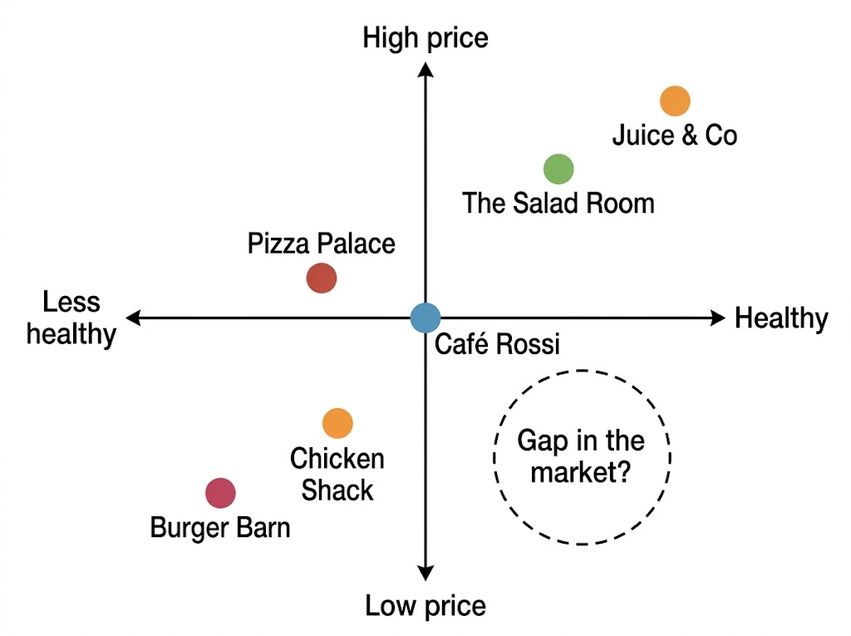
EDEXCEL GCSE BUSINESS · PAPER 1
A Market Map in Action
This market map shows six places to buy lunch in a town centre. The cheap places are all unhealthy, and the healthy places are all expensive. Nobody is selling healthy food at a low price - so there may be a gap in the market for a new business.
Six lunch places plotted on price and healthiness. The low price, healthy corner is empty.
Spotting a business opportunity
openrevise.com
Lesson 4 of 5

Slide 8
EDEXCEL GCSE BUSINESS · PAPER 1
Reading the Map
What the lunch map tells an entrepreneur.
Crowded areas
Two businesses sit in the low price, less healthy corner, so competition there is strong - a new business there would have to fight for customers.
The gap
The low price, healthy corner is empty. No business is meeting the needs of customers who want healthy food they can afford.
Nearest competitors
The Salad Room and Juice & Co are the closest to the gap, so they are the rivals a new business would need to beat.
The next step
Before opening, the entrepreneur must research whether enough customers actually want cheap healthy food - and whether it can be made cheaply enough to make a profit.
Spotting a business opportunity
openrevise.com
Lesson 4 of 5

Slide 9

EDEXCEL GCSE BUSINESS · PAPER 1
PART TWO
Benefits and Limitations
A market map is a starting point, not an answer.
openrevise.com

Slide 10

EDEXCEL GCSE BUSINESS · PAPER 1
Market Mapping: For and Against
BENEFITS
LIMITATIONS
• Shows gaps in the market that a new business could fill.
• Shows where competitors are and how crowded each area is.
• Helps a business decide how to position its product.
• Simple, quick and cheap to draw.
• Easy for owners and investors to understand.
• A gap may exist because there is no demand for it.
• Only two features can be shown at once.
• Where competitors sit is often based on opinion, not fact.
• Markets change, so the map soon goes out of date.
• It does not show how big each competitor is.
Spotting a business opportunity
openrevise.com
Lesson 4 of 5

Slide 11

EDEXCEL GCSE BUSINESS · PAPER 1
Is Every Gap an Opportunity?
Not always. Before filling a gap, a business must ask why it is empty.
No demand
Nobody may want a product in that part of the map - for example very expensive, very low-quality food.
Too costly
It may be impossible to make the product cheaply enough to sell at that price and still make a profit.
Others have tried
Businesses may have filled the gap before and failed.
The test
Use market research to check there are enough customers who want the product before spending money.
Spotting a business opportunity
openrevise.com
Lesson 4 of 5

Slide 12

EDEXCEL GCSE BUSINESS · PAPER 1
Key Terms
Market map
A diagram that plots the businesses or products in a market against two features, such as price and quality.
Axis
One of the two lines on a market map, each showing a feature from low to high.
Gap in the market
An area of a market where customers' needs are not being met by any business.
Positioning
Where a business places its product in the market compared with competitors.
Competitor
Another business selling similar products to the same customers.
Spotting a business opportunity
openrevise.com
Lesson 4 of 5

Slide 13

EDEXCEL GCSE BUSINESS · PAPER 1
YOUR TASK
15 minutes
Map Your Own Market
Draw a market map for places to buy coffee or snacks in your local area. Choose two features customers care about, draw and label the axes, then plot at least five businesses. Circle any gap you find and write two sentences on whether it is a real opportunity.
1
Choose two features and label both ends of each axis.
2
Plot at least five businesses.
3
Circle a gap.
Decide whether it is a real opportunity, and explain why.
4
WHAT A GOOD ANSWER SHOWS
A correctly labelled map with at least five businesses plotted, a gap identified, and a judgement about whether customers would actually want it.
Spotting a business opportunity
openrevise.com
Lesson 4 of 5
Notes:
The judgement is the evaluation marks: push them to say why the gap might be empty, not just that it exists.

Slide 14

EDEXCEL GCSE BUSINESS · PAPER 1
Can I...?
Explain what a market map is.
Draw and label a market map.
Use a market map to identify a gap in the market.
Use a market map to identify competitors.
Explain the benefits of market mapping.
Explain the limitations of market mapping.
Spotting a business opportunity
openrevise.com
Lesson 4 of 5

Slide 15
EDEXCEL GCSE BUSINESS · PAPER 1
Summary & Exam Focus
A market map plots competitors against two features customers care about.
It shows where competition is crowded and where there may be a gap.
It is simple and cheap, and helps a business position its product.
But a gap may have no demand, only two features are shown, and positions are based on opinion.
EXAM FOCUS
Explain one limitation to a business of using a market map. (3 marks)
The strongest limitation answers explain what could go wrong for the business - a gap that has no demand leads to low sales and possible failure.
openrevise.com

Slide 16
EDEXCEL GCSE BUSINESS · PAPER 1
Exam Practice: Market Mapping
Answer all questions. Use the market map where it is referred to. · 20 minutes
Question 1 · 1 mark · Define
Define the term 'gap in the market'.
Question 2 · 1 mark · State
State one feature that could be used as an axis on a market map.
Question 3 · 2 marks · Outline
Outline one benefit to a business of using a market map.
Spotting a business opportunity
openrevise.com
Lesson 4 of 5

Slide 17
EDEXCEL GCSE BUSINESS · PAPER 1
Exam Practice: Market Mapping (cont.)
Question 4 · 3 marks · Explain
Explain one limitation to a business of using a market map.
Question 5 · 9 marks · Justify
Justify which one of these two options Sam should choose.
Spotting a business opportunity
openrevise.com
Lesson 4 of 5

Slide 18
EDEXCEL GCSE BUSINESS · PAPER 1
Question 1 · 1 mark · Define
“
Define the term 'gap in the market'.
HOW TO ANSWER IT
Command word: Define. Worth 1 mark, so plan before writing.
Spotting a business opportunity
openrevise.com
Lesson 4 of 5

Slide 19
EDEXCEL GCSE BUSINESS · PAPER 1
Question 1 · mark scheme
1 mark available. Award a mark for each point made.
Customer needs not met / no products in that part of the market
1 mark
Spotting a business opportunity
openrevise.com
Lesson 4 of 5

Slide 20
EDEXCEL GCSE BUSINESS · PAPER 1
Question 2 · 1 mark · State
“
State one feature that could be used as an axis on a market map.
HOW TO ANSWER IT
Command word: State. Worth 1 mark, so plan before writing.
Spotting a business opportunity
openrevise.com
Lesson 4 of 5

Slide 21
EDEXCEL GCSE BUSINESS · PAPER 1
Question 2 · mark scheme
1 mark available. Award a mark for each point made.
Any valid feature, e.g. price; quality; healthy/unhealthy; luxury/basic; modern/traditional
1 mark
Spotting a business opportunity
openrevise.com
Lesson 4 of 5

Slide 22
EDEXCEL GCSE BUSINESS · PAPER 1
Question 3 · 2 marks · Outline
“
Outline one benefit to a business of using a market map.
HOW TO ANSWER IT
Command word: Outline. Worth 2 marks, so plan before writing.
Spotting a business opportunity
openrevise.com
Lesson 4 of 5

Slide 23
EDEXCEL GCSE BUSINESS · PAPER 1
Question 3 · mark scheme
2 marks available. Award a mark for each point made.
A benefit identified, e.g. identifies gaps / shows competitors / helps positioning
1 mark
Developed: how this helps the business
1 mark
Spotting a business opportunity
openrevise.com
Lesson 4 of 5

Slide 24
EDEXCEL GCSE BUSINESS · PAPER 1
Question 4 · 3 marks · Explain
“
Explain one limitation to a business of using a market map.
HOW TO ANSWER IT
Command word: Explain. Worth 3 marks, so plan before writing.
Spotting a business opportunity
openrevise.com
Lesson 4 of 5

Slide 25
EDEXCEL GCSE BUSINESS · PAPER 1
Question 4 · mark scheme
3 marks available. Award a mark for each point made.
A limitation identified, e.g. gap may have no demand / only two features / based on opinion / goes out of date
1 mark
First linked point of explanation
1 mark
Second linked point of explanation
1 mark
Spotting a business opportunity
openrevise.com
Lesson 4 of 5

Slide 26
EDEXCEL GCSE BUSINESS · PAPER 1
Question 5 · 9 marks · Justify
“
Justify which one of these two options Sam should choose.
— Sam wants to open a lunch bar in a town centre. A market map of the town's six lunch places shows that all the cheap places sell unhealthy food, and all the healthy places are…
HOW TO ANSWER IT
Command word: Justify. Worth 9 marks, so plan before writing.
Spotting a business opportunity
openrevise.com
Lesson 4 of 5

Slide 27
EDEXCEL GCSE BUSINESS · PAPER 1
Question 5 · mark scheme
9 marks available. Award a mark for each point made.
AO2 (Application, 3 marks): uses Sam's context - the market map, students, the two existing burger and chicken shops
Level 1-3
AO3a (Analysis, 3 marks): chains of reasoning about each option
Level 1-3
AO3b (Evaluation, 3 marks): a justified choice with a supported judgement, e.g. "it depends on"
Level 1-3
Spotting a business opportunity
openrevise.com
Lesson 4 of 5

