Slide 1

EDEXCEL GCSE BUSINESS · PAPER 1
Business aims and objectives
Putting a business idea into practice
Lesson 1 of 5
openrevise.com

Slide 2

EDEXCEL GCSE BUSINESS · PAPER 1
Last Chapter
Answer from memory before the answers appear.
Name the four customer needs.
1
What is the difference between primary and secondary research?
2
Name the five ways to segment a market.
3
Give one limitation of a market map.
4
Putting a business idea into practice
openrevise.com
Lesson 1 of 5

Slide 3
EDEXCEL GCSE BUSINESS · PAPER 1
Last Chapter - Answers
Name the four customer needs.
Price, quality, choice and convenience.
1
What is the difference between primary and secondary research?
Primary is new, first-hand information; secondary already exists.
2
Name the five ways to segment a market.
Location, demographics, lifestyle, income and age.
3
Give one limitation of a market map.
A gap may have no demand, only two features are shown, or positions are based on opinion.
4
Putting a business idea into practice
openrevise.com
Lesson 1 of 5

Slide 4

EDEXCEL GCSE BUSINESS · PAPER 1
Learning Objectives
Explain the difference between business aims and objectives.
1
Explain the financial aims and objectives of a business: survival, profit, sales, market share and financial security.
2
Explain the non-financial aims and objectives: social objectives, personal satisfaction, challenge, independence and control.
3
Explain why aims and objectives differ between businesses.
4
Putting a business idea into practice
openrevise.com
Lesson 1 of 5

Slide 5
EDEXCEL GCSE BUSINESS · PAPER 1
Aims and Objectives
An aim says where a business wants to go; its objectives are the steps that get it there.
Aim
A general, long-term goal the business wants to achieve, for example "to become the most popular café in town".
Objective
A specific, measurable target that helps achieve the aim, for example "to increase sales by 10% within 12 months".
SMART objectives
Good objectives are Specific, Measurable, Achievable, Realistic and Time-bound, so the owner can tell whether they have been met.
Why set them
Aims and objectives give the business a direction, motivate staff, help with decisions and let the owner measure success.
Putting a business idea into practice
openrevise.com
Lesson 1 of 5

Slide 6


EDEXCEL GCSE BUSINESS · PAPER 1
Setting the Direction
Before a business opens its doors, its owner has to decide what it is for. Is the first goal simply to survive the first year? To make as much profit as possible? To help the local community? The answer shapes every decision that follows.
Aims and objectives turn a business idea into a plan.
Putting a business idea into practice
openrevise.com
Lesson 1 of 5

Slide 7

EDEXCEL GCSE BUSINESS · PAPER 1
PART ONE
Financial Aims and Objectives
Goals that are measured in money.
openrevise.com

Slide 8

EDEXCEL GCSE BUSINESS · PAPER 1
Financial Aims and Objectives
Survival
Staying in business, especially in the first year or two when many new businesses fail.
Profit
Making revenue greater than costs - the reward for the owner's risk.
Sales
Increasing the number of products sold, or the value of sales (revenue).
Market share
Increasing the business's percentage of the total sales in its market.
Financial security
Having enough money to cover costs and unexpected problems, so the owner is not worried about paying bills.
Putting a business idea into practice
openrevise.com
Lesson 1 of 5

Slide 9

EDEXCEL GCSE BUSINESS · PAPER 1
Understanding the Financial Aims
Which financial aim matters most depends on the business's situation.
Survival first
A brand-new business, or one facing a new competitor or a recession, may simply aim to survive.
Profit
Once it is established, most owners want profit - to reward themselves and to reinvest.
Sales and market share
A business may aim to grow sales even at the expense of short-term profit, to beat competitors and become well known.
Putting a business idea into practice
openrevise.com
Lesson 1 of 5

Slide 10
EDEXCEL GCSE BUSINESS · PAPER 1
Understanding the Financial Aims (cont.)
Market share formula
Market share (%) = (the business's sales ÷ total market sales) × 100.
Financial security
Building up savings and cash so the business, and the owner's income, are safe from surprises.
Putting a business idea into practice
openrevise.com
Lesson 1 of 5

Slide 11
EDEXCEL GCSE BUSINESS · PAPER 1
PART TWO
Non-financial Aims and Objectives
Goals that are not measured in money.
openrevise.com

Slide 12
EDEXCEL GCSE BUSINESS · PAPER 1
Non-financial Aims and Objectives
Social objectives
Doing good for society or the environment, such as helping the local community or reducing waste.
Personal satisfaction
The pride and enjoyment of doing something worthwhile and doing it well.
Challenge
Testing yourself by building something new and overcoming problems.
Independence and control
Being your own boss and making your own decisions.
Putting a business idea into practice
openrevise.com
Lesson 1 of 5

Slide 13
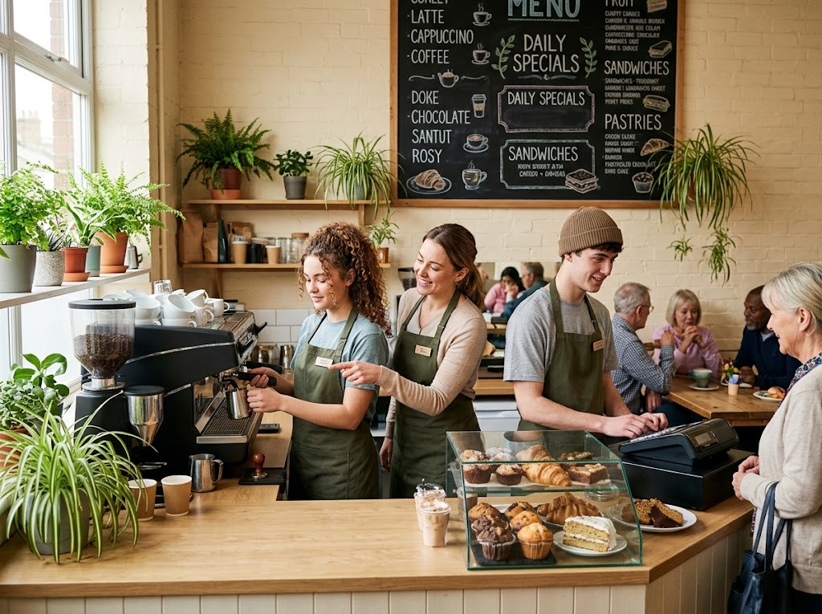
EDEXCEL GCSE BUSINESS · PAPER 1
Business With a Purpose
Some businesses are set up mainly for social objectives. A social enterprise sells products like any other business, but uses its profits to help people or the environment - for example by training young people who struggle to find work.
A social enterprise: a business run to help people, not only to make money.
Putting a business idea into practice
openrevise.com
Lesson 1 of 5

Slide 14

EDEXCEL GCSE BUSINESS · PAPER 1
CASE STUDY
The Big Issue: A Social Objective
The Big Issue was launched in 1991 by John Bird and Gordon Roddick to help people who were homeless earn a legitimate income. Vendors buy copies of the magazine and sell them on the street at the cover price, keeping the difference. The business still needs to cover its costs, but its main aim is social: giving people a way to work their way out of poverty.
1991
Social
The Big Issue launched
Its main aim: helping vendors earn an income
Putting a business idea into practice
openrevise.com
Lesson 1 of 5

Slide 15

EDEXCEL GCSE BUSINESS · PAPER 1
Why Aims and Objectives Differ
No two businesses have exactly the same aims.
Size
A small business may aim to survive or give its owner independence; a large one may aim for market share.
Age
A new business usually aims to survive; an established one aims for growth and profit.
The owner's priorities
Some owners want to make as much money as possible; others want a good work-life balance or to help their community.
Putting a business idea into practice
openrevise.com
Lesson 1 of 5

Slide 16
EDEXCEL GCSE BUSINESS · PAPER 1
Why Aims and Objectives Differ (cont.)
Type of business
A social enterprise puts social objectives first; a company owned by shareholders puts profit first.
Competition
A business in a fiercely competitive market may have to focus on survival or keeping its market share.
Putting a business idea into practice
openrevise.com
Lesson 1 of 5

Slide 17
EDEXCEL GCSE BUSINESS · PAPER 1
Financial or Non-financial?
FINANCIAL AIMS
NON-FINANCIAL AIMS
• Survival.
• Profit.
• Sales.
• Market share.
• Financial security.
• Social objectives.
• Personal satisfaction.
• Challenge.
• Independence and control.
Putting a business idea into practice
openrevise.com
Lesson 1 of 5

Slide 18

EDEXCEL GCSE BUSINESS · PAPER 1
Key Terms
Aim
A general, long-term goal a business wants to achieve.
Objective
A specific, measurable target that helps a business achieve its aim.
Survival
Continuing to trade rather than closing down.
Market share
The percentage of total sales in a market made by one business.
Financial security
Having enough money to cover costs and deal with unexpected problems.
Social objective
An aim to help society or the environment.
Social enterprise
A business whose main aim is social, using its profits to do good.
Putting a business idea into practice
openrevise.com
Lesson 1 of 5

Slide 19

EDEXCEL GCSE BUSINESS · PAPER 1
YOUR TASK
10 minutes
Whose Aims Are These?
For each business, decide on its most likely main aim and explain why - a market stall that opened last month; a café run by a charity that trains young people; a gym chain with 200 branches; a freelance web designer who left a stressful office job.
1
Name the most likely main aim.
2
Say whether it is financial or non-financial.
3
Explain why it suits that business.
WHAT A GOOD ANSWER SHOWS
A named aim for each business, with a reason linked to its size, age, type or owner.
Putting a business idea into practice
openrevise.com
Lesson 1 of 5

Slide 20

EDEXCEL GCSE BUSINESS · PAPER 1
Can I...?
Explain the difference between an aim and an objective.
Explain the five financial aims.
Explain the four non-financial aims.
Calculate market share.
Explain why aims differ between businesses.
Putting a business idea into practice
openrevise.com
Lesson 1 of 5

Slide 21
EDEXCEL GCSE BUSINESS · PAPER 1
Summary & Exam Focus
Aims are long-term goals; objectives are specific, measurable targets.
Financial aims: survival, profit, sales, market share and financial security.
Non-financial aims: social objectives, personal satisfaction, challenge, independence and control.
Aims differ with the size, age and type of business and the owner's priorities.
EXAM FOCUS
Explain one reason why the aims of a new business might be different from the aims of an established business. (3 marks)
Name the difference, then explain why the business's situation causes it - a new business has few customers and little cash, so survival comes first.
openrevise.com

