Slide 1

EDEXCEL GCSE BUSINESS · PAPER 1
Revenue, costs and profit
Putting a business idea into practice
Lesson 2 of 5
openrevise.com

Slide 2

EDEXCEL GCSE BUSINESS · PAPER 1
Last Lesson
Answer from memory before the answers appear.
What is the difference between an aim and an objective?
1
Name three financial aims.
2
Name two non-financial aims.
3
How do you calculate market share?
4
Putting a business idea into practice
openrevise.com
Lesson 2 of 5

Slide 3
EDEXCEL GCSE BUSINESS · PAPER 1
Last Lesson - Answers
What is the difference between an aim and an objective?
An aim is a general long-term goal; an objective is a specific, measurable target.
1
Name three financial aims.
Any three of: survival, profit, sales, market share, financial security.
2
Name two non-financial aims.
Any two of: social objectives, personal satisfaction, challenge, independence and control.
3
How do you calculate market share?
(Business's sales ÷ total market sales) × 100.
4
Putting a business idea into practice
openrevise.com
Lesson 2 of 5

Slide 4

EDEXCEL GCSE BUSINESS · PAPER 1
Learning Objectives
Calculate revenue.
1
Explain and calculate fixed costs, variable costs and total costs.
2
Calculate profit and loss.
3
Calculate interest on a loan as a percentage.
4
Putting a business idea into practice
openrevise.com
Lesson 2 of 5

Slide 5

EDEXCEL GCSE BUSINESS · PAPER 1
THE BIG IDEA
Profit = revenue - costs. Everything else in this lesson is about getting those two numbers right.
Putting a business idea into practice
openrevise.com
Lesson 2 of 5

Slide 6

EDEXCEL GCSE BUSINESS · PAPER 1
Revenue
Revenue is the money a business receives from selling its products.
Formula
Revenue = sales price × quantity sold.
Also called
Sales revenue, turnover or income.
Not the same as profit
Revenue is all the money coming in, before any costs are paid.
Example
A café sells 3,000 coffees at £4 each: revenue = £4 × 3,000 = £12,000.
Putting a business idea into practice
openrevise.com
Lesson 2 of 5

Slide 7


EDEXCEL GCSE BUSINESS · PAPER 1
Every Sale Is Revenue
Every time a customer pays, the business's revenue goes up. But revenue alone says nothing about whether the business is doing well - that depends on how much it cost to make and sell the product.
Price × quantity: every sale adds to revenue.
Putting a business idea into practice
openrevise.com
Lesson 2 of 5

Slide 8

EDEXCEL GCSE BUSINESS · PAPER 1
PART ONE
Costs
Some costs stay the same however much is sold. Others rise with every sale.
openrevise.com

Slide 9

EDEXCEL GCSE BUSINESS · PAPER 1
Fixed or Variable Costs?
FIXED COSTS
VARIABLE COSTS
• Do not change with the number of products made or sold.
• Must be paid even if nothing is sold.
• Examples: rent, salaries, insurance, loan repayments, advertising.
• Can change over time, e.g. when the rent goes up.
• Change directly with the number of products made or sold.
• Are zero if nothing is made.
• Examples: raw materials, ingredients, packaging, stock.
• Total variable costs = variable cost per unit × quantity.
Putting a business idea into practice
openrevise.com
Lesson 2 of 5

Slide 10

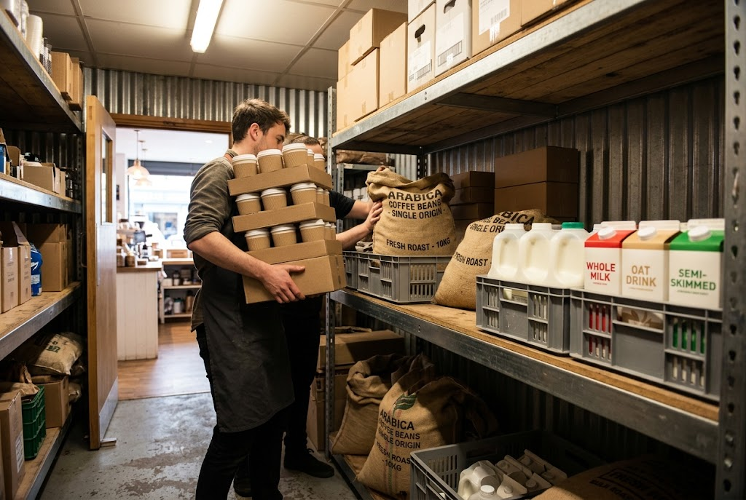
EDEXCEL GCSE BUSINESS · PAPER 1
Fixed and Variable Costs
Rent must be paid whatever happens. Ingredients are only needed for every cup sold.
Rent: a fixed cost.
Ingredients: a variable cost.
Putting a business idea into practice
openrevise.com
Lesson 2 of 5

Slide 11

EDEXCEL GCSE BUSINESS · PAPER 1
Total Costs
Total costs are everything a business spends to make and sell its products.
Formula
Total costs = fixed costs + total variable costs.
Total variable costs
Variable cost per unit × quantity sold.
Example
The café's fixed costs are £6,000 a month and each coffee costs £1.50 to make. Selling 3,000 coffees: total variable costs = £1.50 × 3,000 = £4,500. Total costs = £6,000 + £4,500 = £10,500.
Putting a business idea into practice
openrevise.com
Lesson 2 of 5

Slide 12
EDEXCEL GCSE BUSINESS · PAPER 1
PART TWO
Profit and Loss
What is left - or missing - once costs are paid.
openrevise.com

Slide 13

EDEXCEL GCSE BUSINESS · PAPER 1
Profit and Loss
Profit = total revenue - total costs.
Profit
When revenue is greater than total costs, the business makes a profit.
Loss
When total costs are greater than revenue, the business makes a loss. A loss is shown as a negative number or in brackets, e.g. -£500 or (£500).
Why it matters
Profit rewards the owner and can be reinvested; losses cannot go on for ever, or the business will fail.
Example
The café's revenue is £12,000 and its total costs are £10,500, so its profit = £12,000 - £10,500 = £1,500.
Putting a business idea into practice
openrevise.com
Lesson 2 of 5

Slide 14

EDEXCEL GCSE BUSINESS · PAPER 1
The Café's Month in Numbers
Work through it in order, and show every step.
A café sells 3,000 coffees at £4 each. Its fixed costs are £6,000 a month and each coffee costs £1.50 to make. Calculate its profit.
1
Revenue
£4 × 3,000 = £12,000
2
Total variable costs
£1.50 × 3,000 = £4,500
3
Total costs
£6,000 + £4,500 = £10,500
4
Profit
£12,000 - £10,500 = £1,500
ANSWER
Profit = £1,500
Putting a business idea into practice
openrevise.com
Lesson 2 of 5

Slide 15
EDEXCEL GCSE BUSINESS · PAPER 1
The Café's Month at a Glance
£12,000
£6,000
£4,500
£1,500
Revenue
Fixed costs
Total variable costs
Profit
Putting a business idea into practice
openrevise.com
Lesson 2 of 5

Slide 16
EDEXCEL GCSE BUSINESS · PAPER 1
PART THREE
Interest
The cost of borrowing money.
openrevise.com

Slide 17
EDEXCEL GCSE BUSINESS · PAPER 1
Interest on Loans
Interest is the extra money a business pays back on top of what it borrowed.
What it is
The cost of borrowing - the reward the lender gets for lending the money.
Formula
Interest (%) = (total repayment - borrowed amount) ÷ borrowed amount × 100.
A fixed cost
Interest must be paid whatever the business sells, so it adds to fixed costs and reduces profit.
Why it matters
A high interest rate makes borrowing expensive, so a business may borrow less or look for cheaper finance.
Putting a business idea into practice
openrevise.com
Lesson 2 of 5

Slide 18
EDEXCEL GCSE BUSINESS · PAPER 1
Calculating Interest as a Percentage
Edexcel asks for interest as a percentage of the amount borrowed.
A business borrows £5,000 and repays £5,600 in total. Calculate the rate of interest.
Find the interest paid
£5,600 - £5,000 = £600
1
Divide by the amount borrowed
£600 ÷ £5,000 = 0.12
2
Multiply by 100
0.12 × 100 = 12%
3
ANSWER
Interest = 12%
Putting a business idea into practice
openrevise.com
Lesson 2 of 5

Slide 19

EDEXCEL GCSE BUSINESS · PAPER 1
CASE STUDY
When Fixed Costs Rise
In 2022 wholesale energy prices rose sharply across the UK. Many small bakeries, which run ovens for hours every day, saw their energy bills rise several times over. Energy is largely a fixed cost for a bakery - the ovens must be heated whether it sells 100 loaves or 1,000 - so higher bills cut straight into profit. Some bakeries raised their prices to protect their profit, some cut their opening hours, and some were forced to close.
2022
Profit
Energy prices rise sharply
Falls when fixed costs rise and prices do not
Putting a business idea into practice
openrevise.com
Lesson 2 of 5

Slide 20

EDEXCEL GCSE BUSINESS · PAPER 1
Key Terms
Revenue
The money a business receives from sales. Price × quantity sold.
Fixed costs
Costs that do not change with the number of products made or sold, such as rent.
Variable costs
Costs that change directly with the number of products made or sold, such as raw materials.
Total costs
Fixed costs + total variable costs.
Profit
Total revenue minus total costs, when revenue is greater.
Loss
When total costs are greater than total revenue.
Interest
The cost of borrowing money, paid on top of the amount borrowed.
Putting a business idea into practice
openrevise.com
Lesson 2 of 5

Slide 21
EDEXCEL GCSE BUSINESS · PAPER 1
Fixed or Variable?
Match each cost to its type.
Cost
Type
A
Rent for the shop
Fixed
1
B
Flour for each loaf
Variable
2
C
The manager's salary
Fixed
3
D
Packaging for each order
Variable
4
E
Insurance
Fixed
5
F
Stock bought to sell
Variable
6
Putting a business idea into practice
openrevise.com
Lesson 2 of 5

Slide 22

EDEXCEL GCSE BUSINESS · PAPER 1
YOUR TASK
12 minutes
Run the Numbers
A phone case business sells 500 cases a month at £12 each. Its fixed costs are £2,000 a month and each case costs £5 to make. Calculate its revenue, total costs and profit. Then work out what happens to its profit if it sells only 250 cases.
1
Calculate revenue.
2
Calculate total variable costs, then total costs.
3
Calculate profit.
Repeat for 250 cases.
4
WHAT A GOOD ANSWER SHOWS
Revenue £6,000, total costs £4,500 and profit £1,500 at 500 cases; revenue £3,000, total costs £3,250 and a loss of £250 at 250 cases.
Putting a business idea into practice
openrevise.com
Lesson 2 of 5

Slide 23

EDEXCEL GCSE BUSINESS · PAPER 1
Can I...?
Calculate revenue.
Calculate total costs.
Explain fixed costs, with examples.
Calculate profit or loss.
Explain variable costs, with examples.
Calculate interest as a percentage.
Calculate total variable costs.
Putting a business idea into practice
openrevise.com
Lesson 2 of 5

Slide 24
EDEXCEL GCSE BUSINESS · PAPER 1
Summary & Exam Focus
Revenue = price × quantity.
Total costs = fixed costs + total variable costs.
Profit = total revenue - total costs.
Interest (%) = (total repayment - borrowed amount) ÷ borrowed amount × 100.
EXAM FOCUS
Calculate the profit a business makes if it sells 800 units at £8 each, with fixed costs of £2,000 and variable costs of £3 per unit. (2 marks)
Write the formula first, then the numbers, then the answer with its unit (£ or %). A correct method can earn a mark even if the final answer is wrong.
openrevise.com

