Slide 1

EDEXCEL GCSE BUSINESS · PAPER 1
The marketing mix
Making the business effective
Lesson 3 of 4
openrevise.com

Slide 2

EDEXCEL GCSE BUSINESS · PAPER 1
Last Lesson
Answer from memory before the answers appear.
Name the four location factors.
1
What is e-commerce?
2
Give one advantage of selling online instead of from a shop.
3
Why does a hairdresser still need fixed premises?
4
Making the business effective
openrevise.com
Lesson 3 of 4

Slide 3
EDEXCEL GCSE BUSINESS · PAPER 1
Last Lesson - Answers
Name the four location factors.
Proximity to the market, labour, materials and competitors.
1
What is e-commerce?
Buying and selling goods and services online.
2
Give one advantage of selling online instead of from a shop.
Lower costs, reaching more customers, or being open 24 hours.
3
Why does a hairdresser still need fixed premises?
Customers must visit in person.
4
Making the business effective
openrevise.com
Lesson 3 of 4

Slide 4

EDEXCEL GCSE BUSINESS · PAPER 1
Learning Objectives
Explain what the marketing mix is.
1
Explain the importance of each of the four Ps: product, price, promotion and place.
2
Explain how the elements of the marketing mix work together.
3
Explain how changing customer needs, technology and competition affect the marketing mix.
4
Making the business effective
openrevise.com
Lesson 3 of 4

Slide 5

EDEXCEL GCSE BUSINESS · PAPER 1
THE BIG IDEA
The right product, at the right price, promoted in the right way, in the right place.
That is the whole of the marketing mix - and all four have to be right at once.
Making the business effective
openrevise.com
Lesson 3 of 4

Slide 6


EDEXCEL GCSE BUSINESS · PAPER 1
The marketing mix
Product
▸ what the business sells
▸ its features, quality and appearance
▸ how it meets customer needs
Promotion
▸ how customers find out about it
▸ social media, leaflets, adverts, special offers
The marketing mix
Price
▸ how much customers pay
▸ must suit the target market
▸ must cover costs
Place
▸ where and how customers buy it
▸ shop, market stall, website, app
Making the business effective
openrevise.com
Lesson 3 of 4

Slide 7

EDEXCEL GCSE BUSINESS · PAPER 1
PART ONE
The Four Ps
Why each element matters.
openrevise.com

Slide 8

EDEXCEL GCSE BUSINESS · PAPER 1
Product
The good or service the business sells.
What it includes
What the product does, its quality, how it looks, its size and its packaging.
Why it matters
If the product does not meet customer needs, no amount of promotion will make customers keep buying it.
Standing out
A small business often needs something that makes its product different from competitors' - a unique selling point.
Example
A bakery's product is not just bread: it is fresh, baked on site each morning, with local ingredients.
Making the business effective
openrevise.com
Lesson 3 of 4

Slide 9

EDEXCEL GCSE BUSINESS · PAPER 1
Price
The amount customers pay for the product.
Cover costs
The price must be high enough to cover costs and make a profit.
Suit the target market
It must be a price the target customers are willing and able to pay.
Match the product
Customers expect a high-quality product to cost more; a very low price can make them doubt the quality.
Look at competitors
Customers compare prices, so a business charging more than rivals must give them a reason to pay it.
Making the business effective
openrevise.com
Lesson 3 of 4

Slide 10

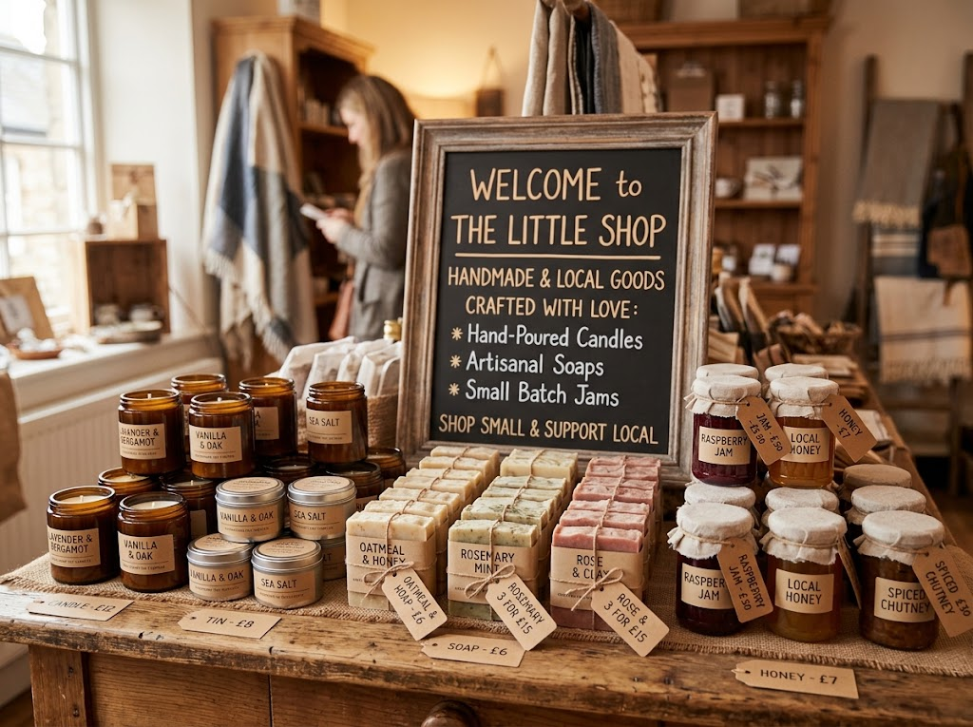
EDEXCEL GCSE BUSINESS · PAPER 1
Product and Price on Show
A customer looking at this table judges the product and the price together. Handmade, attractively displayed products suggest quality, so customers expect - and accept - a higher price than for mass-produced versions in a supermarket.
Product and price: the first two Ps, side by side on the shelf.
Making the business effective
openrevise.com
Lesson 3 of 4

Slide 11

EDEXCEL GCSE BUSINESS · PAPER 1
Promotion
How the business tells customers about its product and persuades them to buy.
Why it matters
Customers cannot buy a product they have never heard of.
Reaching the target market
Promotion must appear where the target customers will see it.
Small-business options
Social media posts, a website, leaflets, local newspapers, word of mouth and special offers.
Cost
Small businesses have small budgets, so they choose cheap methods that reach the right people.
Making the business effective
openrevise.com
Lesson 3 of 4

Slide 12

EDEXCEL GCSE BUSINESS · PAPER 1
Place
Where and how customers can buy the product.
Why it matters
Customers need to be able to buy the product easily, when and where they want.
Options for a small business
Its own shop, a market stall, other shops that stock its products, its own website or an online marketplace.
Match the customer
Place must suit how the target market likes to shop - older customers may prefer a shop; younger customers may prefer an app.
Convenience
The easier it is to buy, the more customers will buy.
Making the business effective
openrevise.com
Lesson 3 of 4

Slide 13
EDEXCEL GCSE BUSINESS · PAPER 1
PART TWO
Making the Mix Work Together
Four Ps that fit together - an integrated marketing mix.
openrevise.com

Slide 14

EDEXCEL GCSE BUSINESS · PAPER 1
An Integrated Marketing Mix
The four Ps must support each other and suit the same target market.
Consistency
Each P sends the same message. A luxury product needs a high price, stylish promotion and an upmarket place to sell.
Mismatches confuse customers
A premium chocolate brand sold cheaply in a discount shop, with cheap-looking adverts, would not be believed.
Changing one P affects the others
Improving the product's quality may mean raising the price and promoting the new quality.
Balancing the mix
A small business may not be able to afford everything, so it balances the four - for example a good product sold at a fair price, with cheap social media promotion.
Making the business effective
openrevise.com
Lesson 3 of 4

Slide 15

EDEXCEL GCSE BUSINESS · PAPER 1
One Café, Two Target Markets
The P
Budget student café
Upmarket brunch café
Product
Simple coffee, toasties, big portions
Speciality coffee, fresh brunch dishes
Price
Low - £2 coffee, meal deals
High - £4 coffee, £14 brunch
Promotion
Student discount, Instagram, flyers on campus
Food bloggers, a stylish website, local magazines
Place
Near the university, fast takeaway counter
Quiet, stylish street with table service
Making the business effective
openrevise.com
Lesson 3 of 4

Slide 16
EDEXCEL GCSE BUSINESS · PAPER 1
PART THREE
A Mix That Changes
The marketing mix never stays fixed.
openrevise.com

Slide 17

EDEXCEL GCSE BUSINESS · PAPER 1
Changing Customer Needs
When customers want something different, the mix has to change.
Product
Businesses add new products as tastes change - vegan options, low-sugar drinks, eco-friendly packaging.
Price
If customers have less money to spend, a business may offer smaller, cheaper versions or value deals.
Promotion
The message changes to show the business meets the new need, such as "plastic-free" or "locally sourced".
Place
As more customers shop online, small businesses add websites, delivery and click-and-collect.
Making the business effective
openrevise.com
Lesson 3 of 4

Slide 18

EDEXCEL GCSE BUSINESS · PAPER 1
The Impact of Technology
E-commerce and digital communication have changed every P for small businesses.
Place: e-commerce
A small business can sell online to customers anywhere, through its own website or an online marketplace.
Promotion: digital communication
Social media, email and websites let a small business promote itself cheaply and target exactly the right customers.
Price
Customers can compare prices online in seconds, so businesses must keep their prices competitive.
Product
Customers leave online reviews, so product quality matters even more - one bad review can put off many buyers.
Making the business effective
openrevise.com
Lesson 3 of 4

Slide 19
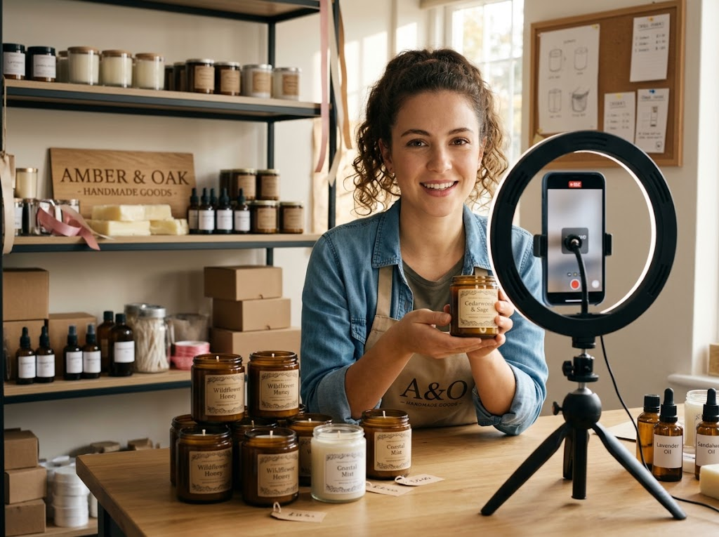
EDEXCEL GCSE BUSINESS · PAPER 1
Promotion on a Small Budget
WHY SOCIAL MEDIA SUITS SMALL BUSINESSES
Cheap
Posting is free; paid adverts can start from a few pounds.
Targeted
Adverts can be shown only to the right age, location and interests.
Two-way
Customers comment and share, spreading word of mouth.
Digital communication: promotion that costs almost nothing.
Making the business effective
openrevise.com
Lesson 3 of 4

Slide 20

EDEXCEL GCSE BUSINESS · PAPER 1
The Mix in a Competitive Market
When there are many competitors, the mix must give customers a reason to choose this business.
Product
Make it different - better quality, a unique feature or better service.
Price
Keep it close to competitors, unless the product is clearly better.
Promotion
Tell customers what makes the business different, not just that it exists.
Place
Be easier to buy from than rivals - open longer, deliver faster or sell online.
Making the business effective
openrevise.com
Lesson 3 of 4

Slide 21

EDEXCEL GCSE BUSINESS · PAPER 1
Key Terms
Marketing mix
The four elements a business uses to market its product: product, price, promotion and place.
Product
The good or service a business sells.
Price
The amount customers pay for a product.
Promotion
How a business tells customers about its product and persuades them to buy.
Place
Where and how customers can buy a product.
Integrated marketing mix
A marketing mix in which the four Ps fit together and suit the same target market.
Digital communication
Promoting a business and talking to customers online, e.g. through social media, email and websites.
Making the business effective
openrevise.com
Lesson 3 of 4

Slide 22

EDEXCEL GCSE BUSINESS · PAPER 1
YOUR TASK
15 minutes
Build a Mix
You are launching a small business selling healthy smoothies to secondary school students. Plan all four Ps, making sure they fit together for your target market. Then explain one change you would make if a rival smoothie bar opened next door.
1
Describe your product.
2
Set a price and explain it.
3
Choose how to promote it.
Choose where to sell it.
4
WHAT A GOOD ANSWER SHOWS
A product, price, promotion and place that all suit teenage students and support each other, plus a response to competition linked to one of the Ps.
5
Plan your response to the new competitor.
Making the business effective
openrevise.com
Lesson 3 of 4
Notes:
Check for integration - a £6 smoothie promoted in a local newspaper does not fit a teenage target market.

Slide 23

EDEXCEL GCSE BUSINESS · PAPER 1
Can I...?
Name the four Ps.
Explain what an integrated marketing mix is.
Explain why product matters.
Explain how changing customer needs affect the mix.
Explain why price matters.
Explain how technology affects the mix.
Explain why promotion matters.
Explain how competition affects the mix.
Explain why place matters.
Making the business effective
openrevise.com
Lesson 3 of 4

Slide 24
EDEXCEL GCSE BUSINESS · PAPER 1
Summary & Exam Focus
The marketing mix is product, price, promotion and place.
Each element matters, and all four must fit together for the target market.
The mix changes as customer needs change.
E-commerce and digital communication have changed every P, especially for small businesses.
EXAM FOCUS
Explain one way that digital communication can help a small business promote its products. (3 marks)
Name the method (social media, email, a website), then explain the benefit for a small business specifically - low cost, targeting the right customers, reaching more people.
openrevise.com

Slide 25
EDEXCEL GCSE BUSINESS · PAPER 1
Exam Practice: The Marketing Mix
Answer all questions. Use the context of the business in the question where one is given. · 25 minutes
Question 1 · 1 mark · Define
Define the term 'marketing mix'.
Question 2 · 1 mark · State
State one element of the marketing mix.
Question 3 · 2 marks · Outline
Outline one way e-commerce has affected the place element of the marketing mix.
Making the business effective
openrevise.com
Lesson 3 of 4

Slide 26
EDEXCEL GCSE BUSINESS · PAPER 1
Exam Practice: The Marketing Mix (cont.)
Question 4 · 3 marks · Explain
Explain one way that digital communication can help a small business promote its products.
Question 5 · 6 marks · Analyse
Analyse the importance to Kai of having an integrated marketing mix.
Making the business effective
openrevise.com
Lesson 3 of 4

Slide 27
EDEXCEL GCSE BUSINESS · PAPER 1
Question 1 · 1 mark · Define
“
Define the term 'marketing mix'.
HOW TO ANSWER IT
Command word: Define. Worth 1 mark, so plan before writing.
Making the business effective
openrevise.com
Lesson 3 of 4

Slide 28
EDEXCEL GCSE BUSINESS · PAPER 1
Question 1 · mark scheme
1 mark available. Award a mark for each point made.
The four Ps / product, price, promotion and place
1 mark
Making the business effective
openrevise.com
Lesson 3 of 4

Slide 29
EDEXCEL GCSE BUSINESS · PAPER 1
Question 2 · 1 mark · State
“
State one element of the marketing mix.
HOW TO ANSWER IT
Command word: State. Worth 1 mark, so plan before writing.
Making the business effective
openrevise.com
Lesson 3 of 4

Slide 30
EDEXCEL GCSE BUSINESS · PAPER 1
Question 2 · mark scheme
1 mark available. Award a mark for each point made.
Any one of: product; price; promotion; place
1 mark
Making the business effective
openrevise.com
Lesson 3 of 4

Slide 31
EDEXCEL GCSE BUSINESS · PAPER 1
Question 3 · 2 marks · Outline
“
Outline one way e-commerce has affected the place element of the marketing mix.
HOW TO ANSWER IT
Command word: Outline. Worth 2 marks, so plan before writing.
Making the business effective
openrevise.com
Lesson 3 of 4

Slide 32
EDEXCEL GCSE BUSINESS · PAPER 1
Question 3 · mark scheme
2 marks available. Award a mark for each point made.
A way identified, e.g. selling online / reaching customers anywhere / no need for a shop
1 mark
Developed: the effect on the business or its customers
1 mark
Making the business effective
openrevise.com
Lesson 3 of 4

Slide 33
EDEXCEL GCSE BUSINESS · PAPER 1
Question 4 · 3 marks · Explain
“
Explain one way that digital communication can help a small business promote its products.
HOW TO ANSWER IT
Command word: Explain. Worth 3 marks, so plan before writing.
Making the business effective
openrevise.com
Lesson 3 of 4

Slide 34
EDEXCEL GCSE BUSINESS · PAPER 1
Question 4 · mark scheme
3 marks available. Award a mark for each point made.
A way identified, e.g. social media / email / website
1 mark
First linked point of explanation
1 mark
Second linked point of explanation
1 mark
Making the business effective
openrevise.com
Lesson 3 of 4

Slide 35
EDEXCEL GCSE BUSINESS · PAPER 1
Question 5 · 6 marks · Analyse
“
Analyse the importance to Kai of having an integrated marketing mix.
— Kai runs a small shop selling handmade leather wallets and bags. His products are high quality and take many hours to make, but he prices them only slightly above mass-produced…
HOW TO ANSWER IT
Command word: Analyse. Worth 6 marks, so plan before writing.
Making the business effective
openrevise.com
Lesson 3 of 4

Slide 36
EDEXCEL GCSE BUSINESS · PAPER 1
Question 5 · mark scheme
6 marks available. Award a mark for each point made.
AO2 (Application, 3 marks): uses the context - handmade leather, low price, leaflets, young professionals
Level 1-3
AO3a (Analysis, 3 marks): chains of reasoning showing why the four Ps must fit together
Level 1-3
Making the business effective
openrevise.com
Lesson 3 of 4

